Slide 1

Coping with:
GRIEF, TRAUMA & CRISES
Term 3:
Week 7 – 10
Health, Social and Environmental Responsibility
Lesson 4

Slide 2

Grief

Slide 3
Trauma

Slide 4
Crisis

Slide 5

If each one of us sits back for just a moment, we will all be able to think back to a time when we experienced these emotions.

Slide 6
How Grief Affects Your Brain And What To Do About It
Understanding grief is an important part of healing.
https://www.youtube.com/watch?v=eEcaUhxAH2g (3 min 22 sec)

Slide 7
The facts about loss and grief

Slide 8
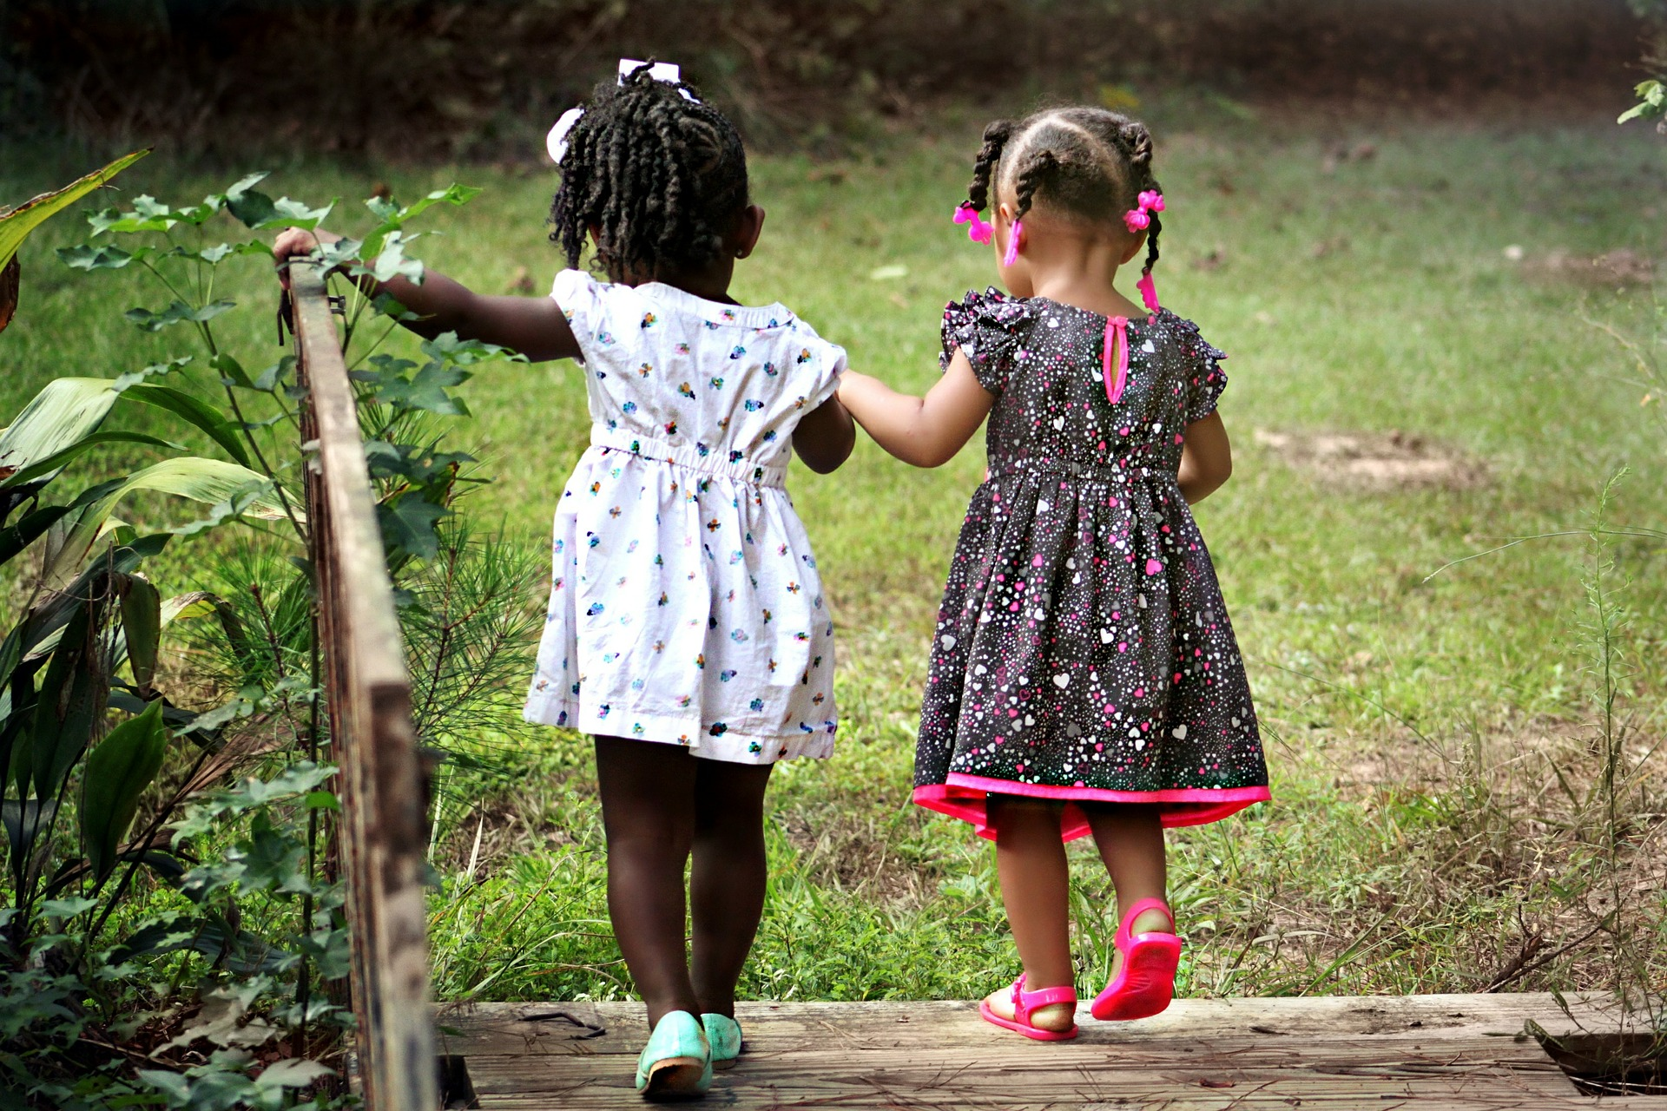
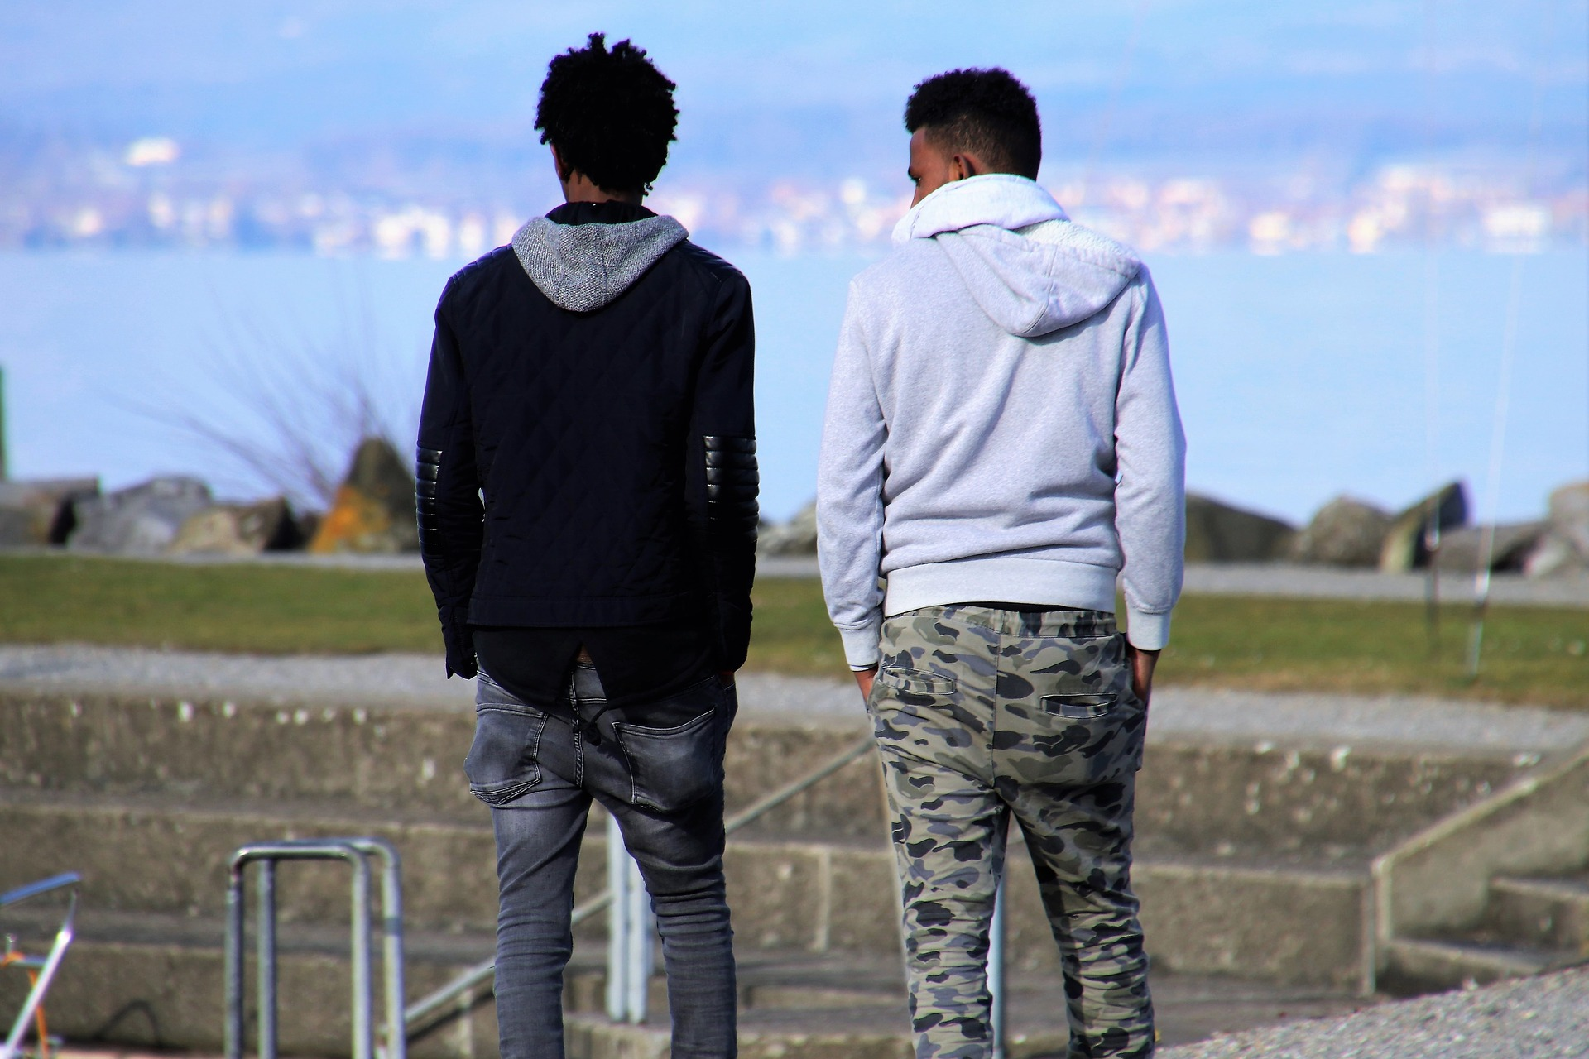
If you or someone you know is dealing with loss, grief or trauma…

Slide 9
Loss, grief and healing
https://www.youtube.com/watch?v=ohykfGc9dc8 (2 min 28 sec)

Slide 10


Slide 11
