Slide 1
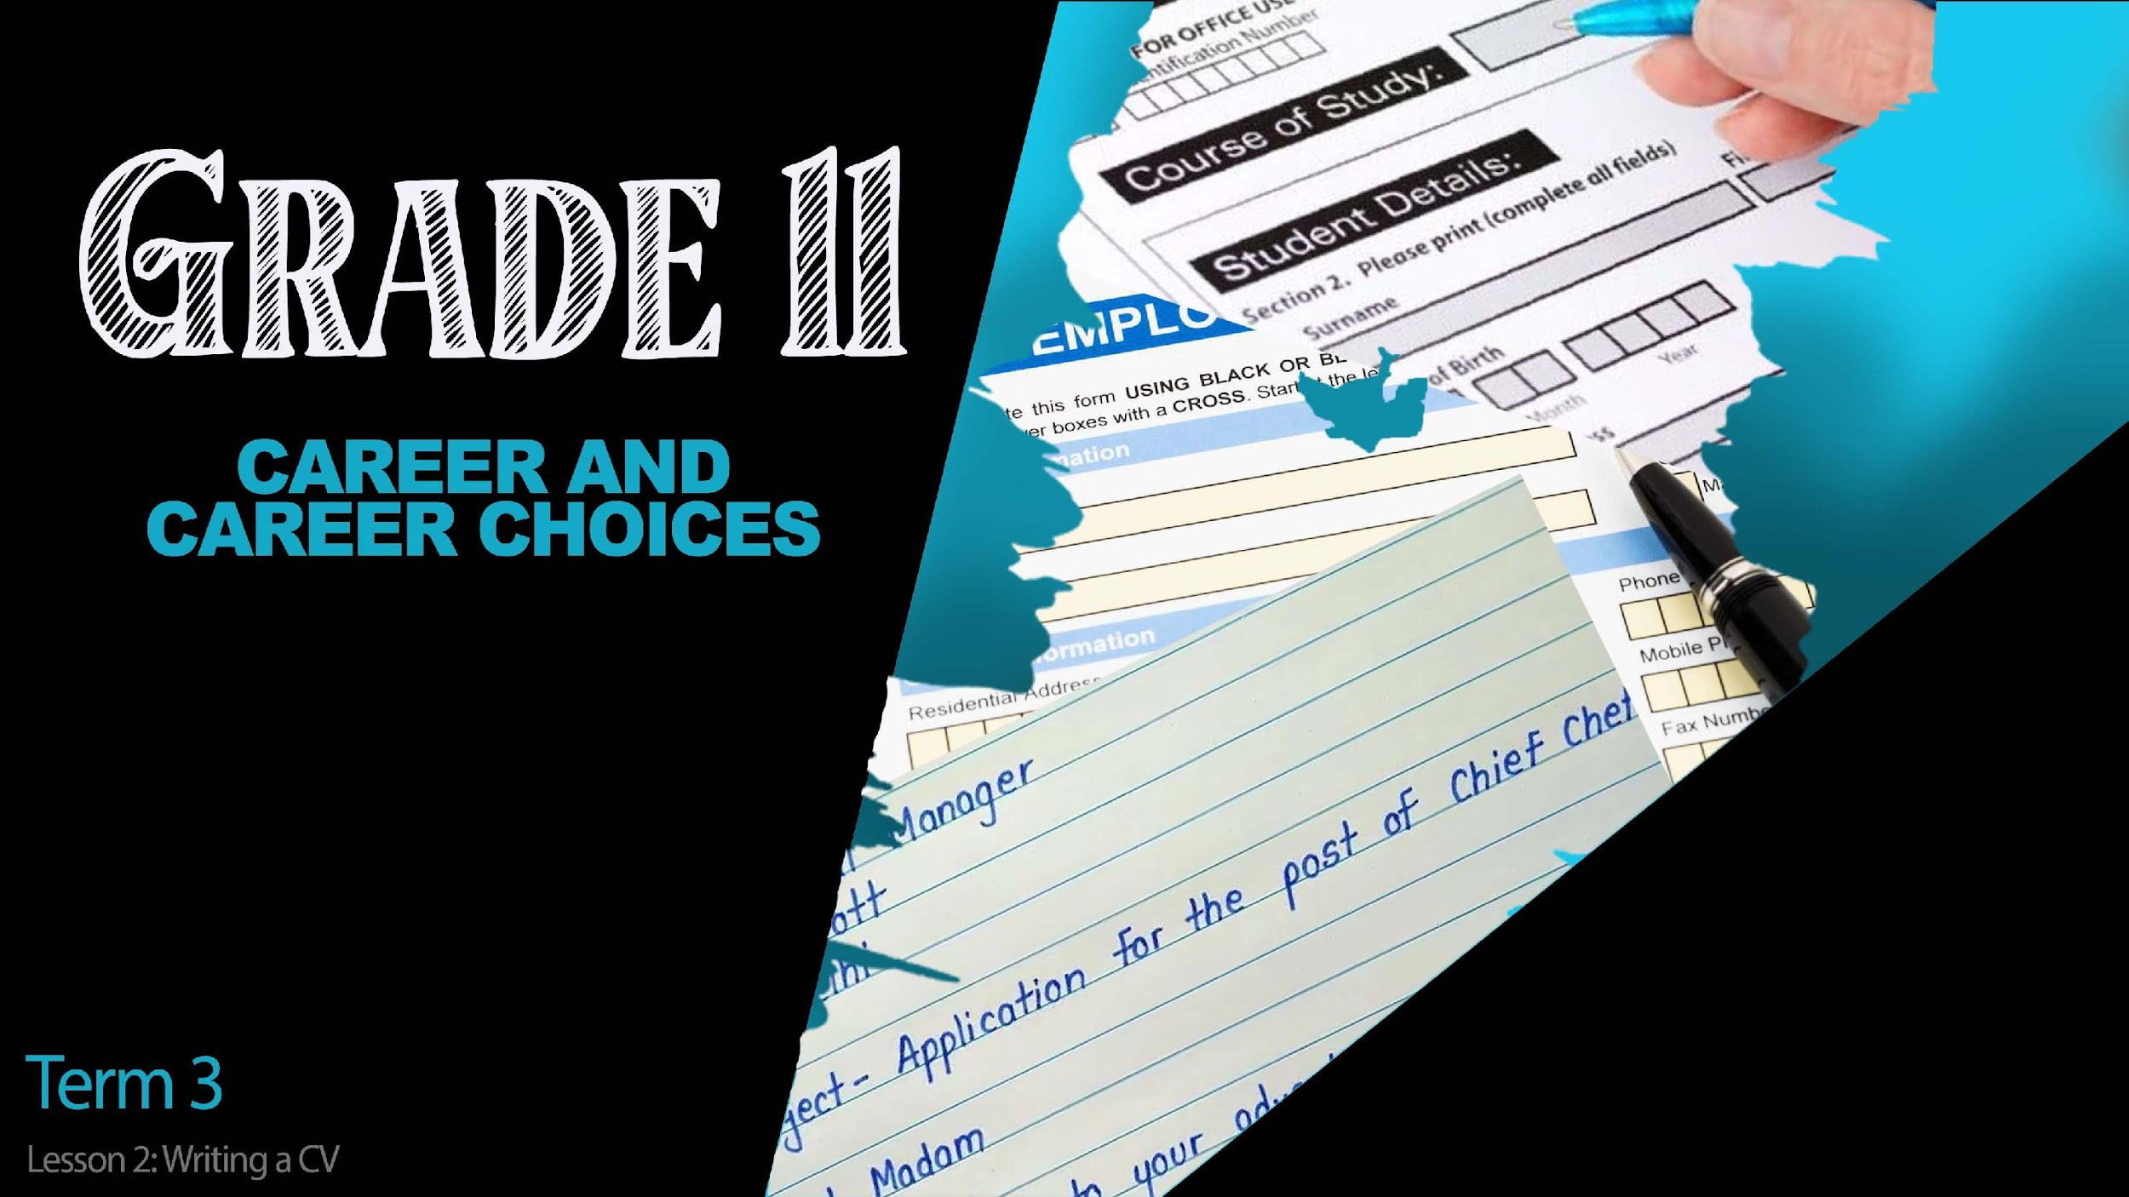

Notes:
Slide 1: 6+2 min intro
(Note to teacher- This lesson will be using an online CV platform to help learners write a CV. They will each need to have access to a computer to write the CV. Should they not have access to a computer, you as the teacher will need to guide them through the process while they write manually in Activity 2)
Good day Grade 11’s. Welcome back to our series of lessons on careers and career choices. Before we get stuck into today's lesson, please take out your homework (i.e. Activity 3 from Lesson 1 – Worksheet). In groups of TWO, you will need to read your job application letter to one another and using the check list given in the homework activity, check that the application letter includes the requirements. (Allow 2min for each person to read their letter and 1min for comment).
Well done everyone! Today we’re going to be looking at writing your own CV. A CV can also be called a résumé which means that this document includes a summary of your contact information, education and previous job experience. Even if you were only interested in a part-time job during the December holidays, you would still need to hand in a CV. It’s important to be honest on your CV. Too many people get caught out in an interview on information that they have fraudulently added onto their CV. If you are not caught out now, then you will be sometime in the future. So be honest!
Now, how do you write a CV and what should it include?

Slide 2
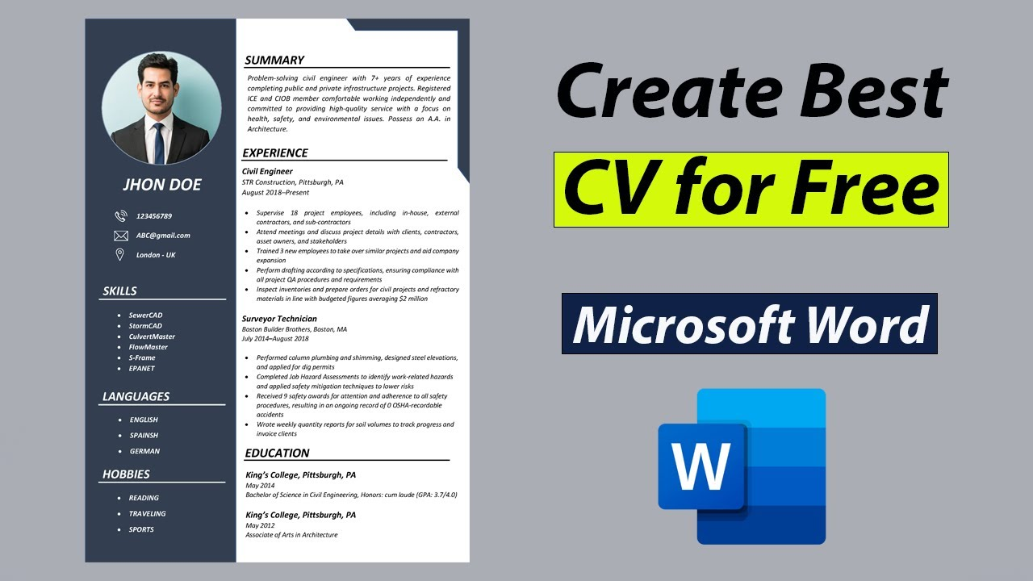
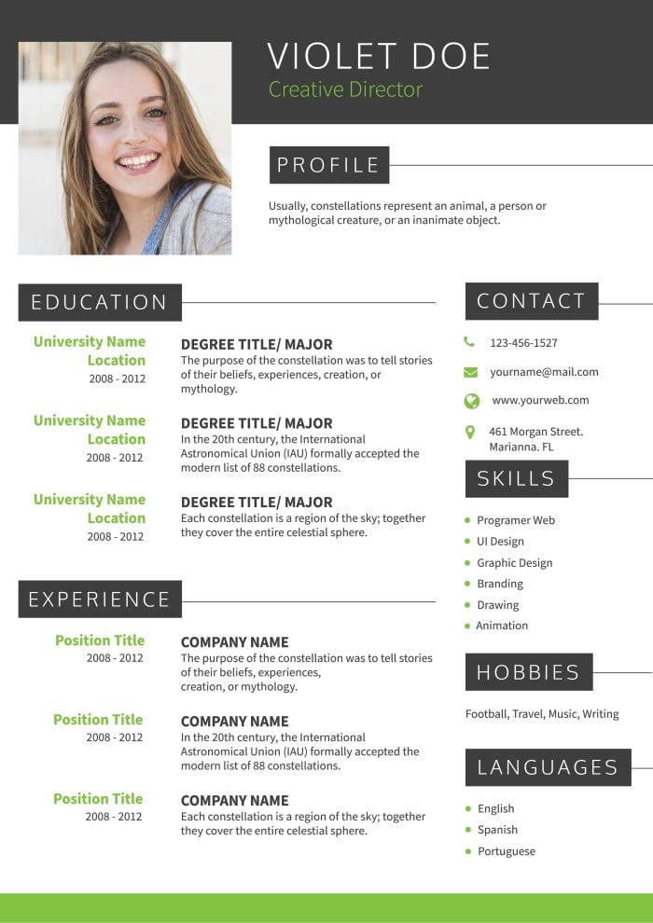
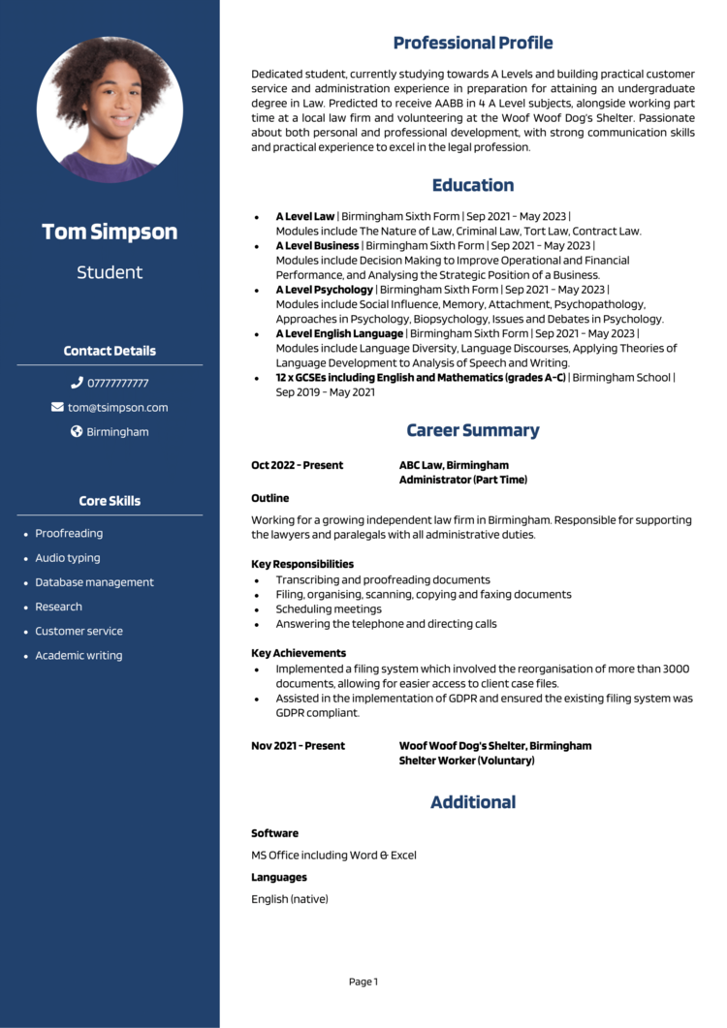
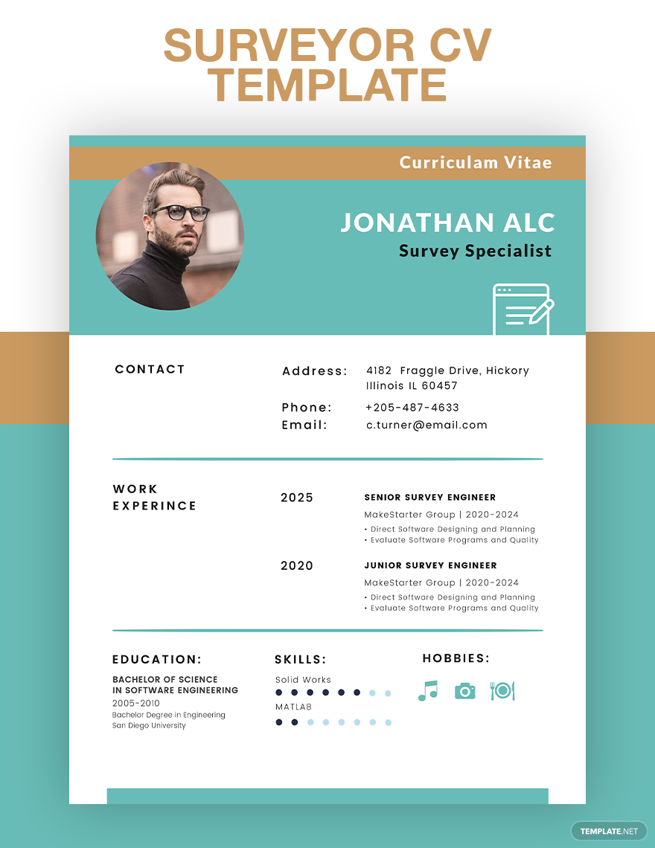
The CV will convince the HR administrator that you’re the one for the job!
Notes:
Slide 2 & 3: Teaching (2 +5+5min)
Your CV is divided into different sections that contain information about you. Before you actually start writing your CV, it’s a good idea to collect the information that you need by planning what you would right in each section. We’re going to go through the different steps of an online application. You’ll be using the same online platform to write your own CV later during the lesson.
Remember, the CV will convince the HR administrator that you’re the one for the job!

Slide 3

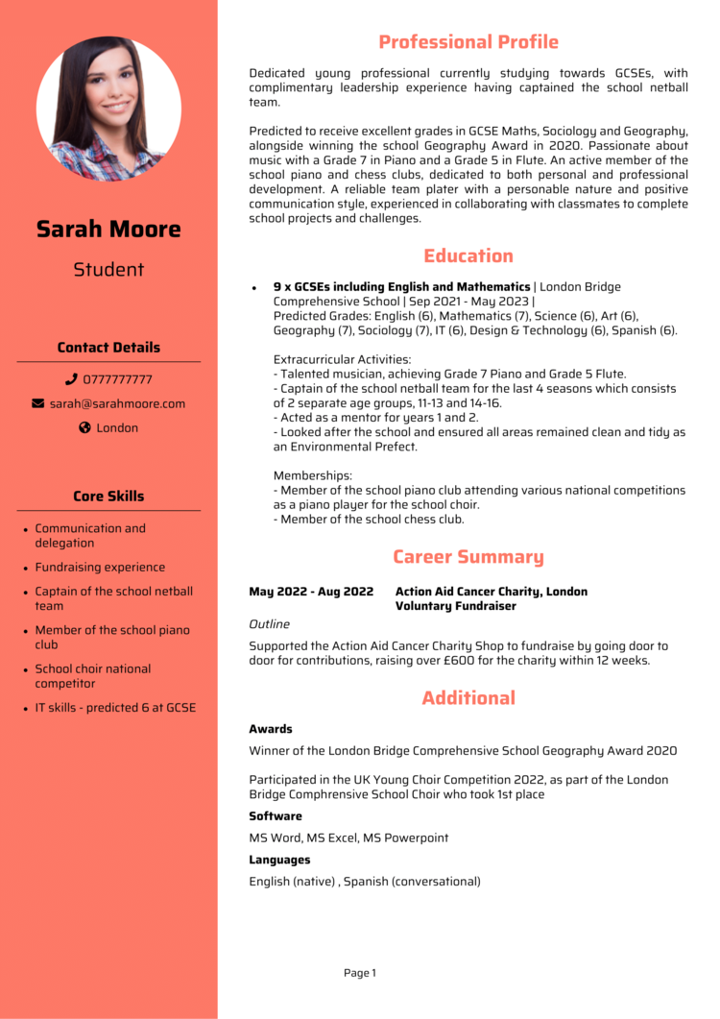
Your CV should include…
Notes:
Slide 3: 2+5min
Let’s start by looking at the CV of a student like you, who is still at school and has no previous working experience.
Your CV will include:
Information about you- this includes a current photograph of your head and shoulders as well as your contact information and the town where you live.
A professional profile that describes your professional goals and where you are at the moment. This CV example is of a student who is presently busy working on finishing GCSE
Your education should include the subjects you are presently studying, how well you have done in each subject and what your extra mural activities are.
All form of experience- this student has never had a job but volunteered at a charity event. As a student, its important to do job shadowing, informal jobs and community work to gain experience to add to your CV. Job Shadowing is when you visit a company or institution where you would find a career that you’re interested in. You would follow the person around and learn from them by experiencing a day in their job. Should you do this for a few days, ask for a letter or certificate as proof of your job shadow experience. Informal jobs include both paid and unpaid jobs. There is no contract and its for a very short period of time eg. Washing cars, mowing the lawn.
There are certain skills that you have developed over the years. In this section you highlight your special skills set.
Include any special awards you have earned at school for sport or academics. Also include special awards outside of school. Don’t forget to include the date. Software indicates the level of your computer literacy. You could even include the programs that you feel you are competent in. Lastly indicate your home language and any other languages that you can speak.
Not included in this example is a reference and testimonial- A reference are the names of TWO people that would be able to give a character reference. You would need to ask them beforehand if they would be willing to be a reference for you. This could include someone you have worked for or a reputable community member who knows you well. Your reference should not be a family member eg. Your youth pastor where you volunteered at church or sport coach where you helped with coaching a younger team. A testimonial is a letter that gives evidence of your character as well as your personal qualities and strengths. It should be written by someone other than the reference name on your CV.
Complete Activity 1 (Lesson 2 – Worksheet).

Slide 4

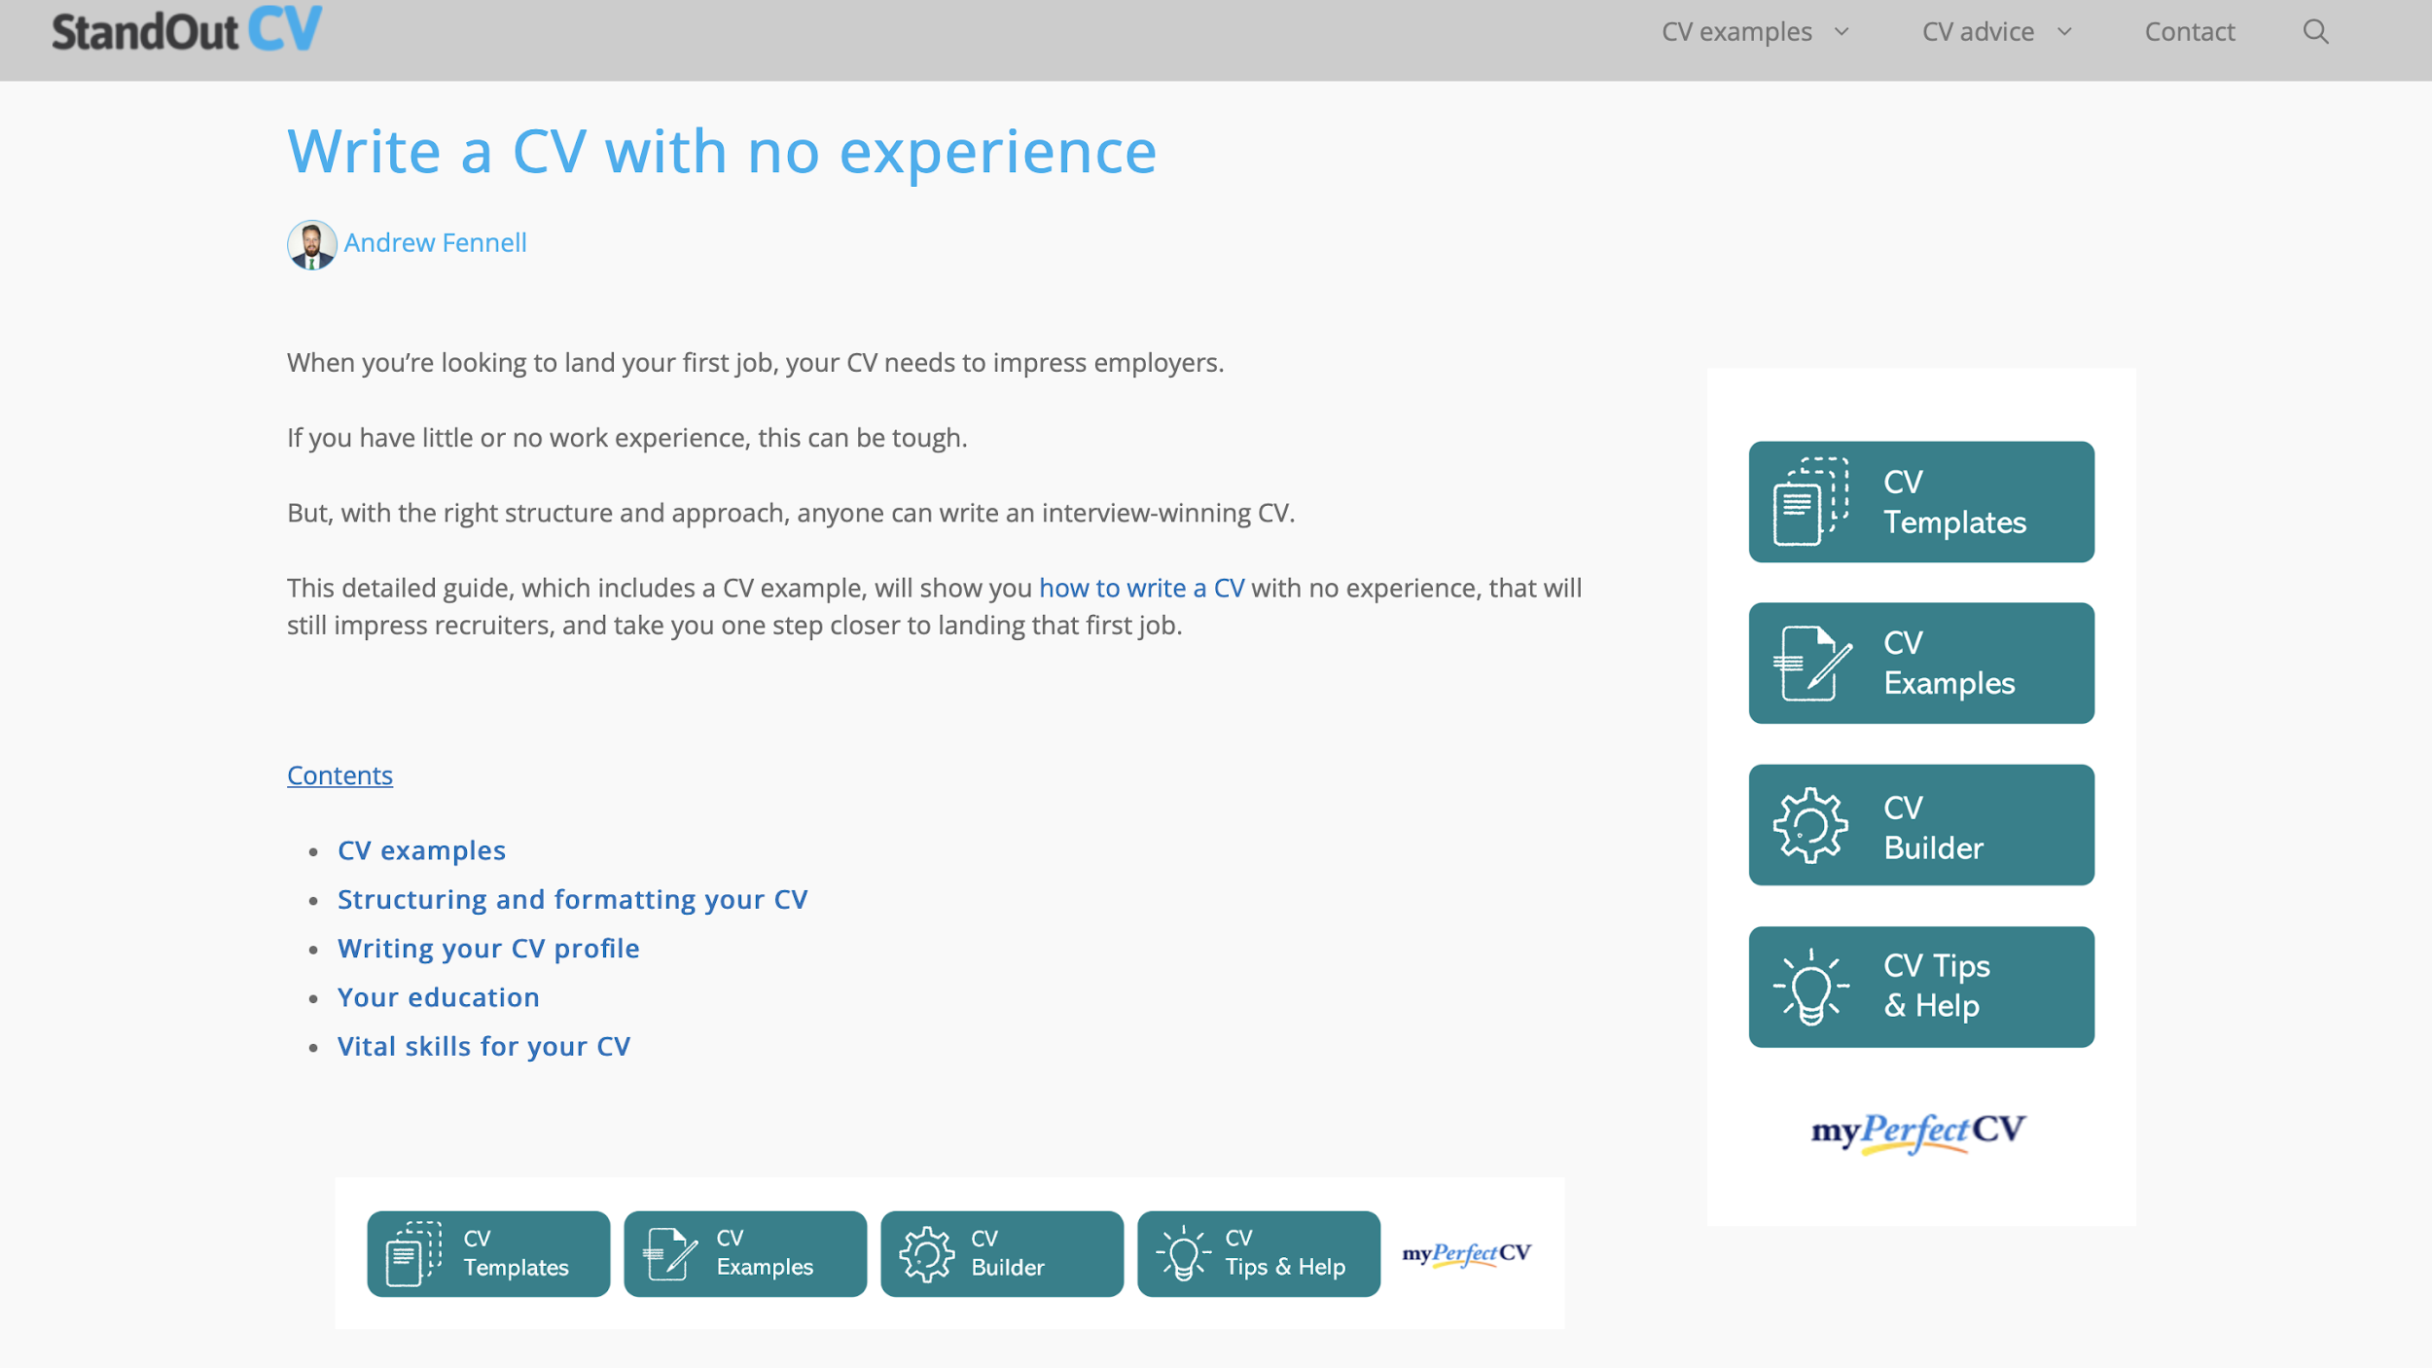
https://standout-cv.com/pages/cv-no-experience
Notes:
Slide 4: Writing an online CV (10min to be completed for homework)
Now that you have an idea of what is required to put into a CV, you will have opportunity to write your own CV. Go to the link https://standout-cv.com/pages/cv-no-experience and click on CV templates.
Go to the site https://standout-cv.com/pages/cv-no-experience and follow the prompts and write your own CV. The step-by-step process is included in Activity 2 (Lesson 2 – Worksheet) to help you plan what you will include. Remember to add you email at the end of the activity so that you can print your CV and bring it to class for the next lesson. Should you struggle to finish, make sure you log in with your email address and you can continue writing your CV for homework.

Slide 5

Notes:
Slide 5: Teaching- Group reflection 5min
Employers look for different skills from their employees. They want to know that you will be a competent worker, but they are also concerned about other values or abilities that ensure you would be a “good fit” for the company. These could include honesty, taking initiative, being responsible, caring, team worker, punctual etc.
(Note to teacher- Hand out the Lesson 2 - Skills Learnt Poster to each group for them to write into for this activity.)
Being a team worker is a skill that you learn when working on projects together. Think of projects that you have worked on with classmates over the years at school. Describe ONE project on your poster. Then, in your groups brainstorm FIVE of the skills you learnt working in a group and name THREE roles that you often find in a group. (Allow 3min for each group to discuss and then ask each group to put it up on a wall in class. This exhibition space will be used in the reflection activity)
Most careers also require administrative skills. Eg. You may be a teacher but you also need to be a good administrator to manage your classes. Being a good administrator can help prevent stress as you are organized and know where everthing is. You can learn this skill while you are still in school by keeping a diary, organizing your school books and planning in advance for upcoming tasks.

Slide 6

Reflection
Notes:
Slide 6: Reflection Activity 5min
As we finish off this lesson, walk past the different posters that were made in the previous activity then complete Activity 4 (Lesson 2 – Worksheet), as you reflect on the following:
Name ONE skill that was identified on a poster that you struggle with and explain how you can improve yourself in that area.
Name ONE challenge you find working on a project with a team.
Evaluate your own administrative skills by describing TWO of your own strengths and weaknesses and think of how you could improve on these weaknesses.

