Slide 1
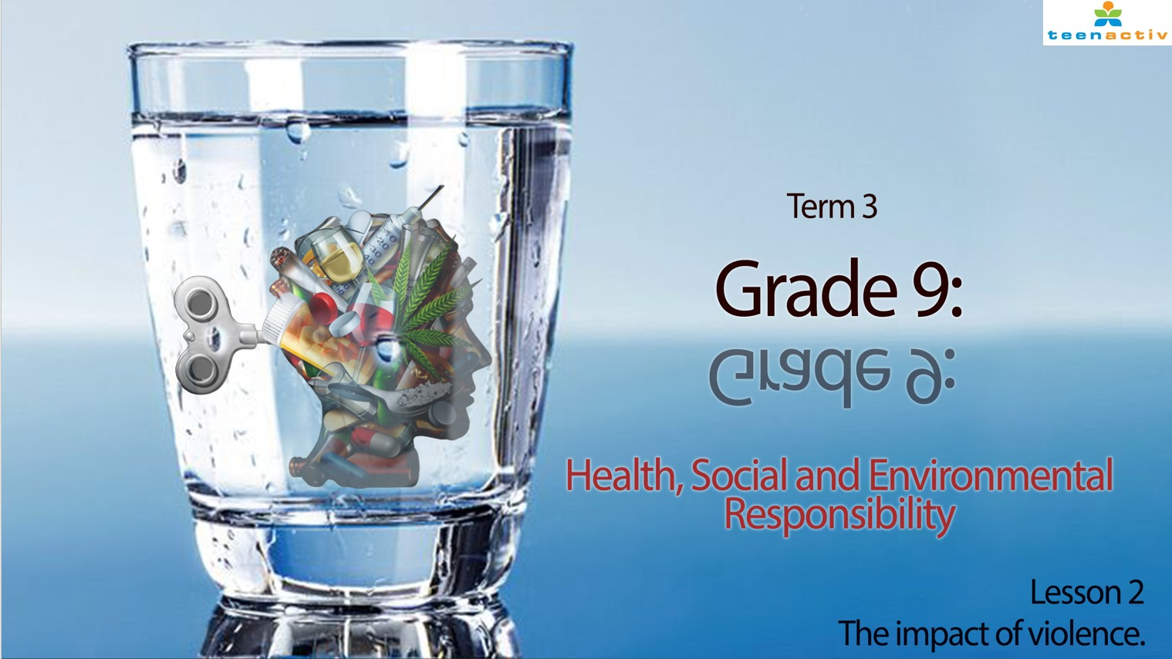

Notes:
Slide 1 + 2: Revision and teaching 7 min
Welcome back grade 9’s. Before we get started today, you need to make sure you have your questionnaires available that you needed to complete for homework (i.e. Activity 3 in Lesson 1 - Worksheet).
Let’s quickly recap the last lesson before we get started today. Can you give me an examples of the following kinds of violence:
Domestic
Violence in school
Violence in community
Let’s get started!

Slide 2
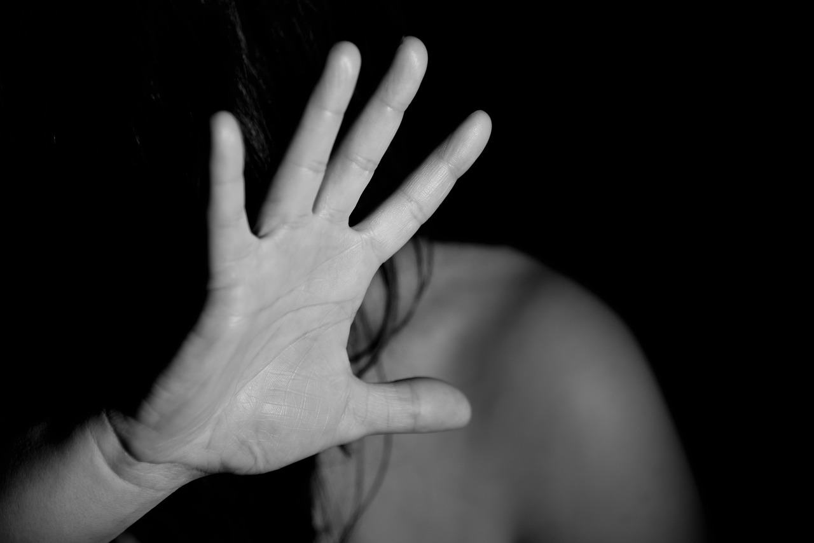
WHY?
Notes:
Slide 2 : teaching and activity
I believe you would have probably heard of even more examples of violence in your communities through your questionnaires (Activity 3 from Lesson 1). It’s so sad to hear of how many people have been victims of violence in our families and communities. I think it’s especially difficult when you know the person that used violence to get what they want. There are many reasons people become violent. On your Lesson 2 - Worksheet in Activity 1, add another 3 reasons to this list:
Some of those include:
*frustration with authorities and so they take the situation into their own hands
*they themselves were victims of abuse and followed in the same pattern
*low self esteem and self worth
*side effects of drug and alcohol abuse
*a belief that you as an individual are better than others and have a right to treat others violently
Sadly, abusers are often respected in their communities and come across as polite individuals. In these instances, it is difficult for the victim to speak about the abuse because they would be afraid of not being believed. Remember we cannot stop people directly from being violent or blame ourselves for not trying to stop them. You could end up getting hurt in the process. There are ways of reporting individuals like this. We will look at this in more detail in the lessons to come.

Slide 3
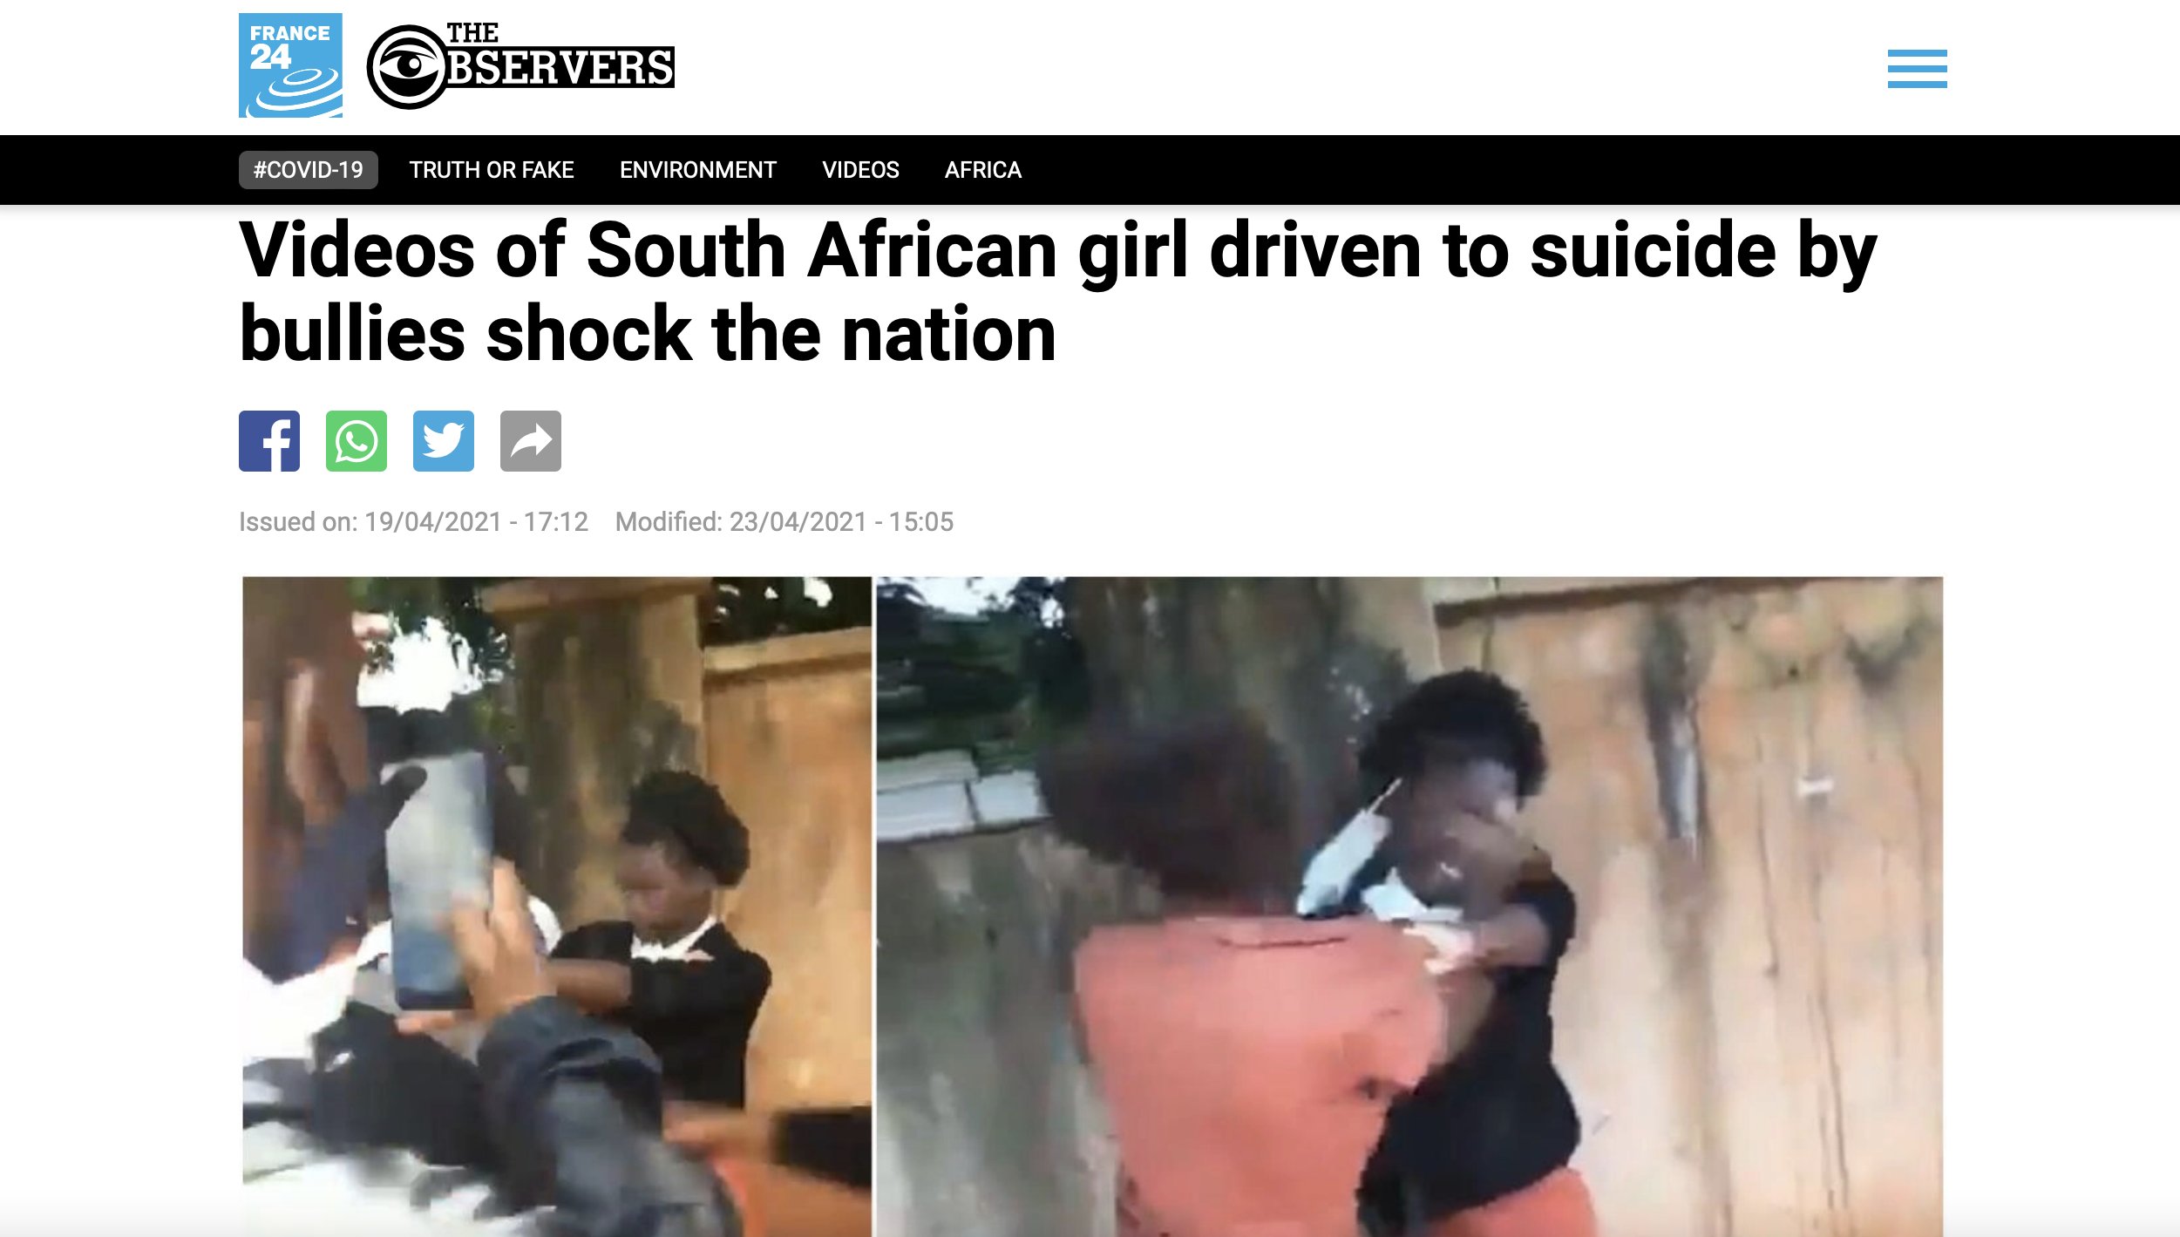
Notes:
Slide 3: Teaching Activity 5 min
Violence will always cause hurt whether it’s a physical and visible hurt or something more internal. It is these internal injuries that often take a long time to heal and sometimes a person will even need assistance to process the trauma of the abuse. Violence can directly impact the health and safety of both the victim and the community.
Let’s look at this case study together. This young girl was recorded on video by onlookers being beaten by a fellow learner. She was laughed at and ridiculed by the viewers. Later that evening she overdosed on tablets. When her brother was later interviewed, he said that he believed that the bullying, together with her fear of failing a test and being further bullied is the reason she killed herself.
Can you see that not only was the victim physically impacted by violence, but her family were impacted as well. They were devasted and very angry. You could imagine that if her brother knew who these learners where he might confront them and beat them up out of revenge. Her parents could become distrustful of the school and community because they did not protect their daughter.
Sadly, there are communities that cannot control their violent members. Some families move out of these areas towards other areas that they feel are safer for their children. Law enforcement increases in these areas and the innocent community members are afraid of being caught in the middle of the violence (between the violent members and the law enforcement).

Slide 4
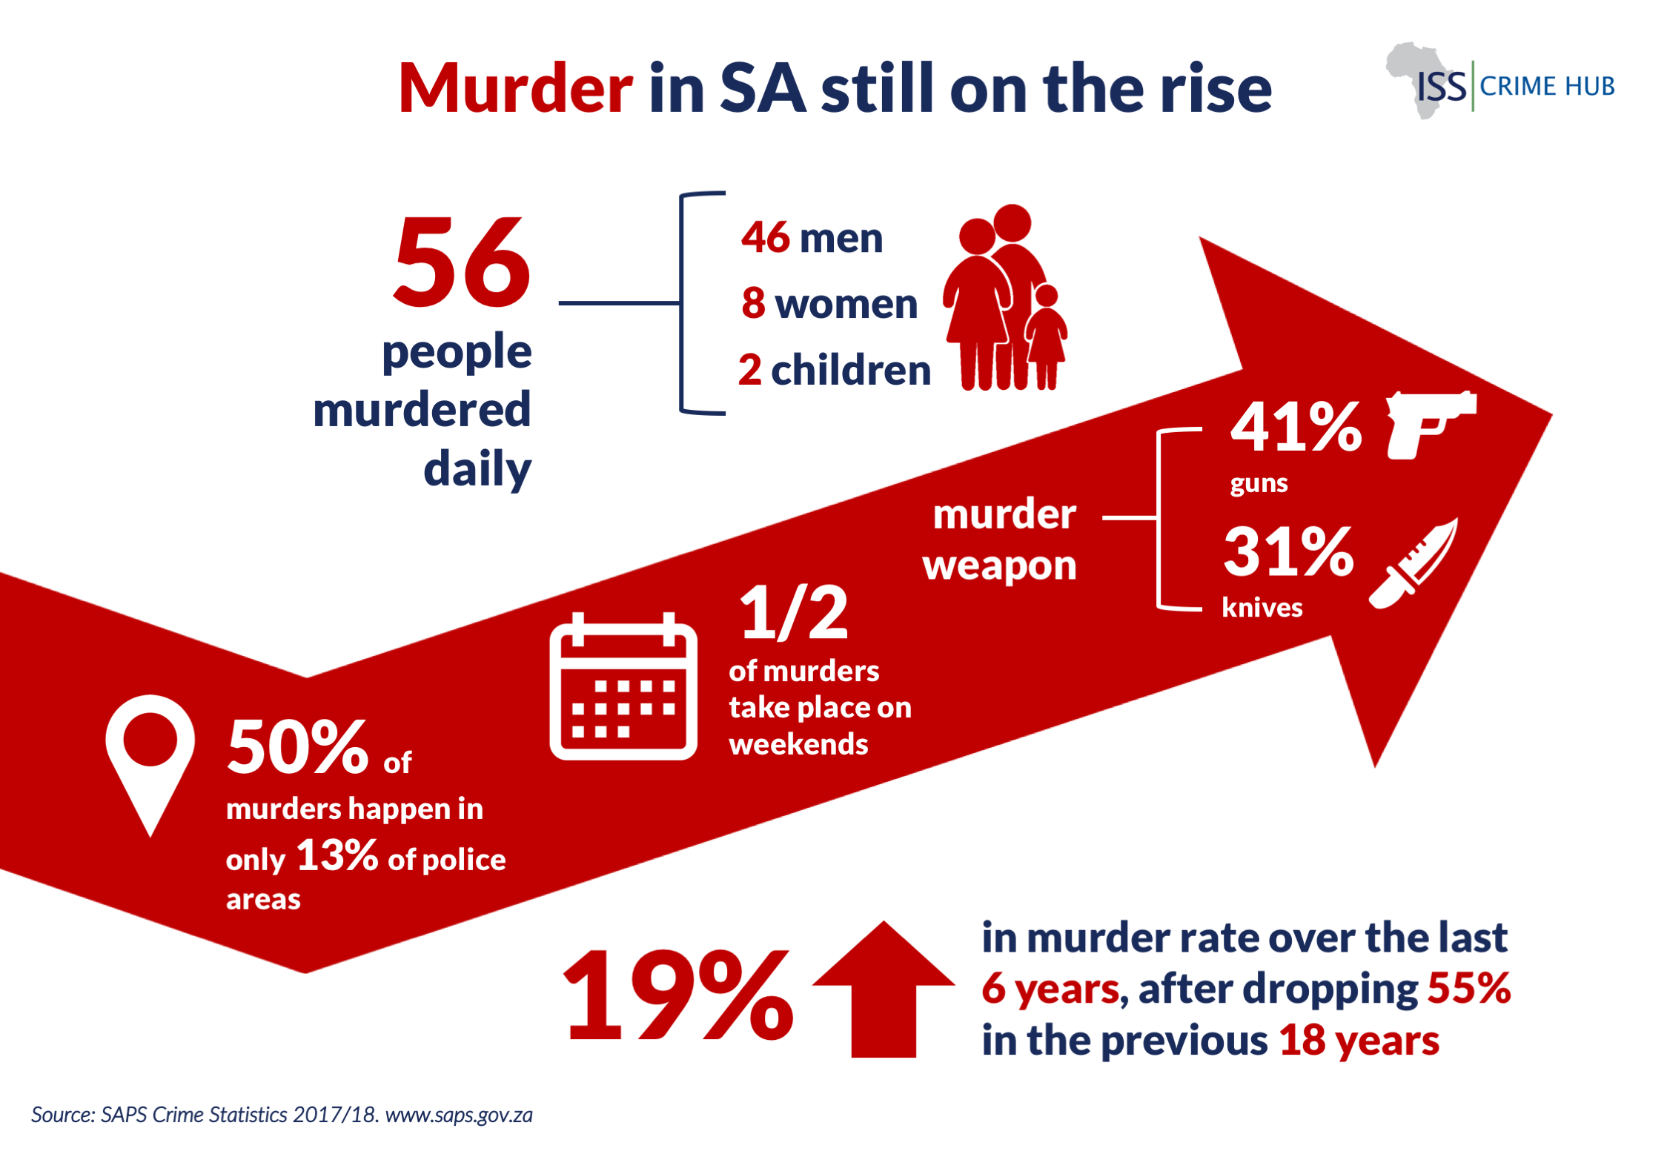

Notes:
Slide 4: Group Activity 10 min + 5 min
Note to Teacher: Hand out blank A4 paper for a poster and markers if there are available for Activity 2 in Lesson 2 – Worksheet.
Allow learners time to work on their collection of questionnaires (from Lesson 1 homework).
Allocate the following violence categories to different groups:
domestic violence,
violence at school,
violence in the community.
You can have more than one group with the same theme.
Using the information you have learnt today and the answers to your questionaries, your group will now have an opportunity to anaylse this information a bit. An infographic is a poster that takes the data we collect and puts it in a visually interesting way so that the average person understands the statistics. Your teacher will allocate a violence category (i.e. domestic violence, violence at school or violence in the community) for your group to reflect on. Use all the questionnaires of the members of your group to collect statistics for your poster. Then work as a group to create this poster that will go up on the wall in your class.
Use the following points as a guideline:
*Include a heading for your poster
*Indicate whether men/ women/ children were the victims
*include a summary of reasons for violent acts
*include summary of impact on the victim and those around them.
(Once the learners are finished, ask each group to present their summary to the class. This is an important learning time. Encourage learners to listen carefully as they will need to reflect on what they hear in Activity 3, Lesson 2 – Worksheet.)

Slide 5

Notes:
Slide 5: Individual Activity 8 min +2 min (complete for homework)
With all the information fresh in your mind from your peers feedback in Activity 2, you will now need to answer the questions to Activity 3. This question resembles the kinds of questions you can expect in your assessment at the end of the year. Take this time seriously when you answer and we will go through the answers together.
(Allow learners about 8 min to answer this question. Encourage silence so they focus on their own answer rather than copying from someone else. Use the last 2 min to go through the question. If the learners need more time, allow them to finish it for homework and revise at the beginning of the next lesson.)

Slide 6
R E F L E C T I O N
How do you stay positive in the face of all the news on violence in South Africa?
Identify ONE aspect of the content covered in the last two lessons that you would like to do additional research on.
What advice would you give your school friends on how to ”be safe” when going out to parties in your community at night?
Notes:
Slide 6: Reflection 3 min
Allow learners to reflect on the questions in Activity 4 (Lesson 2 - Worksheet). Encourage silence in the class. It might be helpful to play soft instrumental music to encourage self reflection.
Answer the following questions:
*How do you stay positive in the face of all the news on violence in South Africa?
*Identify ONE aspect of the content covered in the last two lessons that you would like to do additional research on.
*What advice would you give your school friends on how to ”be safe” when going out to parties in your community at night?
Ask learners to bring coloured pencils and cell phones if they have to the next lesson for a creative activity.

