Slide 1
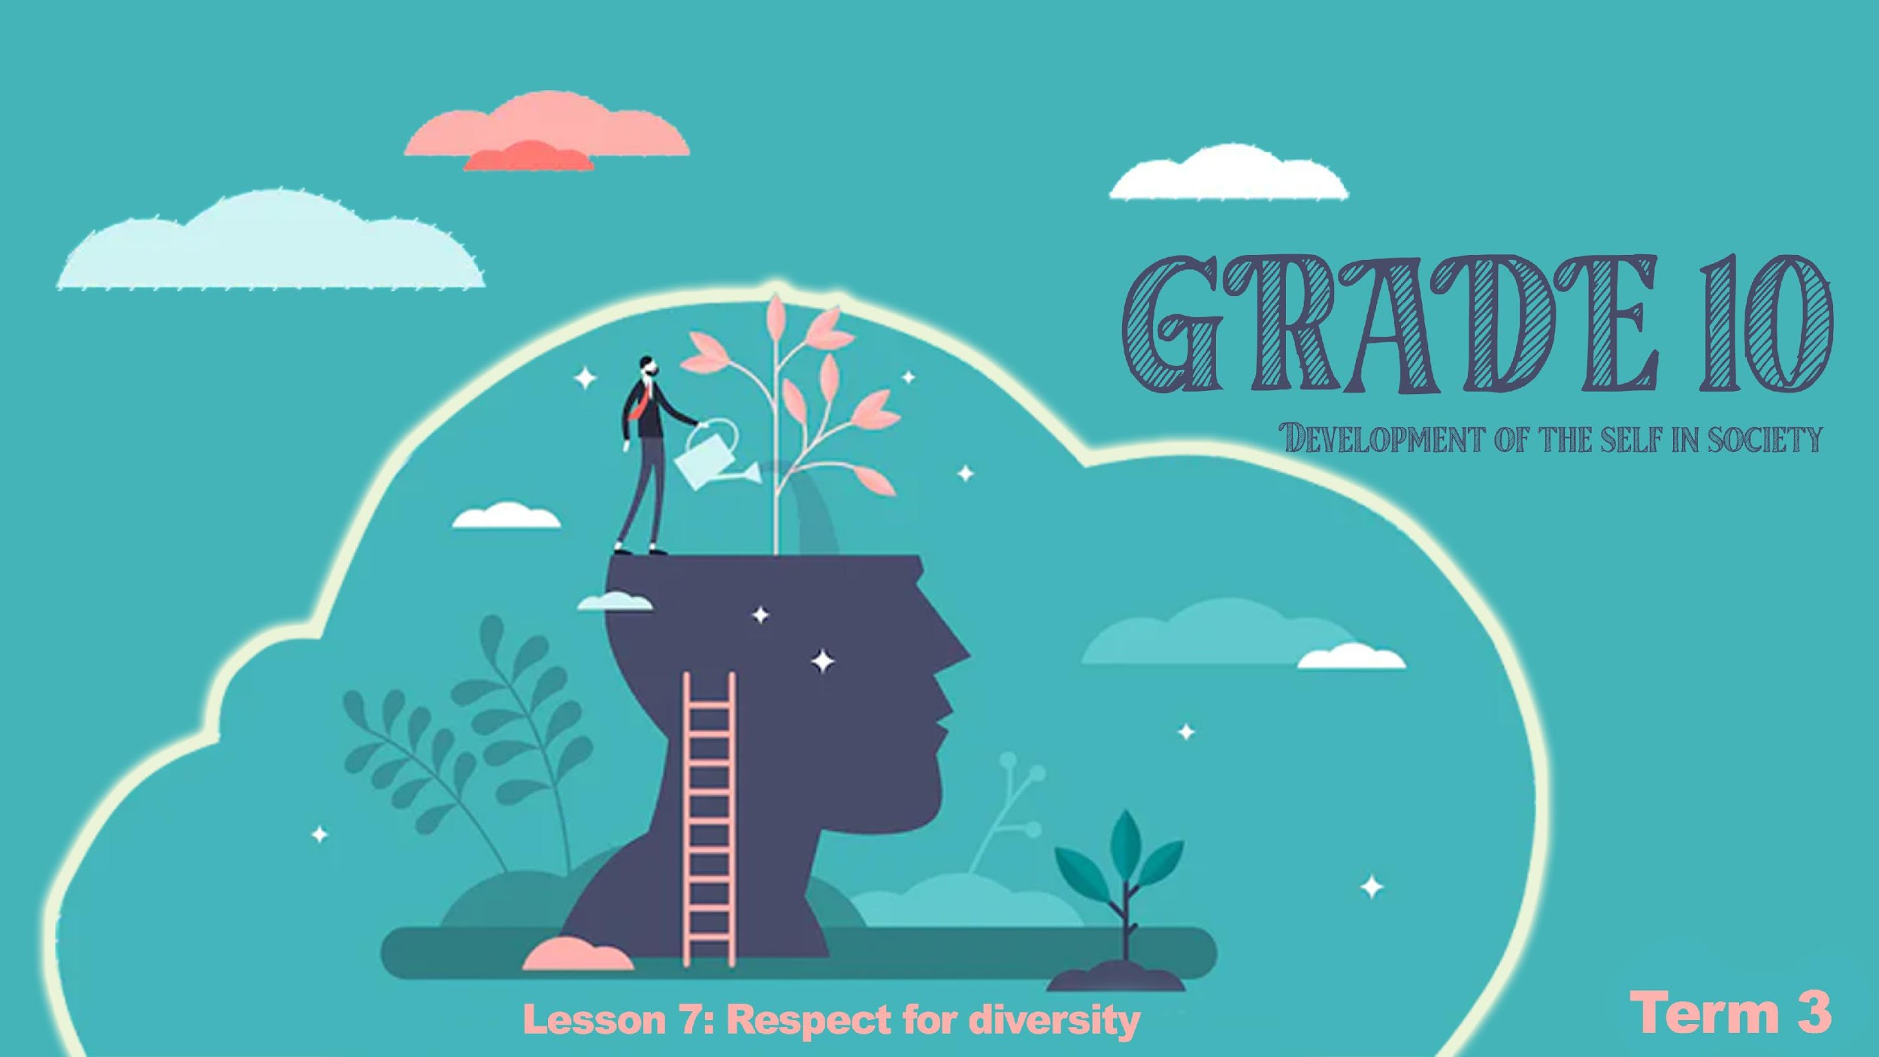

Notes:
Slide 1: 5+2 min Reflection and intro
(Note to teacher: divide the class into a total of 5 groups. Each group will receive a different case study and need to answer the questions and then provide feedback to the class. The lesson today might be sensitive for some learners. Be aware of the learner's body language. Keep encouraging them that our focus is on accepting one another even though we are different. This is not about religious or cultural beliefs, this lesson is about people.)
Good morning grade 10’s! It’s the last lesson this term in this journey from adolescence to adulthood. You were asked to revise the content from the last six lessons in preparation for this lesson. Using the next 4min, in your groups, look back over your work and share ONE thing you learnt that you find has been helpful and ONE positive strategy you have tried implementing in coping with stress.
In the last few years South Africa has seen a large increase of gender-based violence. GBV This type of violence has impacted men and women in so many ways. We have seen an increased in assault, sexual abuse and rape. There has also been what is called corrective rape. This refers to women or men who have been raped, usually by people they know to try and correct their ideas around sexual orientation. Several adolescents have struggled with the effects of corrective rape as their friends and community could not accept their choices.
Today our focus is on how to respect everybody and every one, starting with investigating some of the challenges the LGBTQI+ community experience in South Africa today. The aim is to understand that we live in a diverse country and are all different but all humans. We are embraced for being human not for our differences.

Slide 2
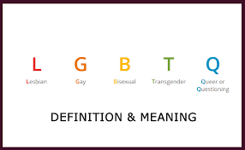
Helpful definitions for:
• Sex
* Gender
• Sexual orientation
• Lesbian
• Gay
• Bisexual
• Transgender
• Queer and
• Intersex
Notes:
Slide 2: Teach terminology 5 min
Before we continue, we must understand what the following terms mean. Write these definitions into your worksheet.
• Sex: either of the two main categories (male and female) into which humans and most other living things are divided on the basis of their reproductive functions.
• Gender: the male sex or the female sex, especially when considered with reference to social and cultural differences rather than biological ones
• Sexual orientation : a person's identity in relation to the gender or genders to which they are sexually attracted; the fact of being heterosexual, homosexual,
• Lesbian :denoting or relating to women who are sexually or romantically attracted exclusively to other women
• Gay: denoting or relating to men who are sexually or romantically attracted exclusively to other men
• Bisexual- denoting or relating to men/women who are sexually or romantically attracted to both women and men
• Transgender - a person whose gender identity does not correspond with the sex registered for them at birth.
• Queer- relating to a sexual or gender identity that does not correspond to established ideas of sexuality and gender, especially heterosexual norms.
• Intersex- The intersex definition is a person is born with a combination of male and female biological traits
(LGBTQI+) LGBTQIA+ is an abbreviation for lesbian, gay, bisexual, transgender, queer or questioning, intersex, asexual, and more.
Complete Activity 1 (Lesson 7 – Worksheet

Slide 3
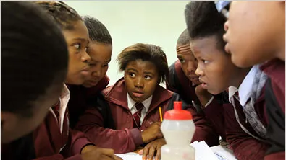
GROUP ACTIVITY
Notes:
Slide 3: Group Activity
Now, you become the teachers this lesson. In your groups, you will each receive an article to read and questions to answer. No group will receive the same article. You will be required to answer the questions and give feedback to your class.
There will be 15min to complete the questions and make a summary and 1min for each group to present.

Slide 4
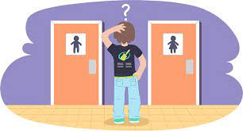
Notes:
Slide 4&5: teaching 5min
As we wrap up this lesson, let's briefly look at where to go if you need help. If you have questions and need to speak to somebody. It is good to know where to find help.
At school you could speak to a counsellor, or a teacher that you trust, even your Life Orientation teacher.
You could go to your local hospital or doctor for advice or support.
There are online support groups that would also be able to assist you.
It’s important to research and make well informed de

Slide 5
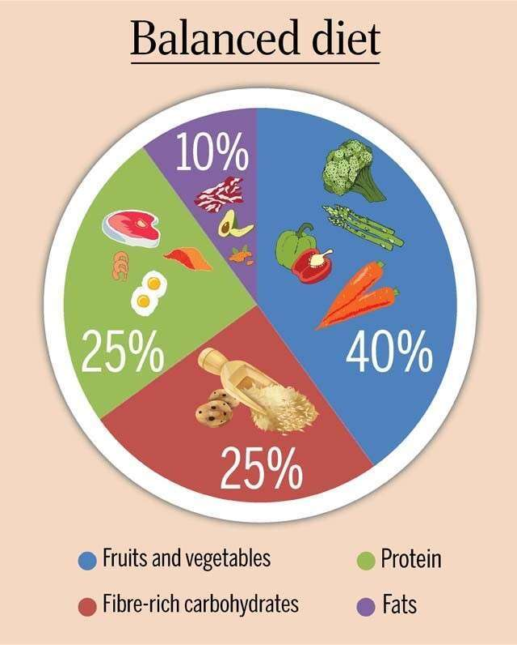
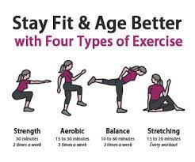
Notes:
Slide 5: 5min
Making healthy lifestyle choices is not only about making the correct decisions about your sexuality and emotions. We also need to look after our bodies by exercising and eating correctly. Nutrition is the balanced approach to eating in a day by ensuring that you eat a balanced diet. This means your daily food intake includes fruit and vegetables, proteins, healthy fats, grains and lots of water.
A balanced exercise program in a week should include:
Cardio which gets your heartrate up and blood flowing eg. Running
Strength- which develops muscle strength and prevents injuries eg. HIT at gym.
Balance- which includes core exercises to prevent back injury and stabalise muscle groups to prevent injury eg. Yoga
Stretching- after all exercise you should do 15min stretching to help your muscles recover and prevent lactic acid build up later in the day which feels like stiffness.

Slide 6

Notes:
Slide 6 & 7: 4min Homework and reflection
We have covered a lot in today’s lesson. Work through Activity 2 (Lesson 7 – Worksheet for homework to help you prepare for test type questions on this content we have covered.

Slide 7

R E F L E C T I O N
Notes:
Slide 7:
As we finish off the last lesson in this series, hopefully today:
- You will have a little bit more respect, compassion and acceptance of others who are different to you
- Those questioning their sexual orientation.
-Where to find help regarding your lifestyle choices and sexuality
- The importance of nutrition and physical activities
Reflect by answering the questions in the Activity:
Evaluate how you behave around learners with different sexual orientation to you. How could you be more tolerant of them as individuals?
Give advice to a friend that struggles with their nutrition on how to eat more balanced meals in a day.
Evaluate your exercise in a week. Which type of exercise do you need to increase in your health and own life?
(Note to teacher- encourage the class to be quiet this time. It might even help to play music. Tell the class to remain quiet until you say they can talk.)
HOMEWORK:
Complete test activity

