Slide 1
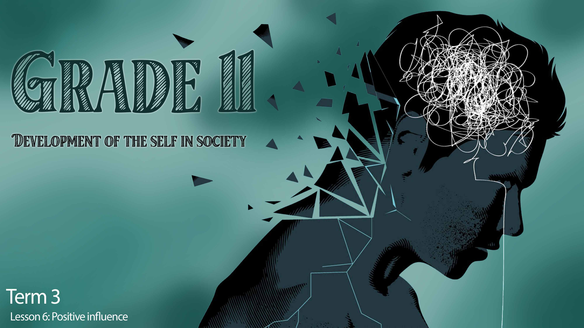

Notes:
Slide 1: 4+3 min Self-reflection and intro
Welcome to the last lesson in this series on developing healthy lifestyle habits. Over the last FIVE weeks we have covered a lot of different content. We started this series of lessons referring to developing skills to help you make the right decisions about lifestyle in preparation for grade 12.
Before we move on, turn back to your notes from the first lesson (Lesson 1 – Worksheet, Activity 4) and look at your homework response to Activity 4. On Lesson 6 – Worksheet, complete Activity 1, reflect how well you have implemented your own plan to improve your lifestyle in the specific areas you identified over the past four weeks.
Be honest with yourself in this activity.
It is important to self-reflect in life when you have tried to implement changes though introducing new habits. Take a moment to think of a person you greatly respect and admire, even look up to. It could be a celebrity, sports coach, family member or even a friend, anyone that you admire.
Turn to someone in your group and describe this person and why you admire them. (Allow 1min for this discussion)
It is important to have someone in your life that you can look up to or who motivates you to make healthy lifestyle choices. The lifestyle and values of this person could inspire you to be a better person. When we take on the positive behaviour, values, or actions of such a person as our own, we could also become a positive influence in our communities. We refer to such a person as a positive role model. Maybe you found it difficult to this of someone.
We’re going to look at a few examples from the local community in South Africa.

Slide 2
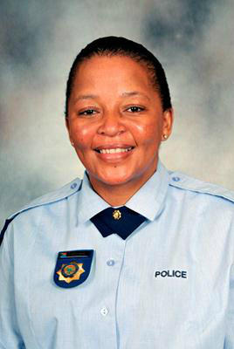
Positive role model…
changed those perceptions by involving herself closely with the community she oversees in crime-ridden eastern Johannesburg.
residents say they have seen fewer incidents of property crime and domestic violence.
formed clubs for the elderly and the young in her patrol area.
started an exercise program for older members of the community.
Notes:
Slide 2- 8min Individual Activity
We have many stories in South Africa of how corrupt the police are. This is a policewoman who is making a difference.
Read the impact that this police officer has had to the class:
Sergeant Olga Masethla says her goal is to change those perceptions by involving herself closely with the community she oversees in crime-ridden eastern Johannesburg.
Since Masethla started patrolling the area three years ago, residents say they have seen fewer incidents of property crime and domestic violence. "When I started the project, I didn’t do the project for any prestige. I did it because I loved what I’m doing, because to me policing is not a career, it's a calling," she said.
Masethla has formed clubs for the elderly and the young in her patrol area. She uses these forums to involve the community in crime prevention and reporting.
She has also started an exercise program for older women in the community.
And she often speaks to children to educate them about police and crime prevention, says day-care operator Zakhele Lushaba.
“She makes the friendship with the kids, and the kids when they saw Olga they feel happy and say Olga our friend our friend, and she always comes here and helps us with some blankets," said Lushaba.
Masethla has received overwhelming support from other police officers, as well as from her bosses - like Lieutenant Colonel Andy Pieke. "You know we have a few bad apples, but the majority of our police members are doing their work properly," said Pieke.
In this community, Sergeant Olga Masethla has given residents something to sing about.
Complete Activity 2 (Lesson 6 – Worksheet)

Slide 3
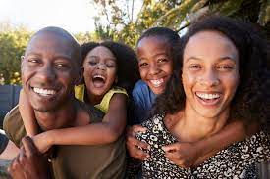
Notes:
Slide 3: Teaching 5min
Your parents (or guardians, or person who plays that role in your family) could also be positive role models to you. Often, young children model the behaviors they see in their parents. As teenagers, parents can have a positive effect in lifestyle choices by:
Being supportive, encouraging and open to communicating on any topic.
Reminding their children that they a precious and valuable and loved.
Educating their children on sexuality and the importance of decision making.
Teaching their children about what is right and wrong and learning that choices have consequences.
Modelling good lifestyle habits by eating healthy and exercising.
Once you have spent some time thinking, I’m sure you could list many more ways that your parents could be positive role models.

Slide 4
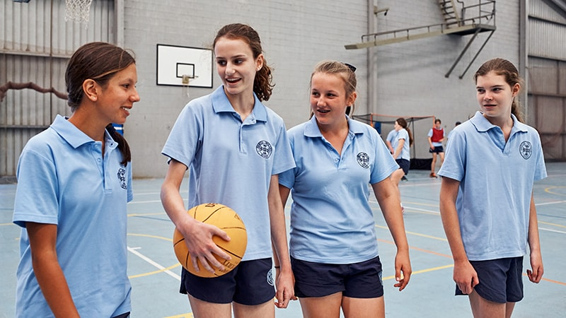
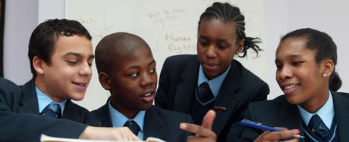
How can your peers or friends be positive role models to you?
Notes:
Slide 4: Group discussion 3+2min
Look at the images on the slide. In your groups, discuss FIVE examples of how your peers or friends can be positive role models to you?
(Allow 3min for discussion and 2min for feedback from the class.)

Slide 5
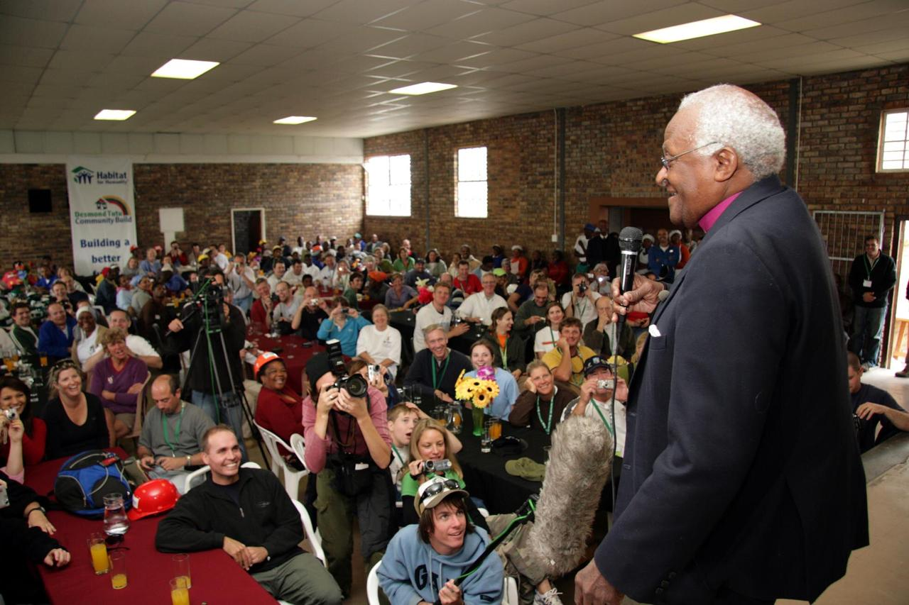

Notes:
Slide 5 + 6: Teaching 10min
Not only people you know like your friends and peers could be a positive influence on you, but also your faith or religion could impact your lifestyle.
Being involved in a religious group in your community, would enable you to meet other people in your local community who are making a positive impact in their communities.
Your religious community might believe and teach certain values that would have a positive impact on yourself and those around you.
Eg. The Christian faith teaches you to forgive others when they have offended you. The Muslim faith promotes a healthy eating lifestyle.
Most religions teach how to live in peace and to accept one another regardless of our differences.
In the same way your cultural beliefs could have a positive influence on your lifestyle. Maybe you live in a community where sexual behaviour before marriage is disapproved of. This will protect you from teen pregnancy and other sexually transmitted infections (STI’s) if you listen to the advice of the community. Sometimes it’s just the traditions followed by a cultural group that remind you that you are not alone. E.g. Joining the Kaapse cloppers on 2de Nuwe Jaar for their celebration.
Your economic condition could also influence your lifestyle. Having money to purchase the healthy food you want to eat or pay for the gym contract where you could go exercise safely, makes it easier to make these positive changes. However, the reality is that not everyone has this privilege.

Slide 6
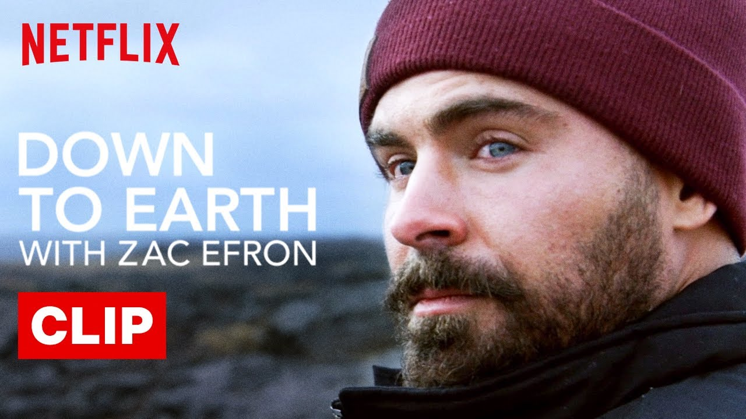
Notes:
Slide 6:
Who can remember the article we looked at in Lesson 1 on the impact of social media on a healthy lifestyle. The article highlighted that social media could be both a negative and positive influence in your life. There are so many inspiring interviews and videos on YouTube that once you follow one thread you end up losing an hour of your day.
It is good to recognize the positive influence that these different media platforms could have. You could learn to cook a healthy meal on Facebook/ Instagram from a group of friends, follow sports heroes in the news and sports matches, or watch a series that challenges you.
Watch: https://www.youtube.com/watch?v=oMzYiY5wcHU (1min 36s)
How can watching a series like this be a positive influence? (Ask the class for a response)
Basically, this series would teach you how to live a sustainable life and leave a minimal carbon footprint.
However, it’s important to manage your social media usage. Remember to put some boundaries in place so that you don’t waste time. E.g. No cell phones at the dinner table, when spending time with a friend, put the phone away and talk face to face. (If you need more ideas look at https://au.reachout.com/articles/5-ways-to-tame-your-social-media-use )

Slide 7
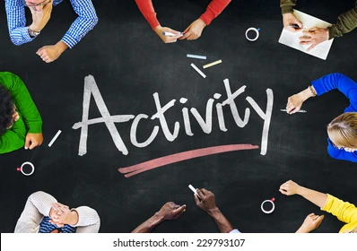
Notes:
Slide 7: 4min
(Note to teacher: This activity will take longer than the time allocated in class. Simply introduce Activity 3 (Lesson 6 – Worksheet) and then move on to the reflection. Leave 3min for the reflection activity to wrap up this section.)
As we come to the end of this series of lessons, you will now have an opportunity to let your skills and knowledge on the content covered. These questions will give you an opportunity to practice the type of questions that might come up in the year end examinations. You will have to finish this activity for homework.
Complete Activity 3 (Lesson 6 – Worksheet) for homework.

Slide 8

REFLECTION
Notes:
Slide 8: 3min Reflection
As we finish off this lesson, read through and answer the questions on Activity 4 (Lesson 6 – Worksheet), as you reflect on the following:
Name THREE positive characteristics in your life that would make you a good role model for others?
Consider your teachers at school. What positive experiences with them has had a positive influence on you?
Identify what you are looking for in a role model to inspire you. Commit to researching, talking to people - if you can’t say you have any positive role models yet.

