Slide 1


Notes:
Slide 1 : 8 min intro
Good day Grade 11’s. We start a new series of lessons today that gives you some of the skills you will need in the months to come.
Have any of you got brothers or sister that have a job? Maybe you have a part time job on the weekends. What would you say are the pro’s and con’s to having a part time job while you are also trying to pass grade 11. I’m going to ask you to share some of your thoughts and we’re going to write them directly onto our list. Let’s see how many reasons you could come up with.
Here are a few obvious possibilities…
Pro’s:
You could have some extra spending money for yourself
Be more independent
Not have to ask for money from your parents all the time
Learn some skills to see how you operate in the working environment
Learn to manage your money
Start saving for the future
Con’s:
The long hours could impact time allocated on studying
Will not have as much time to spend with friends on weekends
Long hours could impact the body which in turn would influence performance in sport and at school
Tiredness after a working weekend could result in a lack of concentration on a Monday at school
As you can see there are many benefits and challenges to working while you are still at school. Whether you work now or in the future, the reality is there is a whole world out there, a language even that you need to know to apply for a job, apply to study or even just to be aware of how to prepare for an interview. In the next five lessons we will be focusing on helping you develop these skills that you will use in the near future.

Slide 2
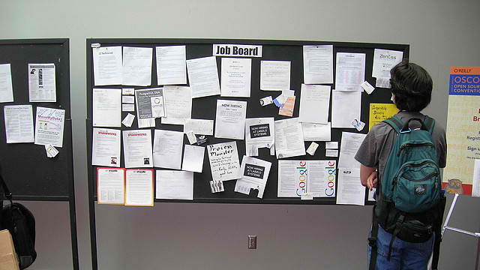
Notes:
Slide 2 &3: 5+9+6min (Teaching and Individual research activity
If you decide to start looking for work, where would you even start looking for advertisements of job opening? (allow learners time to respond)
Maybe some of you have seen the community board at your local grocery stores. Often, they have a list of jobs open, but also people have an opportunity to put their names and contact numbers on the board advertising their availability to work. The challenge with only advertising on the community board is that you only reach people in your local community. A benefit though is that if you found a job, you wouldn’t have to travel far from where you live.
What are some other places where you might hear about a job opening? (Allow time for learners to respond)
You could look in your local newspaper.
Some of you might have heard of internet platforms like “LinkedIn” or searching on sites like “careersa”. There are many platforms online that share job openings.
We are going to give you some time now to do a bit of research. On your worksheet, look at Activity 1 (Lesson 1 – Worksheet).

Slide 3
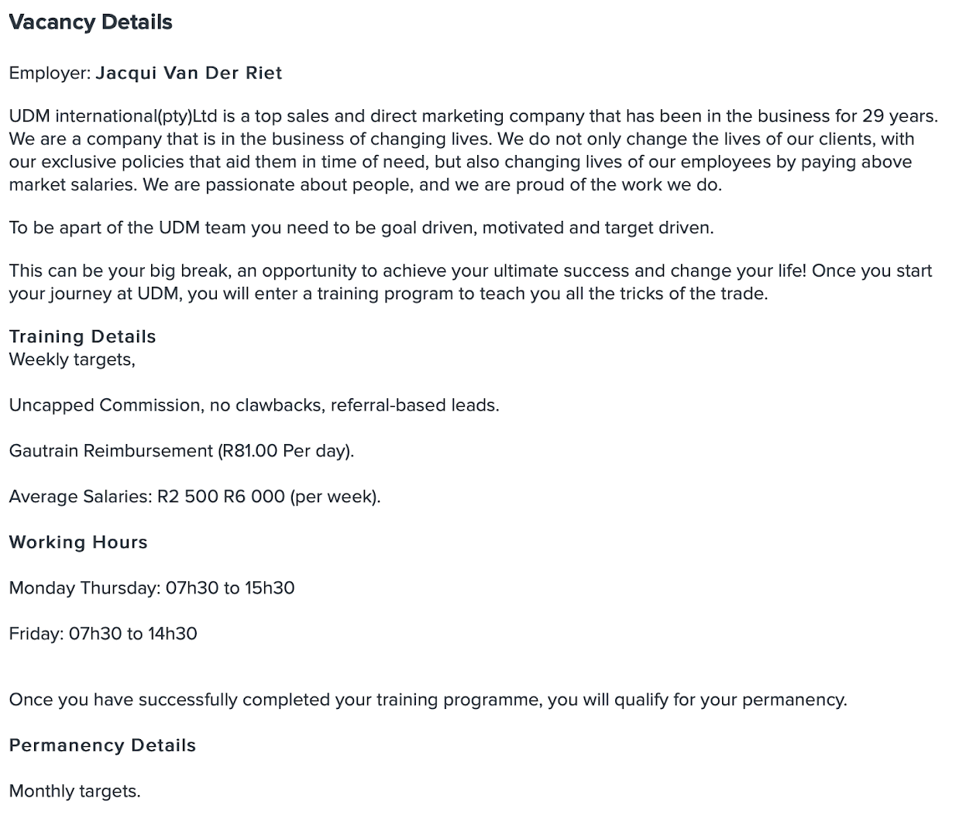
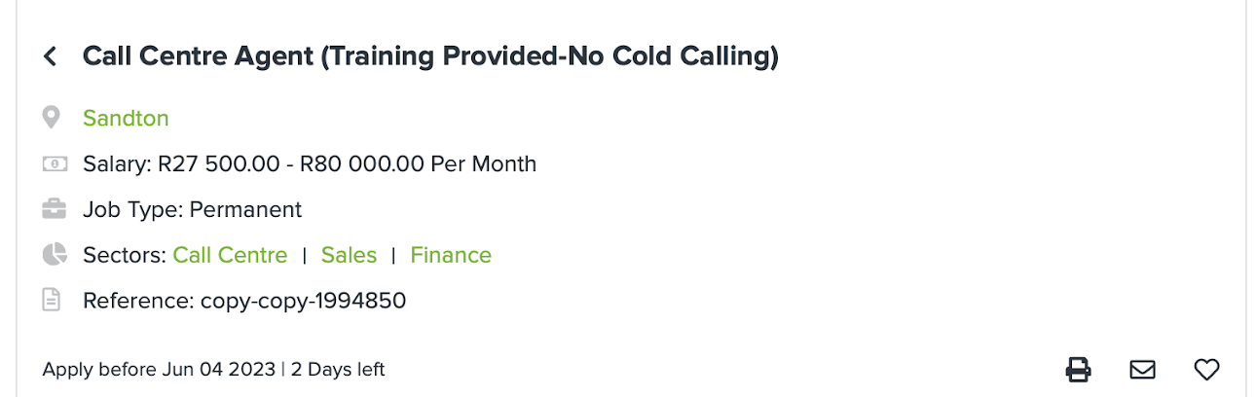
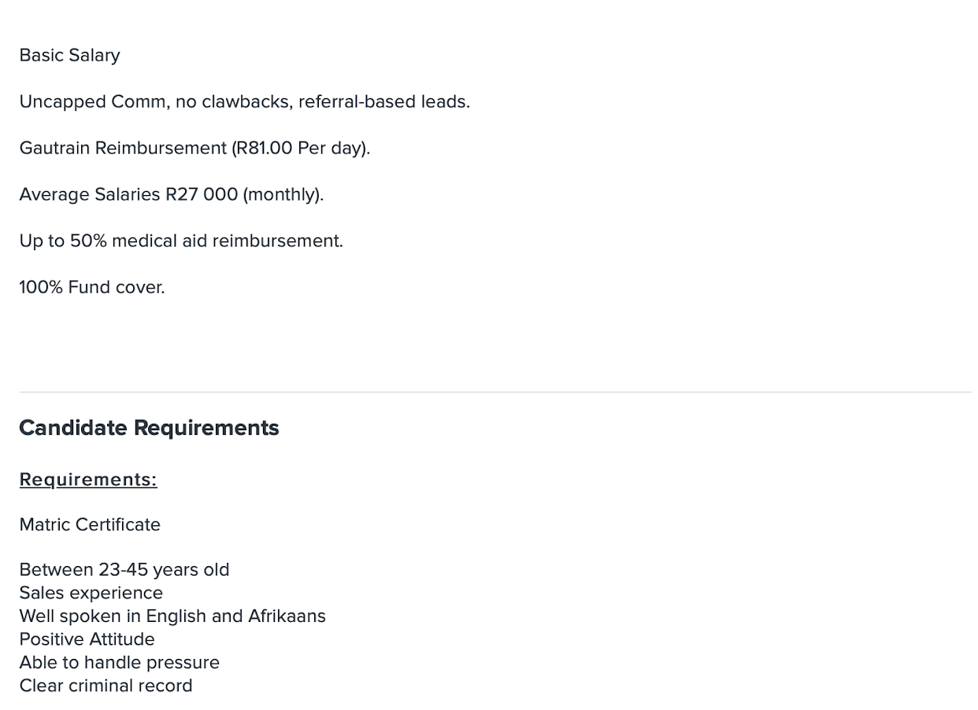

Example…
What comes next?
https://www.gov.za/issues/finding-job-0
Notes:
Slide 3- teaching
Ok, let’s recap and look at what you found out by using this example (i.e. Slide 3).
The job vacancy would be for a job as a call centre agent in Sandton with a basic salary of R27 500 – R80 000. The fluctuation in the amount is because the salary is based on commission. There are some benefits which include 50% medical aid and 100% funeral cover.
The reality is this is not a job you would be able to do while you are still at school. They do indicate in their requirements that the applicant needs to be between 23 and 45 years old with a matric certificate.
However, let’s imagine for a moment that you did meet all the requirements and you were interested in applying for this job. What would the next step be? What would you need to have to apply for the job? (Ask learners to give input. )
Maybe these were some of your responses:
Have your own CV
Driver’s licence
ID Document
Knowing what you need and how to apply for a job is important. You are living in South Africa and living here has requirements about working here. You will now need to go to the following link https://www.gov.za/issues/finding-job-0 and complete Activity 2 (Lesson 1 – Worksheet).

Slide 4
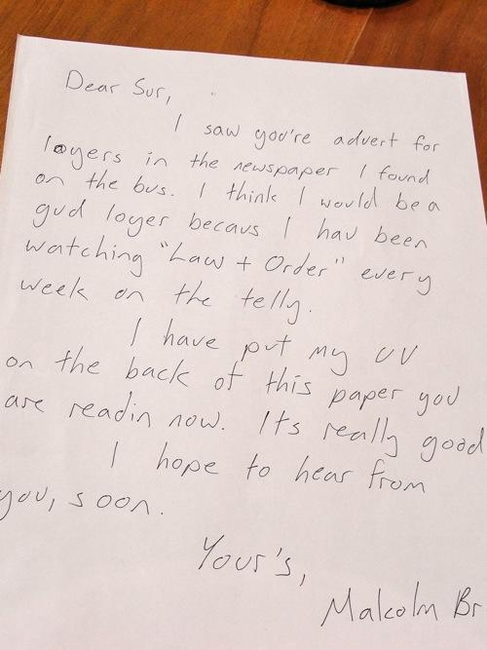
Would you employ this young man?
Notes:
Slide 4&5: 3+3+3min
One of the requirements of applying for a job is writing an application letter. This is letter will give the person filtering through applications a glimpse into who you are and what you have to bring to the company. It will be the first introduction they have to you. This letter needs to convince them that you will be an asset to their company. Let’s read the letter on this slide 4 … Would you employ this young man? Why not? (Allow time for the learners to reply.)
Possible responses:
NO! because…
The hand-written note seems rushed and not serious about the job
The bad spelling shows a lack of education
The fact that the CV could fit on the back of the page means there is very little information in it.
So, how do you write an application letter and what should be in it.
Let’s look at the two letters on the next slide (Slide 5). Both use the correct format but respond differently. Let’s see what we can learn.

Slide 5
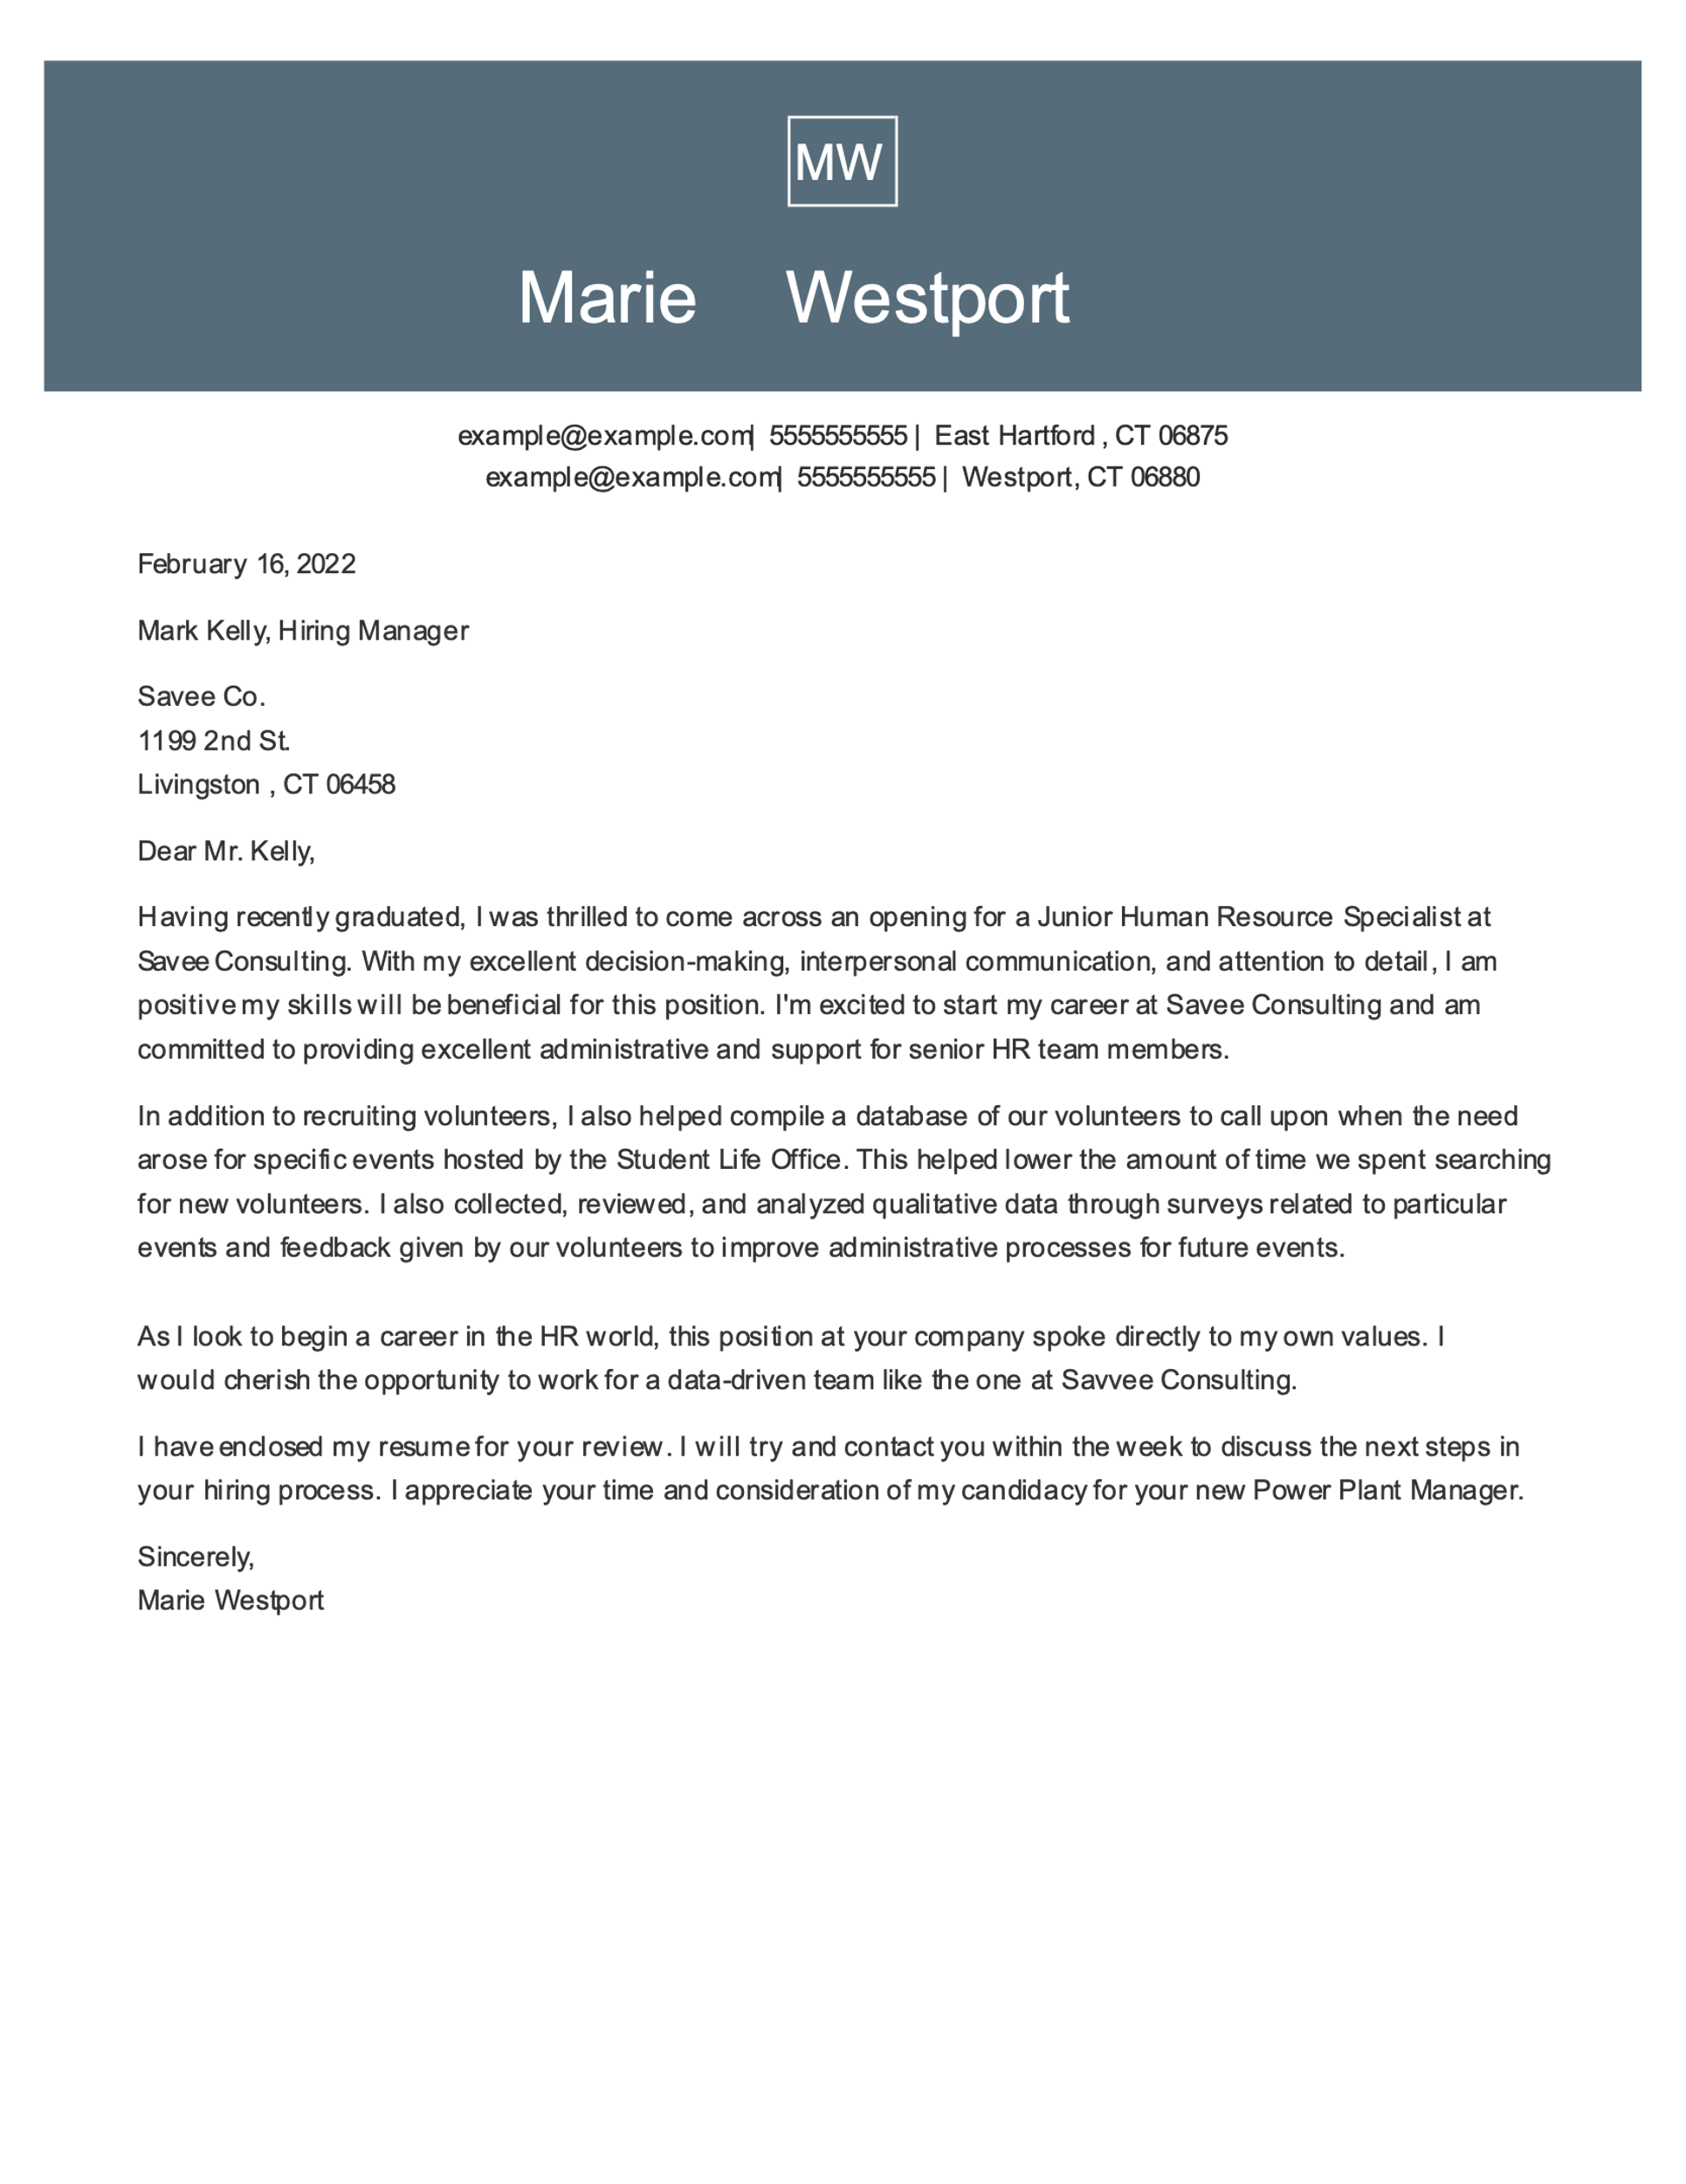
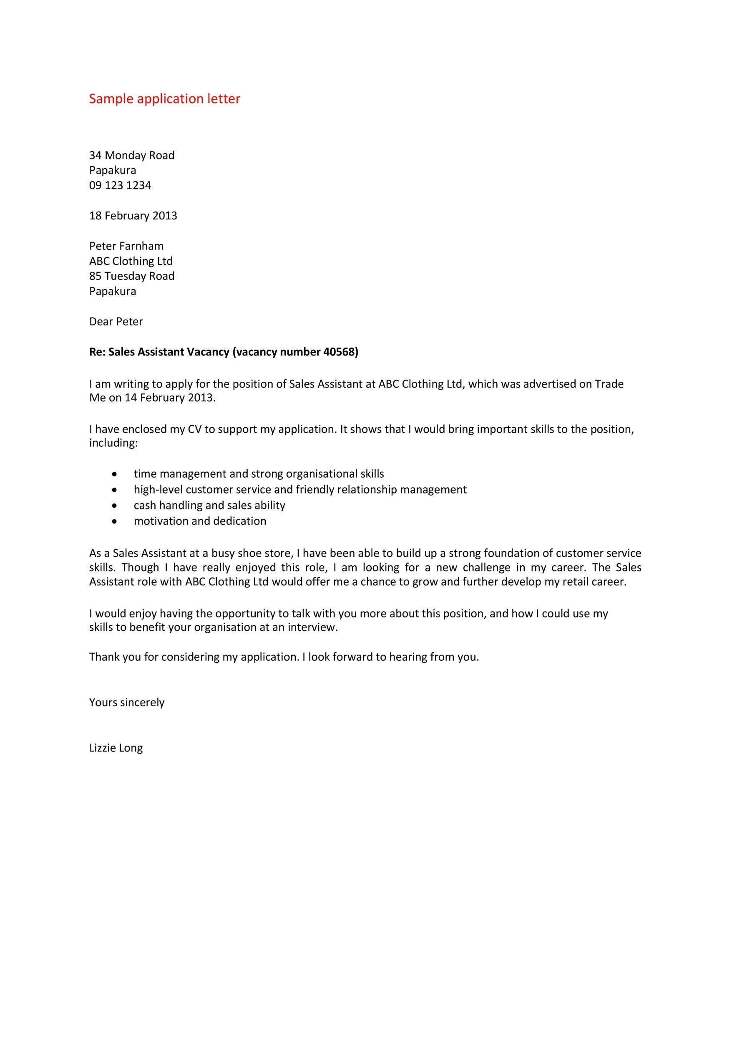
A
B
Notes:
Slide 5:
What can we learn from these two letters?
Start by typing your letter on a computer
Use the correct format for a formal letter
Indicate where you came across the information about this job vacancy and state the name of the job that you are applying for.
Express what skills/ values you have that would that benefit the company
Include past job experience and what you have learnt
Concluding thoughts
Remember to include the mention of attaching your CV to the application.
Once you have decided you are going to apply, you will need to complete an application form. There might be a link online or an actual form that you will need to fill in.
Remember to double check when you are finished - that everything is complete and you have left nothing out.
If you are applying online, ensure that you have all the documents ready to upload. You will also need to include your ID document, any certificates eg NSC (National Senior Certificate- the certificate you receive when passing matric). Make sure you certify your documents if you need to hand in an application form directly to the company.
Hint! Make copies of everything you submit.
Take a moment to start Activity 3 (Lesson 1 – Worksheet). You will need to complete it for homework and bring to class for the next lesson.

Slide 6

Notes:
Slide 6: Twitter Reflection Activity 3min
Quickly reflect on today’s lesson and the tips/ideas that you would take away from it. Compose a short reflection in the form of a “Tweet” (no more than 120 characters in length) on what stood out to you.

