Slide 1
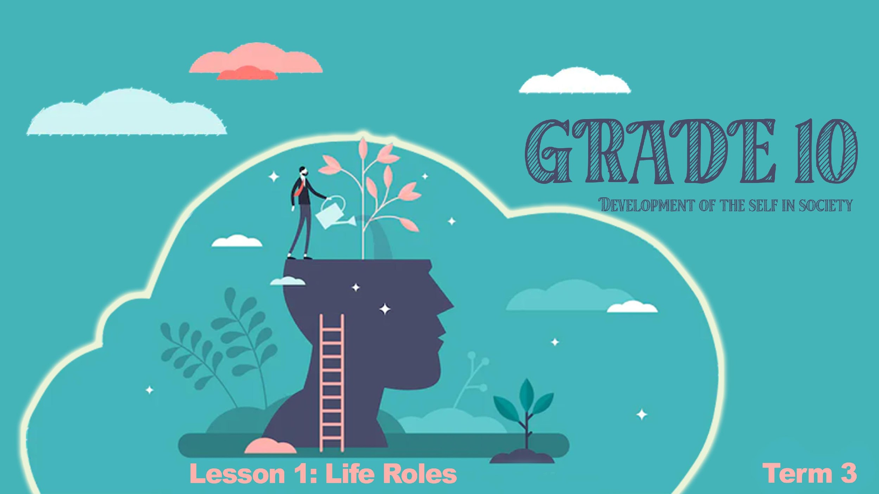

Notes:
Slide 1 & 2: 10 min intro & Group activity
Welcome back to a new term. By this stage of the year, I’m sure you’ve settled into being a senior in high school. Maybe some of you could even look back at the person you were at the beginning of the year and you recognize that you have changed. Some of you are a little taller, some a little more muscles and some just a little bit happier.
Change is part of life and part of growing up. You are not the person you were in primary school and you have different needs and responsibilities than you did in primary school. During your life you will take on many different life roles at different stages. These include being a young child, student, parent, friend, employee and many others. Each of these roles carry different responsibilities eg. Being a young child you were dependant on your parents. It was your responsibility to listen to your parents.

Slide 2
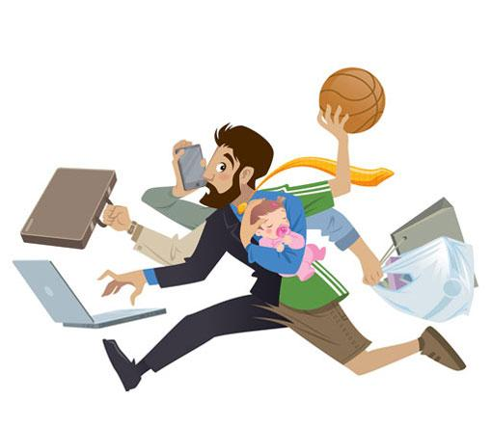
parent
employee
leader
friend
student
Bread winner
Notes:
Slide 2:
In your groups look at the list of life roles on the slide. Can you come up with TWO responsibilities for each of these roles?
(Note to teacher- Allow 6min for each group to work through the list. Provide paper for each group to make notes on. Ask each group to appoint a leader to provide feedback to the class. Allow 2min for feedback by choosing a few groups to respond.)
Well done class! What insightful responses. Just to summarise then, as you go through life, you have a range of roles: employee, provider, caregiver, spouse or partner, parent, grandparent. Each of these roles comes with different expectations. Some of the expectations/ responsibilities could be:
student:- working hard at studies
parent- responsible for looking after your children
Friend- listener, reliable, confidante of another friend
Employee- independent, can support self and take initiative
Bread winner- the person earning an income to provide for the family to buy groceries and basic needs.
Leader- make decisions and guide those that your are called to lead by giving clear instructions.
A person could have more than one role

Slide 3
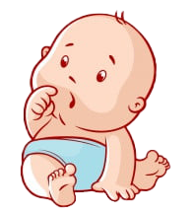

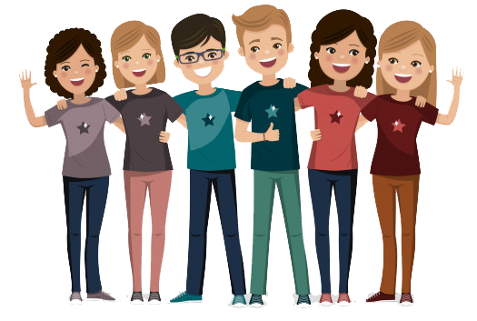
In different roles you can be:
DEPENDENT INDEPENDENT INTERDEPENDENT
Notes:
Slide 3: 5min Activity and teach
(Learners to write these definitions into their worksheet on Activity 1 (Lesson 1 – Worksheet).
A person could have more than one role at a time. In different roles you could be
Read out these definitions so the learner can write it on their summary sheets.
Dependent- you need others to help you like a newborn baby.
Independent- you do not need others help and support
Interdependent- You and someone else depend on one another or need each others support
There are different competencies and skills that you can learn ad practice to handle the different life roles. Eg. In your role as a family member you could be helpful by doing chores, loving, take responsibility, sharing with your siblings.
As you grow older so your life roles will continue to change. There are times some roles will become less important. Example, starting a part time job, you might have less time for your friends. Sometimes circumstances influence the change of roles. You could have a parent who gets ill and now you have to take care of them so you cant take part in sport anymore.

Slide 4
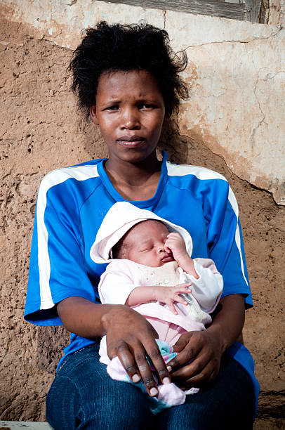
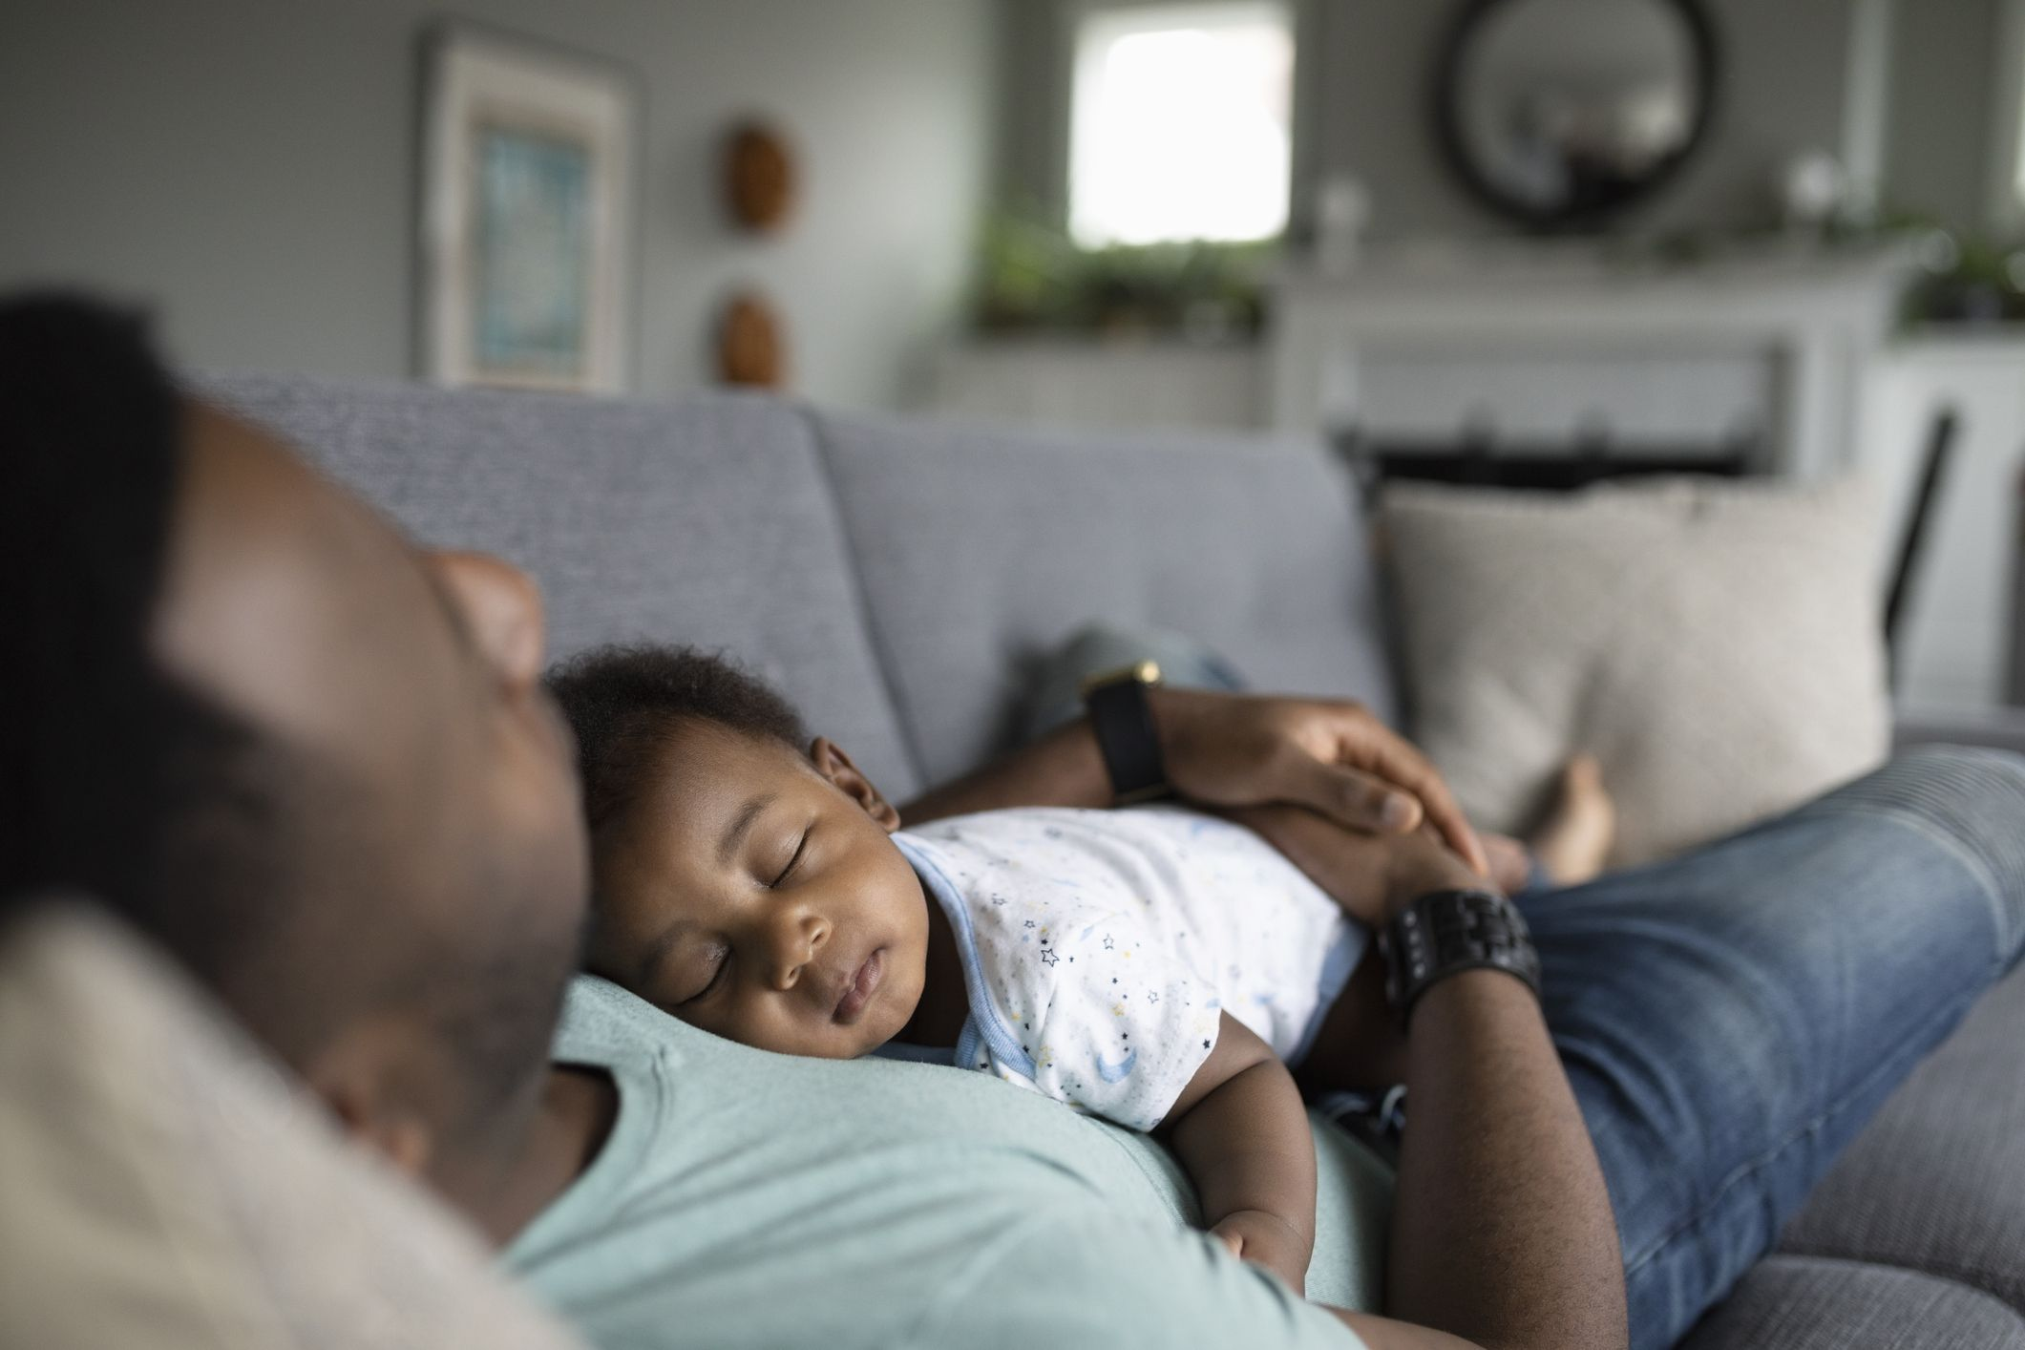

Notes:
Slide 4: Individual Activity 8min
Most of you probably have dreams of playing sport or going on a holiday one day overseas or maybe its just hanging out with your best friends on a special holiday. Sometimes our life roles can change in an instant because we do not take responsibility for the role we are in. Being a teenager and getting pregnant then becoming a parent, is an example of how our roles may change -and not being responsible.
Read the case study of Ruby, Xolani and Sesethu then answer the questions in Activity 2 (Lesson 1 – Worksheet). Reflect on how change can influence your roles and responsibility.

Slide 5
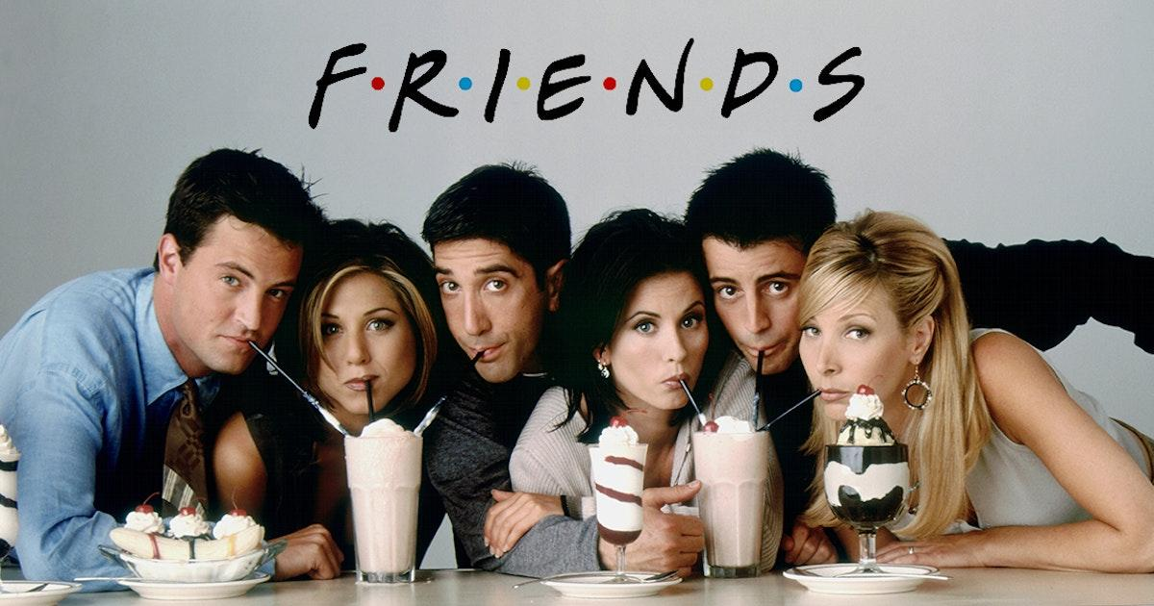
Notes:
Slide 5:
(Note to teacher: One poster should be printed out per group. If you have more than one class, it would be helpful to laminate and provide groups with whiteboard markers. It is suggested to allow learners to put the posters up in the class at the end of the lesson.)
Society and cultures often try to tell us what our roles should be and what our relationships with others should be. Cultures also play a part in bringing on change. Eg. A jewish boy will have a Barmitzvah at the age of 13 which then defines him as a man. In Muslim cultures when a girl starts her period she is a woman and ready to be married. Even if she only starts her period at 11 years old.
Sadly, many teens have believed the lies about casual sex in friendships as well. The media has convinced them it's perfectly normal and acceptable. Many series on Netflix give a distorted view on what healthy relationships actually look like. This 90’’s show has made a comeback and many teens have fallen in love with the characters of the show. The show plays out to the song “I’ll be there for you” with a promise of forever friendship.
As a group- read through the list of 5 lessons you can learn from watching friends in Activity 3 (Lesson 1 – Worksheet). .As a group, the poster should indicate 5 comments that society and culture make about friendship and share FIVE competencies of being a great friend.

Slide 6

R E F L E C T I O N
Notes:
Slide 6: 5min
As we come to an end of this lesson, reflect on the following questions in Activity 4 (Lesson 1 – Worksheet).
How well do you handle change from one life role to another?
How can you improve your ability to adjust?
Explain how much of your perceptions of the role of a person in a relationship has been defined by the music you listen to?
(Note to teacher- encourage the class to be quite in this time. It might even help to play music. Tell the class to remain quite until you say they can talk.)
HOMEWORK:

