Slide 1


Notes:
Slide 1 – 5 min Intro
Good day Grade 9’s! Welcome to the beginning of a new series in LO this term. This will be our last series this term before we start doing some revision. In this series we are going to look at different social issues relating to violence. This theme is a continuation of the same theme in Grade 8 where we looked at gender-based violence and how to prevent violence against women. GBV is one of many kinds of violence we see in South Africa.
In your groups, make a list of as many kinds of violence you can think of.
Give each group an opportunity to read their list.
See Teacher Notes

Slide 2
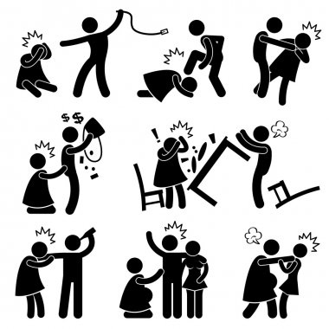
Violence against women
Notes:
Slide 2- Individual Activity 5 min and Group Activity 3 min
Let’s see what you can remember from the end of Grade 8. On your Lesson 1 – Worksheet, in Activity 1, see if you can remember the definitions for:
Physical abuse
Emotional Abuse
Sexual Abuse
Damage to property
Now, in your group, see if you can identify the different examples of violence against women seen in these images on the PowerPoint. Can you put them into three categories namely: Physical Abuse, Emotional Abuse and Verbal Abuse?
See Teacher Notes

Slide 3
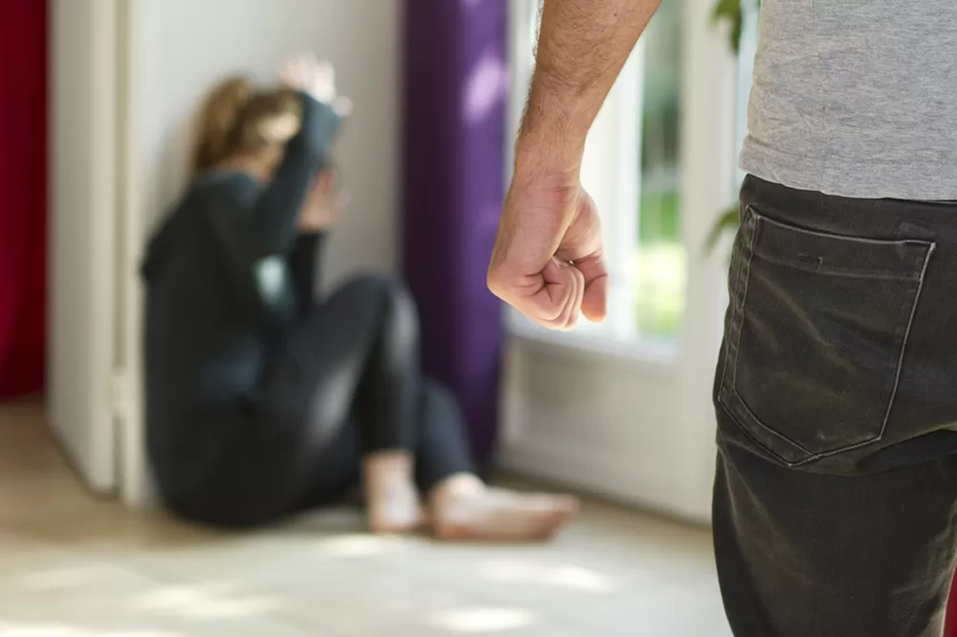
Domestic Violence-
Violence in the home
Notes:
Slide 3-4: Teaching and Individual Activity 7 min
As we’ve seen in some of the examples you’ve just discussed, violence can take on many different forms and appear in different places. Violence includes the obvious examples like murder but can also include damaging someone else's property or manipulating them to feel so afraid they cannot do anything.
You could say that violence is found in the homes, schools and communities. Let’s take a closer look at each of these in more detail. While we are working through these definitions, write them into Activity 1 on your Lesson 1 – Worksheet.
Domestic violence is the term given to violence that takes place in the home. This type of violence could be subtle which means that it’s not always easily recognizable. Often the abuser wants to control the home environment and the people in it. The abuser wants to scare the victim into submission, so they do not fight back and try and leave the situation.
We saw in the previous activity that violence can be:
Physical: when someone uses physical abuse to force to hurt someone else.
Verbal or emotional: when someone uses words to intentional cause emotional trauma. This could include manipulative behavior out of fear of further abuse.
Sexual abuse: when someone is forced into a sexual activity against their own will even if they had consented to it on a previous occasion.
Damage to property: When someone destroys property to show their power and authority.
See Teacher Notes

Slide 4
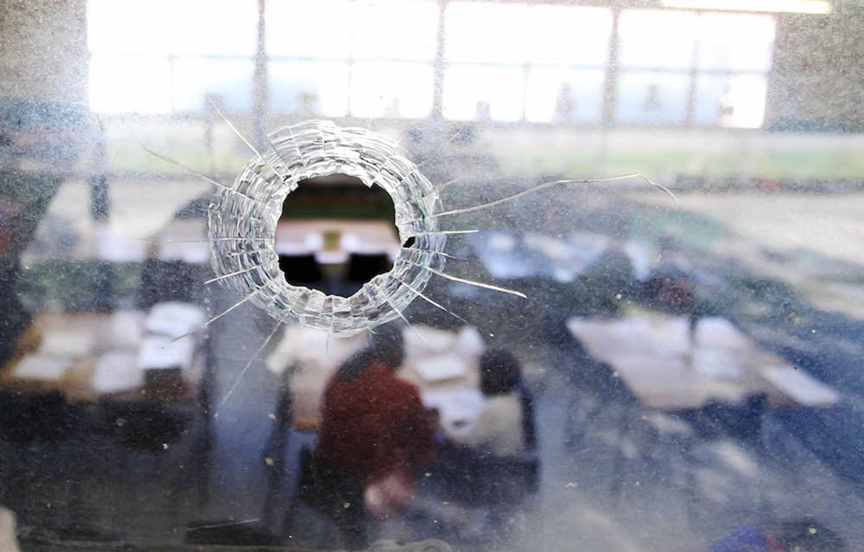
Violence at school
Notes:
Slide 4:
Violence at a school environment is on the rise in South Africa. Sometimes this violence has been occurring for a while but goes unreported until someone gets seriously injured or dies. Some learners feel intimidated or afraid to report this behavior
Unfortunately, you would find examples of the same kind of abuse mentioned in domestic abuse. This includes sexual, physical, emotional and destruction of property.
Physical: when learners are fighting, hitting, pushing or tripping others
Verbal or emotional: when someone slanders another learner by spreading rumours. This could include bullying over social media platforms.
Sexual abuse: this could include a learner forced into (intimidated) a sexual activity with a teacher or other student.

Slide 5
“Dozens of pupils attack each other with MACHETES in shocking school violence filmed in South Africa”
“A 15-year-old pupil was arrested in Johannesburg for pulling out a gun and pointing it at a terrified teacher and threatening to shoot after an argument in class.”
“Earlier this week, police also had to quell riots at the Ndaliso Senior Secondary School in the Eastern Cape where hundreds of pupils went on the rampage after failing their exams
They demanded to be given reports saying they had passed and when the school refused, the deputy principal was attacked and the school administration block burned down. ”
Notes:
Slide 5: Group discussion and feedback- 10 min
(Teacher to hand out blank A4 paper to each group for Activity 2 (Lesson 1 – Worksheet) for groups to mind map answers.)
These examples of violence in schools were recorded in an online article in the UK. In your groups discuss the following questions (see Activity 2) and mind map your answers on the page your teacher has given to you.
Do you think this is a realistic representation of violence in South African schools?
Statistics show that violence is on the increase in SA schools. Why do you think this is?
Why are teenagers afraid to report intimidation types of violence like bullying?
How does bullying impact an individual?
What could you do as a Grade 9 class to have a voice against violence amongst your peers?
See Teacher Notes

Slide 6
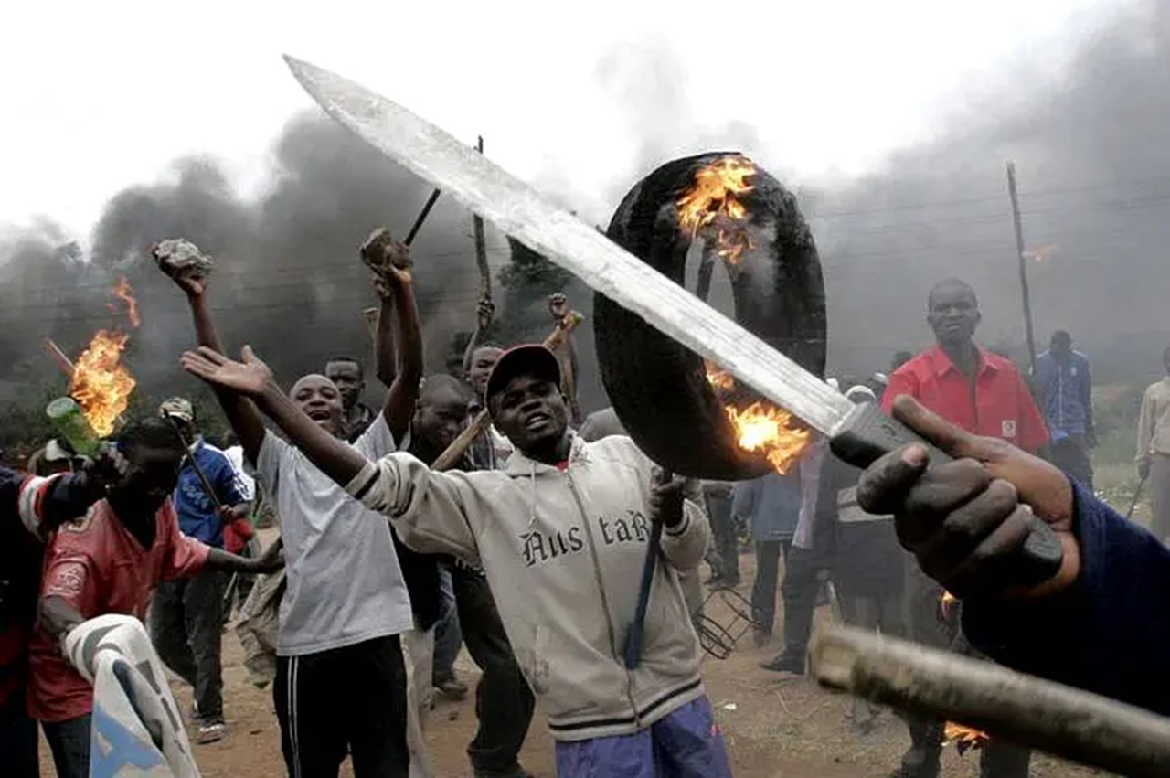
Violence in the community
Notes:
Slide 6 +7: Teaching and Individual Activity 7 min
Violence in the community occurs between the different groups of people that live in a geographical area. We can also see examples of physical, emotional, sexual and damage to property in communities. In South African communities we have seen an increase in gang violence and xenophobia.
In some communities, gangs fight over control and often innocent victims are caught in the middle. Some gangs threaten the community to pay a “safety tax” to ensure their protection by the community gangs. If community members resist, they are often murdered or tortured.
Xenophobia is when groups within a community act upon their prejudice towards foreigners in their community. Sometimes this looks like homes being burnt, individuals being tortured or murdered.

Slide 7

Notes:
Slide 7:
From your group discussion I think you can see that it’s not always easy to point to one particular reason why people act violently. It’s difficult when we hear of people we know and care about doing violent acts.
In the next few minutes complete the questions in Activity 3 on your Lesson 1 – Worksheet. (Allow about 4min)
In preparation for the next lesson, you will need to do some research before you return to class by interviewing FIVE different members of your community. This could include a parent, neighbour, school friends etc.
You are welcome to add another THREE questions to the questionnaire in Activity 3 you just completed that you would like to ask. Your questions should ask for opinions on why violence occurs in communities and the impact this violence has on individuals in the community.
Take a moment to plan who you would like to give your questionnaire to complete before the next lesson.

Slide 8


R E F L E C T I O N
and
I N S P I R A T I O N
Notes:
Slide 8: 3 min
Teacher – hand out square page / “post-it” for Activity 4
We have come to the end of this lesson. It’s never easy addressing a difficult topic like violence. Take a moment to reflect on the content we have covered today. Remember we have addressed Violence in the home, school and community.
Using the two quotes on this slide as inspiration, write an inspirational quote onto your Lesson 1 – Worksheet in Activity 4. Repeat this quote onto the small (‘post-it‘) page that your teacher has handed out that will be pasted up in your classroom.
See Teacher Notes

