Slide 1

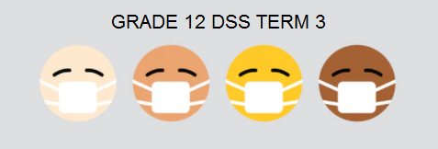
DEVELOPMENT OF THE SELF IN SOCIETY
Factors Causing Ill Health
Lesson 1
Notes:
Today we are going to investigate human factors that cause ill health, accidents, crises and disasters. More specifically, we will be looking at psychological, social, religious, cultural practices and different knowledge perspectives that cause ill health, accidents, crises and disasters.

Slide 2
lll-health
Bad lifestyle choices can lead to ill-health (sickness), such as having sex and getting a sexually transmitted infection (STI), smoking and getting lung cancer or abusing alcohol and getting liver disease.
Accidents
Alcohol related accidents can occur when unexpected or unplanned bad things happen to a person – as a result of their consumption of alcohol. Fire accidents can happen as a result of unsupervised candles. Burn accidents can occur as a result of boiling water or oil being left where a child can overturn it.
Crises
A crisis is an emergency situation that causes great distress and upheaval. A disaster is a great tragedy or devastation. It can be caused by nature or people.

Slide 3
PSYCHOLOGICAL FACTORS
If you have a negative self-image and low self-esteem, you may not think that you are worth demanding safe sex, like using a condom. This psychological factor can lead to getting HIV.
Psychosomatic illness means a sickness that involves both the mind and the body. This illness may start with emotional stress, but can become physical, causing an ulcer or a stroke, digestive or stomach problems.
Notes:
Let’s look at psychological factors that cause ill health, accidents and disasters. (Read slide and discuss).
SHOW VIDEO 1: this video shows the role psychological factors play in contracting HIV/AIDS. Focus in particular on what Aaron Motsoledi (our previous Minister of Health) says (1:03).
WATCH VIDEO
Motsoledi speaks about how girls lack proper guidance and care as they grow up without parents. This results in them turing to older men to meet these needs, making them vulnerable to contracting HIV.

Slide 4
SOCIAL FACTORS
Poor living conditions and poverty result in people having limited or no access to proper sanitation or health care.
People may be unemployed and unable to afford their desired living standard which leads to frustration, and could result in violence and crime.
Living in dirty surroundings and badly maintained houses causes accidents.
Notes:
Let’s look at social factors that cause ill health, accidents and disasters. (Read slide and discuss).
SHOW VIDEO 2: this video shows the role social factors play in disasters.
WATCH VIDEO
People build homes on land that is not sustainable, out of desperation as they have no where else to go. They therefore become vulnerable to the disaster of their home being flooded.

Slide 5
RELIGIOUS FACTORS
Some religions forbid the use of condoms.
Some religions tell their followers that illness is their fault, and they have to pay a penance to show that they are sorry, or be punished. Various potions and medicines are mixed but have not been scientifically tested.
Jehovah’s Witnesses believe that only God can cure them so they refuse medical or mental help - we will watch a video on this now.
Notes:
Let’s look at religious factors that cause ill health, accidents and disasters.
(Read slide and discuss).
SHOW VIDEO 3: this video shows the role religious factors play in ill health.
WATCH VIDEO
People have certain beliefs and this prevents them from getting access to health care.

Slide 6
CULTURAL FACTORS
Culture influences the way we look at health, illness and treatment.
Harmful cultural practices are often aimed at benefiting males, and so cause harm to females, such as FGM (Female genital mutilation) and wife inheritance.
Unkungena: wife inheritance - widow forced to marry her late husband’s brother against her wishes. This could result in forced sex and STDs.
We will watch a video now on FGM.
Notes:
Culture influences the way we look at health, illness and treatment.
Harmful cultural practices are often aimed at benefiting males, and so cause harm to females.
Unkungena: wife inheritance - widow forced to marry her late husband’s brother against her wishes. Could result in forced sex.
FGM: Female genital mutilation
Watch video on FGM.
This video highlights how FGM is not medically necessary and causes a lot of pain and anguish.

Slide 7

PARTNER ACTIVITY
Turn to the person next to you and answer the below
questions on your worksheet to assess your
understanding of the lesson up until now:
1. What are psychosomatic illnesses?
2. How could religious factors result in an unwanted pregnancy?
3. How could the cultural practice of wife inheritance cause the ill
health (physical and emotional) of a woman?
4. Explain the role that social factors play in crime and violence.
Notes:
ANSWERS TO QUESTIONS:
Psychosomatic illness means a sickness that involves both the mind and the body. This illness may start with emotional stress, but can become physical --> can cause an ulcer or a stroke – digestive or stomach problems, muscle pain, tiredness and headaches.
Condoms could be against religious practice, resulting in a woman falling pregnant as she is not using contraception.
A widow forced to marry her late husband’s brother against her wishes could result in forced sex and STDs. This would harm her emotionally and physically.
People may be unemployed and unable to afford their living which leads to frustration, and could result in violence and crime.

Slide 8

Lifestyle diseases
A lifestyle disease is an illness that is linked to the way people live. It is a disease that can be prevented by changes in nutrition, environment, your general lifestyle, avoiding substance abuse, as well as the promotion of gender equality and the reduction of poverty.

Slide 9
CAUSES OF LIFESTYLE DISEASES
Poor eating habits
Lack of exercise
Smoking
Substance abuse
Unsafe sexual behaviour
Notes:
Poor eating habits
Eating too much fat, especially animal fat causes prostate cancer in men
Not eating enough healthy food leads to malnutrition
High levels of salt intake; lack of calcium, potassium and magnesium in food intake; lack of vitamin D leads to hypertension.
Eating too much leads to obesity, being overweight
Lack of exercise
Not doing enough cardiorespiratory and aerobic exercise leads to hypertension, diseases of the heart and circulatory system.
Smoking
Causes hypertension; diseases of the heart and circulatory system; lung cancer; chronic bronchitis.
Substance abuse
Alcohol abuse, alcoholism, drugs
Unsafe sexual behaviour
Sex without a condom; multiple sexual partners causes cervical cancer in women; STIs and HIV; hepatitis B.

Slide 10

GROUP ACTIVITY
Notes:
In this activity, we will be looking at different South African and a few American celebrities. We will be looking at the lifestyle diseases they reportedly battle with, and how factors have contributed to the development of the disease they have.

Slide 11
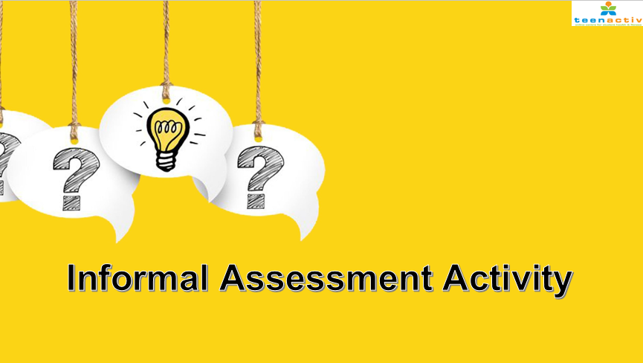
Notes:
Use the Activity 3 questions on the Lesson 1 – Worksheet to assess your understanding of what was covered today.
Complete Activity 3 on your own (i.e. it is an individual activity)
Answers to the questions will be discussed as a class before the end of the lesson.

