Slide 1
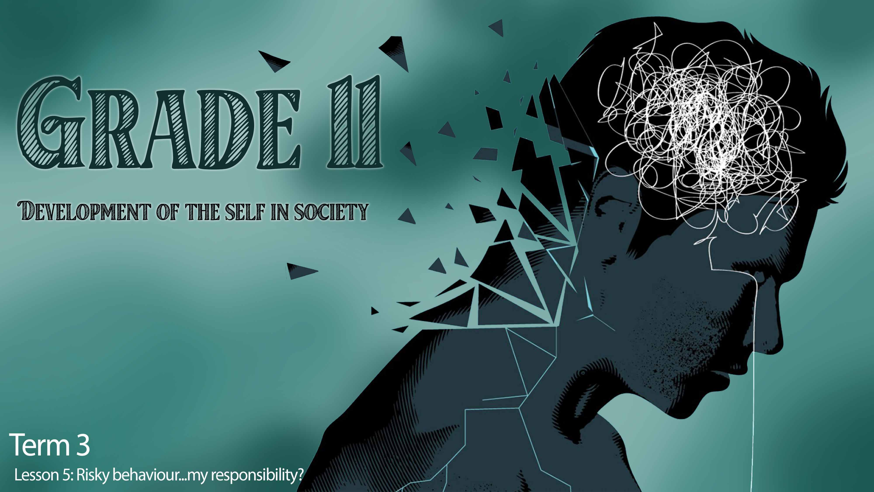

Notes:
Slide 1: 3 min intro and teaching
Welcome back grade 11’s. Hopefully by now you have a grasp on how negative behaviour can impact you, your family, your friends and your community. We have looked at how our choices always have a consequence. The reality is that as human beings, we will make mistakes. But we need to know when we have messed up, so that we’re able to own our mistakes and make things right. This means taking responsibility for our actions and taking responsibility for our decisions.
Example 1:
Someone in your class cheated on a test. You know for a fact that they did. This person messed up the curve for the test. You received a D on the test. Do you tell the teacher? Why or why not?
Example 2:
Your friend does not have enough money to go to the soccer game. He/she wants you to sneak into the game with him/her without paying. What would you do?
Tough decisions like these might be easier to some people than others. No one can make these decisions for you. So how do you make the decision?

Slide 2
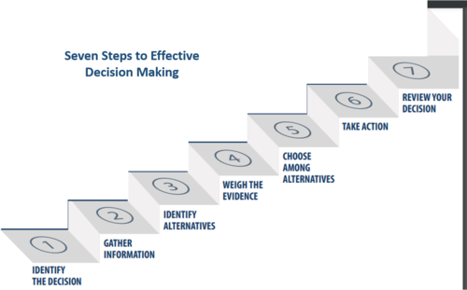
Notes:
Slide 2: Teaching and activity 5 +8min
Let’s take a look at the list of steps to take when making these decisions.
7 Steps to decision making:
Identify the decision you need to make.
Gather information about the decision.
Identify your different options or choices.
Give at least one consequence, impact or effect of each option. (weigh the evidence)
Choose the best option and act on your decision.
Take action
Evaluate your decision.: Are you happy with the outcome of your decision? If you were in a similar situation in the future, would you make the same choice?
Now complete Activity 1 on your Lesson 5 – Worksheet.

Slide 3
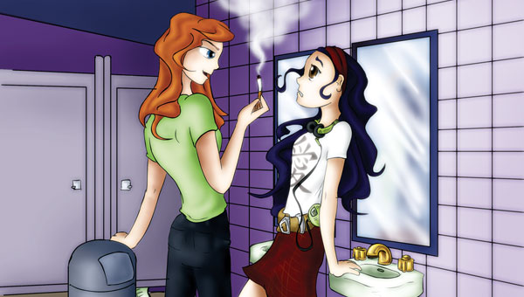
All choices have consequences
Notes:
Slide 3: 3min + 3min
As we’ve mentioned before, the outcome of our decisions or choices ALL have some kind of consequence. Decision making is necessary to make responsible choices where we have considered the outcomes before we act.
Substance abuse will ALWAYS impact decision making in a negative way. Alcohol and drugs cloud your mind and prevent you from making sensible decisions. Peer pressure could result in you taking drugs, impacting your health and maybe even lead to death in the long run.
Take a moment to think of THREE other NEGATIVE outcomes of being under the influence of drugs or alcohol and giving in to peer pressure. Write them into Activity 2 (Lesson 5 – Worksheet).
Remember you need to prioritise your own personal safety. If that means staying away from a certain party that you know there will be drinking, then that’s the tough decision you need to make. It might also mean that you need to go see a doctor if you find you need to make yourself throw up because you feel guilty after the food you have eaten.
Make a decision to look after yourself. After all you only have one life to live.

Slide 4
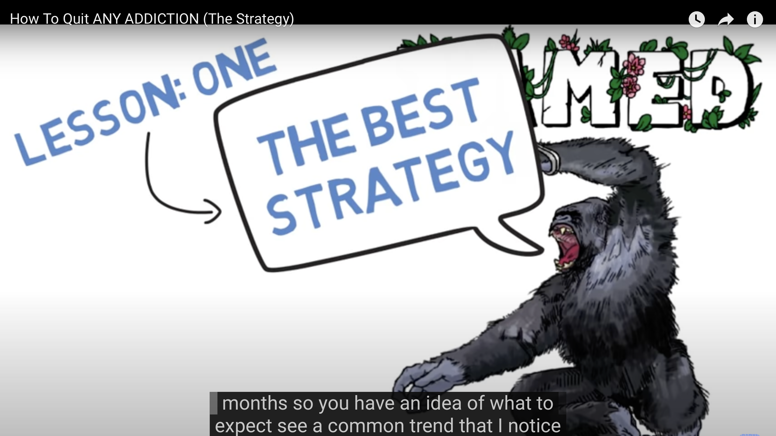
Notes:
Slide 4: Watch 4:45 and then 3min to reflect in notes. (8min)
Early on in this series we looked at how social media can have negative and positive influences on your health. With the accessibility of the internet, it’s easy to search whatever you are looking for. At this stage of the series, maybe you have realized that you have certain secret habits that are not healthy. You want to get rid of them, but you don’t know how.
Watch https://www.youtube.com/watch?v=m8JjuyRIxOg (4min45s)
Then in your groups, briefly discuss:
What advice is given to overcome addiction?
How this type of social media could support you in your journey to overcome your addiction?
Remember, you are not alone. There is always help available. You just need to look and ask. You could contact your local doctor or hospital for advice, talk to a teacher or search for a local community that could help online. Take responsibility and get the help you need.

Slide 5

Notes:
Slide 5: 10min
(Note to teacher: Each group will have an opportunity to make a poster that you can put up in the class. Tell learners this Lesson 5 - Poster is meant to provide support for learners struggling with the issues we have addressed over the last few weeks.
Each group will be allowed to choose their own issue they wish to address. The aim of this activity is to provide steps to breaking a habit and provide guidance on where to find help. Maybe arrange for learners to have access to their phones or computers to research local places that could provide help. If they are not allowed their devices or internet access, then the teacher will need to do some research beforehand. When learners finish their posters, allocate a place in the class where they can be put it up on the wall.)
“Take the step, make the change”. In this Lesson 5 - Poster you need to:
1) Highlight SIX steps that you believe a teenager should take to break bad habits that result in a
negative lifestyle. Think of all the issues we have addressed over the last few weeks. Focus on ONE issue when doing your poster.
2) You need to advise learners of FIVE places they can find help to overcome these issues. If you
have access to computers, research community groups in your area and include contact numbers and email addresses.

Slide 6

REFLECTION
Notes:
Slide 6: 3min Reflection
As we finish off this lesson, walk past the different posters that were made in the previous activity, then complete Activity 3 (Lesson 5 – Worksheet), as you reflect on the following:
Name ONE issue that was addressed on a poster that you found was very creatively done- you think it will catch the eye or attention of your peers too!
Name ONE idea for breaking habits in your own life that you learnt during the lesson today.
Evaluate how effective you are in decision making, based on the 7 steps covered today.

