Slide 1
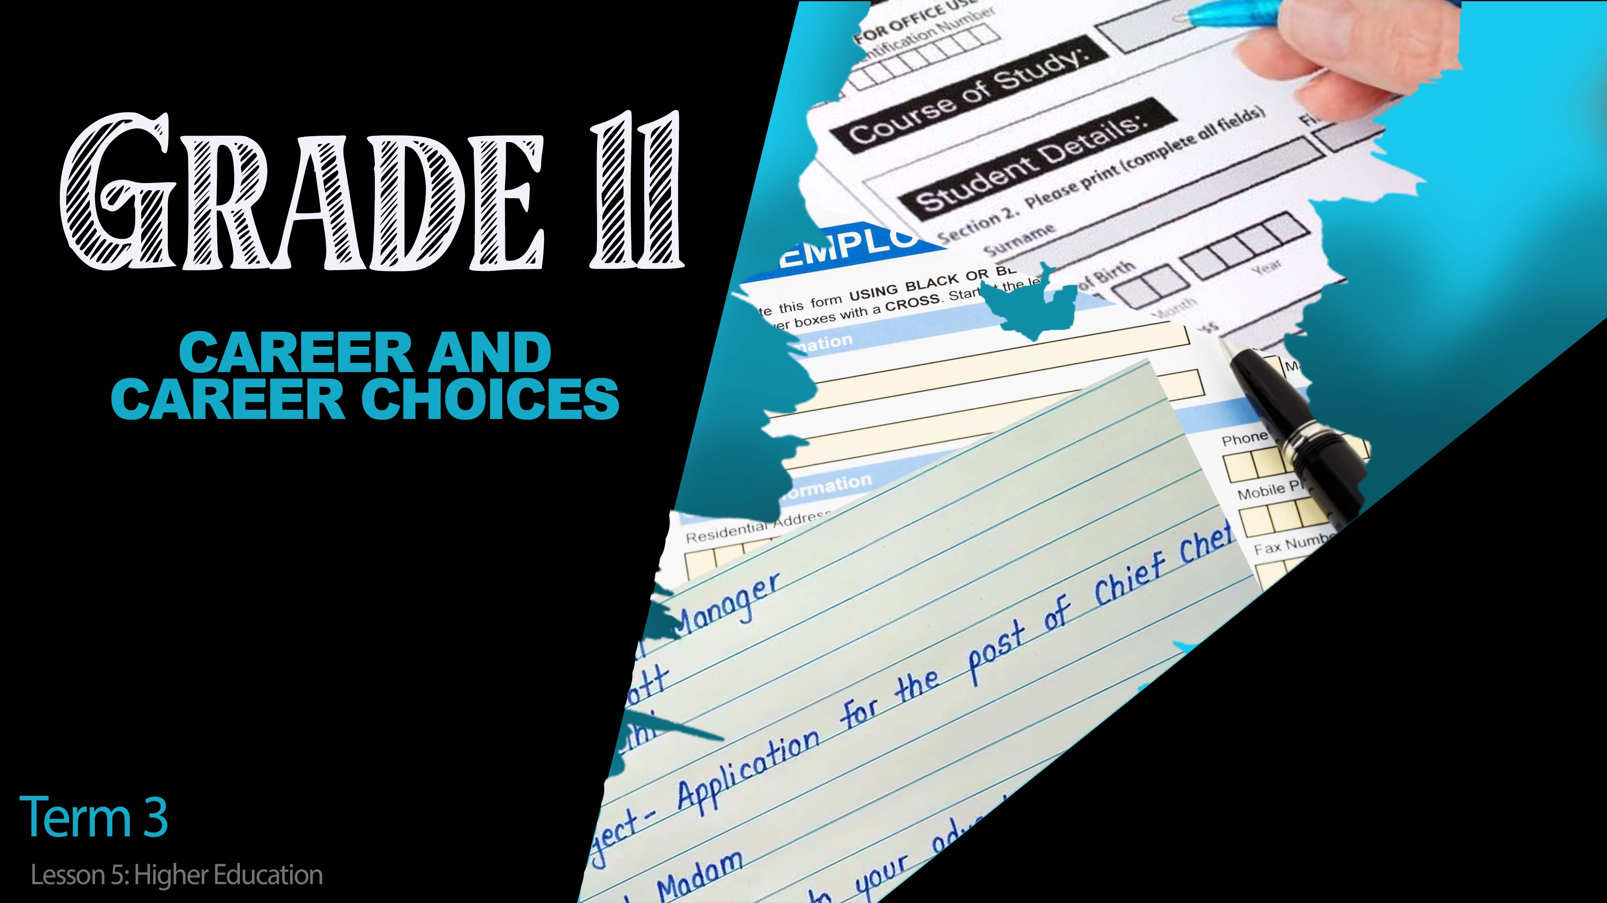
Notes:
Slide 1& 2: 5 min intro & teaching 8min
(Note to teacher: This lesson will basically be divided into two sections. In the first, learners will have the opportunity to listen to inspirational videos on students who have achieved regardless of their socio-economic circumstances. In this part, learners will need to follow a link and use computers to research and listen to the clips. The second half of the lesson will provide time for learners to practice questions representative of an exam situation; giving learners the opportunity to engage in the three cognitive levels and preparing them for formal examination.)
Welcome to the last lesson of this series for the term. We have come along way from the first lesson, looking at the world of work and how to apply for a job. You’ve learnt in these lessons about building your own CV as well as helpful activities like job shadowing and informal jobs. In the last lesson we looked at the different kinds of careers in South Africa.
Before we go any further, can anyone share what the difference is between a skilled career and an unskilled career? (Allow learners an opportunity to respond - refer to Content Summary for answers))
Well done grade 11’s! Remember the goal is to have a skilled career which includes some kind of tertiary qualification where you study further. You could be a gardener and with some studies, become a specialist landscaper. The studies will not only increase your earning potential but also as your knowledge increases, so will your skill level.

Slide 2


Notes:
Slide 2:
There are different kinds of additional and higher education institutions at which studying takes place, depending on the career you are interested in. If the career you are interested in requires a degree, you will need to study at a university. Some careers require that not only do you need a degree but you also need to study further and obtain a post-graduate degree like an honours, masters or doctoral degree.
To obtain a doctorate in a field means that you are a specialist in that field.
To study for a certificate could be as short as two years.
A degree usually lasts 3 or 4 years. Then an additional year for honours, another 2 years for masters.
E.g. Career:
Fashion Designer would study at a college for fashion design and obtain a National Diploma in Fashion Design after 3 years.
An actuary would do a BSC in Actuarial Science over 3 years and additional honours year to be a practicing actuary.

Slide 3

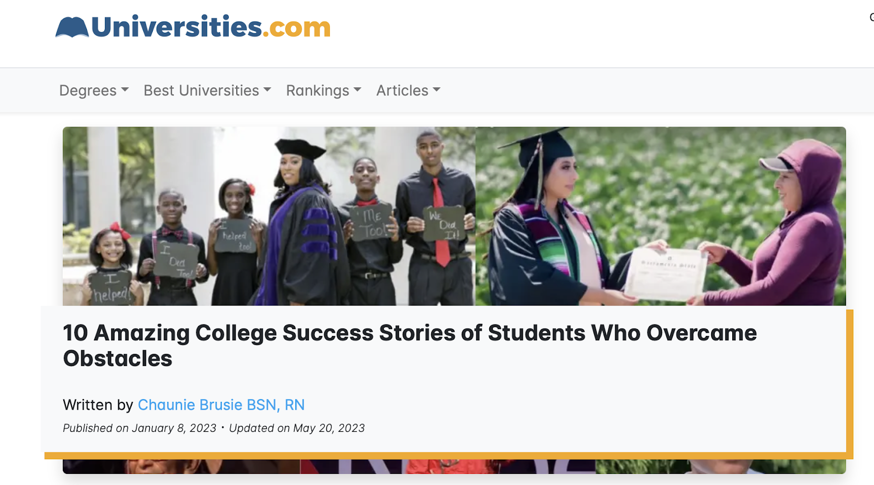
https://www.universities.com/news/10-students-who-overcame-massive-obstacles
Notes:
Slide 3: 10min
Sometimes looking out at the future seems like an impossibility between concerns about funding and the necessary resources to be able to study. There are encouraging stories of many who have persevered through some of the most challenging circumstances.
You will now need to click on the link to the following site. https://www.universities.com/news/10-students-who-overcame-massive-obstacles
This site includes videos of 10 stories from people across the world that have achieved achieved despite / notwithstanding challenging socio-economic conditions. Choose to watch TWO stories and answer the questions that follow on your Activity 1 (Lesson 5 – Worksheet).
Hand out Content Summary after this activity.

Slide 4

Notes:
Slide 4: 17min- Informal Test
The following questions will help you prepare for your examinations at the end of the year. Answer these questions on Activity 2 (Lesson 5 – Worksheet) by working through your notes, using your Content Summary and applying your problem solving skills.

Slide 5

Time to reflect…
Notes:
Slide 5: Reflection Activity 5min
As we come to the end of this lesson and the end of your content for this term. Reflect on where you stand with your career dreams and career choices by answering the questions in Activity 3 (Lesson 5 – Worksheet).
1) Rate your level of understanding in the career and career choices areas covered over the past few weeks:
Writing an application letter.
Writing a CV.
Completing an application form.
Feeling competent in a job interview.
Managing expectations around career goals in relation to socio-economic reality.
Understanding the different kinds of jobs that make up the South African workforce.
Understanding the different higher education study options in South Africa
2) Based on your ratings in the above question, which area do you need to revise and do further research in?
3) Consider the questions you answered in Activity 2 (Lesson 5 – Worksheet), which questions did you find the most challenging?

