Slide 1


Notes:
Slide 1 : 5+3 min group intro & pair discussion
Good day Grade 11’s. Over the last few lessons, we’ve covered quite a lot of area on writing an application letter, compiling a CV and in the last lesson, how to interview well. We also covered some of the following terms in the last few lessons. Turn to the members of your group. Each one needs to provide a definition for the terms. Each member of the group will have to choose a different term. Let’s see if as a group you can get all the definitions correct. You only have 3min.
The terms are:
Job-shadowing
Whistle blower
Accountability
Transparency
Informal job
CV
Ethical Behaviour
(Teacher Note: The definitions to the above terms are highlighted in bold in the Content Summary)
Well done everyone! Today we’re going to look a little more closely at future careers and our expectations around these careers. It’s been 3 years since you made your subject choice in grade 9. Some of you might have chosen your subjects because you had a very specific career direction in mind. Some of you weren't too concerned about your subject choice at the time. Now its time to start looking at the future, the expectations and reality around those careers.
In your pair groups reflect on the following questions. Help one another evaluate whether the career goals are still realistic in relation to the subject choice.
What career are you interested in studying?
Do you have the subjects required to study this career?
Have you done any job shadowing to see if you would enjoy this career?
Write a short summary of your discussion on Activity 1 (Lesson 4 – Worksheet)

Slide 2

Notes:
Slide 2: teaching 8min
Maybe you are now very interested in studying sports science to major is biokinetics because in the last two years you have fallen in love with sport. You know that you have Science and Maths and you’re achieving an aggregate of above 75% for both subjects so you know your goals are realistic. The problem is you don’t really like working with people and listening to the problems and injuries they have. The reality of your everyday job might not be what you thought it would be. You are looking for a career in which you will not only be successful but actually enjoy the work you are doing on most days. Being satisfied means enjoying your work conditions and the tasks that you are required to do.
So, how do you ensure that your expectations meet up with your dreams and are achievable?
Firstly, you would need to do research about not only the career you are interested in, but you would also need to gain knowledge on what it would be like to work in that career in South Africa today. This means understanding how our socio-economic conditions relate to how much you earn and where you live. Eg. If you previously lived in a poorer community and managed to get a bursary to study at university. Your education could open doors for you to earn more in a career and therefore the opportunity / choice to potentially live in a different area.
**Having said the above - it is important not to neglect the communities that raise us. As adults, one should try to help uplift our community from within rather than to move elsewhere.

Slide 3
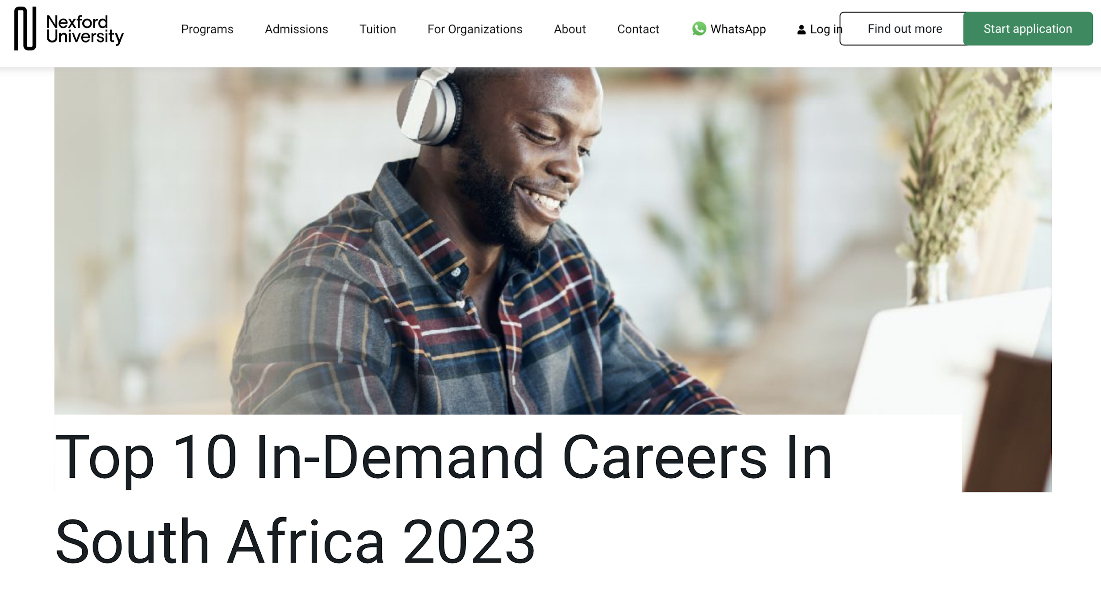
Notes:
Slide 3: Individual Activity 10min
Read the following article in Activity 2 (Lesson 4 – Worksheet) and answer the questions that follow.
Learners to complete for homework if not completed in the allocated time in class.

Slide 4

Why Blue-Collar Work Can Give Gen Z
A Fresh Competitive Advantage
Notes:
Slide 4: 2 +8min
The article you just read in Activity 1 focuses mostly on skilled work. This means that these careers require individuals to get a tertiary qualification to do this type of job. Although these careers are great, they are not the only important career options in South Africa. In most cases these qualifications would result in a higher monthly income but they are not the only career fields in South Africa. All workers need respect, regardless of which career they are in.
In South Africa we have many other career paths that don’t all require a tertiary education. Our labour force has different categories: : skilled, semi-skilled, unskilled and physical labour.
Skilled refers to a person that rerequires specialised training and therefore has obtained a certificate or degree towards their career.
A semi-skilled worker would have completed small courses or certain modules in a course. They could assist in careers like a carpenter or teachers assistant.
An unskilled worker has no formal training but might have work experience eg. Waitering, domestic work.
Physical labour has no formal qualification but often experience from previous short term jobs. Eg. Gardening, builder, packing shelves
Therefore each category will require different levels of study after school.
Read the article “Why Blue-Collar Work Can Give Gen Z A Fresh Competitive Advantage” as a group and discuss the questions that follow on Lesson 4 – Group Activity.
(Allow 2min for some feedback from the class in response to this article)

Slide 5

Notes:
Slide 5: Reflection Activity 4min
In the light of all that you have leant today about careers and expectations, reflect on the response you wrote in Activity 1 (Lesson 4 – Worksheet). Complete the questions in Activity 3 (Lesson 4 – Worksheet).
If I could go back to grade 9, would I approach the career development process differently after having all this knowledge now?
What research do I need to do to best determine if I am suitable for my chosen career?
Where do I need to arrange to job shadow for more experience?

