Slide 1
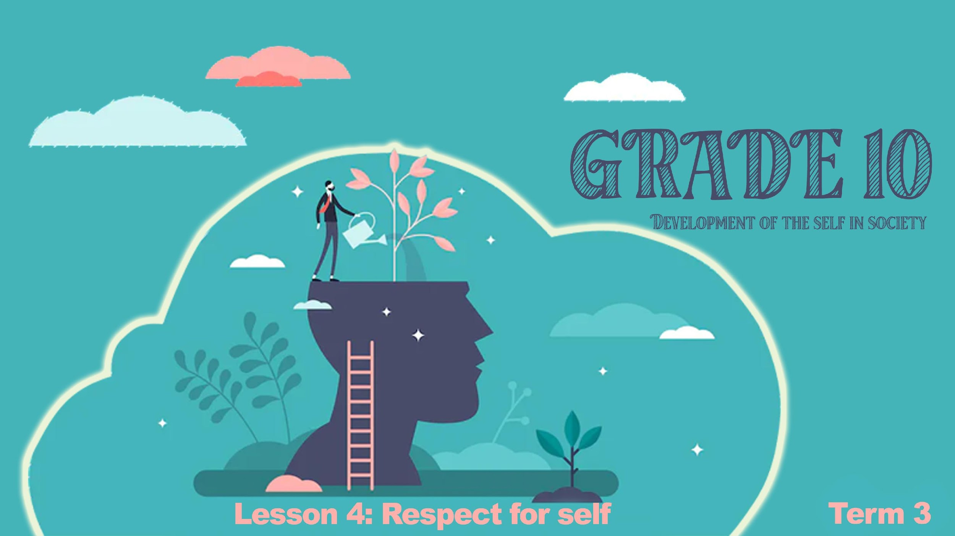

Notes:
Slide 1&2: 5+5min min intro & group discussion
((Note to teachers- One of the best ways for learners to learn is from their peers. This lesson will create opportunities for several short discussions for learners to reflect. Its important to keep these discussions short. If groups look like they are finished, then start the feedback session. Keep on encouraging participation in groups. Learners will take time to warm up but hopefully really get into the discussion.)
Welcome back grade 10’s. We have spent the last few lessons understanding the impact of hormones on our body and emotions. In the last lesson we looked at how your peers could have a negative and positive influence on you. In your groups discuss TWO examples of peer pressure that is negative and TWO that is positive.
(Allow 3min for group discussion.)
We can see that peer pressure can sometimes be the result of being in a situation where we feel pushed into a corner. Many teenagers have been interviewed about teen pregnancy and many of them responded by saying they didn't plan to get pregnant “It just happened” or some would say “I don’t know what I was thinking”. It’s not that they didn’t know that that unprotected sex could end up in an unwanted pregnancy. They just ended up in a situation where feelings became more important than reason.

Slide 2
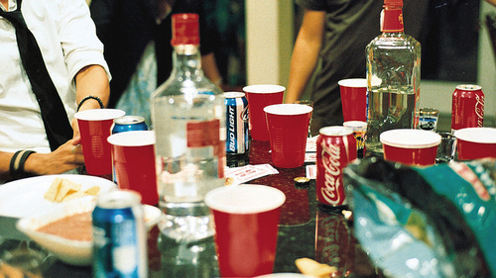
Notes:
Slide 2:
Certain behaviours increase the chance of leading towards sexual intercourse and possibly teen pregnancy. One of the known factors is drugs or alcohol abuse. In your groups discuss the following:
Identify why these substances could lead to an unwanted pregnancy.
Imagine your best friend, Shelly, has told you she is going to a party at Tom’s house. Everyone knows Tom’s parties are wild with lots of alcohol. What advice would you give your friend to ensure she doesn’t end up in situations where she could fall pregnant . As a group, plan a strategy to protect your friend.?
(Allow groups 3min for discussion and 2min for feedback to the class.)
Well done grade 10’s! Great feedback. We can see that the situation is influenced by a lack of clarity that comes from being under the influence as the brain does not function well. There is a lack of responsibility and lack of inhibition. Sadly, when the drugs or alcohol wears off you’ll remember what you did and probably feel guilty and wonder why you did what you did.
As a class you have done so well today in the discussions. It’s time to see if you can help some famous friends with some advice.

Slide 3

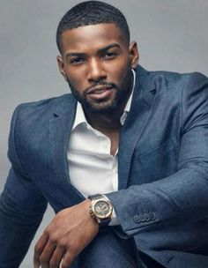
Meet the Cast….
Nelisa and Sandile and they need your help!
Notes:
Slide 3-4 HELP the cast! 10min
On the top row we have Sandile and Nelisa. Today you will catch a glimpse into the behind the scene moments of these four FAMOUS teenagers.
Each of these characters have been struggling through some challenging situations and have requested to sit with a teen counsellor for advice. You are that counsellor. Listen up as we hear what their challenges are.
Get ready because they need your HELP!

Slide 4
Let’s start with Sandile and Nelisa
Sandile is 16 and been together with Nelisa for the last 8 months. His friends cannot believe he has not even kissed her let alone had sex. Sandile is not bothered by all their teasing because he has strong values that influence how he treats Nelisa. He is a virgin and intends to stay that way until he is married one day.
Notes:
Slide 4: Teaching and Case Study
Let’s start with Sandile and Nelisa…
“Sandile is 16 and has been together with Nelisa for the last 8 months. His friends cannot believe he has not even kissed her let alone had sex. Sandile is not bothered by all their teasing because he has strong values that influence how he treats Nelisa. He is a virgin and intends to stay that way until he is married one day.”
Let’s just take a moment and just quickly recap from Grd 9. Can anyone remember what values are?
They are what you believe in and see as important and worthwhile. Looking at what Sandile has said about himself, name THREE values that you think Sandile has. (allow learners in the class to respond)
The fact that Sandile has chosen to abstain from sex until marriage shows that he respects Nelisa. He uses self-control to manage his desires and influence the decisions he makes.
Other values that would protect you from risky behaviour:
Respect for yourself- Always treat your friends the way you would treat yourself. Look out to protect them and don’t choose situations that would cause yourself harm.
Abstinence- This means no sex of any kind at all until marraige. There are many that question the value of abstinance today. However, it is still the only 100% guarantee of not getting pregnant and contracting a STI (sexaully transmitted infection.)
Self-control- Having self-control means you have power over your sexual urges and needs. They don’t drive you and rule your life. You think carefully before you do anything.
Right to privacy- Each teenager has a right to privacy. ,You may keep a private journal where you record your own feelings and urges-and all of it is private! and Nobody has the right to touch you or photograph you and make you uncomfortable.
Right to protect yourself- You have the right to fight off sexual assault, report it and stay away from someone who touches you inappropriately.
Right to say No- Your body is your private property. No one has the right to force you to do anything you don’t want to.

Slide 5
Nelisa’s story…
Nelisa really cares about Sandile. She is also scared to tell him about an incident that happened to her last year. She went to a party with some friends, they were all drinking alcohol and she ended up being raped by one of the boys in her friendship group. Nelisa never told anyone. She was ashamed. Nelisa is relieved Sandile believes in abstinence. She’s not to sure how to tell him what happened.
Notes:
Slide 5: Group and Teach 3+5min
Nelisa’ story…
“Nelisa really cares about Sandile. She is also scared to tell him about an incident that happened to her last year. She went to a party with some friends, they were all drinking alcohol and she ended up being raped by one of the boys in her friendship group. Nelisa never told anyone. She was ashamed. Nelisa is relieved Sandile believes in abstinence. She’s not too sure how to tell him what happened.”
Nelisa clearly has some regrets about her behaviour last year. It’s never ok to rape anyone but sometimes we put ourselves in compromising situations because of alcohol abuse. This experience has clearly impacted Nelisa’s interaction with men.
Nelisa and Sandile have come to you for relationship advice. They want to move forward but don’t know how to address their past issues.
In your groups briefly discuss how you would advise them to talk about the following:
* Past sexual experiences and how that impacts their present relationship
* Future sexual expectations
What can we learn from Nelisa and Sandile’s story?
* Delay becoming sexually active as a teenager. You will prevent problems like an unwanted pregnancy, STI’s and feelings of guilt and self loathing.
* Build a relationship based on friendship and emotional trust and mutual respect rather than sexual experiences.
* Substance abuse influences brain functioning. You are more likely to end up in an uncomfortable situation or make risky decisions.
* Avoid dangerous situations like being alone with someone who doesn't respect you.

Slide 6

Notes:
Slide 6+7: teaching and Individual Activity 3+6min
Nelisa had a horrible experience being raped as an adolescent. There is a difference between rape and sexual abuse.
Rape: This is when assault is made on the sexual organs of another person without their consent. A sexual act is rape when a person says “No!”.
Sexual Abuse: This is when someone takes away your right to choose in terms of sexual experiences. The sexual activity is done for the sake of the offender.
In South Africa today there has been an increase in rape due to many different kinds of situations. We can do our best to try and prevent these situations from happening.Remember, you always have the right to say NO in every situation if you feel awkward …..
In Activity 1 (Lesson 4 – Worksheet) , read the headlines and short story of each of these rape victims as research. You may also talk to your parents as part of your research for this project.
You have been tasked by your school RCL to design a poster that will educate the new grade 8’s on the following:
FIVE dangerous situations to avoid that could result in rape, sexual intercourse or sexual abuse.
Give advice on THREE actions on how teenagers could deal in similar situations.
(Note to teacher: Learners will start very briefly this activity in class and finish it for homework.)

Slide 7

R E F L E C T I O N
Notes:
Slide 7: 3min
Today has been about reflecting on dangerous situations that could result in sexual intercourse. Using these last few minutes of the lesson, reflect by answering the questions in Activity 2 (Lesson 4 – Worksheet)
Answer the following questions:
List THREE values you feel that you need to work on in your own life that would protect you from taking part in unhealthy sexual behaviour.
Write down THREE values around sexual behaviour you would like to see in your future spouse. Why did you include these values? Are these values different to your own set of values around sexual behaviour?
Think of the people in your life you respect, who would you talk to if you needed advice or help?
(Note to teacher- encourage the class to be quite in this time. It might even help to play music. Tell the class to remain quite until you say they can talk.)
HOMEWORK:
Remind learners to complete Activity 1 if they have not finished it for homework.

