Slide 1
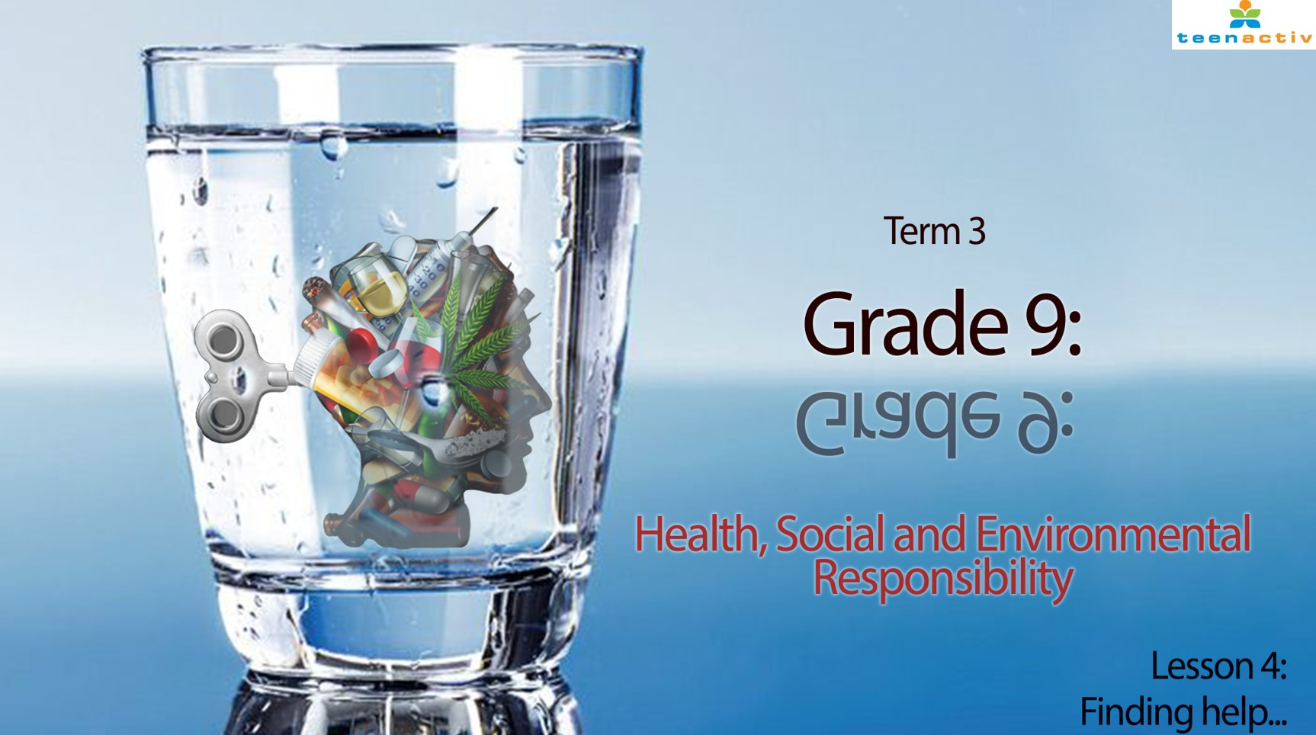

Notes:
Slide 1: Revision discussion 5 min
Welcome back class to the last lesson in the series on health and safety issues relating to violence. We have covered a large amount of content in the last three lessons. Today’s lesson will give you an opportunity to practice some questions in a 20 min “exam setting” to help you prepare for the year-end assessment. Remember, when writing Life Orientation, you will need to use the information you have studied and apply it to different situations.
Before we start today’s lesson, let’s get some feedback on what you have learnt so far in this series.
(Ask the class if anyone would like to share generally. If there is no reply, then ask questions with prompts e.g.
Can you share your opinions on how to stay positive growing up in a country known for its violence?
What did you learn from our NO VIOLENCE FRIDAY campaign?
Allow opportunity for a little bit of discussion and opportunity for learners to share. By this stage, the grade 9’s will usually be more vocal on their opinions around violence and how they think it can be stopped. This discussion will lead into today’s lesson.)

Slide 2

Notes:
Slide 2 -3: Teaching and Activity 7 min
Our focus over the last few lessons has been to identify the kinds of violence happening. Today we are going to look at what you can do to prevent violence and where to go if you need help. Do you remember how I mentioned earlier in this series that it is important to be a listening friend. You cannot solve another person’s problems but you can be there to listen. Sometimes, however, a person who has experienced a trauma like physical or sexual abuse will often need additional help to overcome the long-term effects.

Slide 3
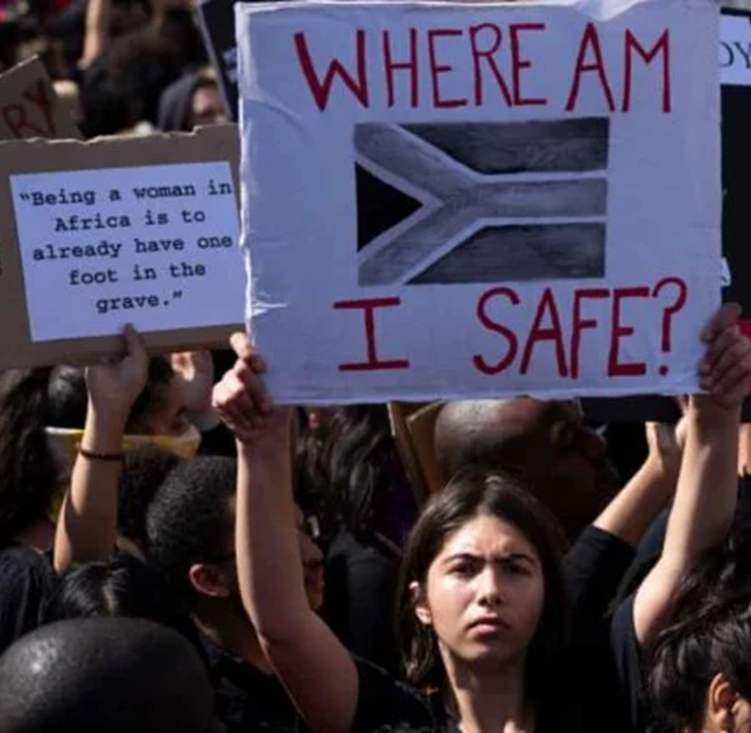
How to protect yourself?
If you feel in danger, try to get away immediately and go somewhere safe like the police station or a friend’s house.
Avoid being alone and walking in places at night alone. Try going out with your friends in groups which will be much safer.
Avoid drugs, alcohol and people that use these substances because these substances cause people to lose inhibitions and make dangerous choices.
Do not carry any weapons. You might think it makes you feel safe, but it also opens the door to violence.
INDIVIDUAL
Notes:
Slide 3:
BUT you can take action on how to protect yourself from violence.
Here is a list of a few suggestions of what you could do. In your Activity 1 (Lesson 4 – Worksheet), add another 3 strategies to this list.
If you feel in danger, try to get away immediately and go somewhere safe like the police station or a friend’s house.
Avoid being alone and walking in places at night alone. Try going out with your friends in groups which will be much safer.
Avoid drugs, alcohol and people that use these substances because these substances cause people to lose inhibitions and make dangerous choices.
Do not carry any weapons. You might think it makes you feel safe, but it also opens the door to violence.

Slide 4




COMMUNITY
Notes:
Slide 4-6: teaching and Individual Activity 10 min
Being an individual within a community means that there are others that can help in times of violence. Each community has different resource or support centres for victims of violence. An individual can go to a local support group like the Rape Crisis Centre or a police station. These specialised units will find out what happened and provide the necessary counselling and support on what to do next.

Slide 5
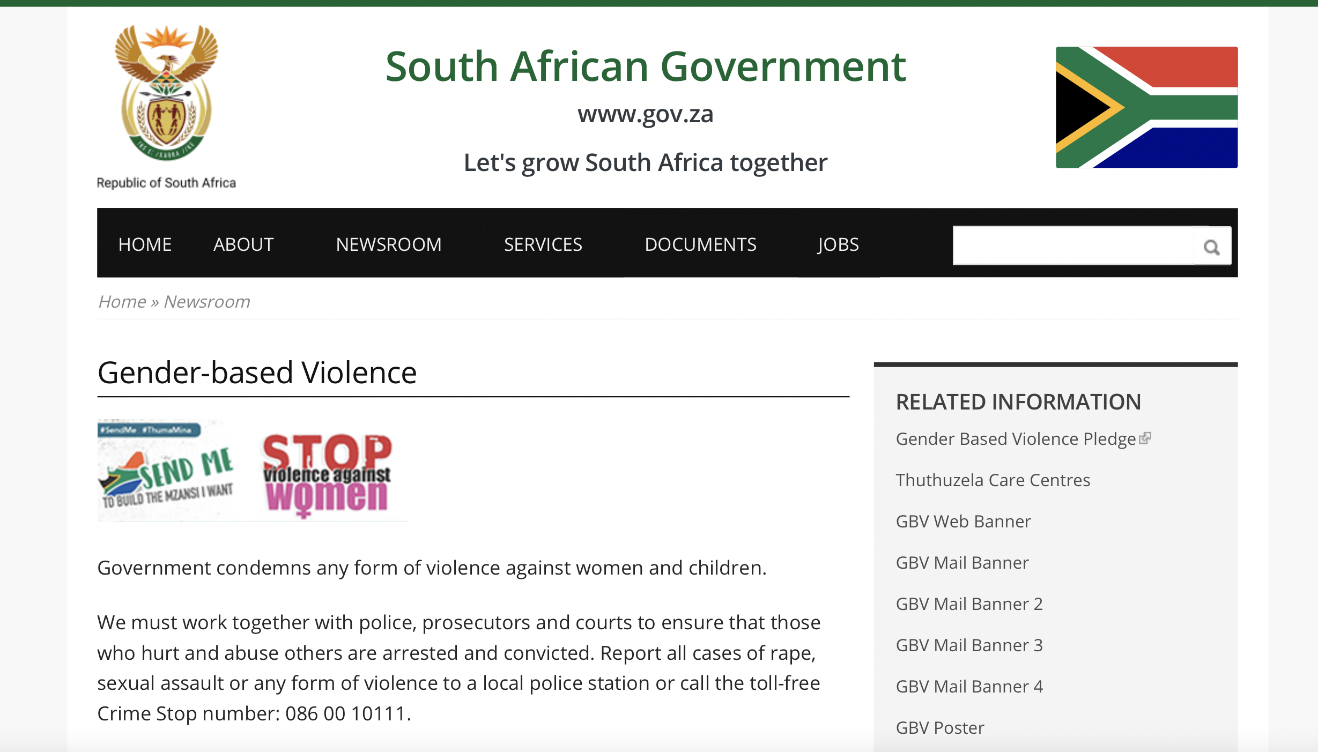
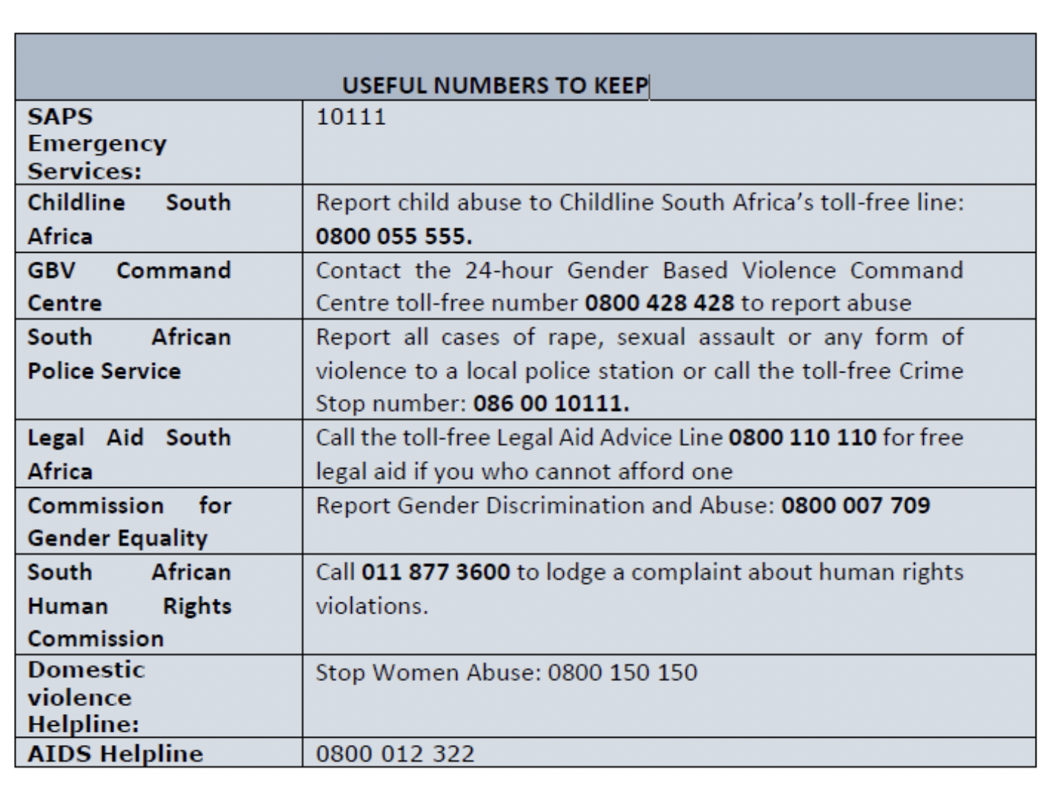

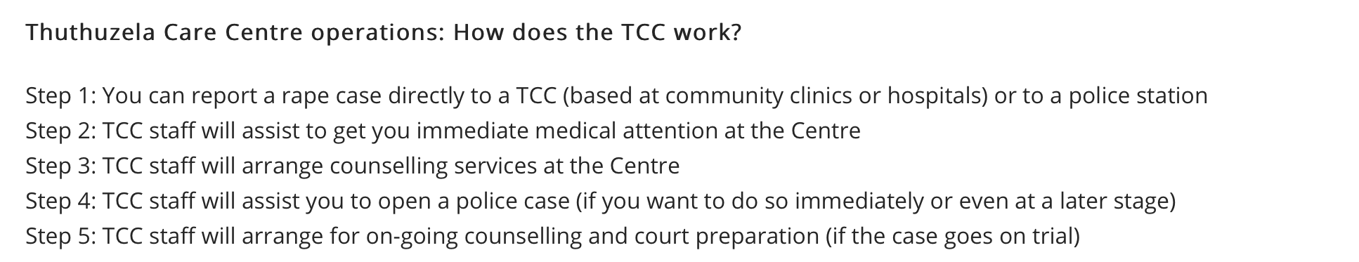
GOVERNMENT
https://www.gov.za/GBV
Notes:
Slide 5:
There are several organisations in South Africa that could help if you have been exposed to violence.
If you go directly to the SA government website at https://www.gov.za/GBV, you will find there is advice on what to do if you have been abused in anyway. There is a direct link to services like Thuthuzela Care Centres in many different communities that will offer support to rape survivors. At a centre like this you would be able to report the case directly and get the necessary support to open a case and get counselling.

Slide 6
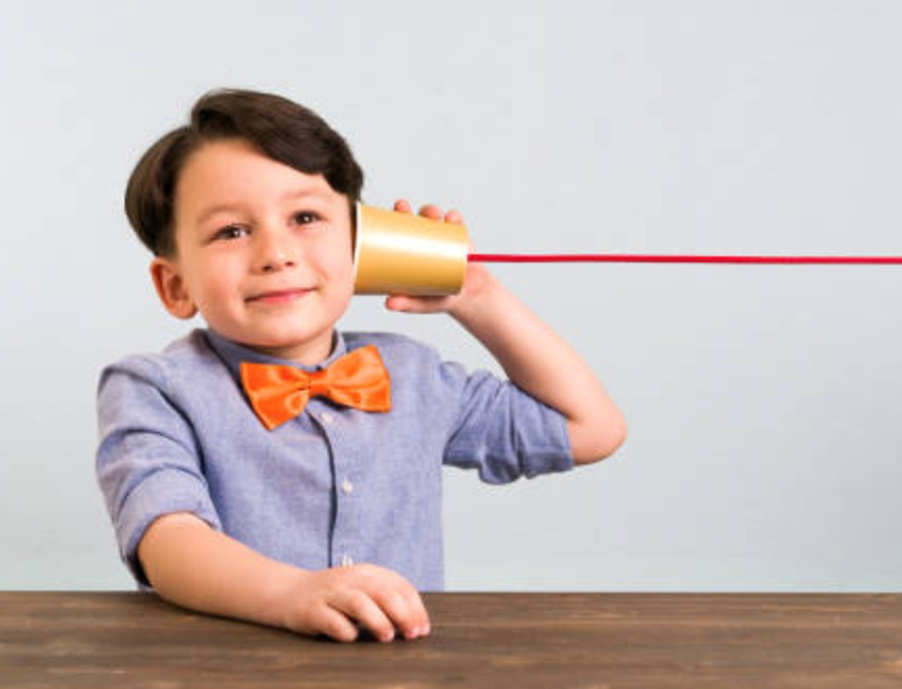
HOW WELL WERE YOU LISTENING?
Notes:
Slide 6: Individual Activity
Now to see how well you have been listening? Complete Activity 2 on your Lesson 4 - Worksheet.

Slide 7

Notes:
Slide 7: Informal Assessment 15 min
We have come to the end of the theory content of the last FOUR lessons on health and safety issues relating to violence. For the next 15 min we are going to see how well you can apply the information you have learnt to the types of questions you would find in your end of year test. Complete Activity 3 and then your teacher will go over the answers with you.
(plan your time so that there is opportunity for learners to do the questions and get the questions marked. You can explain to learners that the first few questions resemble short questions, and the second set of questions resembles a question where full sentences would be needed in answering.
Hand out Content Summary to learners.

Slide 8



R E F L E C T I O N
Notes:
Reflection- 3 min
Allow learners to reflect on what they have learnt by including their final reflective quote of the series of lessons. Encourage learners to first walk through the other quotes still up on the wall in the class from the previous lessons. This quote (i.e. for Activity 4) should be a VALUE to live by that chooses kindness over violence. There are a few examples on the slide of what famous people have said.
Remember that you can make a difference in the lives of your friends and community. Be a Strong person and stand up for those around you!

