Slide 1

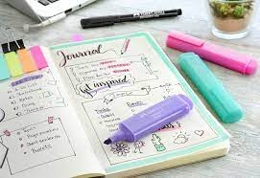
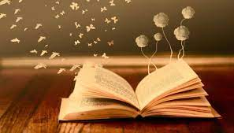
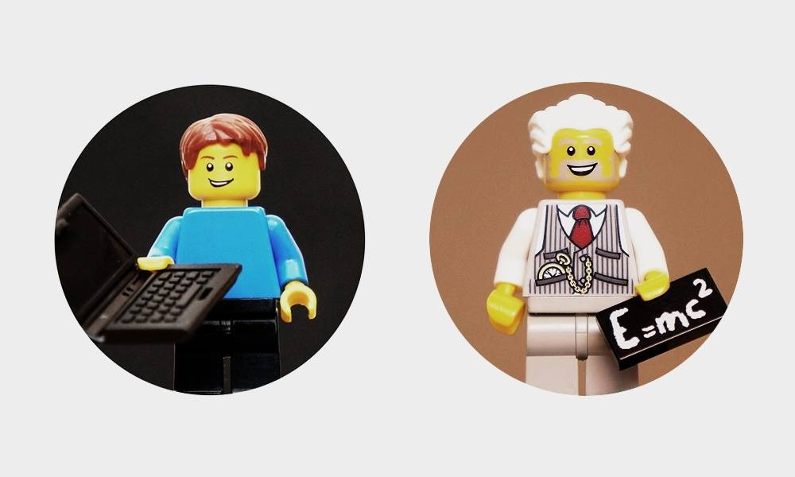
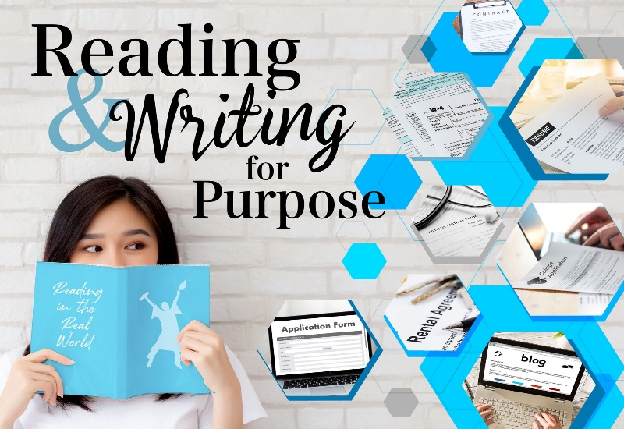
Reading & Writing for DIFFERENT PURPOSES
Notes:
TEACHER NOTE: Please use the Lesson 1-3 Workbook and Content Summary in conjunction with these PowerPoint slides to aid in class discussion and tasks. The slides have the main topics, and the bulk of the information is in the workbook along with class activities.

Slide 2
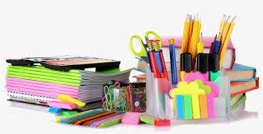
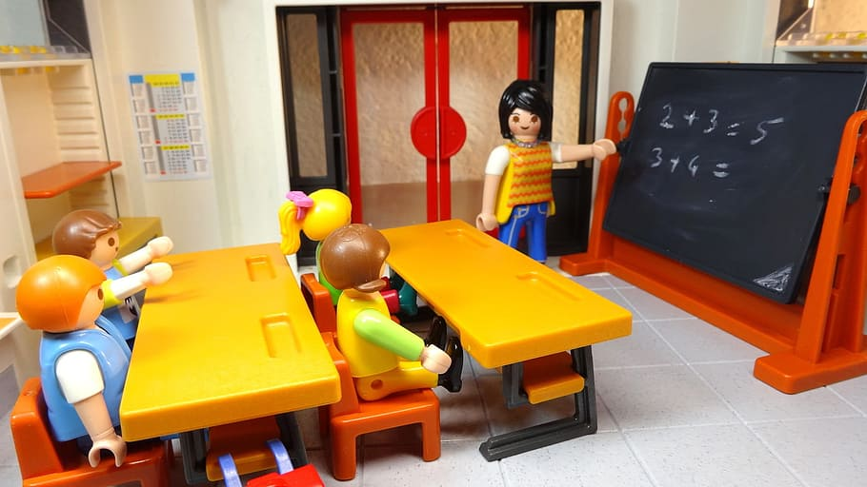
Reading & Writing:
What is the first thing that comes to mind when you think of reading and writing?
Do you think about school? Do you think about that great book you’re reading at home? Or maybe you think about a short story you’re writing? The essay you know you need to finish?
BUT… Did you know that reading and writing is about more than just schoolwork, in fact we can read and write for a variety of purposes. It's more than just studying or reading a paragraph or a case study. It's more than just writing an essay or completing a task.
Notes:
It's important to differentiate between reading and writing and stress the importance of it being for more than just schoolwork team or homework. give learners the opportunity to have that lightbulb moment that it can be for so much more.

Slide 3
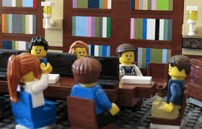
So, what are they?
Reading is a process of making sense of symbols and letters to form words and sentences that we can understand. It is more than that however, we can read for information, relaxation or to learn.
Writing is the process of using symbols (letters of the alphabet, punctuation and spaces) to communicate thoughts and ideas in a readable form.
Like reading, writing can also be done for different reasons. Think about how often we write something down, maybe you are making a list, writing notes, giving instructions or completing a school assignment. Writing is a type of communication and a very important skill. Writing is used in the workplace, in academics for personal reasons, and for record keeping.
Notes:
these definitions explain reading and writing at their core, it is important that learners know what these terms mean.

Slide 4

Reflect on this:
Do you like to read for a reason other than schoolwork?
What do you read?
Or if you don’t, what would you like to read about?
Notes:
Give learners a few minutes to answer this reflection question on page 16 in their workbook.
Ask learners what they read for or what are things that they may potentially be interested in, this could be something used to get them interested in reading.

Slide 5
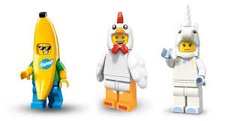
Journaling:
A journal is a type of record but it's a record of personal experiences that we take the time to write down. It's a little bit more detailed than a diary, it gives more details and more descriptions of events. Some people may use a notebook, other people an exercise book and some people use blank journals and write all kinds of different things. Journals are deeply personal and it's often something that is unique to a person. Sometimes diaries can be for historical or political reasons, and other times just a case of clearing one's mind and getting things on paper.
The Diary of Anne Frank for example was a record of a young girl who hid in an attic to avoid being captured in World War Two. This is what we would consider being historical.
Summarising:
A summary gives us an overview of a larger text and can be very helpful when organizing revision notes. There are many ways to summarize and which way you prefer - depends on your learning style. Most importantly: a summary is short and to the point and must make sense. It contains the main points or focal points.
Summarizing however is a skill and like any skill it takes time to practice. Once you know how to do it, it will become second nature.
Notes:
Following page 17 in the workbook - here's a short extract on journaling and summarizing – the difference between the two.

Slide 6
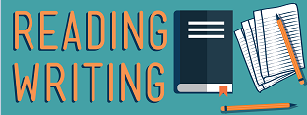
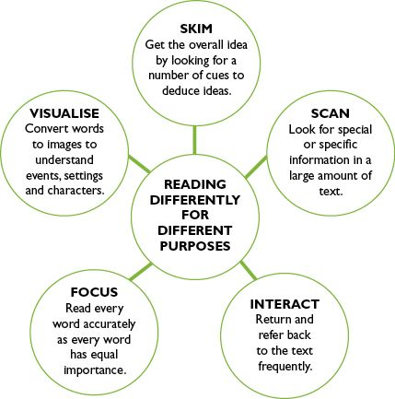
Improving Skills:
As you've learned, reading and writing are both very
important skills and there are things, we can do to improve them.
Reading can help in all aspects of our lives and if we read efficiently, we can absorb information easily and increase our understanding. Good writing skills help us to be able to communicate our ideas and knowledge effectively, as well as being able to get your point across in an exam or an assessment.
Notes:
Learners may enjoy reading but be unaware of how to improve their reading skills.. It is important to understand the usefulness of these skills and why improving them would be to their benefit. The next two slides go into it in more detail.

Slide 7

Improving reading skills:
By practicing every day, reading speed and accuracy will increase. The more you read the better you will become.
You can test yourself after reading a chapter or an extract and see how much you remember.
By practicing, reading speeds can also increase. This will mean you are able to read more in a shorter space of time.
Reading conditions are also important. Things like good lighting and few distractions can make the process easier.

Slide 8
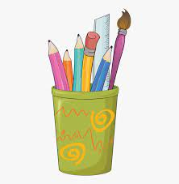
Improving writing skills:
Making use of a dictionary, can help to understand words that you not sure of, and ultimately increase your vocabulary. In a textbook, you will often find a glossary for this purpose.
Practicing your writing as much as you can (especially if writing in a second language) will also help to strengthen your skills. Practicing longer paragraph style answers - can also help you in expressing yourself.
Paying attention to spelling, grammar, punctuation and sentence structure – it is important to reread your work once you've finished to make sure that everything makes sense.
Comprehension is important. You need to be able to understand the information that you've read so that you can answer questions correctly. Plagiarism should always be avoided.
Memorizing can also help. Using your learning style can help you to remember things more effectively.
Things like handwriting speed and neatness (which are the mechanics of writing) are also important. Correct posture and pencil grip is important.

Slide 9
Reasons for Reading & Writing
WRITING
Journals
Messages
READING
For INFORMATION
Meaning of words
Public Info
Labels
For LEISURE
Books and Novels for enjoyment
Graphic Novels
Interests
Study Notes
Instructions
Summarising:
Bullet Points
Memories
Tables + Pictographs
Mindamps
Keywords
For LEARNING
Instructions
World News
Studying
Notes:
Summary of reasons for reading and writing. See page 18 of workbook.

Slide 10
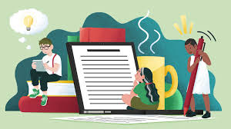
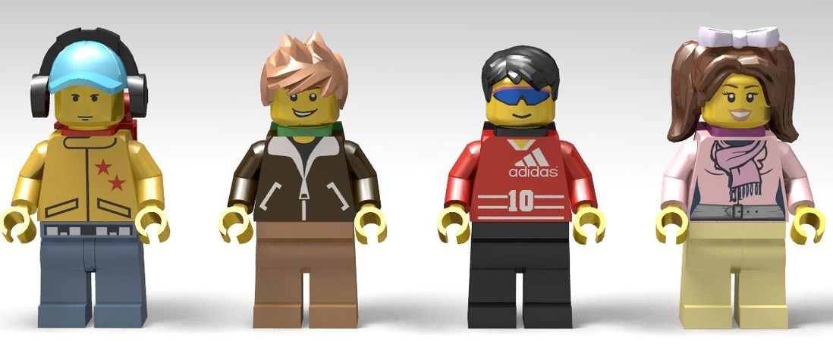
JOURNALING:
You might already know that journaling is a great outlet. It’s recommended for anyone, from children to adults, who
wants to relax, become more grateful, and get to know themselves better.
Journaling evokes mindfulness and helps writers remain present while keeping perspective. It presents an opportunity for emotional catharsis (letting emotion out instead of bottling it in – it is alike a release) and helps the brain regulate emotions. It provides a greater sense of confidence and self-identity
Many people think a diary is the same thing as a journal. However, there is a difference between the two: A diary is a book to record events as they happen. A journal is a book used to explore ideas that take shape.
Journaling video:
https://www.youtube.com/watch?v=9L4J-u7Vi24
Notes:
https://www.youtube.com/watch?v=9L4J-u7Vi24
A journaling video by a young girl

Slide 11
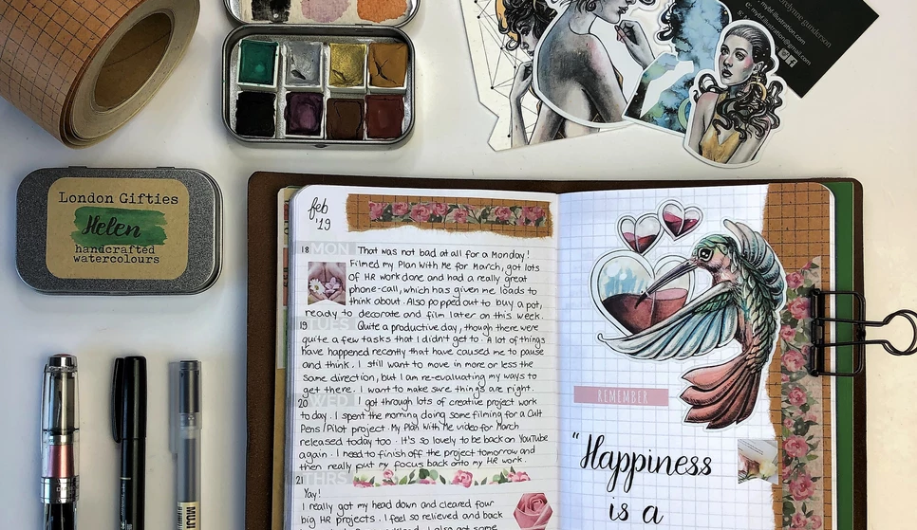
Notes:
Ask learners what they could journal about and how they could use it themselves.

Slide 12
Types of Journals
The Day-to-Day Happenings of your Life
Not every day is going to be full of exciting adventures, but over time you can
create a record of the normal ups and downs of your daily life.
Thoughts and Feelings
Some days are great, and some days aren't. Having a place to unload feelings, process the difficult and celebrate the great can do you the world of good.
Quotes Journal
Do you ever read a quote just at the right time? Or hear lyrics that instantly make you feel better? This is what a Quotes Journal can be for.
Things you Need to Get Done
To stay on top of tasks, organise projects and make sure you meet deadlines.
Your Hopes and Dreams / Vision Board
Inspire you to focus on what's important and take on projects that scare you.
A Gratitude Log
Helps remind us of what we have and what we can be grateful for
Reasons to be Proud of Yourself
No matter how big or small an accomplishment is, it’s important to remember that you should be proud of what you’ve done.
Travel Journal
Any time you go traveling or have a special day out, it is well worth documenting in your journal. You can add photos, tickets, and other memorabilia to remind you of where you went and the things you saw.
Plan out Projects
Your journal can be a great place to plan out projects for school or things at home.
Review Your Progress
It can help you to decide what is working for you and where you may have gone slightly off track. This can help you to reset your intentions and learn from the experiences you’ve had.
Notes:
Here are some examples:

Slide 13

Questions or Comments?
Notes:
Finally ask learners of they have questions or comments – remember that in LO learners need to ask questions, sometimes these concepts may seem a bit abstract for them. Let them assimilate what you've covered and move onto the Class Activity (page 20 and 21 in workbook) at the end of Lesson 3.

Slide 14

Final Reflection
Notes:
Give known as a chance to complete the final reflection use it to look at what they've learned what they may need help on and how they feel about the lesson stop. It will help you identify anything that may need to be gone over again or explained again.

