Slide 1


Notes:
Slide 1: 3min
Welcome back to class Grade 12’s. In the last lesson we briefly looked at some of the options you have for “life after high school”. Can you remind me the options we discussed? (allow for learners to respond)
We looked at:
Studying
Working
Gap year
Not sure
You were required to do some research for homework on possible careers at different institutions. Can you share with the class some challenges you found when doing this research. (allow for learners to respond)
We are going to briefly look at a university website and discuss where to look for information. This is just a sample of a university. While we are working through these slides make notes on your Lesson 2 – Worksheet in the different categories.
Let’s get started!

Slide 2

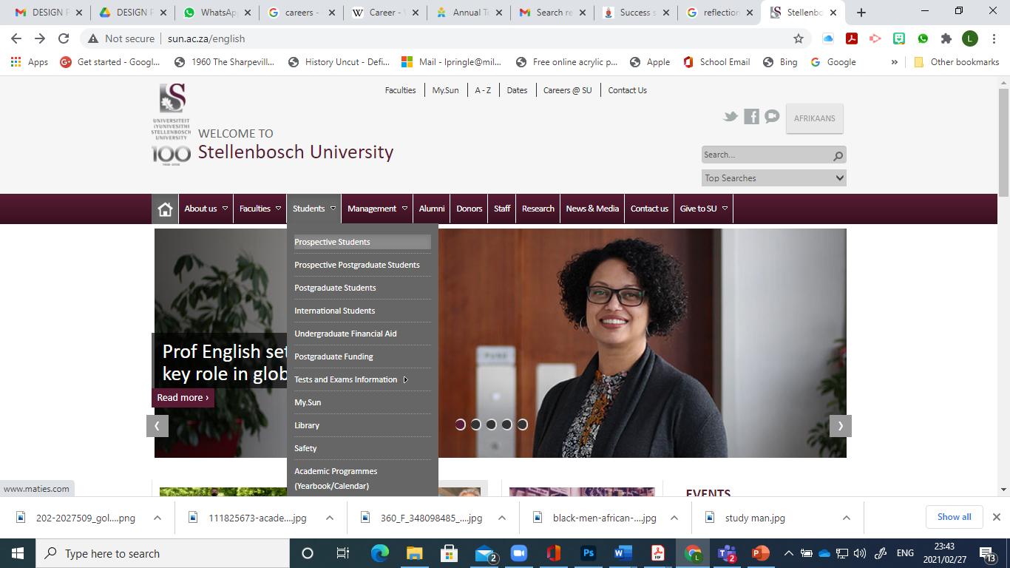
Notes:
Slide 2 – 4: 12min
We are going to start by looking at the site of a local university in the Western Cape. This section forms a basic guideline that can be followed on any university / college website.
As you can see this site belongs to the University of Stellenbosch. When looking for information you will need to start on the home page and work your way through the different sections of information relevant to you. You will find this information by clicking on the “prospective students tab”
(Notes to teacher: The images in this slide can be found at http://www.sun.ac.za/English
Due to the changing state of web addresses the following images might no longer be available on the site. These images inform the learners on the process involved in applying.)

Slide 3
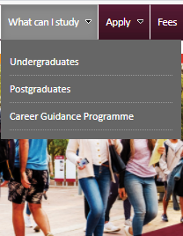
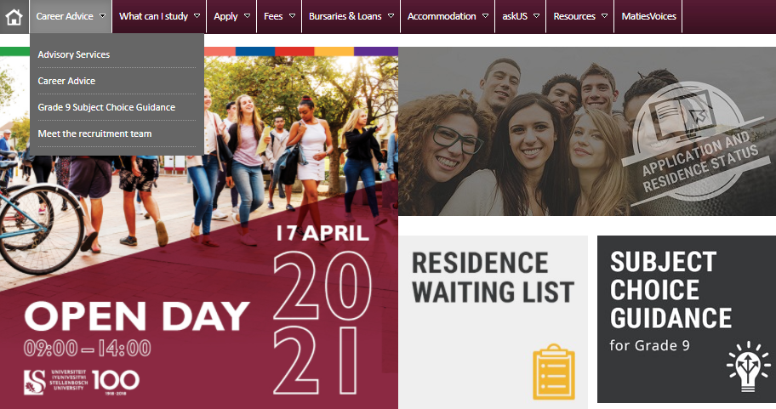
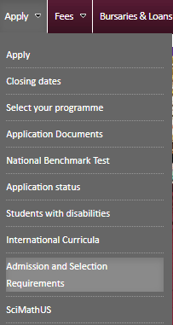
Notes:
Slide 3:
This home page offers advice to any learners considering studying in the future. There is even advice on subject choices in grade 9 in relation to careers that you are considering as well as dates of the various open days to attend.
As a new university student without a tertiary qualification you would be referred to as an “undergraduate”. By clicking on this tab you will find all the information you need to know to apply of the following year. Each university has their own admission requirements for the different courses they offer. As a matric learner you will need to meet these requirements in order to be considered for this institution. Let’s take a look at some of the requirements of Stellenbosch University.

Slide 4
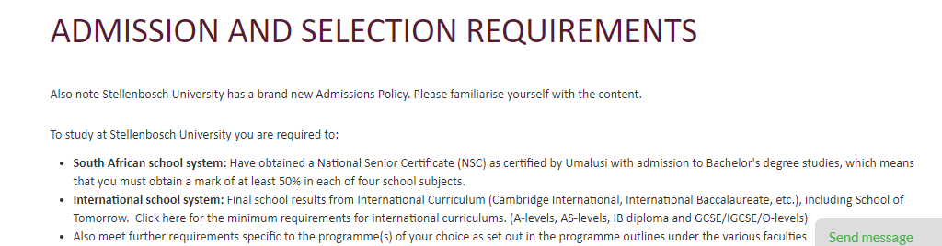
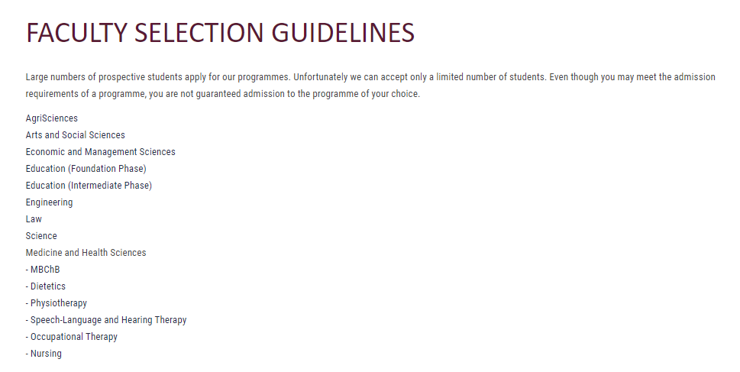
Notes:
Slide 4
As you can see you would need an NSC (National Senior Certificate and an average of above 50% in FOUR subjects excluding Life Orientation. The university continues to explain that a large number of applications come in every year but there is limited space in each faculty. When you choose a course to study it will fall under a specific faculty. That is why you might meet the admission requirements for the university but the faculty might have other requirements. When applying you need to make sure you have researched the extent of the requirements for your course.
We mentioned in the previous lesson that universities require that learners write the NBT. Can you remember what this means?
(allow the class opportunity to respond.)
The NBT’s are called the National Benchmark Tests. They are done by an independent body to provide an accurate standard of grades in subjects like mathematics, English and physical science. Universities use these grades as an influence on processing your application.

Slide 5
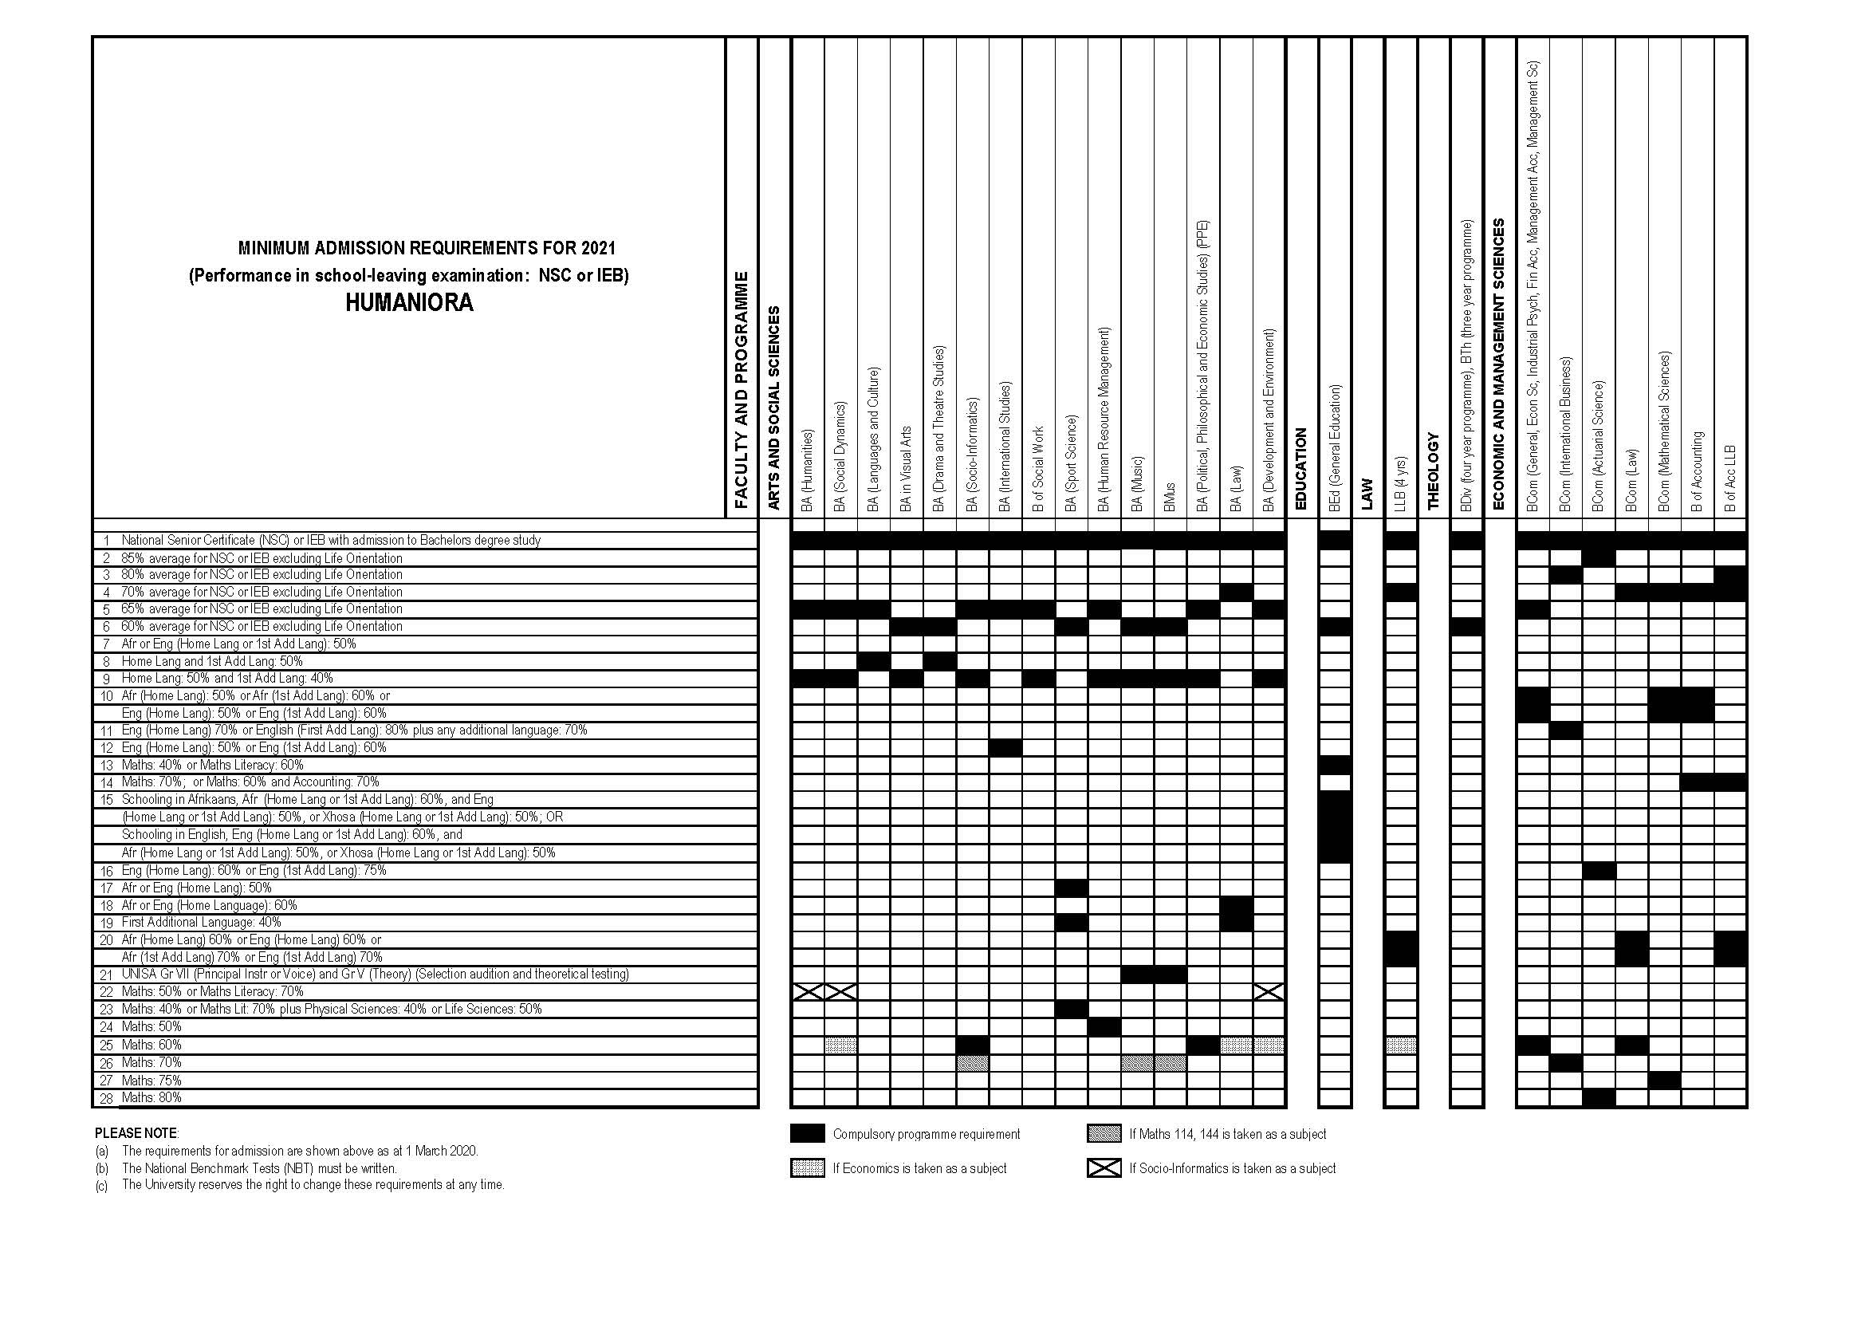
Notes:
Slide 5: 5min
This image has also been included in your Lesson 2 – Worksheet. Complete the questions in Activity 2 ( Due to the difficulty in reading it might also be helpful to print out a larger copy per group.)
The questions are as follows:
1) Should you choose to study a BCom (law), what subjects do you have to have in matric?
2) Of all the courses, which appears to have the most difficult entry requirements? Motivate your answer
3) Based on your present subjects and your grades at the end of Grade 11, which courses do you qualify to apply for?
4) Should you not meet the requirements for your chosen course, recommend TWO strategies to improve your chances?

Slide 6
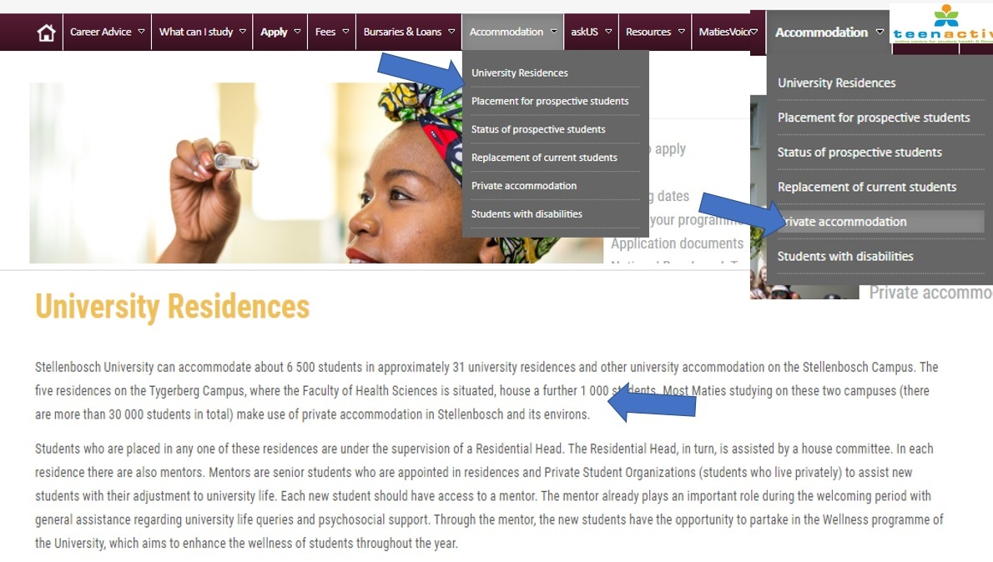
Notes:
Slide 6-8: 5min
One of the concerns when studying is “where will you stay?” and “how will you get there?”
Universities have both residences in the form of hostels and then offer advice on private accommodation near the university. It is necessary to decide for more than one option as not all learners are placed in accommodation. At
Should you choose to stay at home (assuming the desired university is near where you live), how could you make alternate arrangements for transport? Discuss briefly in your groups. (2min)

Slide 7
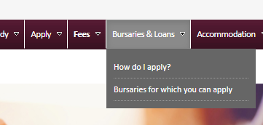
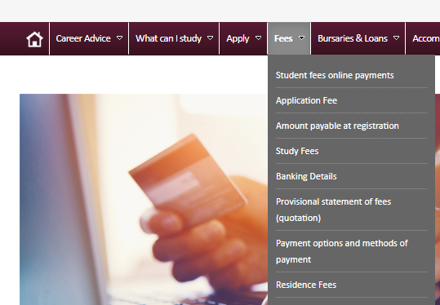
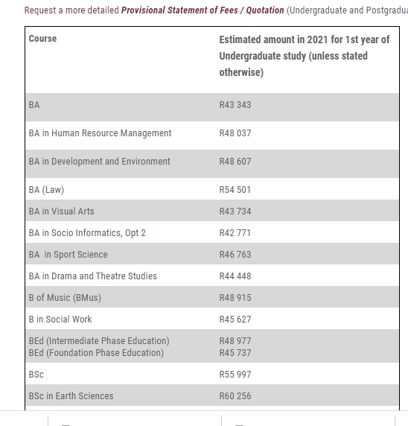
Notes:
Slide 7:
The cost of a course is usually the part that completely overwhelms learners. Looking at these slides we can see for example that the average yearly fees for a course like BA (law) is R51501 (in 2021). This does not include any textbooks or stationery. And about R15000 would be payable on registration. There are several options for learners to study and obtain funding. Let us look at a few options:
Parents pay for your fees
Take out a student loan from an institution like FNB/ ABSA that requires you pay the money back when you are qualified and have a job. In this case you would need someone willing to pay the insurance and interest on the loan monthly.
Loan through the university is similar to the bank
Bursaries- this would be money provided for all you would need without the requirement to pay it back. An example would be NASFAS- a bursary for learners who come from a household where parents earn a low income or are unemployed.
Scholarships- an amount towards study fees but not necessarily the entire amount based on academic achievement.
Universities often have a list of the scholarships or bursaries available for specific courses.

Slide 8
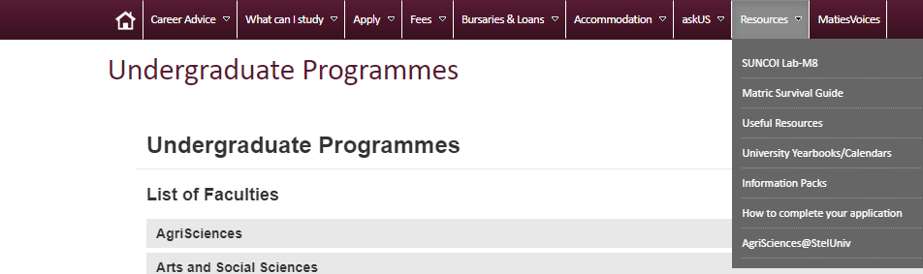
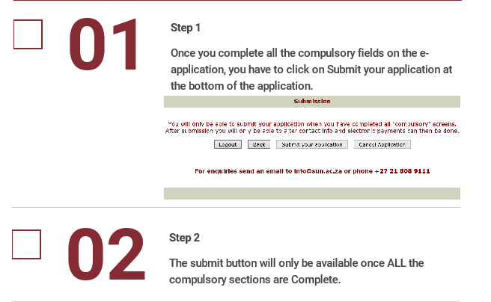
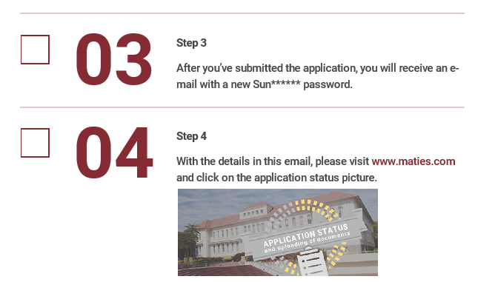
Notes:
Slide 8:
Once you have completed all your research, you will then need to apply. The website will further assist you with the instructions on how to apply.

Slide 9

JOB APPLICATION- you will need…
A curriculum vitae (CV) is a comprehensive document that lists your qualifications for academic employment
A career portfolio is a visual representation of your abilities, skills, capabilities, knowledge, qualities - and it represents your potential. Physically, it's a collection of things - tangible materials - that represent work-related events in your life.
Notes:
Slide 9 &10: 9min
Maybe you have carefully considered your options and feel that you need to find a job straight out of school. Be sure that this decision is truly what you want to do and that you have prepared well in advance. This includes researching different job opportunities. In other words, you know what qualifications you need , what you will do, how many hours you will work, what you will get paid and how you will get to and from work.
Before you can actually start looking for a job you will need a CV and career portfolio. The CV lists your qualifications for academic employment and the career portfolio serves as a visual picture of your skills. This is really helpful coming out of school when you don’t have much work experience. (allow learners time to write these definitions onto their Lesson 2 – Worksheets.)

Slide 10


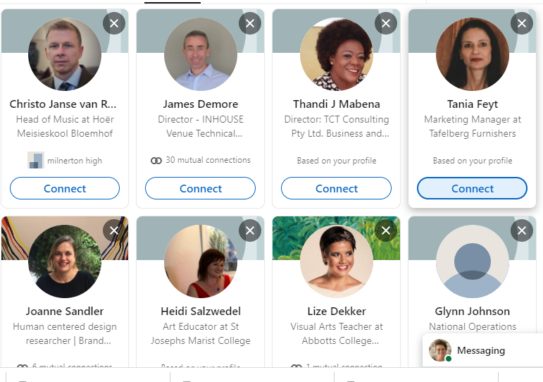
Digital platforms
Notes:
Slide 10:
Digital platforms like Linkedin help you develop an online CV and place your credentials out on the internet for others to see what you have done. Within these platforms you can also upload examples of work done and develop a career portfolio.
Take a moment to reflect on your Lesson 2 – Worksheet in Activity 3 in response to an article “How Facebook and Linkedin can get you a job?” (allow learners 5min to work on this activity). Explain they will need to finish it for homework. Encourage them that should they be interested in working after school, to spend some time working through the Linkedin profile and web interface at home.

Slide 11


With the knowledge that you have gained about studying after school,
reflect on how you feel about your options for the future.
What advice would you give to a friend who would like to study but cannot comprehend where the finances would come from to study .
Certain responsibilities would change leaving home.
Rate yourself in your ability to complete the following skilfully.
(1 = needs work and 5 = very capable.)
* cooking for yourself
* doing your own washing
* managing your money to buy groceries, petrol toiletries
* cleaning your room / apartment or accommodation
* driving to and from work / university
For all the 1’s, write a plan on how you intend to improve these skills while still living at home.
Notes:
Slide 11: 3min
Allow 5min to take a moment to reflect on what they have learnt about themselves today.
Answer the following questions:
With the knowledge that you have gained about studying after school:
- Reflect on how you feel about your options for the future.
What advice would you give to a friend who would like to study but cannot comprehend where the finances would come from to study.
Certain responsibilities would change leaving home.
Rate yourself in your ability to complete the following skilfully. (1 is needs work and 5 very capable.)
* cooking for yourself
* doing your own washing
* managing your money to buy groceries, petrol toiletries
* cleaning your room / apartment or accommodation
* driving to and from work / university
For all the 1’s, write a plan on how you intend to improve these skills while still living at home.
There are no memo answers to these questions. Make sure in this time the class is quiet. You can even play an instrumental song to encourage a quieting down and reflecting.
Remind learners to complete the homework!

