Slide 1


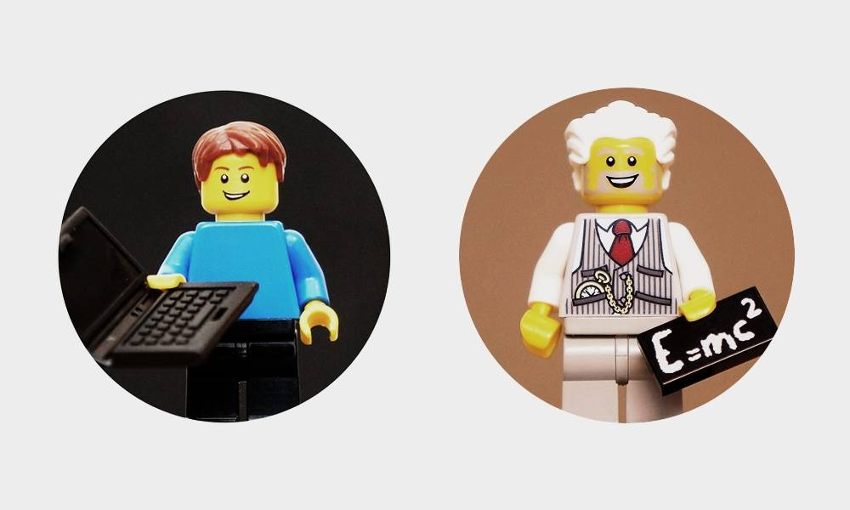
ORGANISATION
Notes:
Please use the Lesson 1-3 Workbook and Content Summary document for in detail explanations for the concepts discussed in these slides

Slide 2

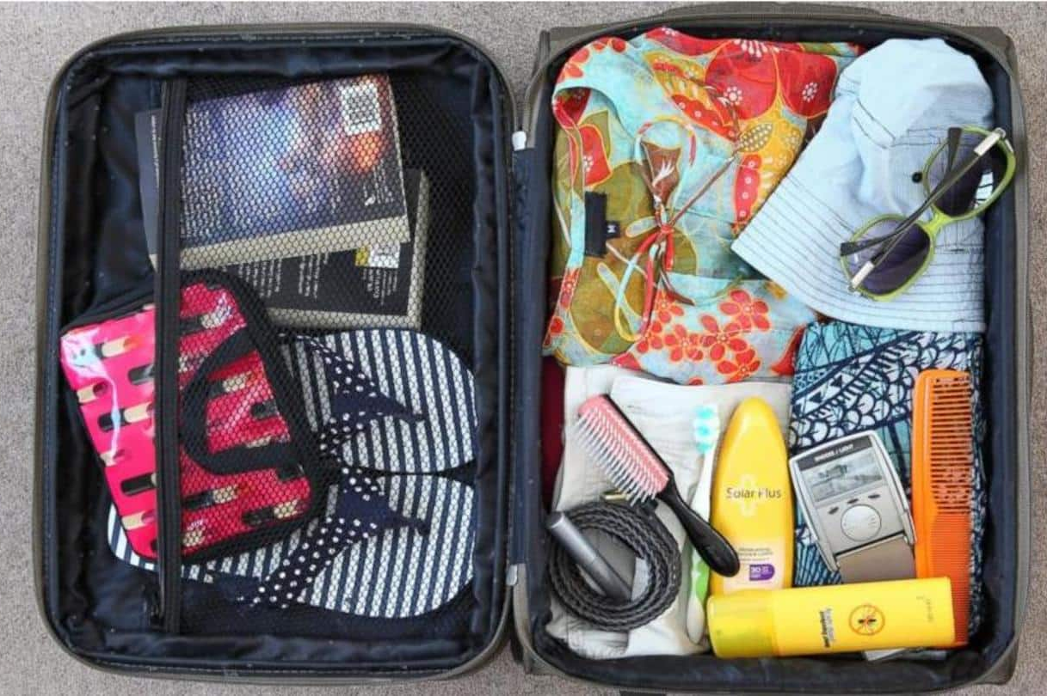
Consider this:
You’re going to visit your relatives for the school holidays – look at these two suitcases…
Which one will you be able to find what you’ve packed easily? Why?
Notes:
This will be a quick introductory discussion to start Learners thinking on how ORGANISATION can help them. Please feel free adjust the scenario and edit it to suit your Learners.

Slide 3
Organisation:
The two main benefits with respect to organisation and time management is that organisation saves time directly by minimising the amount of time you need to complete your task and making it easier to achieve your task.
If you had two suitcases – the one that was packed and organised would make it easier to find what we need. We can apply the same logic to time management. By using the skills, we looked at in our last lesson and using organisation we are can achieve so much.
Notes:
Use this to show the link between being ORGANISED and TIME MANAGEMENT.

Slide 4
Let's look at Sally’s situation:
Let's have a look at Sally, she has drawn up a timetable for her week. She has included in the timetable, all of her schoolwork (including her homework) and all of her activities (including after school). It is close to the end of the term and assignments are due for her report. Sally likes to be organised so let's look at what she does:
Sally has worked out that on a Monday to Thursday she is busy with extracurricular activities until approximately 5 PM.
She is also scheduled when she is most likely to eat supper.
From roughly 5:30 to 7:00 PM Sally can do all of her homework.
After supper she watches TV and helps around the house.
From 8:00 PM she is free to do some revision if all her assignments are completed.
Sally has really struggled with Maths this year, so she's decided to dedicate at least 45 minutes per day after supper to doing Maths revision. She has realized that because of the vast amount of work in Maths, she needs to revise as much as she can.
Sally gets into bed every night at around 9:30 PM and reads her English novel. She likes to keep up to date with what's being read in class so that she does not fall behind.
Notes:
This can be used as a class task – use Sally’s situation to show how to manage time and organise our activities effectively. See page 10 in Workbook.
Ideally, learners can make the connection that by taking a few moments to organise what they will do when - will save them time in the long run.

Slide 5
How can she organise her time?
Time | Monday | Tuesday | Wednesday | Thursday | Friday
4:00 PM to 5:00 PM | Dancing | Netball Practice | Dancing | Netball Matches
5:00 PM to 6:00 PM
6:00 PM to 7:00 PM
7:00 PM to 8:00 PM | Eat Supper | Eat Supper | Eat Supper | Eat Supper | Eat Supper
8:00 PM to 9:00 PM
9:00 PM to 10:00 PM

Slide 6


Effective vs Efficient
These two words, although similar have two different meanings:
Effectiveness is defined as the degree to which something is successful in producing a desired result, success.
Efficiency is defined as the ability to accomplish something with the least amount of wasted time, money, and effort or competency in performance.
Notes:
Example: Efficiency would be preparing the food quickly for your cat, dog, and hamster. But effectiveness is doing the right task, preparing the correct food, and then giving each food to the correct pet (dog, cat, hamster). It’s not just about getting food to each pet quickly, but about getting the right food to the right pet.

Slide 7


What could YOU do to be more EFFICIENT and EFFECTIVE at school?
Notes:
Give Learners a few moments to reflect on what they could do at school to be more efficient and effective – they can give ideas and spend a minute or two to talk about their ideas.

Slide 8
Things we can do to manage our time effectively and efficiently:
Use a notepad or a diary.
Getting enough sleep.
Listening and concentrating during class.
Revision.
Organising and planning.
Trying to enjoy studying
Not procrastinating.
Notes:
Sometimes it’s more exciting to see our friends and go out, catch up and be on video calls, make a TikTok or look at what's happening on social media. All of these can sometimes be distractions and stop us from using our time effectively and efficiently.
If we practice time management and put all these skills to use, then we can stay up to date with schoolwork and still do all the things that we enjoy and things that we find fun. See page 11 of Workbook.

Slide 9

Which of the 7 strategies above could YOU put in place to assist you in Grade 9?
Notes:
Give learners a few moments to reflect on which time management strategy (from the list of seven on page 11 to 12 in the Workbook) they could use and would suit them best.
The next activity in the workbook is about Kelsey and her time (page 13) – give learners a 5 minute break to complete this activity, let all the information covered “sink in”.

Slide 10
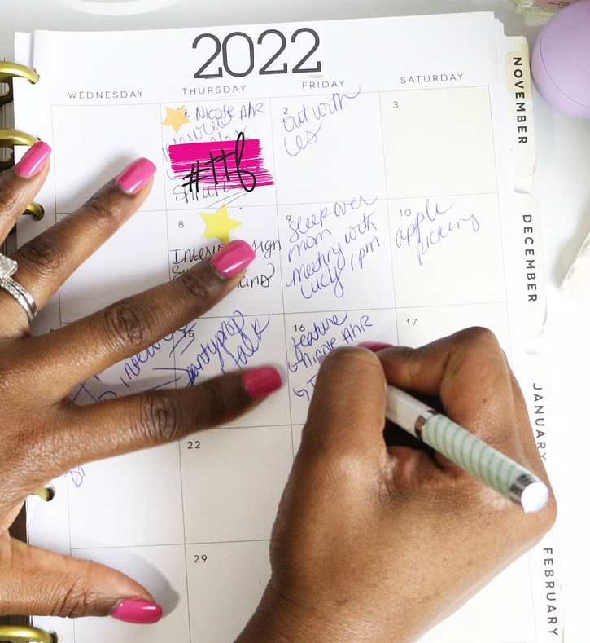
Activity:
Kelsey has just been told that she has a Maths test in one weeks’ time. She struggles with Mathematics and must study hard for this test - but it's going to be such a busy week and she doesn't know how to fit everything in. She found out about the test on Monday the 30th of July and the test is on the 6th of August.
Draw up a weekly planner
for Kelsey to help her
organize her time efficiently
and effectively.
Notes:
The next activity (on page 13 in the workbook) is about Kelsey and her time – give learners 5-minutes to complete this activity, let all the information covered “sink in”.

Slide 11
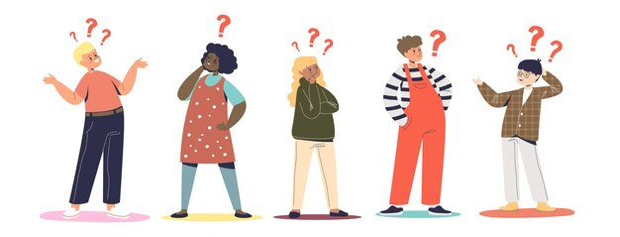

5 TIME-MANAGEMENT TIPS EVERY TEEN SHOULD KNOW
Read the article in your workbook, once you’ve read through it – decide which tips will be most
beneficial for you and what you can apply in your daily activities in the space provided.
Notes:
See page 14 in the workbook.

Slide 12

Reflection:
Which TWO tips from the article could be most beneficial for YOU?
Why did you choose those TWO tips?
Notes:
Give learners a few moments to reflect on what TWO tips they could use and would suit them best and why they would use them. See page 14 in the workbook.
The next activity (page 15) in the workbook is a Concept Map– let learners complete that activity, let all the information covered “sink in”.
Finally, see if there are any questions and use the time to draw all the threads together.

