Slide 1

Healthy and unhealthy relationships
Lesson 1 - PowerPoint 2
Notes:
Optional: WATCH video: https://youtu.be/AcGXlM7vrMQ (Healthy and Unhealthy Behaviors in Teenage Relationships 1min 57s)
Paste the link directly into YouTube or a Video Downloader

Slide 2
Characteristics of healthy relationships
In a positive relationship, a person can still be their own person, as well as being part of a couple.
A healthy relationship makes a person feel good about themselves and their partner. They can have fun together and still be themselves. All relationships are different, but healthy relationships share at least five things in common - the S.H.A.R.E. qualities.
Notes:
As per Content Summary page 7

Slide 3
01
02
03
Safety: In a healthy relationship, a person feels safe. They do not have to worry that their partner will harm them physically or emotionally, and they are not tempted to harm them. A person can change their mind about something - without being afraid of how their friend will respond.
Honesty: A person does not hide anything important from their friend and can say what they think without fear of being ridiculed. They can admit to being wrong and working with their partner to resolve disagreements by talking honestly.
Acceptance: They accept each other as they are. They appreciate their friends’ unique qualities, such as shyness or outgoing, and do not try to “fix” them. If there are qualities a person does not like about their partner, then maybe they should not be with that person.
Respect: Both partners think highly of each other. They do not feel superior or inferior to their partner in important ways. They respect each other’s right to have separate opinions and ideas.
Enjoyment: A good relationship is not just about how two people treat each other - it also must be enjoyable. In a healthy relationship, they can play, laugh together, and have fun.
Notes:
As per Content Summary page 7
What POSITIVE words do YOU associate with a HEALTHY Relationship? – write these down in the space provided on page 7 of the Content Summary

Slide 4
CHARACTERISTICS OF UNHEALTHY RELATHIONSHIPS
Control: one person makes all the decisions and tells the other what to do, what to wear, or who to spend time with. They are jealous, and/or try to isolate the other person from their friends and family.
Dependence: one person feels that they “can’t live without” the other. Or they threaten to do something drastic if the relationship ends.
Digital monitoring or “clocking”: one person uses social media sites like Instagram and Snapchat to keep tabs on the other person. They constantly message or text the other person and demand quick responses.
Dishonesty: one person lies to, steals from, or keeps information from the other.
Disrespect: one person makes fun of the other or talks about them behind their back.
Notes:
As per Content Summary page 8
It is important to recognize signs of unhealthy relationships before they escalate, unhealthy characteristics may include the following:

Slide 5
Hostility: one person picks a fight with the other. This may lead to one person changing their behaviour to avoid upsetting the other.
Harassment: one person uses unwanted, unwelcome, and uninvited behaviour to make the other feel unsafe. They may use cat calls to make inappropriate comments about the other's body or make physical advances without consent.
Intimidation: one person tries to control the other by making them fearful or timid. They may attempt to keep the other person from friends and family or threaten violence or a break-up.
Physical violence: one person uses force to get their way
(such as hitting, slapping, grabbing, or shoving).
Notes:
As per Content Summary page 8

Slide 6
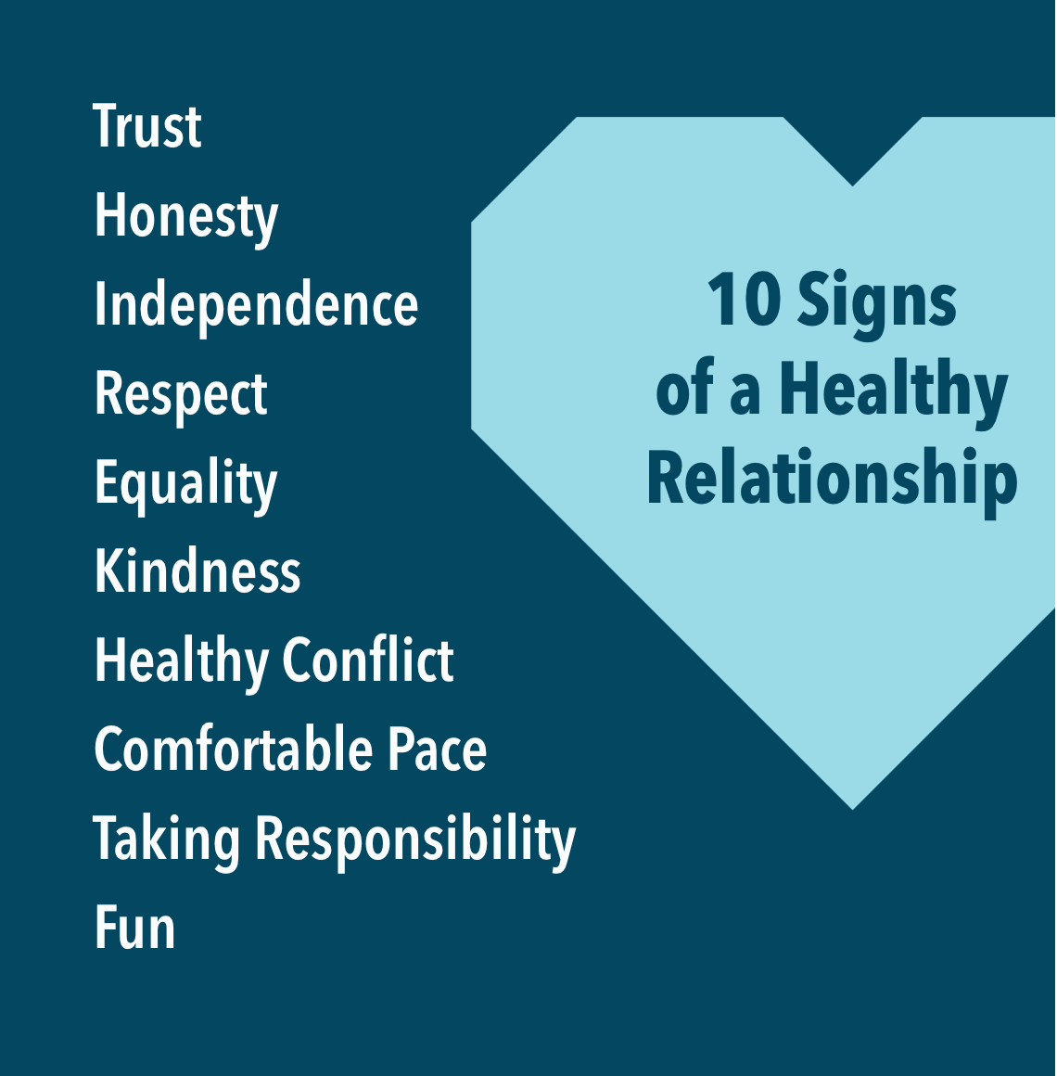
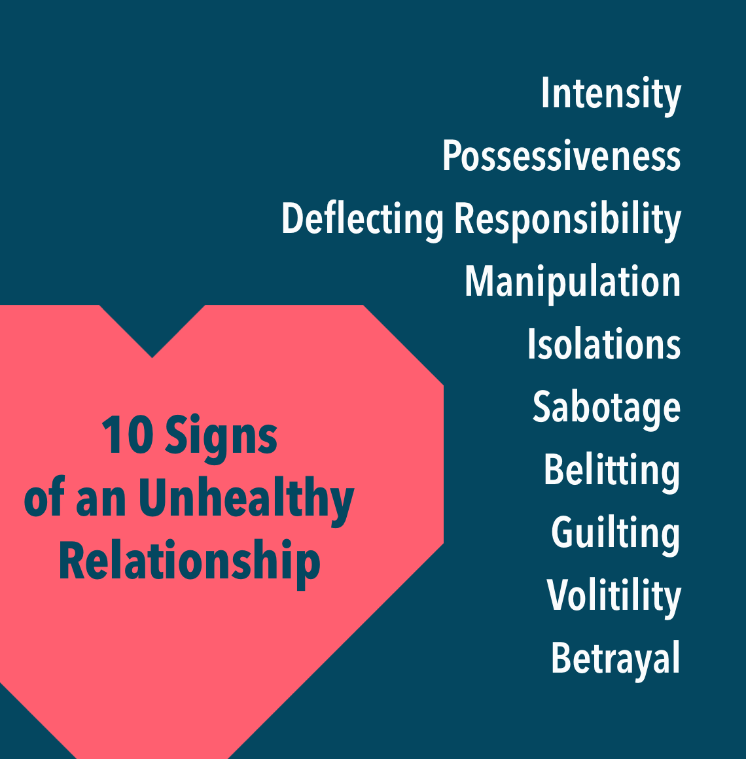
Notes:
As per Content Summary page 8
After discussing the contents on this slide, refer to Lesson 1 – Red Flag Activity. This class activity will help learners to distinguish between various healthy and unhealthy relationship scenarios.
After the Red Flag Activity, refer learners to the Health, Unhealthy and Abusive Relationships Table on page 9 in the Content Summary – for more examples of each.
If there is time, ask learners to briefly reflect on some of their current relationships – would they say these are healthy or unhealthy?
Before leaving class, remind learners to pop their questions into the Question Box for the next lesson.

