Slide 1


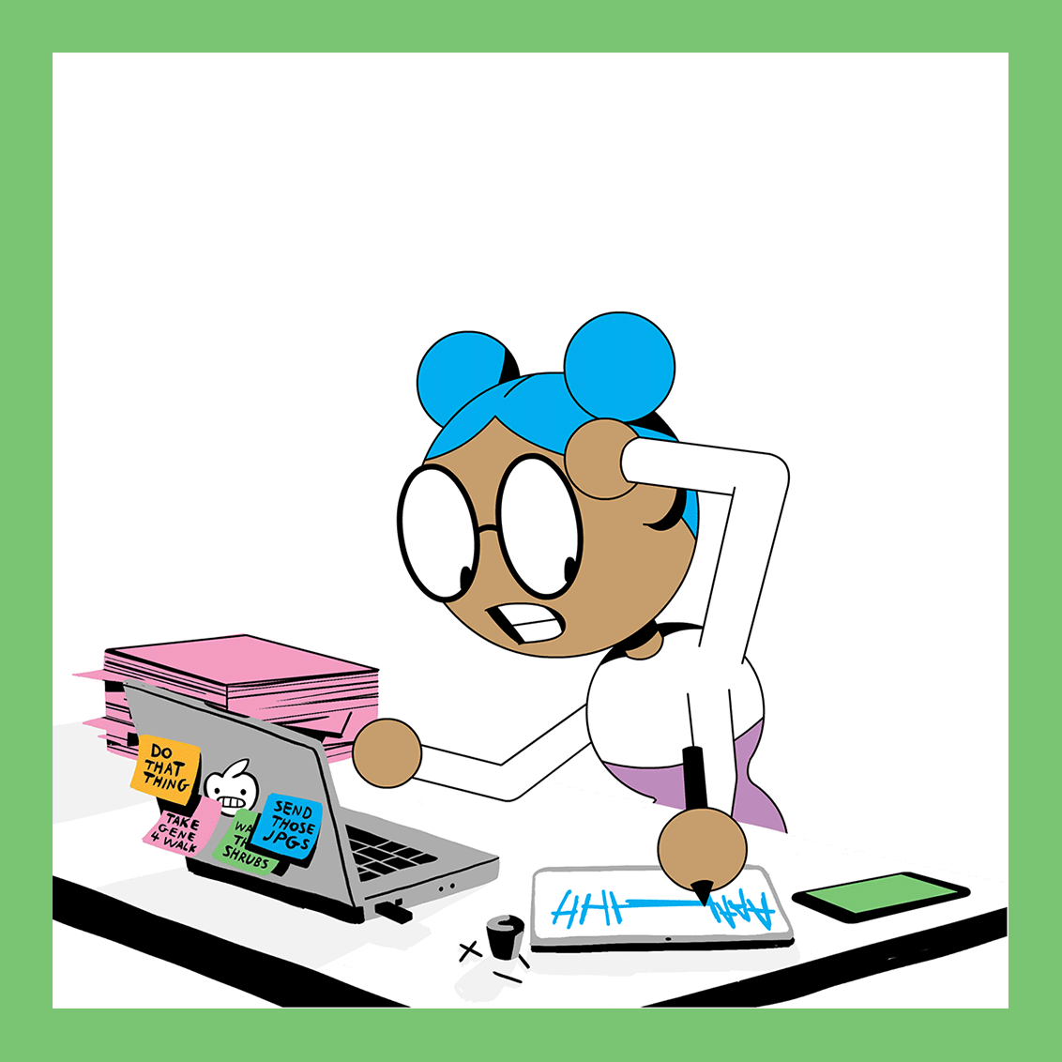
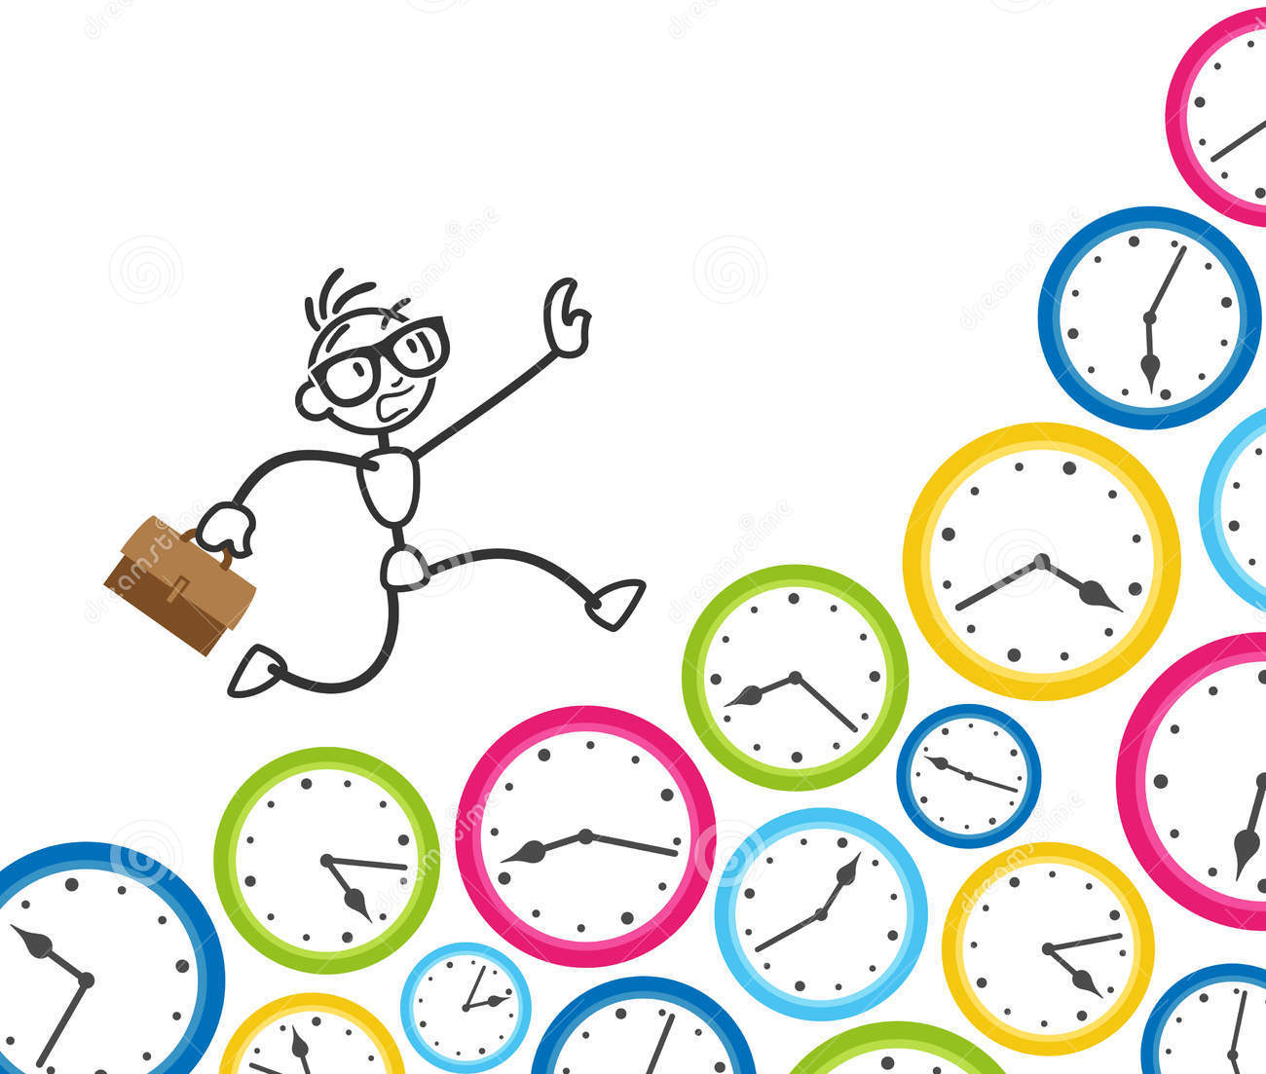
Grade 9
World of Work
Week 8-10
Notes:
TEACHER NOTE: Please use the WORKBOOK in conjunction with these PowerPoint slides to aid in class discussion and tasks. The slides have the main topics, and the bulk of the information is in the workbook (called Lesson 1-3 Workbook and Content Summary) along with class activities.

Slide 2

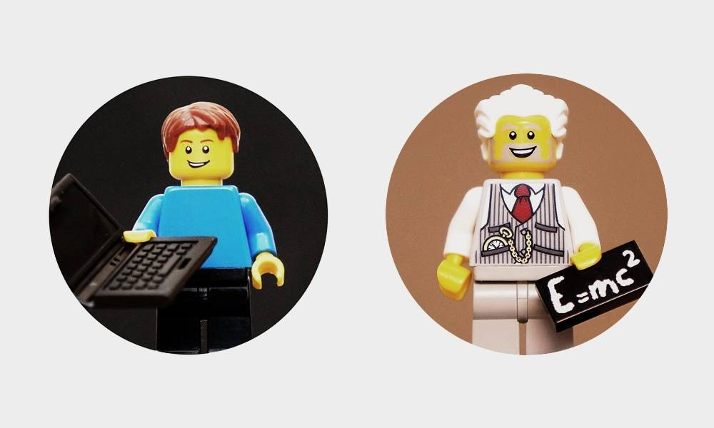
TIME
QUESTIONS TO THINK ABOUT:
Why do some achieve more in a day?
HOW do YOU maximise YOUR time?
Time is such a strange concept, its something we sometimes wish we had more of, and sometimes we may feel like we have so much time on our hands.
Time is a used to quantify, measure or compare the duration of events or the intervals between them, and even, sequence events
But what makes up time?
One day is the equivalent of 24 hours…
Which is 1440 minutes...
And that equates to 86 400 seconds...
It may sound like a lot when we break it down into hours, minutes and seconds doesn’t it?
The big question is how is it that some people can accomplish more than others in the same mount of time??
Notes:
This is to make the point that we all have the same numbers of hours in the day regardless – at the end of the day, it is up to us how we use that time.
Use the WORKBOOK for the in detail explanation.
Allow learners a few moments to answer the question posed in the workbook on page 3.

Slide 3
TIME MANAGEMENT
Time management is the process of organising and planning how to divide your time between different activities.
Time Management Skills
These skills are all about being able to manage your tasks within a given timeframe to make your time and workload more manageable
Let's talk about STUDENT A and STUDENT B
Who is more effective?
Why are they more effective?
.
Notes:
The question you are asking is WHY DO SOME PEOPLE SEEM TO ACHIEVE MORE IN A DAY – and the big answer is TIME MANAGEMENT.
Discuss the concept of what Time Management is and what it means.
Explain Student A and B, their different habits and the given scenario. See page 4 of Workbook

Slide 4


Notes:
Leave this slide up while the deliberate about which student is more effective and why (page 4 of Workbook) . Give them a few moments to answer the question.
Their answers will aid in starting a discussion about good and bad habits.
You can ask what they should do if they were in that situation.

Slide 5
Consider this:
Being in high school, you will have a lot of work to do for multiple subjects and time management skills are something that will count in your favour. Different subjects will have different requirements, so being able to manage your time is crucial. Get it right, and you'll end up working smarter, not harder, to get more done in less time – even when time is tight, and pressures are high. The highest achievers manage their time exceptionally well.
Time Management includes:
Effective Planning
Setting goals and objectives
  Think back to when you learnt about GOAL SETTING and how that can help us in figuring out where we are going and what we want to achieve.
Setting deadlines
Prioritizing activities as per their importance
Spending the right time on the right activity
Notes:
Given the scenario above (high school, lots of subjects, lots to do etc) – explain and talk about Time Management and what it includes.
The workbook has an in detail breakdown of what it includes.

Slide 6
Advantages of TIME MANAGEMENT
Less stress
Time to exercise, sleep and eat properly
Better marks
You won’t miss any important deadlines
Things will be easier for you and in turn for your friends and family
Prepare you for life and studies after school
Notes:
Using the workbokl,l talk through the ways that Time Management can hep us, why it can make our lives easier – the advantages of using it or applying it.

Slide 7
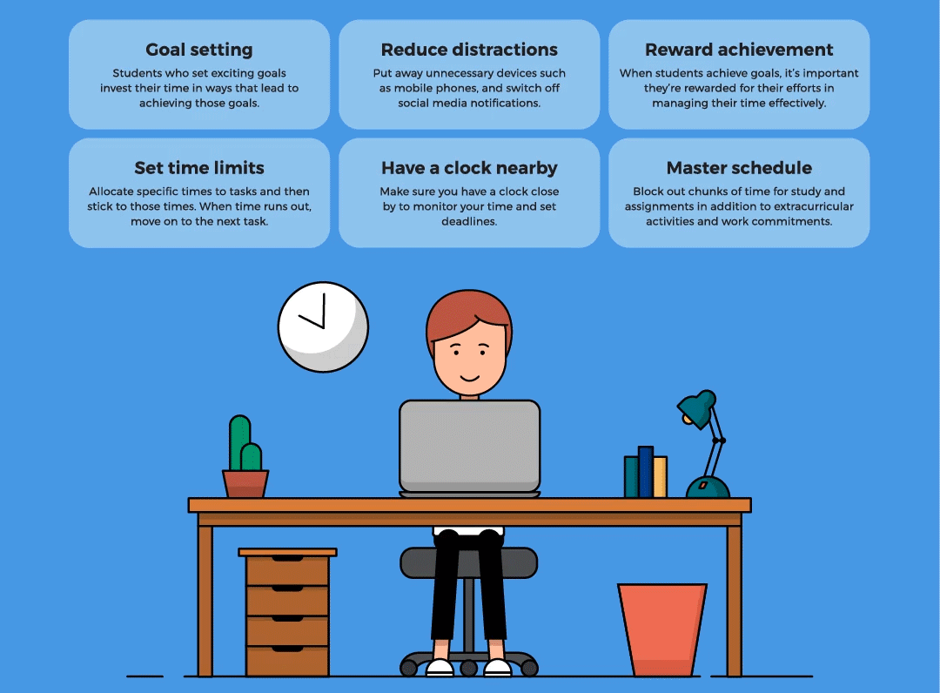
How can TIME MANAGEMENT potentially help you organise your time?
Reflection…
Notes:
Allow a few moments for Learners to think how they can apply what they have learnt so far. (page 6 of workbook)
You can have a short talk about what they could do, what would they use.

Slide 8
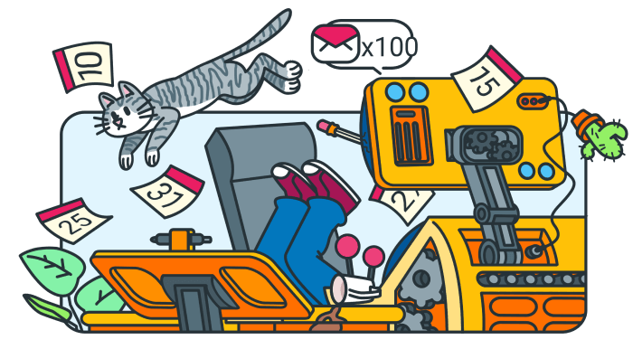
Time Management gone wrong…
Notes:
Go through Tim’s scenario titled “Time Management gone wrong” give learners a few minutes to complete the two questions attached to the case study. (see page 7 of Workbook)
Use this as an extension opportunity to ask questions , hep guide the class on what the story is telling them.

Slide 9

ACCOUNTABILITY
Any ideas??
  What does it mean?
  What does it mean specifically for teenagers?
Notes:
Take a few moments to discuss as a group what ACCOUNTABILITY means and what it means for teenagers

Slide 10

ACCOUNTABILITY
Simply put, when you're accountable, you take ownership of what happens because of your choices and actions.
You don't blame others or make excuses, and you do what you can to make amends when things go wrong.
To become more accountable, make sure that you are clear about your roles and responsibilities.
It also means that you are aware of what is expected of you .
Notes:
It is important to understand what it means to be accountable and why we can be held accountable. Ask Learners why they should be held accountable.
Give them a few moments to reflect on what it is and what they could be held accountable for in the reflection.

Slide 11

Questions & answers
Reflection:
  What should you be held accountable for? Why?
LEBO’s predicament:
  Is Lebo right? Why?
  What should he have differently?
Notes:
Give them a few moments to reflect on what it is and what they could be held accountable for in the reflection.
Lebo’s situation is next (page 8 of workbook), discuss the scenario and then let learners answer the questions.
When discussing the answers – it will be useful to bring into the conversation that learners are all responsible for their own learning. Part of being accountable for their own actions and being willing to accept the consequences of their actions – for example not being prepared for lessons, not studying for a test and not getting the grade you were hoping for.

Slide 12

Notes:
Finally ask learners if they have any questions or comments – remember that in LO learners need to ask questions, sometimes these concepts may seem a bit abstract for them. Let them assimilate what you've covered and move onto the Class Activity at the end of Lesson 1. See page 9 of workbook.

