Slide 1
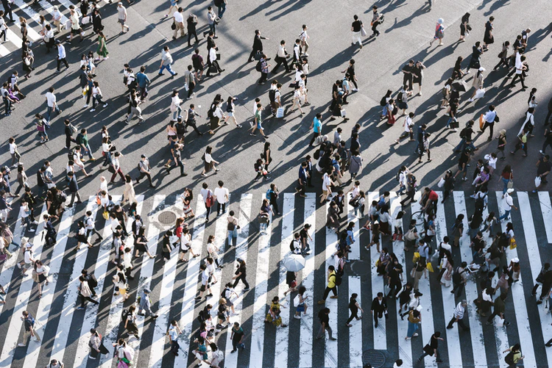

DEMOCRACY AND HUMAN RIGHTS
LESSON ONE

Slide 2
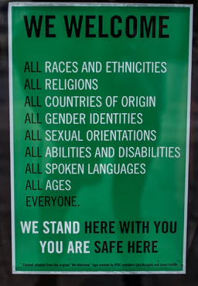
Diversity means being different.
DIVERSITY
Diversity means being different.
We are different in many ways:
Religion and belief system
Race
Language
Gender
Age
Health status
Place of birth
Culture
Where you stay, etc.
Notes:
Diversity means being different.
Culture
Religion and belief system
Race
Language
Gender
Age
Health status
Place of birth
Where you stay, etc.
This picture is of a sign outside a shop / restaurant. It shows how everyone is welcome, listing how we can be different from one another.

Slide 3
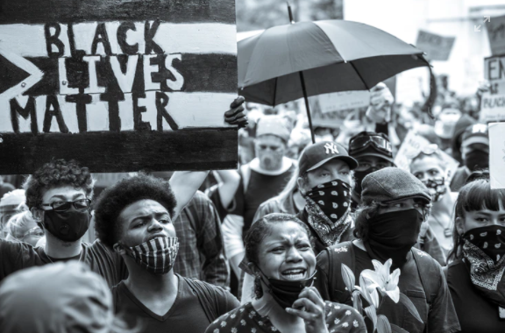
Discrimination means to treat people unfairly and differently. Discrimination denies people their rights, power and privileges. To discriminate is to violate human rights.
Notes:
Discrimination means to treat people unfairly and differently. Discrimination denies people their rights, power and privileges. To discriminate is to violate human rights.
This picture shows people protesting as part of the Black Lives Matter movement. For years people have been discriminated against and treated unfairly because of their black skin. This movement is protesting this discrimination.

Slide 4
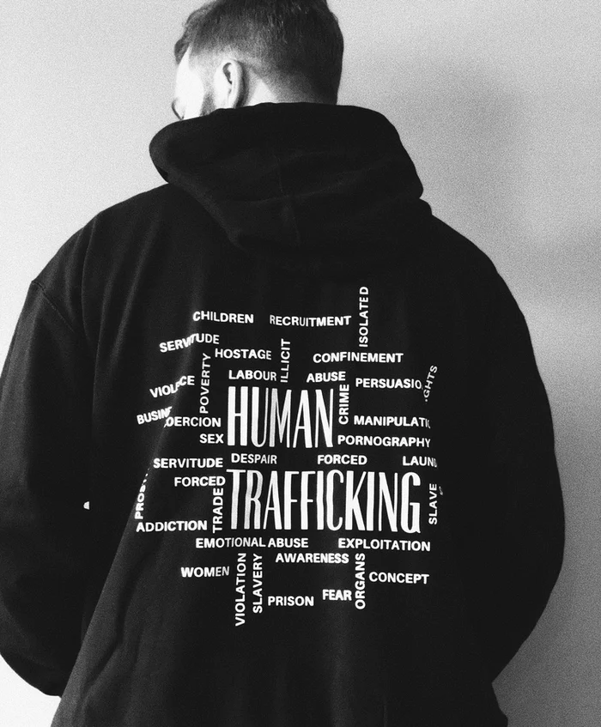
Violation of human rights:
To violate the human rights is to deny individuals their fundamental rights. It is, in a sense, to treat them as if they are less than human and undeserving of respect and dignity.
Notes:
Violation of human rights: To violate the most basic human rights is to deny individuals their fundamental rights. It is, in a sense, to treat them as if they are less than human and undeserving of respect and dignity.
An example of human rights violations is human trafficking
Human trafficking is the global illegal transport of people across international and local boarders. To be trafficked means to be taken against your will or tricked into going with traffickers or criminals who then sell you. You may be bought, sold, and transported into slavery.

Slide 5
OTHER IMPORTANT CONCEPTS FOR THIS LESSON SERIES
Prejudice | A preconceived opinion that is not based on reason or actual experience.
Racism | To discriminate against someone because of their race
Bias | To give someone or a group unfair preference or favour them unfairly

Slide 6
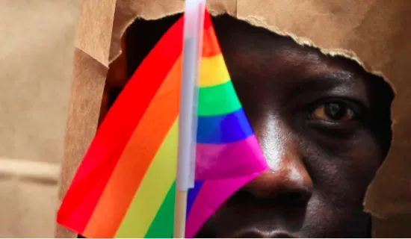
LGBTQI

Slide 7
LESBIAN, GAY AND BISEXUAL
The L, G, and B refer to sexual orientation,
who a person feels romantically and/or sexually attracted to.
Lesbian = a woman who is sexually attracted to other women.
Gay = a man who is sexually attracted to other men.
Bisexual = a man/woman who is sexually attracted to both genders.

Slide 8
TRANS
The T refers to gender identity and expression.
QUEER
Queer is a multi-faceted word that is used in different ways and means
different things to different people:
1) Attraction to people of many genders.
2) Don’t conform to cultural norms around gender and/or sexuality.
3) A general term referring to all non-heterosexual people. Some within the community, however, may feel the word has been hatefully used against them for too long and are reluctant to embrace it.

Slide 9
INTERSEX
Intersex people are individuals born with any of several variations in sex characteristics including chromosomes, gonads, sex hormones or genitals that do not fit the typical definitions for male or female bodies.

Slide 10
DEMOCRACY AND HUMAN RIGHTS
LESSON TWO

Slide 11
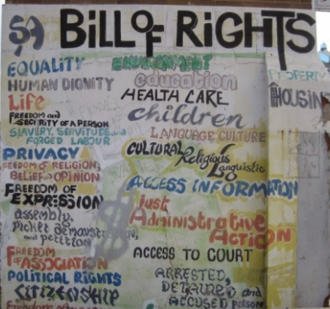
Bill of Rights:
Chapter 2 of our constitution. Chapter 2 contains the human rights which will be protected in South Africa.
These rights are based on dignity, democracy, equality and freedom.
Notes:
Bill of Rights: Chapter 2 of our constitution. Chapter 2 contains the human rights which will be protected in South Africa. These rights are based on dignity, democracy, equality and freedom.
This picture shows graffiti art of the Bill of Rights.

Slide 12
International Conventions and Instruments:
Convention on the Rights of the Child
The Committee on the Elimination of Discrimination Against Women (CEDAW)
Notes:
International Conventions and Instruments:
- Convention on the Rights of the Child;
- Committee on the Elimination of Discrimination Against Women (CEDAW)

Slide 13

The United Nations Convention on the Rights of the Child (UNCRC)
This is a legally-binding international agreement setting out the civil, political, economic, social and cultural rights of every child, regardless of their race, religion or abilities.
Notes:
The Convention on the Rights of the Child sets out the rights that must be realized for children to develop to their full potential.
The Convention recognizes the fundamental human dignity of all children and the urgency of ensuring their well-being and development.

Slide 14
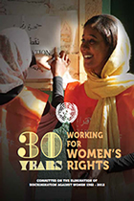
2. The Committee on the Elimination of Discrimination Against Women (CEDAW)
The Committee on the Elimination of Discrimination against Women (CEDAW) is the body of independent experts that monitors implementation the human rights for woman, protecting them from discrimination.
CEDAW Committee consists of 23 experts on women’s rights from around the world.
Notes:
The Convention on the Elimination of All Forms of Discrimination against Women (CEDAW), adopted in 1979 by the UN General Assembly, is often described as an international bill of rights for women. Consisting of a preamble and 30 articles, it defines what constitutes discrimination against women and sets up an agenda for national action to end such discrimination.

Slide 15

IN PAIRS, DISCUSS THE FOLLOWING:
GIVE TWO REASONS WHY THE BILL OF RIGHTS IS SO IMPORTANT?
HOW HAS THE WORK OF ORGANIZATIONS THAT FIGHT FOR HUMAN RIGHTS OF CHILDREN AND WOMEN BEEN IMPACTED BY THE COVID 19 PANDEMIC?
YOU HAVE FIVE MINUTES TO DISCUSS THESE QUESTIONS. PREPARE TO FEEDBACK TO THE CLASS.
Notes:
QUESTION 1
GIVE TWO REASONS WHY THE BILL OF RIGHTS IS SO IMPORTANT?
QUESTION 2:
HOW HAS THE WORK OF ORGANIZATIONS THAT FIGHT FOR HUMAN RIGHTS OF CHILDREN AND WOMEN BEEN IMPACTED BY THE COVID 19 PANDEMIC?

Slide 16
DEMOCRACY AND HUMAN RIGHTS
LESSON THREE

Slide 17
BIAS:
Bias is a tendency to lean in a certain direction,
either in favor of or against a particular thing.
To be truly biased means to lack a neutral viewpoint on a particular topic.
OPPRESSION
prolonged cruel or unjust treatment or exercise of authority.
PREJUDICE
Prejudice is an unjustified or incorrect attitude (usually negative) towards an individual based solely on the individual's membership of a social group.
For example, a person may hold prejudiced views towards a certain race or gender etc. (e.g. sexist).

