Slide 1





Term 1
Grd 9: Development of Self in Society
Lesson 1 - Sexual behaviour and sexual health
Notes:
Slide 1 - Intro 5min
Note to teacher
- make sure your class is divided into groups of SIX learners each before you start this lesson. Each group must nominate a leader to report to the group their answers.
- create and email address or google form where learners can send questions to that they would like answers on during these four lessons. You could even continue this approach throughout the year for discussing sensitive topics. Explain to learners that this is completely anonymous, and you will be the only person receiving these emails. Free email accounts can be made on gmail / yahoo/ hotmail). Print out this email address or Google Form Link on the Lesson 1- Email Poster and keep it in a visible area of the class. IF learners don’t have access to email, keep an old shoe box in your class that could act as a class postbox. Learners can pop their questions in this box at any stage without adding their name. Make time in the lessons to respond to some of these questions if they are not covered in the content.
As the educator, make sure:
Learners must know that the classroom is SAFE PLACE, and everyone must show respect for all kinds of differences.
You could encourage learners to keep a journal to write down all questions that they are uncomfortable to ask in class.
Concepts must be used to consolidate your teaching and you should always monitor the learners’ understanding of the concepts.
Manage diversity in a sensitive way to accommodate barriers to learning and teaching, different age groups and experiences.
Language (to accommodate all language levels of learners is not possible, the language competency levels of learners is too diverse however you should aim to facilitate in such a way that meaningful learning does take place.)
Slide 1: Welcome to a new series of lessons Grade 9’s. Today we will start a new section that will run over four lessons. These discussions might make some of you feel a little uncomfortable and shy. Remember that you do not need to know all the answers and having questions is always good. If you feel embarrassed by your questions, you are welcome to put an anonymous note in the post-box or email this address ___________________.
Let’s get started!
By now, hopefully you would have settled into your grade 9 year at school, made new friends, maybe even noticed a good looking guy or girl in your friendship circles or community? This is completely normal!
Last year in Life Orientation we looked at understanding what sexuality is compared to sex. This year we are going to look at how to look after you sexual health. You are a young adult now and some of you might find that you are experiencing feelings of attraction toward someone else.
Remember that all choices have consequences. They could have a positive impact when making a healthy choice or a negative impact when making an unhealthy choice. Example: choosing to hang out drinking alcohol with friends lowers inhibitions and you could do something physically with someone you would normally not do when sober. Then you’ll have to deal with the embarrassment and possible pregnancy from that choice.
In your groups, can you think of specific examples of where positive behaviour has impacted on physical, emotional or sexual health.
(Allow only 2 minutes for learners to discuss in their groups, then give opportunity for one or two groups to respond in the class.)
You need to develop standards for yourself by which you will live your life that protects your physical, emotional and sexual health. These standards are influenced by your physical health, self-image, quality of the relationships you have with others and your values.
The choice is now yours! You choose the future of your own sexual health. Let’s get started by looking at WHAT you need to be informed about to make the correct choices.
Teacher NOTE: Remind learners of Weeks 1 - 3 where discussed different Influences on Personal Lifestyle Choices esp family, culture, religion, community, friends, peers, environment and the media.

Slide 2

Risk factors that lead to unhealthy sexual behaviour
Believing that nothing bad will happen to you even if you take risks.
Believing you need to do something to be accepted by your peers.
Believing you have no control or say over what happens to you.
Living in poverty often feels like you have no choice. And choices are made to survive.
The use of drugs/and alcohol inhibits your ability to make wise decisions.
Notes:
Slide 2: 5min - teaching
As we mentioned in the previous slide, you develop standards for yourself by which you will live your life that protects your physical, emotional and sexual health.
Risk factors are those things that impact you to making poor choices about your sexual behaviour. These choices could place you at risk and lead to unhealthy sexual behaviour.
Here are some common beliefs of teenagers:
Believing that nothing bad will happen to you even if you take risks. Example: Having sex without contraception and believing that pregnancy won’t happen to them.
Believing you need to do something to be accepted by your peers. Example: Boys that believe to be accepted and “cool” amongst their peers they must have sex with a girl
Believing you have no control or say over what happens to you. Example: Feeling so insecure in yourself that you can’t say no to unhealthy sexual attention.
The use of drugs / and alcohol inhibits your ability to make wise decisions.
Take a few minutes to write these choices / risk factors into Activity 1 on your Lesson 1 - Worksheet.

Slide 3

When you don’t say to unhealthy sexual behaviour
NO
TEEN PREGNANCY
SEXUALLY TRANSMITTED INFECTIONS (STIs)
HIV and AIDS
LOW SELF-IMAGE
EMOTIONAL SCARS
Notes:
Slide 3-5 Teaching and Activtiy :10m
Unhealthy sexual behaviour will result in serious outcomes that you DONT want. These include:
Teen Pregnancy
Sexually Transmitted Infections (STIs)
HIV and AIDS
Low self-image
Emotional scars
Let’s take a look at each of these outcomes separately.

Slide 4
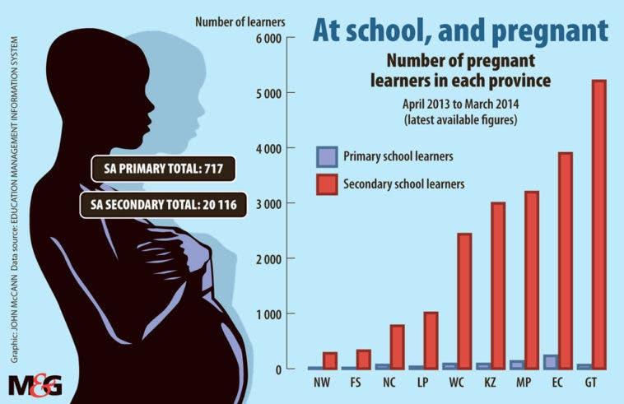
APRIL 2013 – MARCH 2014
OUTCOME 1- TEEN PREGNANCY
Notes:
Slide 4-5 teaching and class discussion in response to the data
As you can see from this graph, teen pregnancy is a huge problem in South Africa. Young people are sexually active and are not using contraceptives.
Can anyone tell me the different kinds of contraceptives you get? (3min for the class to respond)
Some women feel that using the pill will make them fat or that it will stop them from falling pregnant as an adult. This is a myth. Some men think that women need to be responsible and prevent pregnancy. This is dangerous thinking as STI’s can still be transmitted.
Let’s look at the statistics on this slide for a moment. Graph Source: https://mg.co.za/article/2017-03-10-00-back-to-school-for-gymslip-mothers/
Take note the data is drawn from 20833 teen pregnancy cases. We know that 717 come from primary schools … that means the learners were mostly under 13 years old. Imagine being a parent in primary school?
Looking at the graph:
-Which province has the greatest number of pregnancies? (Ask the class to respond)
-How many pregnancies did they have? (Above 5000) That means about 14 teen girls would fall pregnant a day in Gauteng.
Many of them had difficult decisions to make. Some kept the baby but struggled tremendously, dropping out of school. Some had abortions (where they chose to terminate the life of their unborn child) and some gave their baby up for adoption (where the baby went to another family who would raise them as their own). All three outcomes are emotionally traumatic for the young parents involved.

Slide 5
South Africa Teenage Pregnancy Spikes During Pandemic
South Africa's teenage pregnancy rate has jumped 60% amid the COVID-19 pandemic, an increase affecting the education of many young women and their hopes to escape the cycle of poverty.
When schoolgirls in South Africa become pregnant, only one-third return to class — a major factor contributing to socioeconomic disadvantage among youth.
Implementation of sex education programs was abandoned in the face of resistance by many parents, says Mugwena Maluleke, the head of a South African teachers' union.
"When it was supposed to be introduced, the sexuality education, the communities started to make a lot of arguments, so it had to be stopped and, therefore, the training didn't take place," Maluleke said. "The communities were not happy with that, and we are seeing the consequences of not having sexuality education; is the highest rate of teenage pregnancy."
OUTCOME 1- TEEN PREGNANCY
https://www.voanews.com/a/south-africa-teenage-pregnancy-spikes-during-pandemic-/6333967.html
Notes:
Slide 5
If we take the statistics from the previous slide and see the impact of the pandemic. A 60% increase means that we have 92 young teenage women falling pregnant every day in South Africa.This article states that lack of education has been a contributing factor.
In your groups, discuss FIVE other possible factors / reasons why the statistics have increased. Each group will have a leader to provide feedback to the class. (Allow 3min for discussion and then choose two groups to give feedback.)

Slide 6
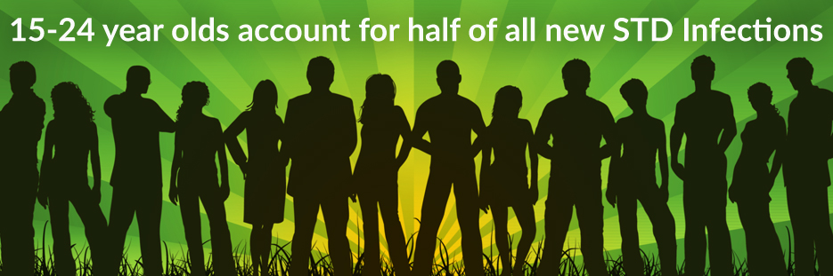
OUTCOME 2-SEXUALLY TRANSMITTED INFECTIONS
While sexually transmitted diseases (STDs) affect individuals of all ages, STDs take a particularly heavy toll on young people. CDC estimates that youth ages 15-24 account for almost half of the 26 million new sexually transmitted infections that occurred in the United States in 2018.
Notes:
Slide 6- Activity 10min
Teen pregnancy is not the only result of unhealthy sexual behaviour. It is disturbing to see that half of the 26million new infections in America are teenagers. These diseases are transmitted because a person with an STI had sex with another person without using a condom. Without treatment, they can cause very serious problems which include impotency and in some cases even death.
Many of the STI’s have similar symptoms. What do some of the symptoms looks like? (Ask learners if they know the answer?)
Guide learners towards Activity 2 in their Lesson 1 - Worksheet. They will need to read the extract and respond by writing a letter once they have completed the reading. Allow only 10min for Activity 2. Tell learners they can finish for homework if not completed in time.

Slide 7
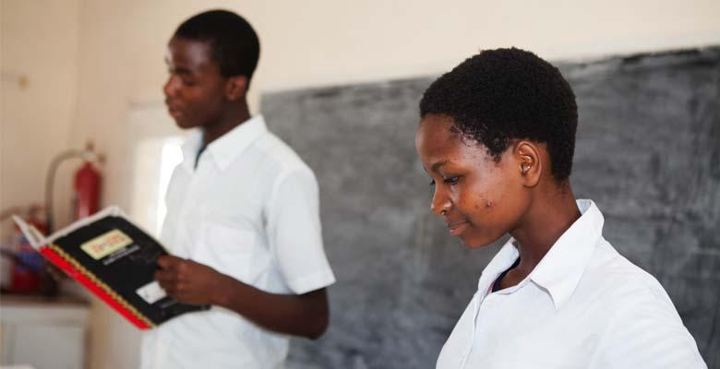
The medical advances that have transformed HIV treatment have yet to alter the stark reality for young people, particularly in low to middle-income countries, such as those in sub-Saharan Africa, and young people within key populations. While AIDS related deaths have halved in children since 2010, they have only fallen by 5% in adolescents. AIDS, in other words, is far from over - especially for young people.
OUTCOME 3- HIV & YOUNG PEOPLE
https://www.avert.org/professionals/hiv-social-issues/key-affected-populations/young-people
Notes:
Slide 7-9- teaching 7min
Note to teacher - start by reading slide 7:
“The medical advances that have transformed HIV treatment have yet to alter the stark reality for young people, particularly in low to middle-income countries, such as those in sub-Saharan Africa, and young people within key populations. While AIDS related deaths have halved in children since 2010, they have only fallen by 5% in adolescents. AIDS, in other words, is far from over - especially for young people.”
HIV and AIDS is still very much a problem amongst teenagers. In the same way that an STI is transmitted, HIV infections are a result of unprotected sex. If you become infected, your immune system becomes weak and you cannot be protected from other infections or diseases.
Think about what you want in your life. Remember your choices will have consequences!!

Slide 8

OUTCOME 4- LOW SELF-IMAGE
Notes:
Slide 8- teaching
All the effects we have looked at so far are purely physical in their impact. Unhealthy sexual behaviour also impacts your self-image. It could make you feel bad about yourself and lower your self-image. You could feel disappointed, ashamed, scared and blame yourself for making poor decisions. Having a low self-esteem can impact your decision making and be dangerous and damaging to yourself e.g. cutting or struggling with severe depression.

Slide 9
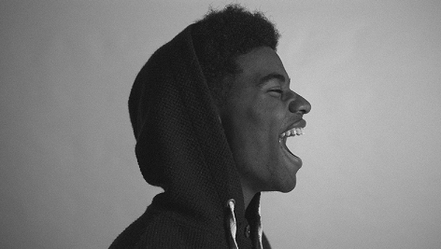
OUTCOME 5- EMOTIONAL SCARS
Notes:
Slide 9
The impact of these choices may result in a quick solution to the problem (like having an abortion), but you need to know that these choices leave emotional scars. An emotional scar is a mental or emotional pain that you carry for a long time. For many it’s the rest of their lives without seeking help from counsellors to deal with the pain. Some teenagers struggle with this pain and find it difficult to go back to normal life. They pull away from friends and partners, often becoming depressed.
Maybe you have had an experience in your life that has caused you an emotional scar…
Please reach out, either contact a counsellor or email the virtual postbox (Lesson 1 – Email Poster) to ask for advice on what to do. You are still young, deal with your emotional scars while you are young so you can move forward in life.

Slide 10
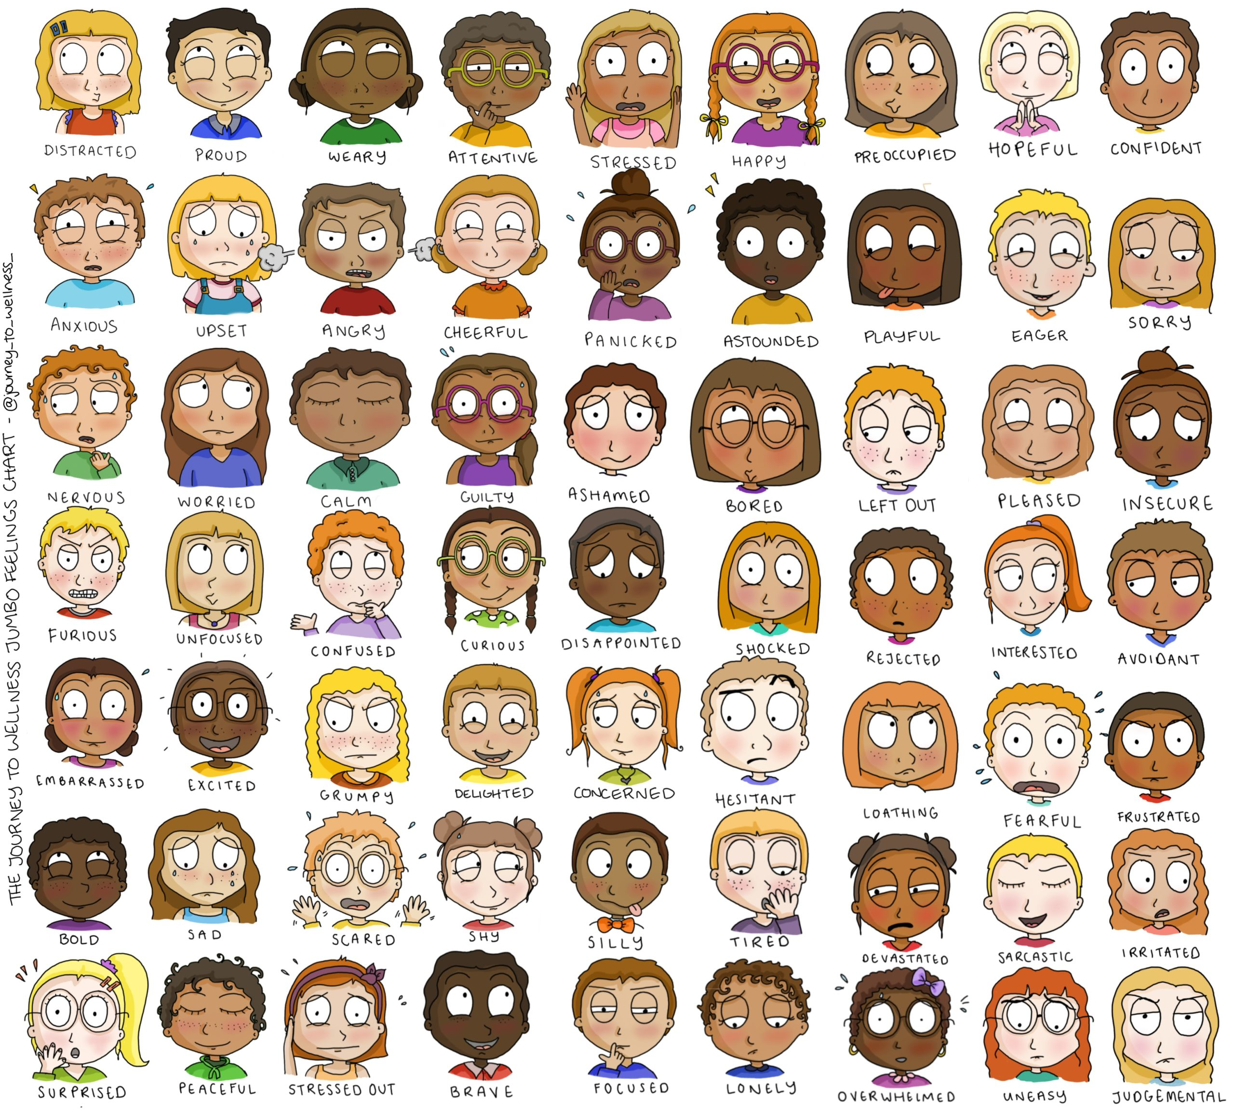
REFLECTION
How do I feel?
Notes:
Slide 10: 3min Reflection
We have come to the end of this lesson. It is never easy addressing a sensitive and uncomfortable topic like sexual habits and unhealthy sexual behaviour. Take a moment to reflect on how you feel about the work you have covered in this lesson. Complete Activity 3 on Lesson 1 – Worksheet.
Note to Teacher: Encourage the class to be quite in this time. It might even help to play music.
Tell the class to remain quite until you say they can talk. It is an opportunity for you as the teacher to also observe your learners and check that they are ok. If some seem a bit upset, consider approaching them secretly or referring to the school counsellor. Do not embarrass them by publicly addressing their emotional response!

