Slide 1

Different Learning Styles
Visual, Auditory, Kinaesthetic

Slide 2
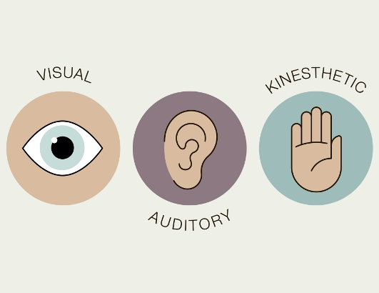
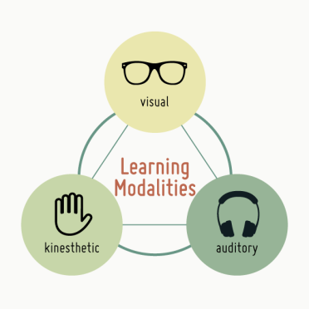
VAK Learning Styles
Visual: a visually-dominant learner absorbs and retains information better when it is presented in pictures, diagrams and charts.
Auditory: an auditory-dominant learner prefers listening to what is being presented. He or she responds best to voices, for example, in a lecture or group discussion.
Kinesthetic: a kinesthetic-dominant learner prefers a physical experience. She/ he likes a "hands-on" approach and responds well to being able to touch or feel an object or learning prop.

Slide 3
VARK
A variation on the acronym, developed by New Zealand-based teacher Neil D. Fleming, is VARK®, or visual, auditory, reading/writing, and kinesthetic:
Reading/Writing: a reading- or writing-dominant learner uses repetition of words and writing. Clearly, there is an overlap with visual and auditory styles, as words and writing can be both, but, commonly, a person who prefers to learn this way remembers or organizes things best in his mind by taking down notes.

Slide 4

Ideas for visual learners
Utilize graphic organizers such as charts, graphs, and diagrams.
Redraw your pages from memory.
Replace important words with symbols or initials.
Highlight/ underline important key terms in corresponding colors.
Study using pictures, videos, posters, slides, flowcharts
Get textbooks with diagrams and pictures
Use symbols @, #, & and white space
Reconstruct the images in different ways… try different spatial arrangements.
Look at your pages and see any patterns.

Slide 5

Ideas for Auditory Learners
Record your summarized notes and listen to them again
Talk it out. Have a discussion with others to expand upon your understanding of a topic.
Reread your notes and/or assignment out loud.
Explain your notes to your peers
Attend classes, discussions and tutorials (and pay attention)
Ask your teachers questions
Use a recording device (if you have permission)
Remember the interesting spoken examples, stories, jokes…
Describe the overheads, pictures and other visuals to somebody who was not there
Leave spaces in your notes for later recall and ‘filling.’

Slide 6

Ideas for Kinaesthetic Learners
Redo lab experiments or projects.
Utilize pictures and photographs that illustrate your idea.
Put plenty of examples into your summary. Use case studies and applications to help with principles and abstract concepts.
Talk about your notes with another “K” person.
Make use of all your senses – sight, touch, taste, smell, hearing …
Collect related items, e.g. rock types, plants, shells, grasses, etc.
Work through previous exam papers
Try to organize a field trip on the relevant topic.
Walk around or play with a stress ball whilst studying.

Slide 7


Ideas for Read and Write Learners
Re-write your notes and re-read your notes
Write out summaries of key concepts and ideas
Use subheadings, bullets and lists when organizing notes
Use colored pens and highlighters to focus in on key ideas
Translate into words key information on diagrams, graphs, charts
Study alone and in quiet areas to avoid distractions
Print out your notes for later review
Stick cards / post-it summaries in visible places (on the fridge, cupboard) to view regularly

Slide 8
Sources:
VARK Strategies: http://vark-learn.com/strategies/kinesthetic-strategies/
Mind Tools: Learning Styles https://www.mindtools.com/pages/article/vak-learning-styles.htm

