Slide 1


Notes:
Slide 1: Intro- 2min
Welcome back to the last lesson in this series. We have worked through to develop a comprehensive understanding of gender-based violence in South Africa as well as around the world. Today our focus is on the solution. We will look at strategies that have been used to address the unequal power relations and power inequality between genders.
We will start by working through an article in the mail and guardian that contextualises the problem we face in South Africa right now and how it impacts every province.
For the full article: https://mg.co.za/news/2020-08-27-real-action-on-gender-based-violence-a-pipe-dream-as-women-die-every-day/
Let’s get started!

Slide 2

Nearly a year ago, Portia* had to leave her little girl with a neighbour so she could run to the communal toilet. When she returned, her five-year-old was no longer with the neighbour but sitting inside their one-room house crying, traumatised. Portia asked her child what happened. She wouldn’t speak. Portia’s little girl was naked from the waist down.
“I asked her over and over again, what happened. Finally, she said that our neighbour hurt her. I could see her clothes were a mess. She wouldn’t stop crying,” said Portia.
She does not want the perpetrator to be named, even though he has appeared in court for sexual assault, because this might prompt an attack on her and her daughter.
The alleged perpetrator was released on bail a few days after his arrest in October last year. According to Portia, the magistrate said that they could not keep the alleged sex offender behind bars unless the forensic laboratory had returned the DNA results.
In the year since, there has been no progress in the case.
This is not unique.
Notes:
Slide 2
This exert is the opening of the M&G article which highlights how quickly gender-based violence can occur. It is incredibly sad that we have gotten to the point in South Africa where statistically a child OR women is abused everyday.

Slide 3
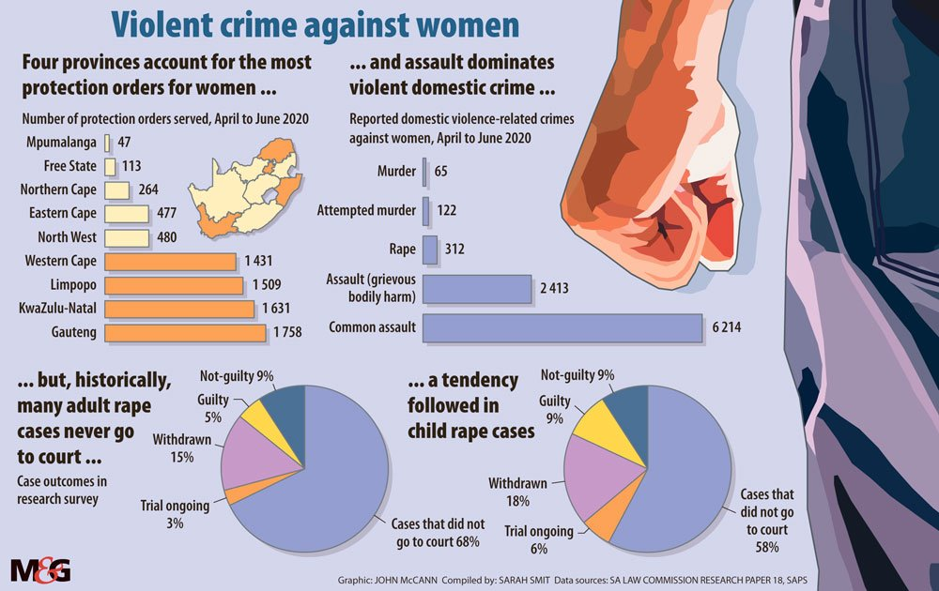
Notes:
Slide 3:
In your groups of four, study the data on this slide and answer the following questions?
Why was there an increase in protection orders issued from April to June 2020.
Why do you think cases get thrown out of court?
The article states:
1) “The statistics show that during the lockdown, the pattern of gender-based violence changed. Statistics presented to the Parliament’s portfolio committee on police on Wednesday revealed a 7.8% increase in reported contact crimes against women — from 24 723 in the first quarter of 2019-20 to 26 658 in the first quarter of 2020-21.
Between April and June this year, there were 65 femicides, 122 attempted femicides, 2 413 assaults with the intention of causing grievous bodily harm and 6 214 common assaults on women that were reported to the police. These crimes were all attributed to domestic violence. And these are just the reported crimes.”
2) “The police forensic science laboratory has a backlog of more than 35 000 specimens. This means that thousands of victims of gender-based violence, alive or dead, are waiting for justice.
The laboratory in the Western Cape has the highest backlog of the three main provinces, with 9 959 entries. The Eastern Cape has 1 433 entries, followed by KwaZulu-Natal with 1 222 entries. At national headquarters, the backlog sits at 22 430 specimen entries.
According to police spokesperson Colonel Brenda Muridili, the forensic laboratory receives an average of 1 463 gender-based-violence-related specimens for analysis every week. This equates to more than 200 cases a day.”

Slide 4
What are the causes of GBV in SA?
Vetten said there is no “magic bullet” to solving the country’s gender-based violence crisis. The debate around the connection between alcohol abuse and violence against women has a long history in South Africa, she said. “I think this is just the latest iteration in that history. There is certainly an association, but the association is not causality.”
But Cele is not the only minister making sweeping statements about the causes of gender-based violence. At a Women’s Month gathering, Deputy Minister of Social Development Hendrietta Bogopane-Zulu said that breast and testicular cancers are contributors to gender-based violence because all of these are sexually related.
Activist Onica Makwakwa said the deputy minister’s statement detracts from the real cause of gender-based violence: patriarchy.
Notes:
Slide 4:
We can see that this article highlights three main causes:
Alcohol abuse - adding and intensify more violence
Breast and testicular cancer - impacting sexual intimate relationships and causing frustration
Patriarchy - where the decisions are made by men within a society most often in the interests of men to the detriment of women.
In your groups, discuss whether you agree or disagree with these causes. Consider THREE changes your group would recommend to government to minimise GBV in SA.

Slide 5
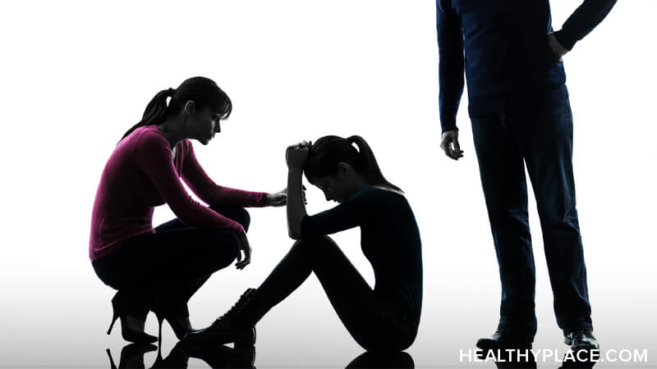
Sometimes we think we can’t make a difference because the problem is so big… well, make a difference to ONE person and you’ve already made an impact.
Notes:
Slide 5
Sometimes we think we cant make a difference because the problem is so big… well, make a difference to ONE person and you’ve already made an impact.

Slide 6








STRATEGIES to PREVENT/ REDUCE GBV
Notes:
Slide 6:
Many attempts have been made to improve the condition of gender-based violence around the world. You will have an opportunity now to further develop strategies relevant to South Africa.
The class should be divided into EIGHT groups. Assign ONE page of the Lesson 4 – Brainstorm Strategies to each group. Their page will include further information on strategies that have been implemented worldwide regarding their category (e.g. education, health care, faith-based, media etc). Each group needs to brainstorm THREE strategies that can be implemented in South Africa based on their category.
Remind learners that a strategy includes:
- a statement e.g. Create awareness campaigns on protecting your children against abusers.
- a detailed justifier- explaining how this can be done. e.g. putting posters up in shopping centres that give women advice on how to protect their children.
- end off with how this will impact e.g. this will enable women to know that they should not leave their children with strangers or people they don’t trust for fear of the danger of abuse.
Allow 7min for each group to brainstorm and then give each group 1min to propose their strategy to the class.
It is recommended to make copies of the Lesson 4 – Brainstorm Strategies document and for learners to insert these into their workbooks - as it provides great suggestions for answering these sections in an exam.
Hang the original brainstorms on the class wall

Slide 7

Ways to address and promote gender equality in our daily life:
Help individual women succeed to increase self-esteem and confidence.
Discuss gender equality with family members and children to empower them and raise awareness
Encourage financial inclusion of both genders.
Support women-owned businesses to ensure they succeed
Shop from companies and businesses that promote gender equality.
Promote gender equality at home by having discussions about it and living and keep all accountable.
Notes:
Slide 2
This exert is the opening of the M&G article which highlights how quickly gender-based violence can occur. It is incredibly sad that we have gotten to the point in South Africa where statistically a child OR women is abused everyday.

Slide 8

Notes:
Slide 8: Informal Assessment
Let’s see how well you have understood the terms covered today. Complete Activity 1 and Activity 2 in your Lesson 4 – Worksheet and mark individually using the Lesson 3 – Worksheet MEMO. Today you will have 10min to practice an essay question similar to the kind of question you would get in an end of year assessment.

Slide 9

Notes:
Slide 9 & 10- 3min
To wrap up the last FOUR lessons, remember:
Don’t be afraid to speak out about abuse. You need to be somebody that tells others to report abuse. Abusers cannot be stopped if we don’t say something. IF you are being abused:
Go to the police, report it! They can assist you with a restraining order. If you are under 18 years of age, they will put a social worker on your case to assist you.

Slide 10


REFLECTION
Why do you think some people find it difficult to report abuse? What advice would you give them?
What changes can you make in your own attitude towards gender-based violence in South Africa?
What changes can you make in your own attitude towards inequality in power relations and inequality in genders.
Notes:
Slide 10:
Allow 3min to take a moment to reflect on what they have learnt about themselves today.
Answer the following questions in Activity 3 (Lesson 4 – Worksheet):
- Why do you think some people find it difficult to report abuse? What advice would you give them?
What changes can you make in your own attitude towards gender-based violence in South Africa?
What changes can you make in your own attitude towards inequality in power relations and inequality in genders.
There are no memo answers to these questions. Make sure in this time the class is quiet. You can even play an instrumental song to encourage a quieting down and reflection.
Remind learners to make sure any outstanding notes and worksheets are up to date as a new section starts in the next lesson.

