Slide 1



Notes:
Slide 1 & 2: 5min
This is our lesson on this series on Careers and Career choices. I hope you have learnt enough to be able to apply to a tertiary institution after researching a career you are interested in. You should now have some skills to help find a job and start in the job market and include volunteering and other ways to gain skills and counteract unemployment.
In a world where people are working and earning an income and money is moving in and out of companies and government, unfortunately South Africa is riddled with stories of corruption. Corruption impacts you and me as citizens and this country and especially those struggling in poverty.

Slide 2


Notes:
Slide 2:
Let’s start by familiarising ourselves with some terminology around corruption. Listen carefully to these definitions and then see if you can complete Activity 1 on your Lesson 4 – Worksheet.
Corruption- is the misuse of public power and money for private gain.
Fraud- refers to when someone steals money from others through a scam, cheating or deceiving them
Cronyism- refers to the favouritism shown to friends regardless of their qualifications
Bribery- is to pay for an illegal favour.
Extortion- is to obtain money or favours through threats
Influence peddling- the illegal practice of using your influence in government or connections with persons in authority to receive information or benefits.
Nepotism- the practice among those with power or influence of favouring relatives or friends, especially by giving them jobs.
Embezzlement- theft or misappropriation of funds placed in one's trust or belonging to one's employer.

Slide 3
Corruption impacts:
Individuals
Companies
Communities
Country
Notes:
Slide 3 - 6: 15 min
(Encourage learners to write a key phrase from these descriptions onto their Lesson 4 – Worksheets.)
As we mentioned early corruption impacts everyone, but it corrupts the poor individual in the community the most. With the increase of corruption in society the cost of living increases as the cost of public services increase and the poor feel these increases the most. E.g. The poor using public hospitals and struggling to get help whereas those with money have medical aid and better healthcare benefits. The result is that hopelessness settles in because it seems as though unfair advantages are given to those who have money.
People within a company start to mistrust one another. The company or government gets a bad name. The company might have to spend a lot of money just to put measures in place to stop corruption. This money could have been better spent on improving social responsibility programs.
Communities are also hugely affected when corruption is prevalent. Many believe the only way to access services is through bribery or even threats. If bribery becomes common, others begin to believe this is a way of life and corruption is normal when you want to get something. E.g. a community member bribes someone else to push their name up on the waiting list for housing. The result could be a breakdown in community relations.
When a country is corrupt everyone is impacted, taxes increase and service deliveries fall apart. Money that was set apart for infrastructure improvement is used for something else where individuals benefit rather than the country. An example would be money given to companies run by friends to build roads. Roads are built of poor quality using cheap materials that are not acceptable, resulting in the roads falling apart in very little time.

Slide 4
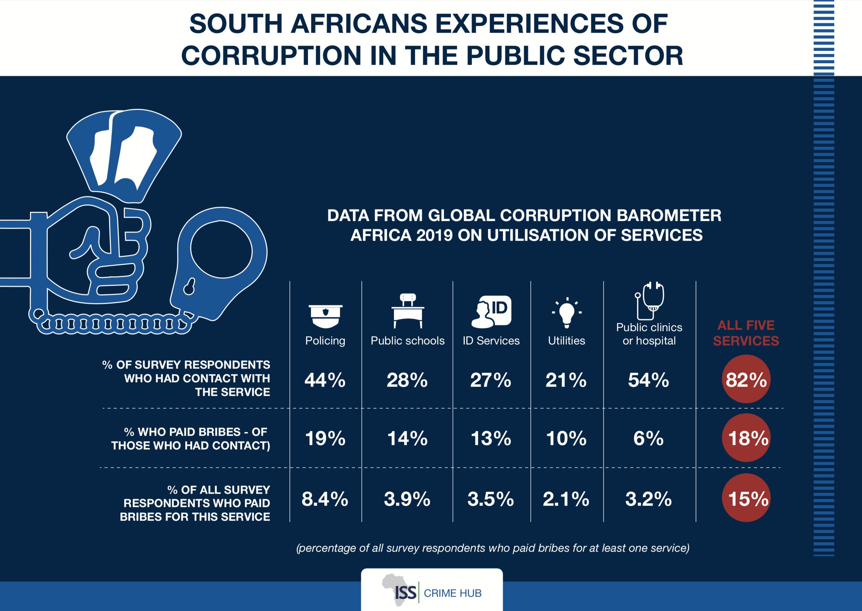
Notes:
Slide 4-6
Study the following images on the slides and answer the questions on your Activity sheet. A copy of the questions from the Lesson 4 – Worksheet can be found below:
Slide 4:
1.2.1 Identify the FIVE public sectors in which corruption was investigated:
1.2.2 Which public sector used bribery the most?
1.2.3 Give an example of what bribery could look like in a school environment.
1.2.4 Discuss TWO strategies that government could implement to curb bribery in the public sector.

Slide 5
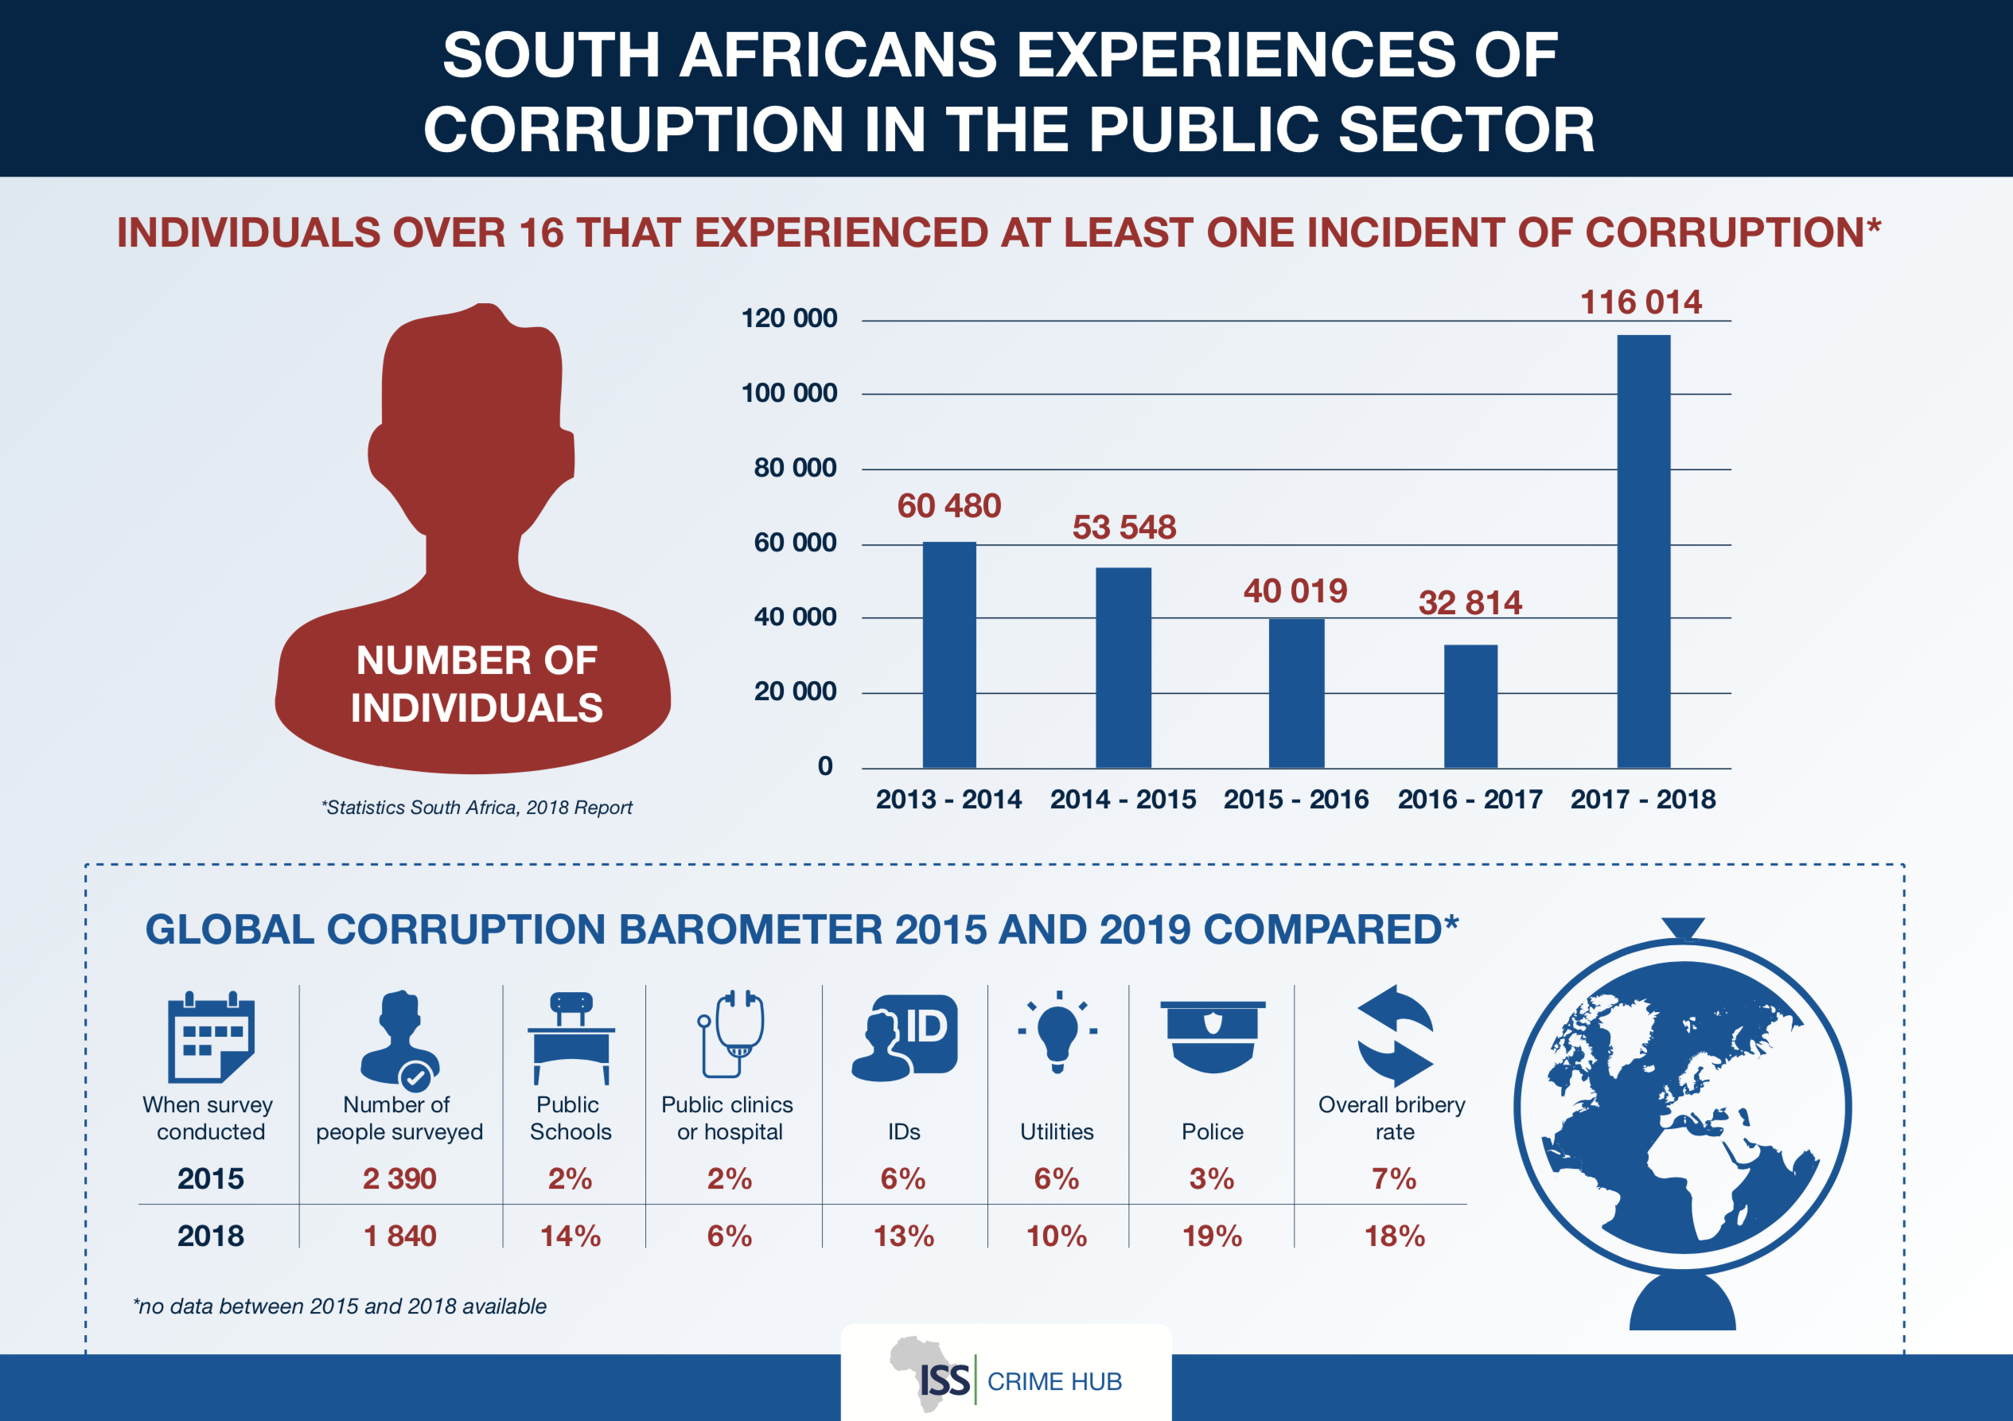
Notes:
Slide 5:
Worksheet Activity continues. A copy of the questions from the Lesson 4 – Worksheet can be found below:
Slide 5:
1.2.6 How many people took part in this survey?
1.2.7 Based on the barometer statistics below, which sector saw the least increase in corruption?

Slide 6
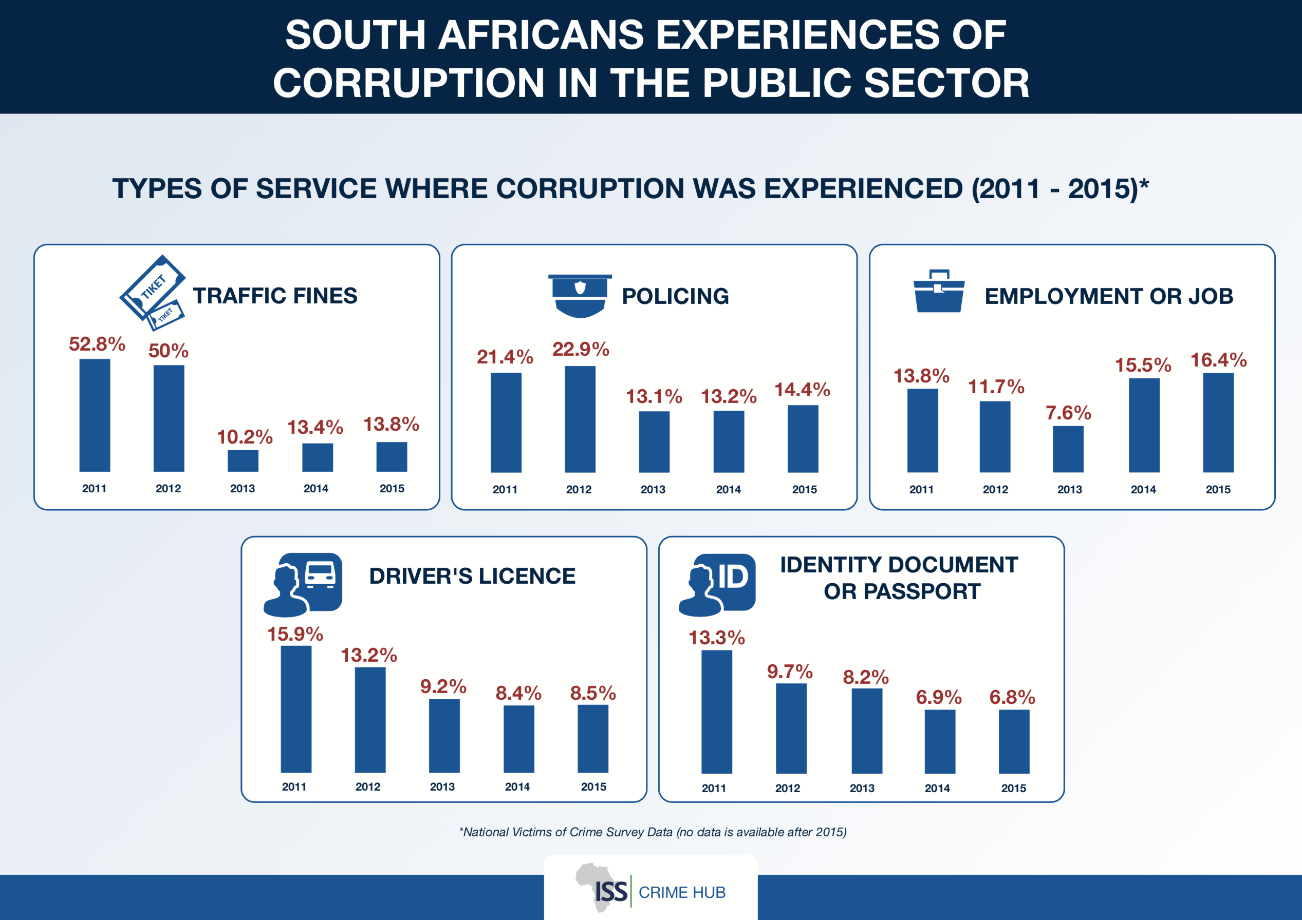
Notes:
Slide 6:
1.2.8 There has been a noted decrease in ID document and Drivers licenses corruption since 2011. Discuss the strategies government implemented that lead to this decrease in corruption in these sectors?

Slide 7
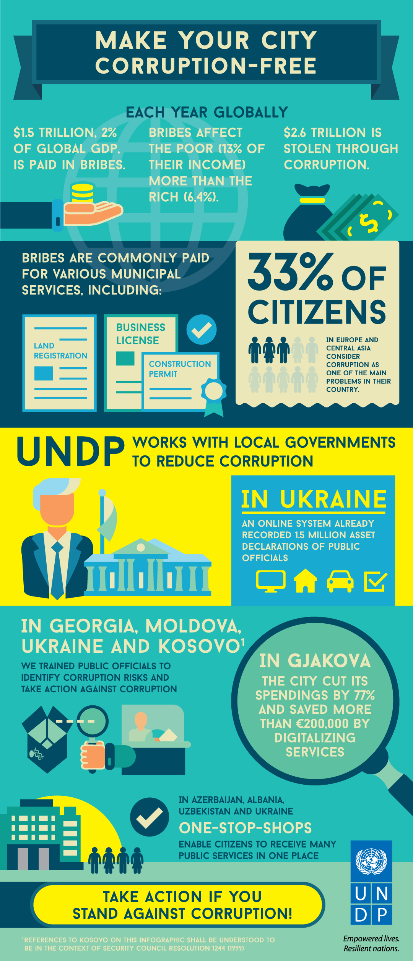
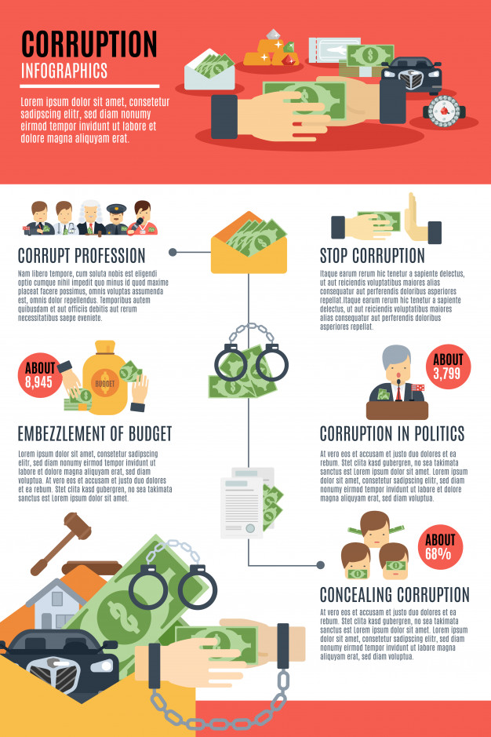
Corruption in South Africa
The Problem…
The Solution…
Notes:
Slide 7: 15min
(Although this activity is discussed as a group, you could adjust the activity so learners complete their own poster in their notebooks. Should learners complete it as a group rather, then make arrangements for the posters to be copied and placed in their notebook to study from.)
Encourage learners to get creative with this activity. They can use different coloured markers, illustrate some of their examples. Encourage them to place a heading at the top: Corruption in South Africa (causes and prevention)
Firstly learners should brainstorm these TWO questions in their groups:
Why do we have a problem with corruption and fraud in South Africa?
Strategies to prevent corruption. What can you do? What can government do? What can your community do?
Then use this information to create a poster on Corruption in South Africa and what we can do to deal with it? Create one poster as a group to illustrate your major points. This poster in the slide (Slide 7) is an example. Let’s see what each group comes up with.
Once everyone is finished, opportunity will be given to give feedback to the class.

Slide 8

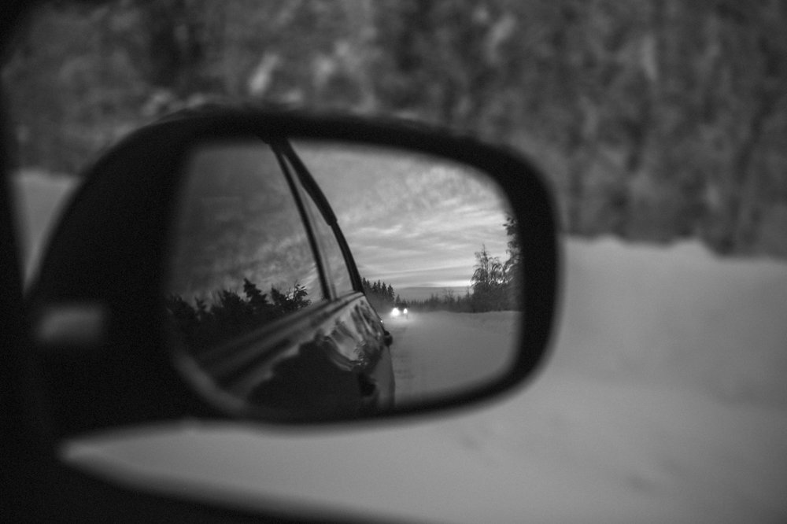
* Why do you think teenagers avoid reporting corruption when they see it amongst their peers - like selling drugs?
* How could you become a leader / activist who says NO to corruption amongst his / her peers and people in the local community?
Notes:
Slide 8: 5min
Allow 5min to take a moment to reflect on what they have learnt about themselves and their community today.
Answer the following questions:
* Why do you think teenagers avoid reporting corruption when they see it amongst their peers - like selling drugs?
* How could you become a leader / activist who says NO to corruption amongst his / her peers and people in the local community?
There are no memo answers to these questions. Make sure in this time the class is quiet. You can even play an instrumental song to encourage a quieting down and reflecting.

