Slide 1

Self Talk
Positive self-talk:
Individuality and uniqueness
and personal achievements

Slide 2
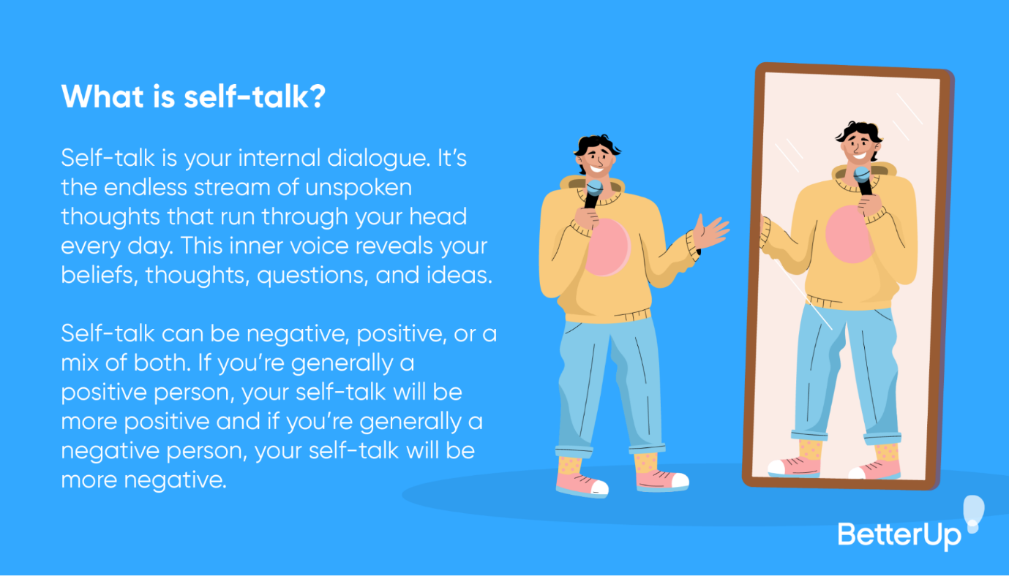
Notes:
Explain this concept – what it means. Our inner dialogue.

Slide 3
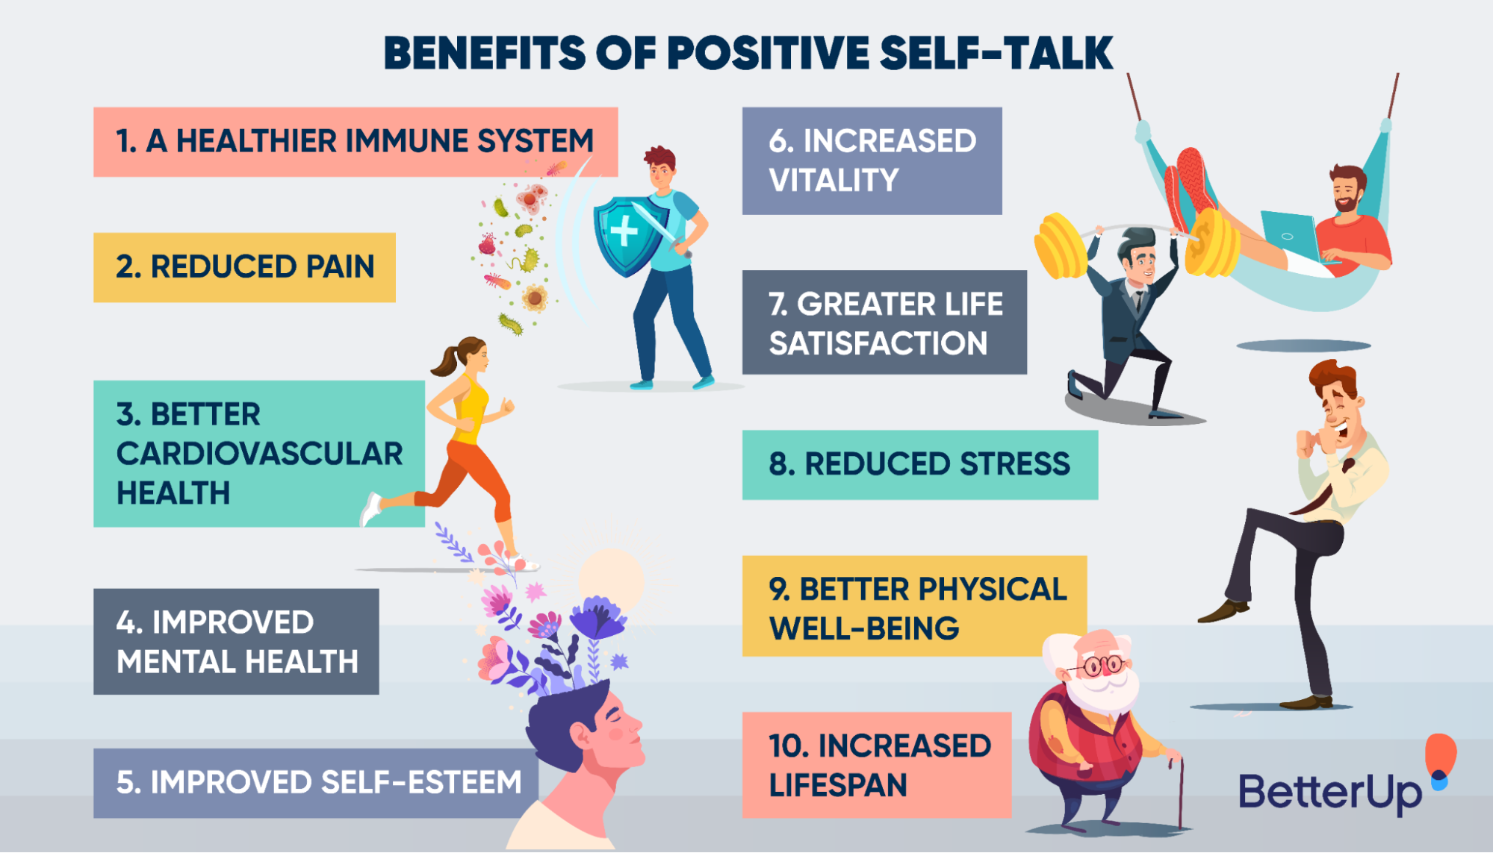
04

Slide 4
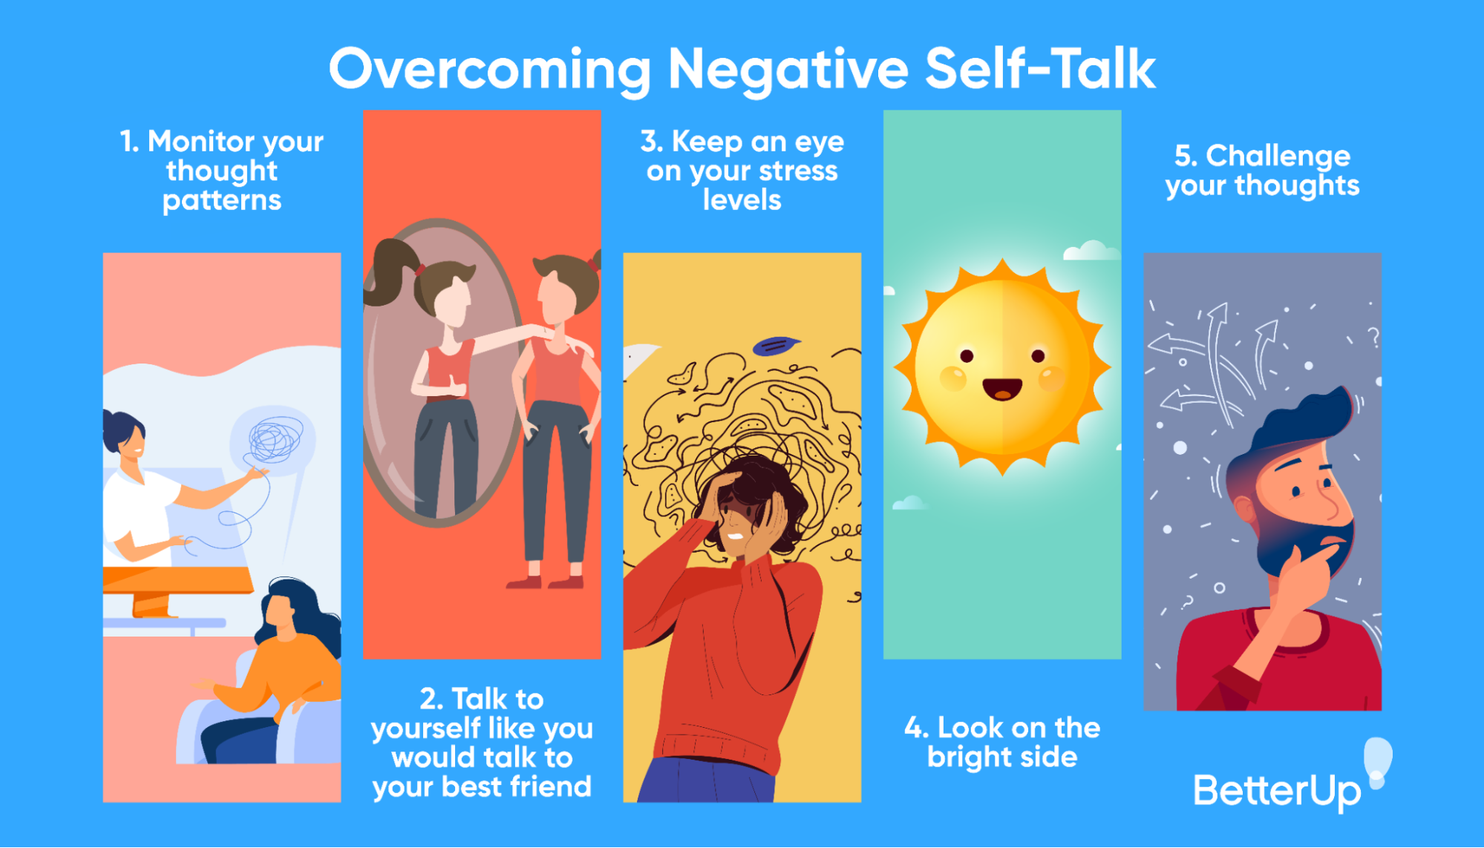

Slide 5
Jesus Apolinaris
“Self-talk should be a conversation of priority with oneself. It can be encouraging when having a positive outlook on life with your thoughts, beliefs, and ideas. Be Optimistic with positive thinking, and it can be an effective way to better your wellbeing with excellent outcomes in life. As a result, you will have greater life satisfaction.”
Notes:
Use this as a talking point, what it means and how we can apply it – Learners to write their answers in their workbook.

Slide 6
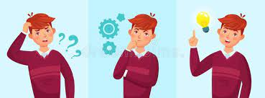

Slide 7
I AM…
Proud of my achievements
A unique individual
I have potential
EXCEPTIONAL!!
Celebrate your success, small or big – they mean something!
There isnt another YOU on this planet – you are one of a kind!
Yes you are!!
Appreciate the ability within yourself, draw on YOUR unique talents, abilities and strengths.

Slide 8
7 900 000 000
7,9 billion people on this planet –
and only one YOU. That is just how UNIQUE you are.
ONE of a KIND
Notes:
Stress the importance of the fact that each one of us is in fact 100% unique. Even twins, they may look the same- but there will be traits and characteristics that will set them spart.

