Slide 1
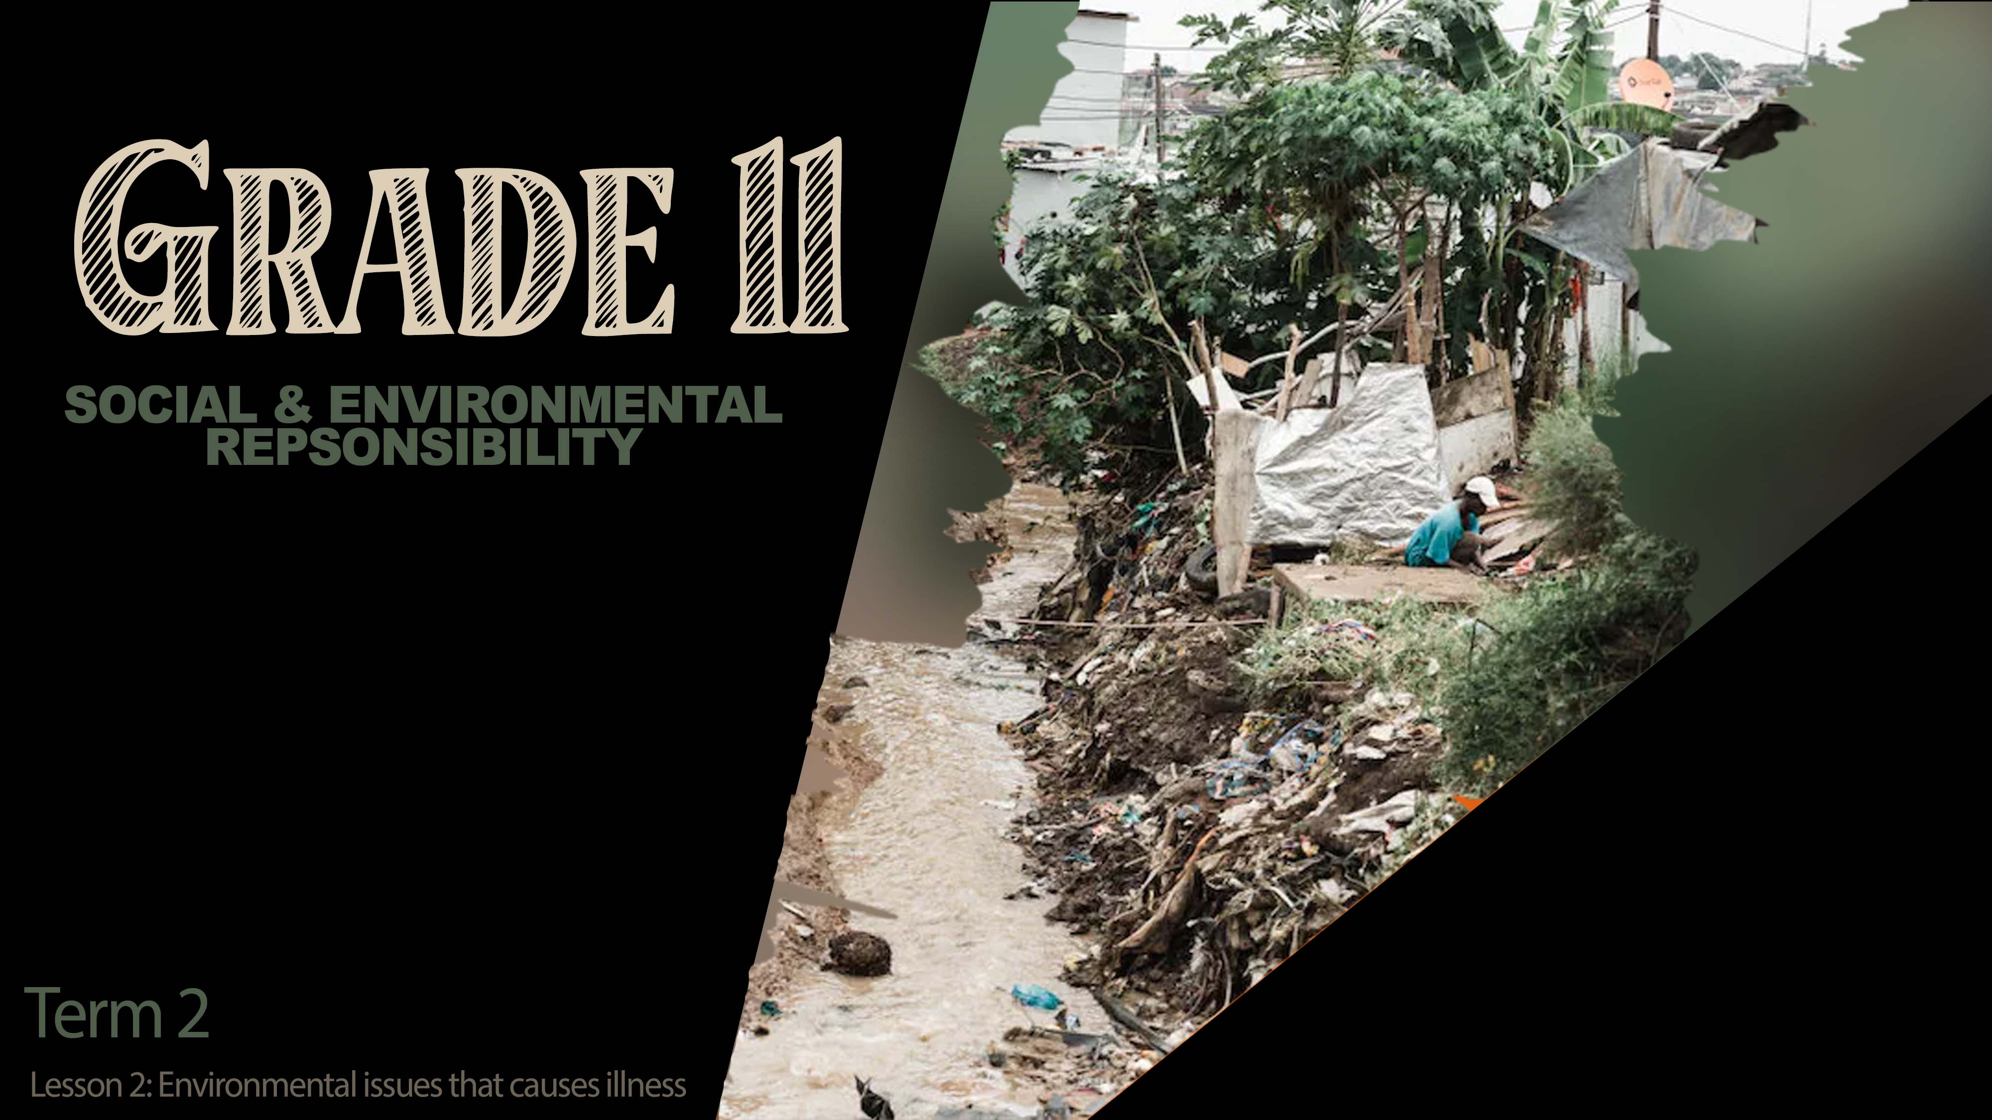

Notes:
Slide 1: 3 min intro and reflection on homework
Welcome back grade 11’s. In the previous lesson, we introduced this new section on social and environmental issues. You were required to bring two labels to class where you looked at the ingredients to see if any harmful substances were in these products. Turn to a person in your group and share with them in 30sec what you discovered by showing them your labels.
Today we continue by looking at the impact of the depletion of certain resources would have on humans. Let me use an example: A few years ago, in Cape town there was a drought that impacted the lives of many people. Water is not only used to drink but also in the production of many products. For months after the drought, there was a shortage of certain products in stores because they could not be mass produced without water.
When we have a large population of people on the planet and limited resources like fish, meat or trees, it will not be long before there are less and less resources for us to use.

Slide 2
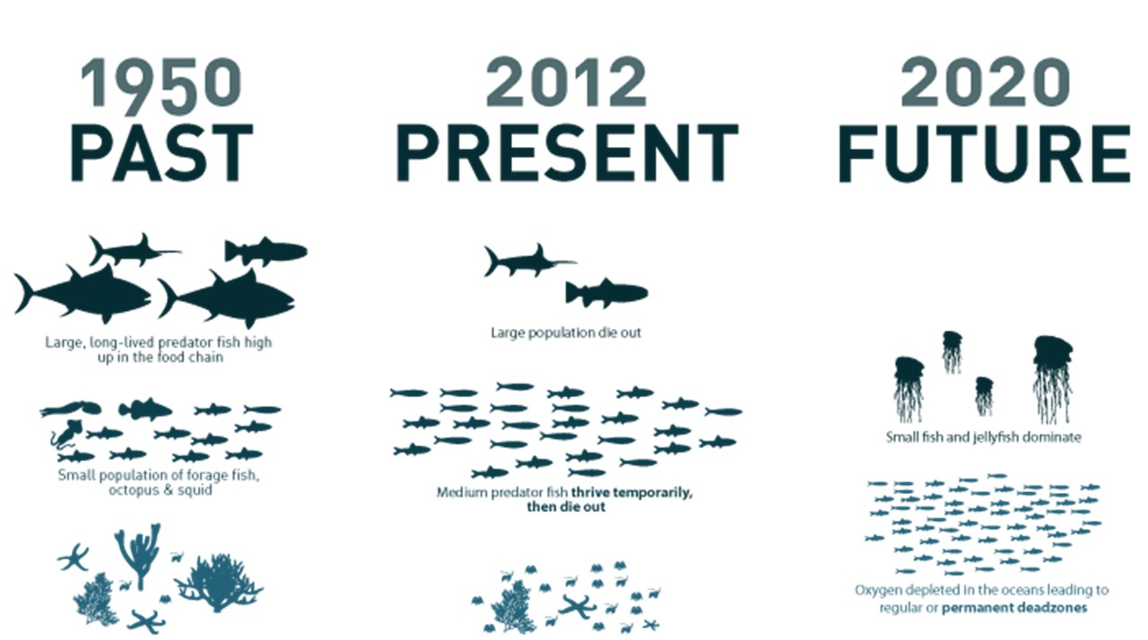
Notes:
Slide 2: 10min Individual Activity
Many people depend on the ocean to feed their families and prevent them from starvation. Overfishing is the concept of catching so many adult fish in the sea or in a dam that not enough remain to breed and increase again. We can see that since 1950 overfishing has had a radical impact on the ocean’s eco-system. With the decrease in fish numbers, families will be impacted as they don’t have food. Others that earned an income from selling their fish will no longer have a job.
On your Activity 1 (Lesson 2 – Worksheet) you will now have 10min to read the article and then answer the questions.

Slide 3
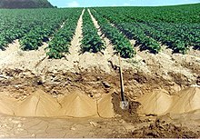
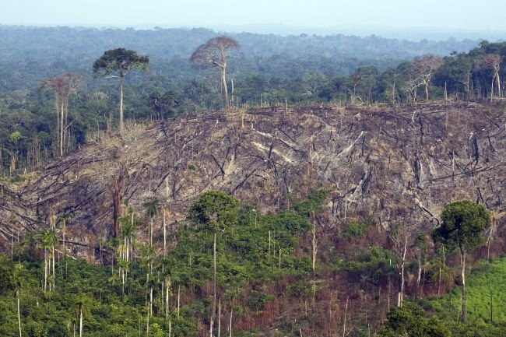

Firewood and soil depletion
Notes:
Slide 3: 5min Group Activity + 4min Individual Response + 3min Teaching
Other examples of resources that could be depleted would be firewood and land. In your groups, look at these images and discuss THREE ways that the impact of the depletion of these resources would have on local communities. Allow groups to give brief feedback to the class.
Based on the responses from the class, complete Activity 2 (Lesson 2 – Worksheet) by writing down THREE reasons from the group feedback that stood out for you.
To summarise:
People rely on firewood for heating and cooking. Some people will also cut down wood and sell firewood to earn an income. With the depletion of these resources, there will be less trees, which means less carbon dioxide will be removed from the atmosphere.
As more crops are planted on land and the soil is not given time to recover, this impacts the topsoil and then in the future, the crops won’t grow again. As areas become more populated, more houses and buildings go up and there is less place for natural resources like trees and plants to grow.
Remember that as these resources are depleted (whether it is fish, firewood or land), the health of those in the communities is impacted. Without fish, people will lack good nutrients and oils to keep them healthy. Without trees, there will be increased air pollution because of all the CO2 in the air. Without land to grow crops, people will get hungry as there wont be enough crops to feed all the people.
We need a positive attitude towards the environmental factors so that we contribute towards change rather than just ignore what is going on around us.

Slide 4
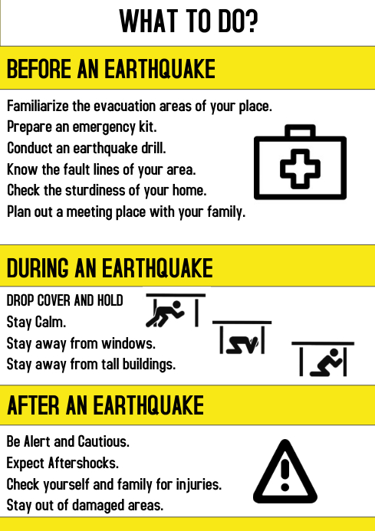
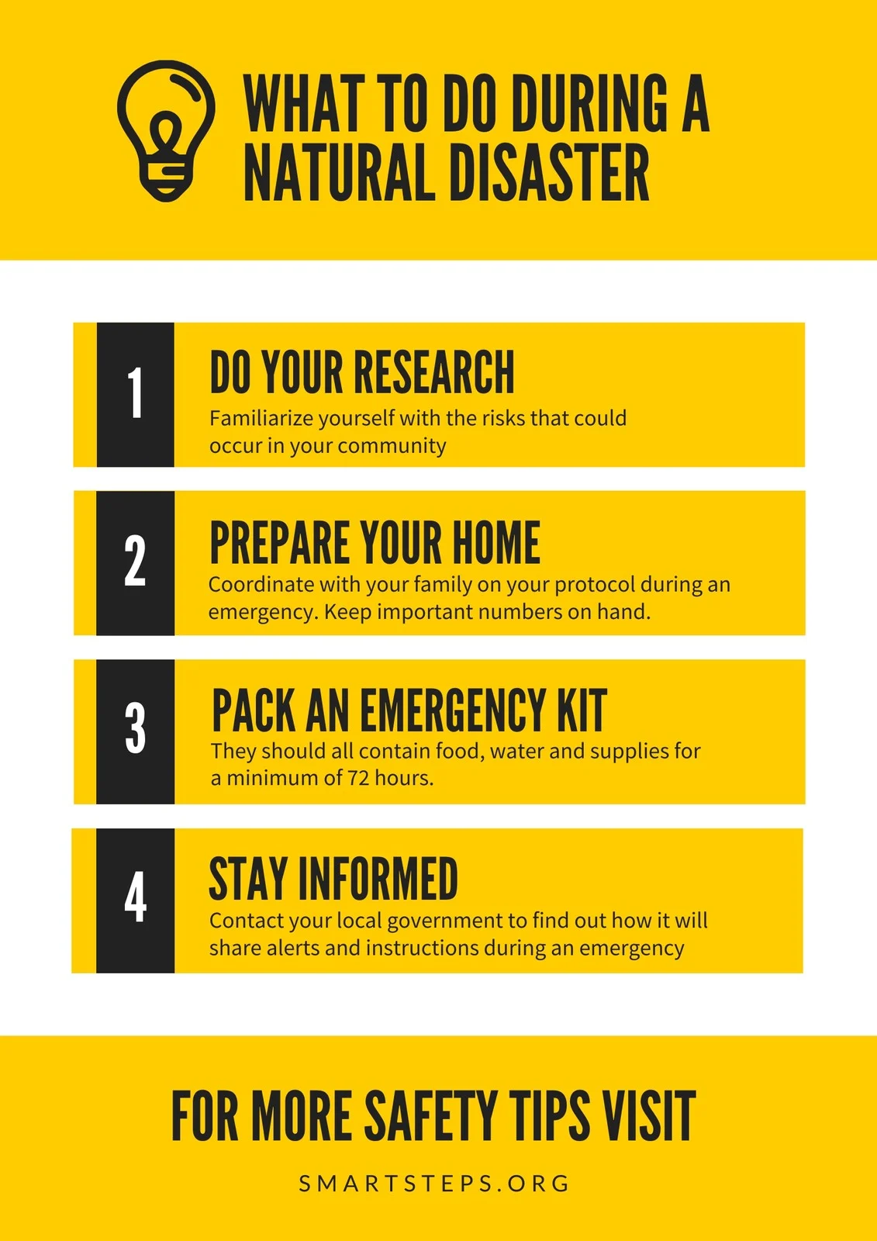
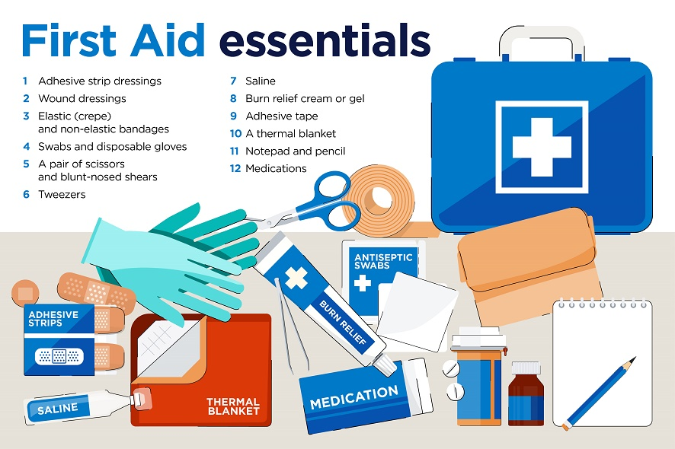
What to do?
Notes:
Slide 4 & 5: Teaching and homework 13min (start in class)
So how can we be positive in the light of all these scary possibilities? Firstly, you need to realise you cannot change the things that do happen. Be optimistic and look for a positive solution rather than complaining and pitying yourself.
Secondly, you need to have a plan for the more likely environmental hazards that you might encounter. E.g. if you live near a river, there is a chance of flooding or pollution. If you use gas cylinders for cooking, there is a chance of a gas leak and therefore a fire.
Put together a first aid kit for your home and learn how to help someone in an emergency. Go on a first aid course to be prepared in the event of an emergency.

Slide 5

Notes:
Slide 5:
Now that you know what attitude to have towards a natural disaster, its important to have a plan. You will now have an opportunity to start the homework Activity 3 (Lesson 2 – Worksheet) in class. For homework you need to create an infographic poster highlighting the FOUR main parts to your Family Action Plan. Think of disasters that could occur in your home or community based on your location. Think of things like a fire outbreak or an earthquake or flooding. Your emergency action plan needs to include a focus on:
Possible hazard in your area?
Attitude? How to remain positive and calm?
What to do when this emergency occurs? How to escape?
Where to meet as a family in the case of an emergency?
A list of what you should include in your home emergency kit.
Who to contact in an emergency?
Paste your poster in your notebook. You will need it for the next lesson.

Slide 6

REFLECTION
Notes:
Slide 6: 2min Reflection
As we finish off this lesson, read through and answer the questions on Activity 4 (Lesson 2 – Worksheet), as you reflect on the following:
Reflect on any content covered in the lesson today that you are still not sure of and will have to follow up on for homework.
What advice would you give to your younger brother/ sister to preserve the environment for future generations.

