Slide 1
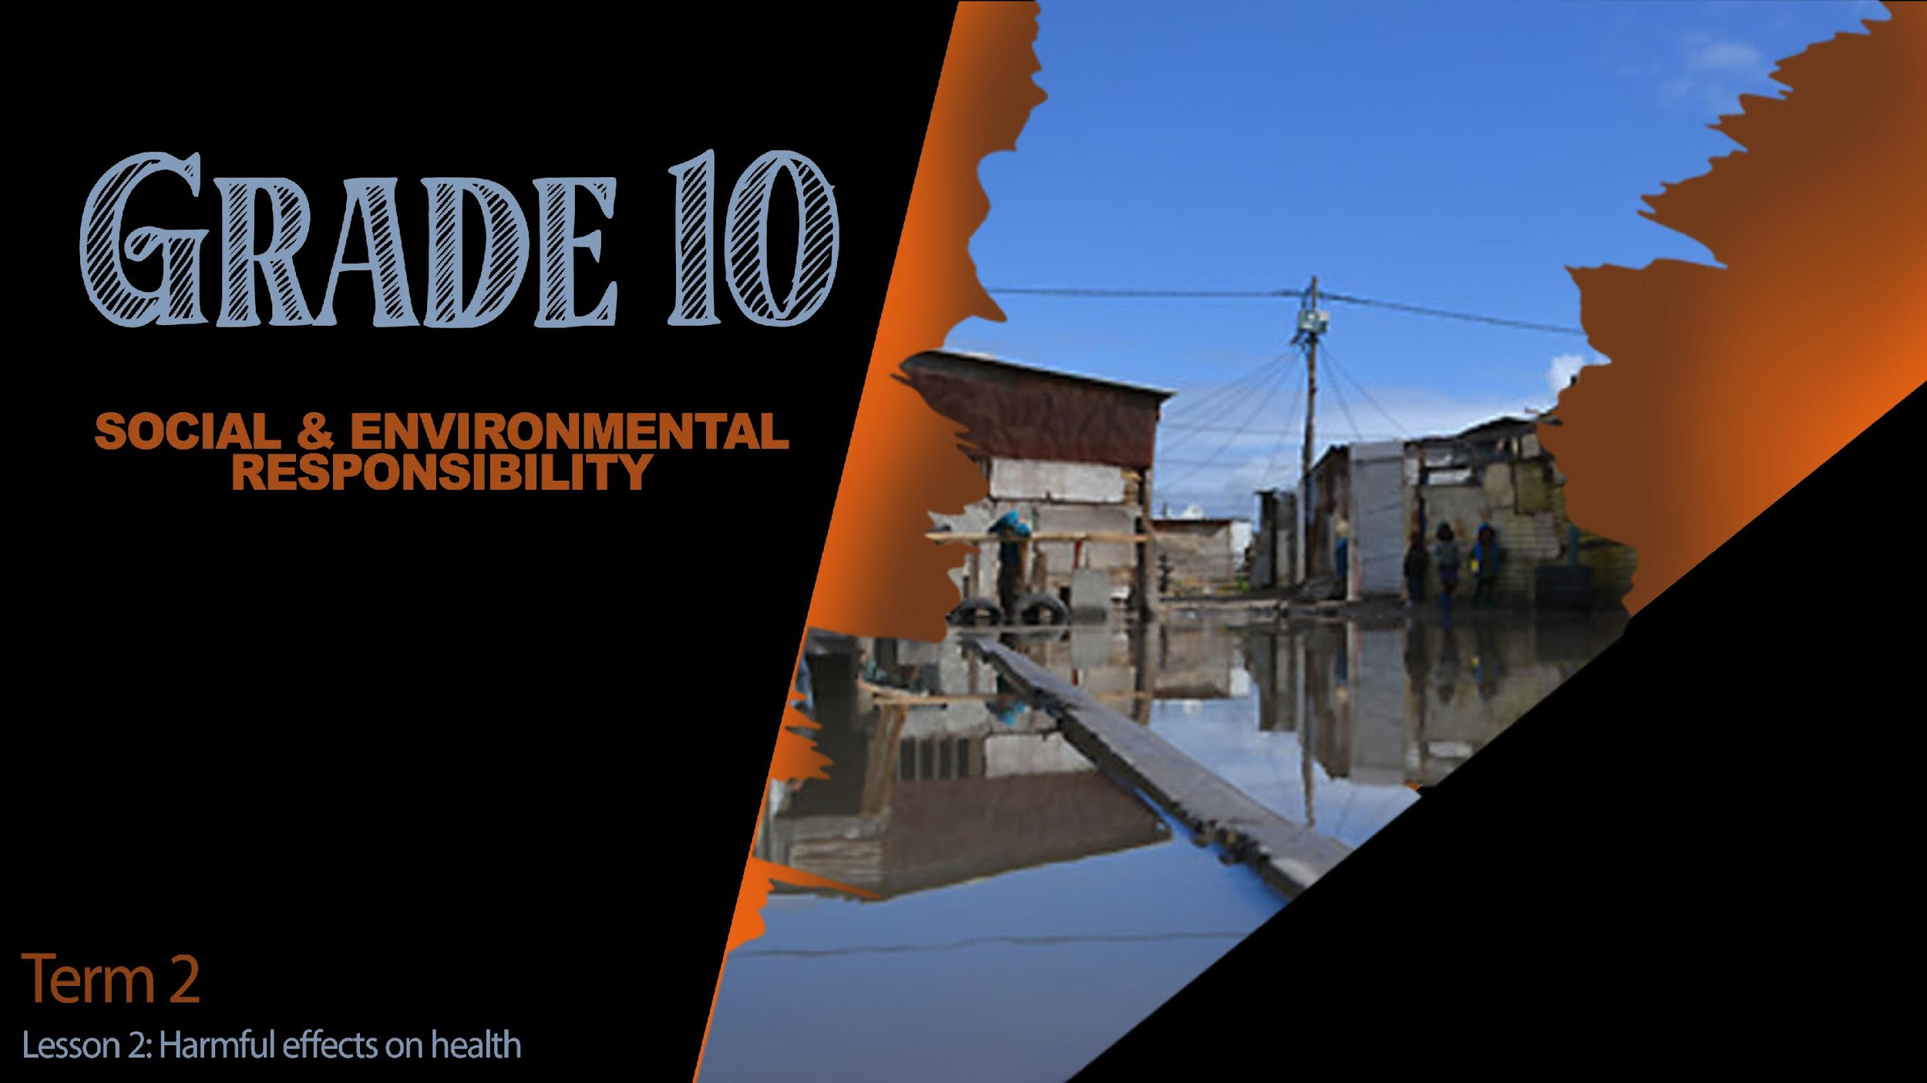

Notes:
Slide 1: Intro and Group discussion 4+4min
Welcome back grade 10’s! I’m sure since our last lesson you have become more aware of the social and environmental issues on the news or in your community and globally?
Can someone share what the term social injustice means?
Can someone share what the term environmental injustice means??
Well done class! Its great to see you have been listening! Let’s get stuck into today’s lesson.
I’m going to describe a scenario and ask you to share what emotion you would feel:
You get home from school after a long day, you’re tired and hungry. Your mom/dad put some food in the microwave to cook for supper and 30sec later the electricity goes out …. loadshedding! Again!
How would you feel? Maybe angry? Frustrated? Still hungry because you can’t make any supper?
Loadshedding has a direct impact on everyone in South Africa. Electricity is part of the basic services supplied by municipalities to communities.
In your groups briefly describe the impact that load shedding has had on you in the following area. (Allow 3min)
Your life at home
Your schoolwork
Your parents’ ability to work.
We can see that everyone in this class has been impacted someway by loadshedding. To some in South Africa the impact is so severe that it has directly impacted their health or income. Some small businesses in South Africa have closed because they cannot run without electricity. This means that more people loose jobs which causes increased unemployment and poverty. Loadshedding is a contemporary environment issue that has a harmful effect on individual people, communities as well as our country. The reality is load shedding is not just going to go away. As South Africans we need to be positive and learn how to overcome the challenges of difficult situations like loadshedding.

Slide 2
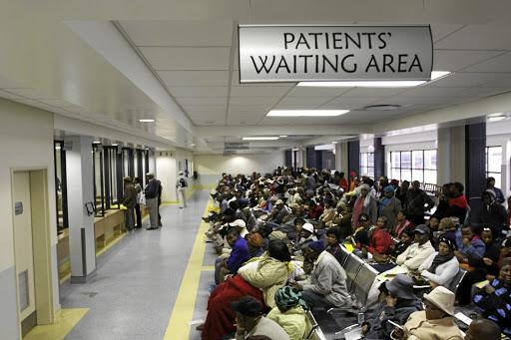


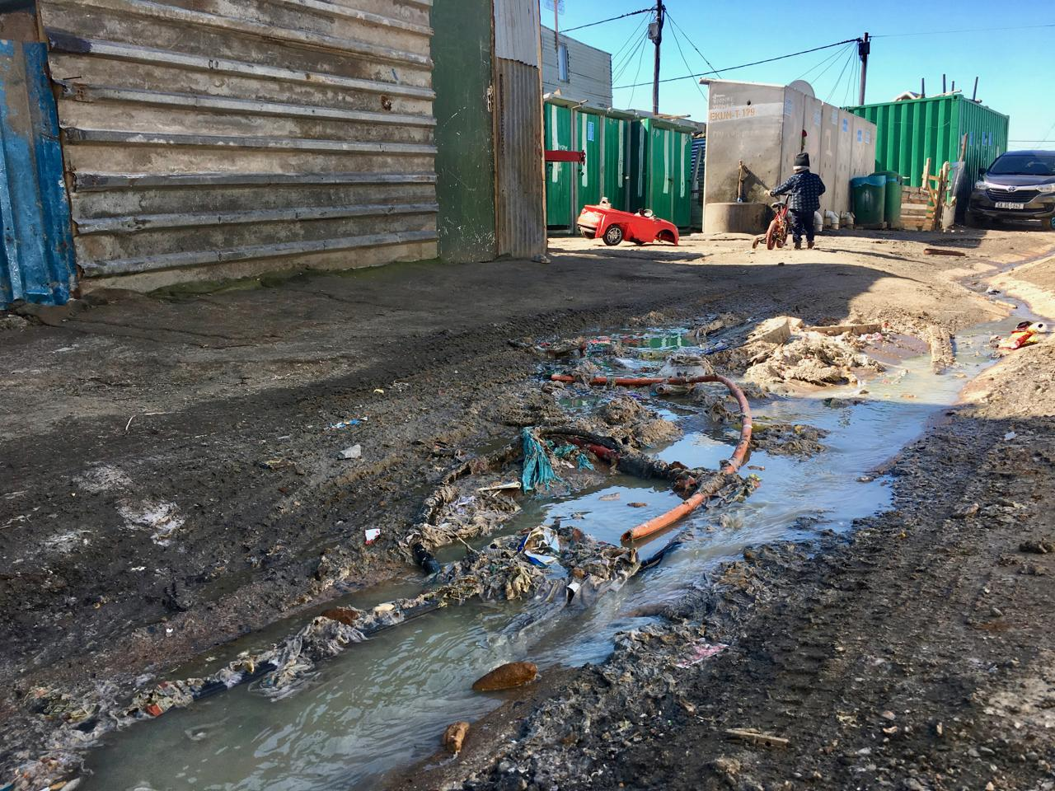
Can you remember????
?
?
?
?
?
Notes:
Slide 2: (3min) Flash Activity
(Note to teacher: A flash activity happens very quickly. It’s meant to be done by timing the learners and seeing how much they can remember under pressure.
In the same way as loadshedding, we struggle with many other social issues. In the last lesson we researched different instances of social injustice and the impact they had on local and global communities. Can you remember some of the examples we looked at? See if you can identify them on your worksheet in Activity 1 (Lesson 2 – Worksheet) ?
(Read the list below after giving learners 2min to quickly try and remember)
Violence
Crime
Poverty
Lack of basic services and resources
Unequal access to basic resources.
Safety and security
What are some of the harmful effects these these contemporary social issues will have on you as an individual and your community? Let’s evaluate by looking at one example in more detail.

Slide 3
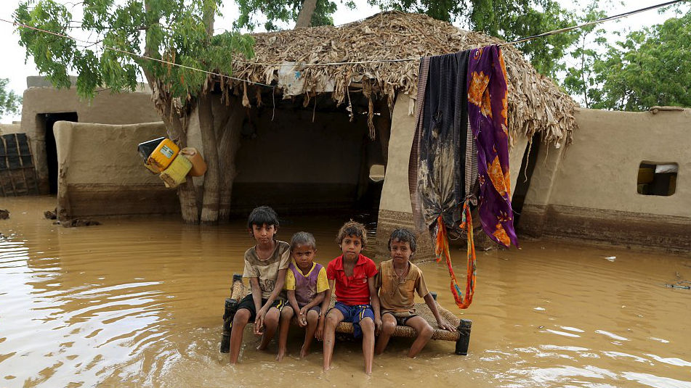
Impact on physical health
Impact on safety
Impact on mental health
Notes:
Slide 3: Group Activity 10min and teaching 5min
Imagine this was you and your friends. You live in this community of houses along a flood plane where sometimes its dry but whenever it rains, then everything floods.
Remember you need to use your imagination when discussing this activity. In your group, take a moment to imagine what your life would be like every day? Use these phrases to help guide your group discussion. Identify FIVE characteristics of a life of poverty.
School
Hungry
Always wet-sickness
Where to sleep
Clothes
Mental health
Safety
(Ask two groups to briefly give feedback.)
I think we can see that poverty will impact every area of life. We know that poverty impacts how your basic daily needs are met. People who live in poverty don’t have money to buy food every day and often struggle with hunger. Sometimes, like in this picture, they are forced to live in an area where their health is impacted and it's easy to get sick and communities even suffer from diseases like cholera (this is a bacterial infection caught from drinking contaminated water that can often be deadly especially to young children and the elderly). We can also see from this image that housing is a problem as not everyone has their own home that is stable. There are challenges with privacy as often many sleep in small spaces.
One of the causes of poverty is unemployment, but inequality, or social injustices, lack of education (links with unemployment); lack of access to clean water and nutritious food (all social issues).
Who can remember what the definition of unemployment is?
The term unemployment refers to a situation where a person actively searches for employment but is unable to find work. In South Africa the largest group of people who are unemployed are the youth.
Poverty is when people cannot fulfil their most basic needs.
(What are our most basic needs?)

Slide 4
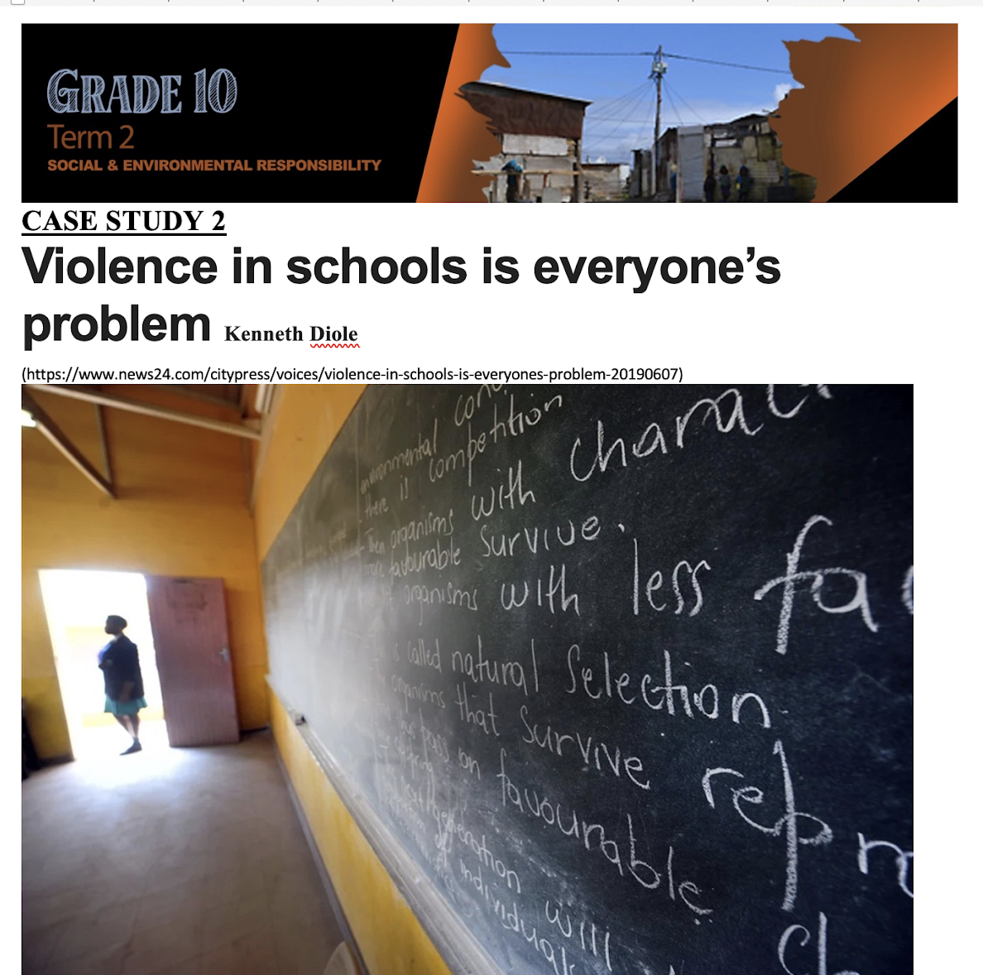
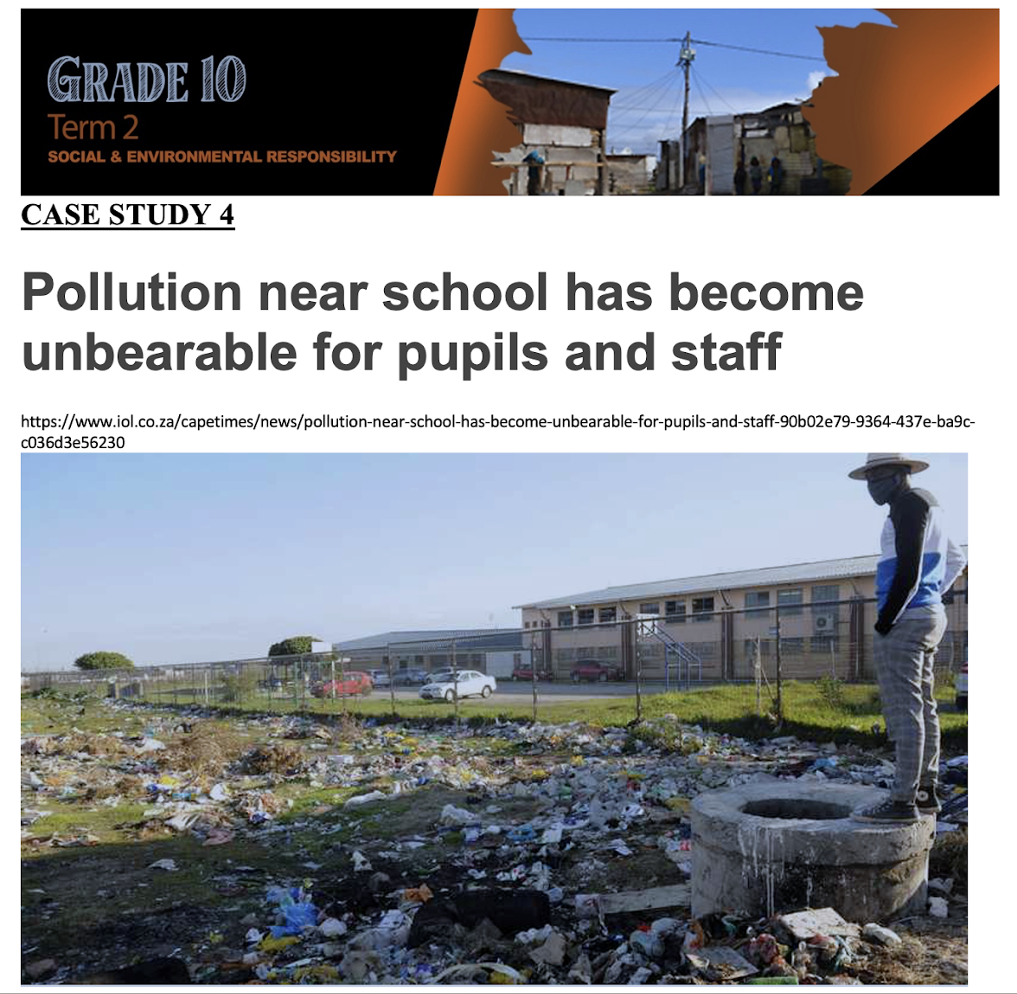
Notes:
Slide 4: Individual 10 min (Reflection of information)
In the last lesson we looked at these two case studies (refer to Lesson 1 – Case Study 1-5). I’m sure you could look at these same two case studies again and identify some of the harmful effects that crime (a social injustice) and pollution (an environmental injustice) have on the individuals and the community.
Choose ONE of these case studies when answering the question in Activity 2 (Lesson 2 – Worksheet)
On your worksheet start the activity.

Slide 5
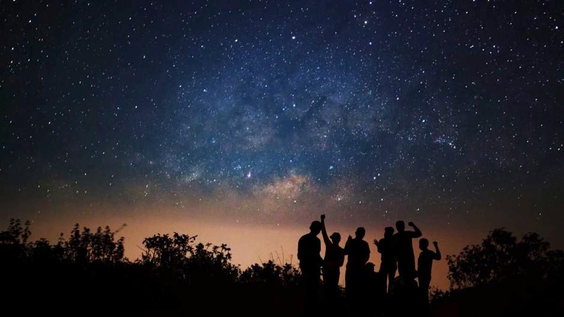
Loadshedding challenge…
Notes:
Slide 5- Wrap up Challenge! 4min
Remember there are many issues that seem so overwhelming and sometimes we feel we cannot make a difference. Sometimes it’s the outlook we have towards the issue that makes the difference. We started this lesson talking about all the negative impacts of loadshedding. Today, I’m going to challenge you to do something different when there is load shedding again. Look at this list on your worksheet under Activity 4 (Lesson 2 – Worksheet) . Circle three that you are going to try out this week.
Watch the stars with my mom/dad/ brother/ sister and tell them about my day
Drink a glass of water/juice together with a friend and share your favourite memories of your primary school years.
Play a game of dominoes/ thirty seconds or another game you loved with your family.
Book an appointment to give your mom or dad a back massage or foot massage.
Pick up that instrument you’ve always wanted to play and work through a tutorial book that will teach you to play.
Write a poem for someone special in your life that will let them know how special they are to you.
Find a quiet area, listen to music and make an artwork just for the fun of it.

