Slide 1
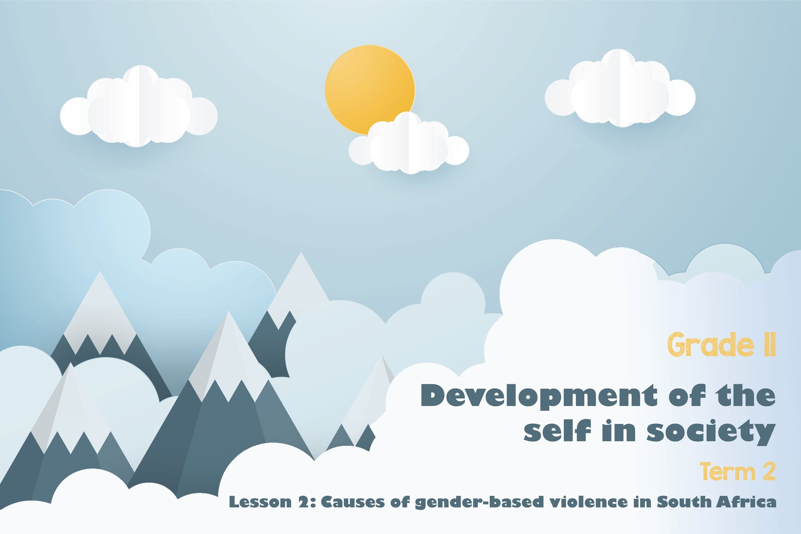

Notes:
Slide 1
Welcome back! Last lesson we researched incidences of gender-based violence in SA and the world. Can you remember the different forms of gender based violence? Allow learners an opportunity to answer …
Namely:
domestic
sexual
rape
physical
emotional / mental
femicide
sexual harassment
Today we are going to look and critically discuss some of the causes of gender based violence. Lets get started!

Slide 2

Indicate which of the following is relevant when reading your articles as a group:
No of Women abused
No of children abused
Type of abuse – domestic, sexual, rape, physical, emotional / mental, femicide, sexual harassment
Case reported
Perpetrator caught
Perpetrator convicted in court
Perpetrator in jail
Notes:
Slide 2: Group Activity (10min)
You were required to bring FOUR news articles on gender-based violence. (See homework i.e. Lesson 1 – Activity 6).
Get into groups of THREE.
Each person needs to choose ONE article (from the four they brought to class) to read to their group. Each group will collect data from the THREE articles read. (The other articles will be used in the other lesson so learners should hold onto them.)
Each group will need to give a summary of the feedback to the class. The aim of this activity is for each group to develop a set of statistics from the articles they have in front of them.
Allow time for the learners to collect data on the articles they have read. In their groups they should record a summary of this data. They will use these articles throughout this lesson.

Slide 3
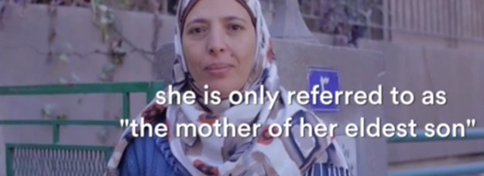
Gender roles are the different roles, behaviour and activities that society thinks are appropriate for women and men determined by prevailing cultural norms.
Notes:
Slide 3 & 4: 5min
Before we go any further let us revise some important definitions:
Gender roles are the different roles, behaviour and activities that society thinks are appropriate for women and men determined by prevailing cultural norms.

Slide 4

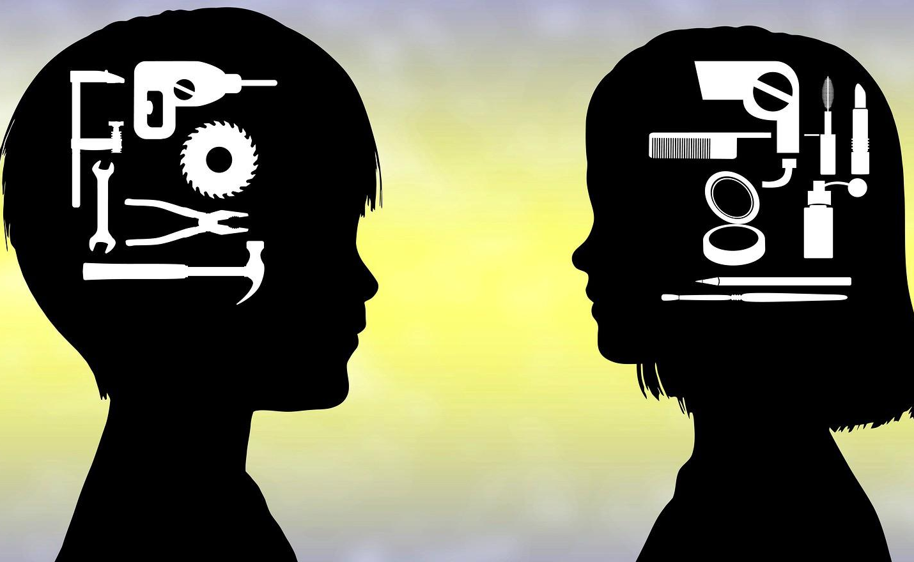
In your groups, briefly identify the roles of men and women represented by the imagery below.
A
B
Notes:
Slide 4: 5min
Take a moment to discuss in your groups what gender roles you see represented in the imagery A and B. Allow the class a short opportunity to give feedback.
Ask the learners if they agree that these roles reflect a gender equal society? If not, why not?

Slide 5
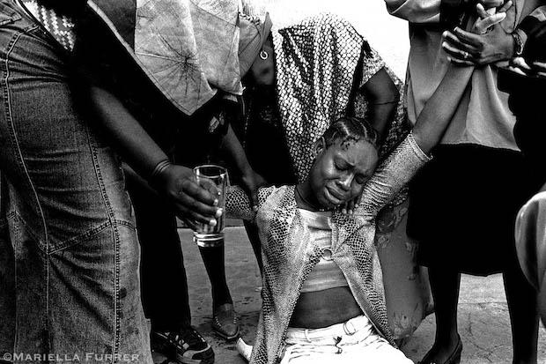
Power inequality means that some people have more rights and opportunities than others. This could lead to power struggles where one gender is treated unfairly or unjustly. In relationships we refer to unequal power relations
Notes:
Slide 5
We know that society gives men and women different roles. But sometimes these roles lead to conflict because of their inequality. Power inequality means that some people have more rights and opportunities than others.

Slide 6
ABUSE OF POWER
Individual - Physical Abuse: this includes physical harm like choking, pushing, beating, drowning, strangling etc. This could also include intentionally starving a person.
Family- Incest: This is sexual intercourse between people who are closely related and would not be allowed to marry by law.
Cultural- Mourning Period: Many cultures have different rituals surrounding mourning. In some cultures, there are different roles for men and women. E.g. woman wearing only black clothing during the entire mourning period whereas a man doesn’t have to wear any particular mourning clothes. Bigotry is when someone is disliked because of their culture.
Social- Domestic Violence: This happens when one person in a close relationship or marriage tries to dominate the other person. The abuser uses fear and guilt to manipulate and control.
Notes:
Slide 6:
With an increase in power between people, sometimes one person becomes the abuser. The abuser can harm the other person by treating them badly or harming them. Let us briefly look at FOUR examples of the abuse of power.
Physical Abuse: this includes physical harm like choking, pushing, beating, drowning, strangling etc. This could also include intentionally starving a person.
Family- Incest: This is sexual intercourse between people who are closely related and would not be allowed to marry by law.
Cultural-Mourning Period: Many cultures have different rituals surrounding mourning. In some cultures there are different roles for men and women. E.g. woman wearing only black clothing during the entire mourning period whereas a man doesn’t have to wear any particular mourning clothes. Bigotry is when someone is disliked because of their culture.
Social- Domestic Violence: This happens when one person in a close relationship or marriage tries to dominate the other person. The abuser uses fear and guilt to manipulate and control.
On your Lesson 2 – Worksheet, provide an example of each of these types of abuse of power in Activity 1.

Slide 7
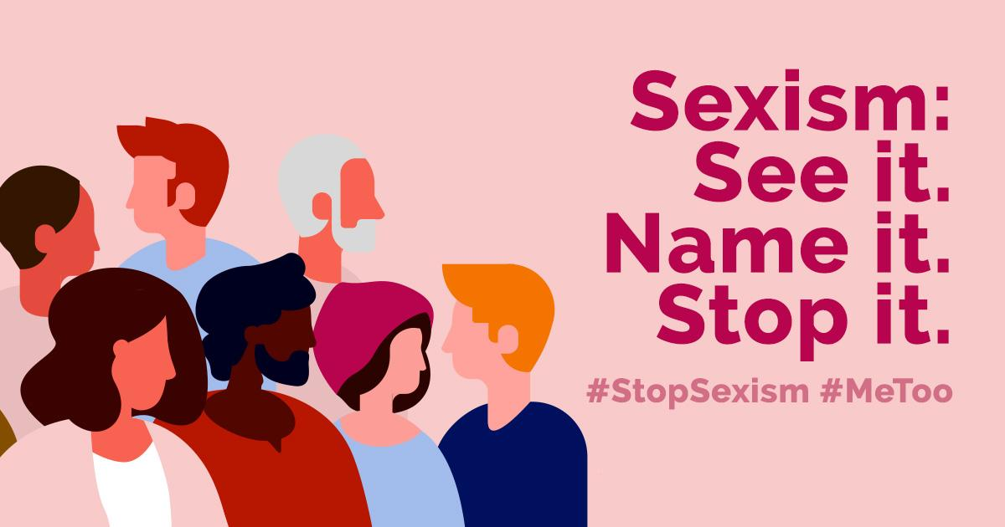
High school teacher recreates sexist ads to teach students a lesson
Sexism is prejudice or discrimination based on one's sex or gender. Sexism can affect anyone, but it primarily affects women and girls. It has been linked to stereotypes and gender roles, and may include the belief that one sex or gender is intrinsically superior to another.
Notes:
Slide 7
A high school teacher in American recreated famous sexist ads to teach his students a lesson about sexism and gender stereotyping.
Sexism is prejudice or discrimination based on one's sex or gender. Sexism can affect anyone, but it primarily affects women and girls. It has been linked to stereotypes and gender roles, and may include the belief that one sex or gender is intrinsically superior to another.
In the following slide, study the images and complete the Activity 2 on your Lesson 2 – Worksheet

Slide 8
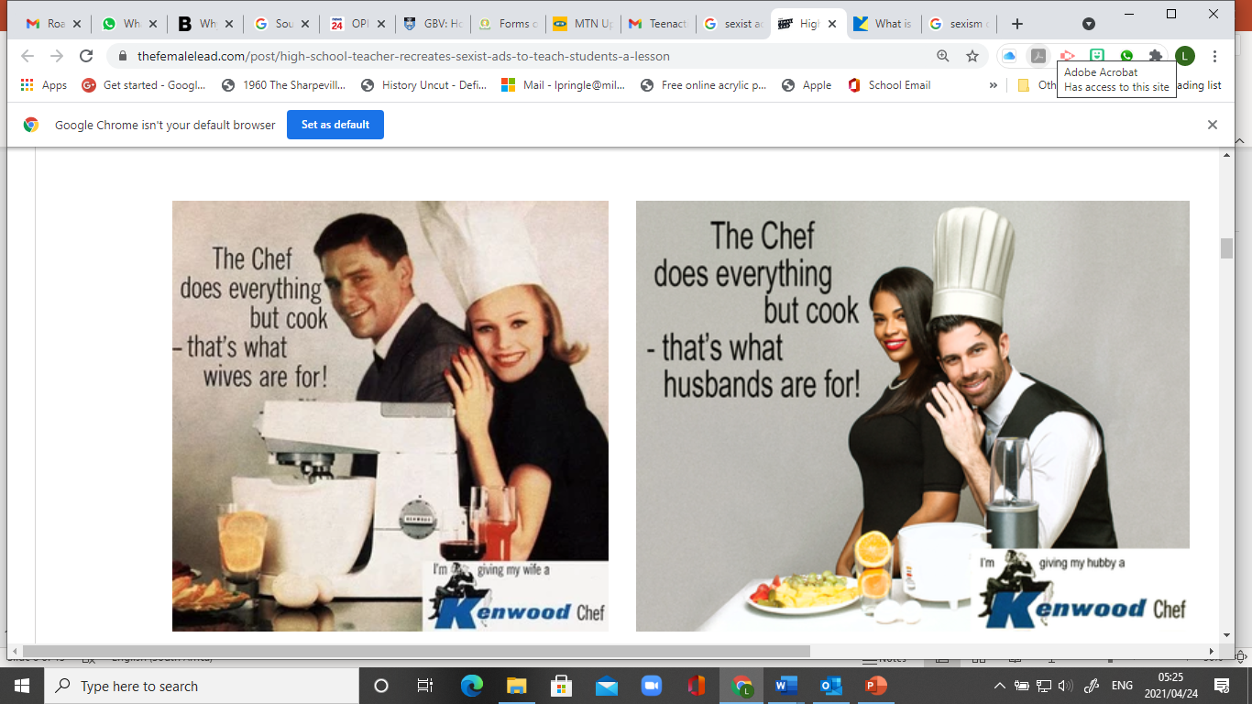
Notes:
Slide 8:
Study the images and complete Activity 2 on your Lesson 2 – Worksheet.

Slide 9
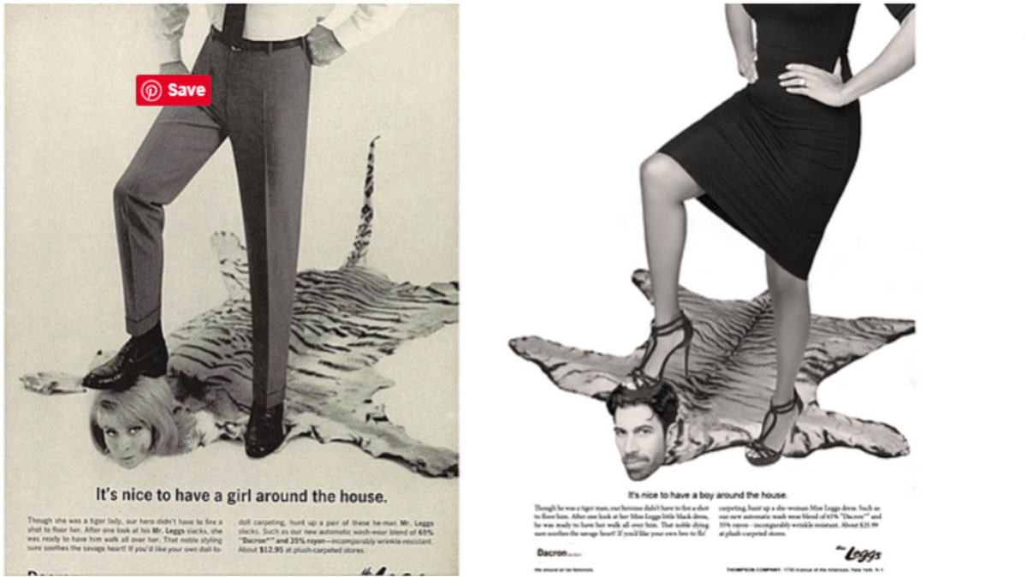
Notes:
Slide 8:
Study the images and complete Activity 2 on your Lesson 2 – Worksheet.

Slide 10
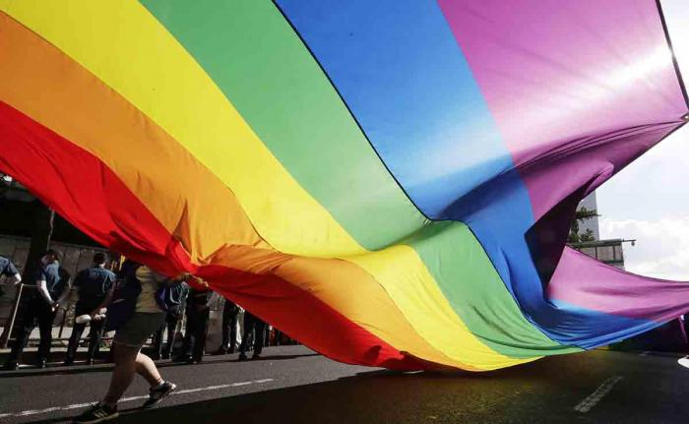
What does the term LGBTQI+ stand for?
What does the term
SEXUAL ORIENTATION
mean?
Notes:
Slide 10:
The term LGBTQI+ has been all over the media in the last few year. Do you know what this term stands for? (Allow the class to answer)
This term refers to a community of people, both male and female - Lesbian, Gay, Bisexual, Transgender, Queer, Questioning, Intersex and many other gender and sexual identities. These terms refer to the different groups within the gay culture.
What does the term sexual orientation mean?
According to researchers Susan Cochran and Vickie Mays, sexual orientation includes the following dimensions:
sexual attraction
sexual behavior
sexual fantasies
emotional, social, and lifestyle preferences
self-identification.
Allow learners time to write these definitions onto their Lesson 2 – Worksheet.
Take a moment to ask the class to discuss the following questions and include their own response in their Lesson 2 – Worksheet. Provide opportunity for general feedback:
“Why do people get uncomfortable talking about sexual orientation and race?”
“Why are more people from the LGBTQI+ community prejudiced against?

Slide 11


REFLECTION
What have you learnt about yourself and your opinions on gender equality?
We have seen an increase in bullying around sexual orientation. What advice would you give a friend who has been bullied at school?
Notes:
Slide 11: 3min
Allow 3min for learners to take a moment to reflect on what they have learnt about themselves today.
Answer the following questions in Activity 3 (Lesson 2 – Worksheet):
What have you learnt about yourself and your opinions on gender equality?
We have seen an increase in bullying around sexual orientation. What advice would you give a friend who has been bullied at school?
There are no memo answers to these questions. Make sure in this time the class is quiet. You can even play an instrumental song to encourage a quieting down and reflection.
Explain to learners that they need to complete Activity 4 for Homework to practice applying the content from this section.
Remind learners to complete Activity 4 for Homework and bring the other three news articles (from Lesson 1 homework) to class for the next lesson.

