Slide 1

Grade 8
Life Orientation
Career Categories
Lesson 2

Slide 2
What are the SIX Career Categories?
Using the Lesson 2 – Worksheet 1, write them down and swop with the person next to you – compare answers and see how many you got right.

Slide 3
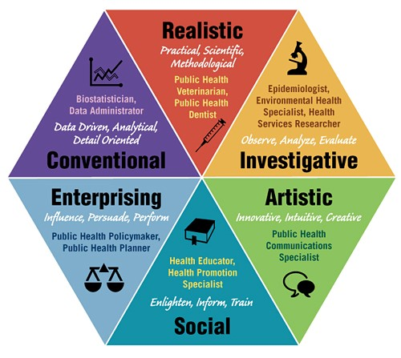
A QUICK
RECAP…

Slide 4
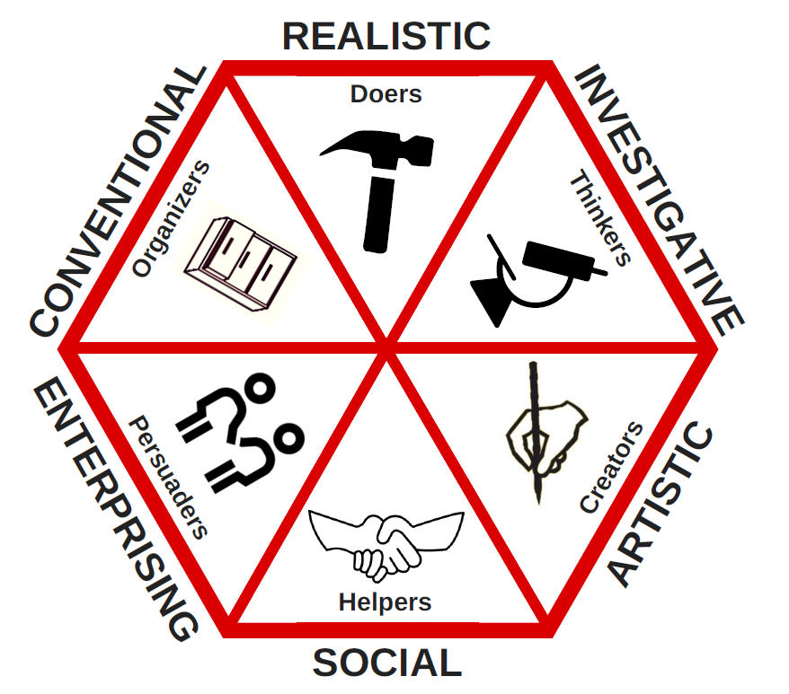

Slide 5

WHOA!
WHOA!
Remember: RAISEC if you’re ever stuck
RealisticArtisticInvestigativeSocialEnterprisingConventional

Slide 6
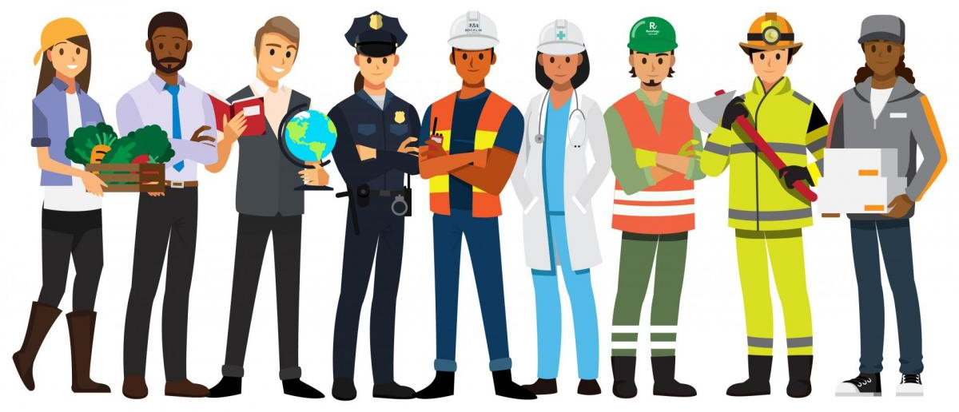
Think about this:
We can identify “essential workers” as those who conduct a range of operations and services in industries that are essential to ensure the continuity of critical functions – this can be within the public or private sector.
Having looked at the different categories, where would we fit in ESSENTIAL WORKERS?

Slide 7
Activity time!
Which category do you think suits YOU best? Where do you see YOURSELF?
Lesson 2 - Worksheet 2 will help you figure out just that – let’s do that now

Slide 8
Let’s reflect:
It’s been a BIG lesson and we’ve covered quite a significant amount of information – let’s think about how what we’ve looked at applies to YOU.
Complete the Activity: Lesson 2 - Worksheet 2

