Slide 1
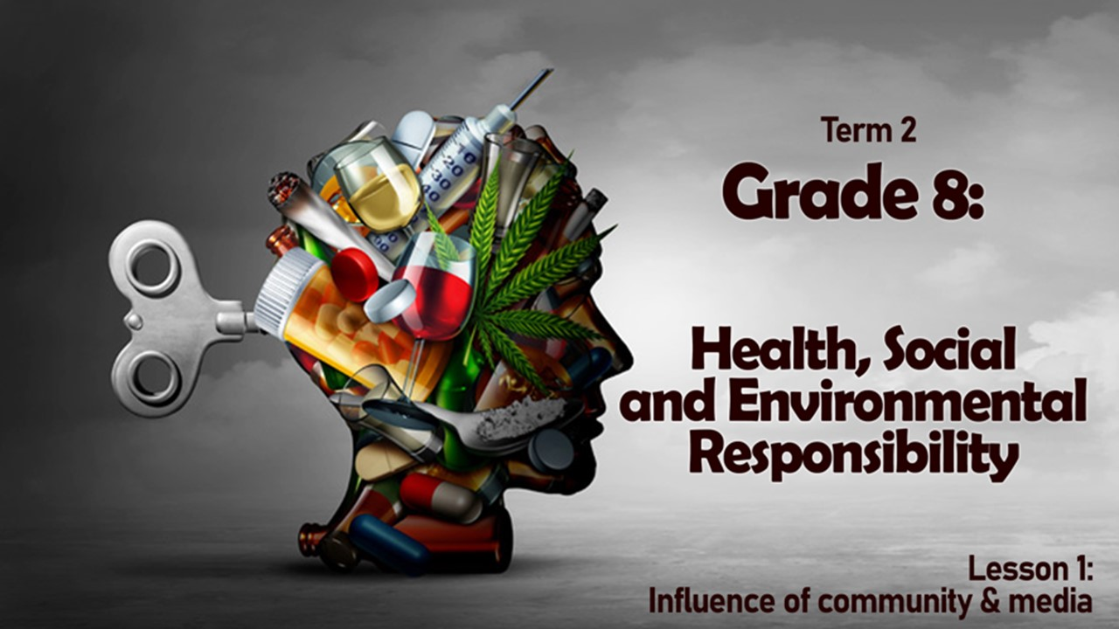

Notes:
Slide 1- intro 5min
(Hint: Arrange learners into groups. They will need to respond toward the end of the lesson in a group activity)
Welcome back Grade 8’s to our new section on health, social and environmental responsibility.
Lets see quickly, (allow opportunity for learners to put their hands up)
How many of you think its important to be healthy?
How many believe that exercise and proper eating is important to maintain being healthy?
Who believes that when you are sick with flu you should take anti-biotics to help you get healthy again?
If we take this last question, maybe some of you are not sure you agree. You might rather agree with your parents that its better to not take antibiotics when you have the flu because your body will build anti-bodies and make you stronger and immune from getting sick again.
What we believe about health is directly influenced by our families. We also live in a society where there are many other factors that influence us and impact the way we live. Can you think of some other factors in your life?
(Give opportunity for learners to answer, use some of theses examples to prompt an additional response.)
E.g. extended family, church, sports team, school friends, movie stars,

Slide 2

Substance Abuse: The use of illegal drugs or the use of prescription or over-the-counter drugs or alcohol for purposes other than those for which they are meant to be used, or in excessive amounts. Substance abuse may lead to social, physical, emotional, and job-related problems.
Notes:
Slide 2 & 3- Teaching 10min
These social factors have a direct influence on what we believe about ourselves, what we believe is important and what we choose to do. These factors also play a major influence on addictions and substance abuse.
(Give learners a few minutes to write this definition onto their worksheet.)
Substance Abuse: The use of illegal drugs or the use of prescription or over-the-counter drugs or alcohol for purposes other than those for which they are meant to be used, or in excessive amounts. Substance abuse may lead to social, physical, emotional, and job-related problems.

Slide 3
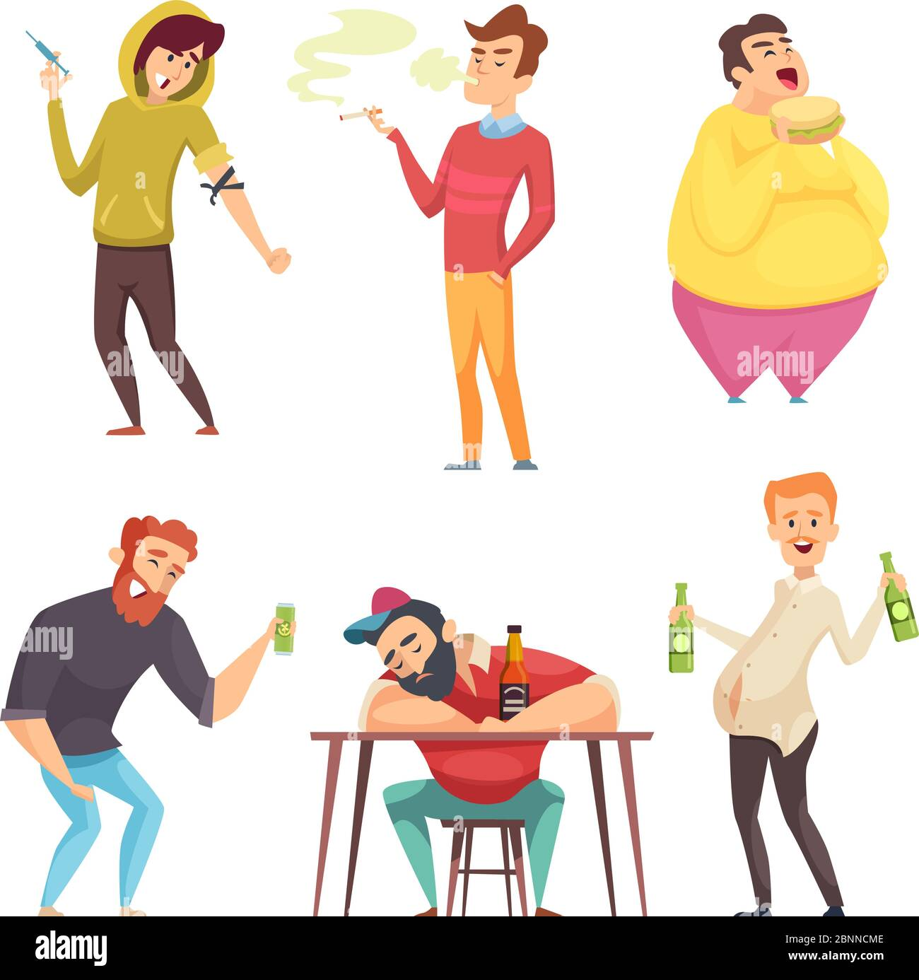
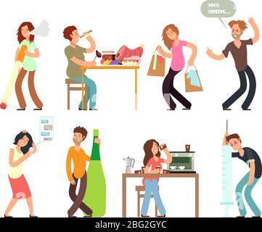
Notes:
Slide 3:
Let’s take a look at some examples of substance abuse:
Look at the image in the slide. Keep in mind the definition of substance abuse. Can you name the different kind of addictions? Write the correct term onto your worksheet under Lesson 1 - Worksheet Activity 1. Which one is not indicated in these images?
Alcohol addiction
Prescription Medication
Tobacco
Illegal drugs

Slide 4
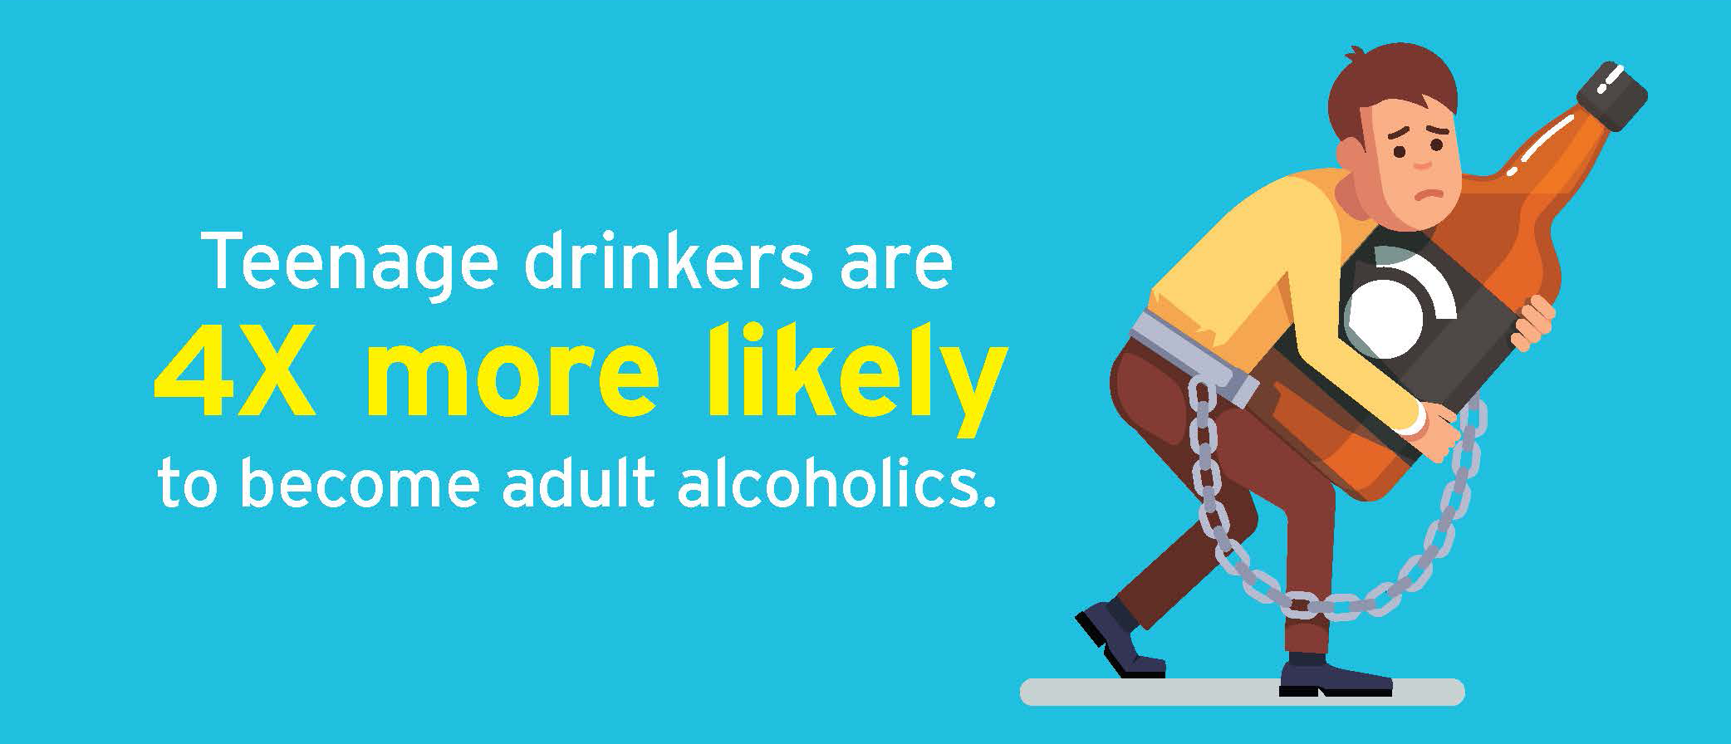
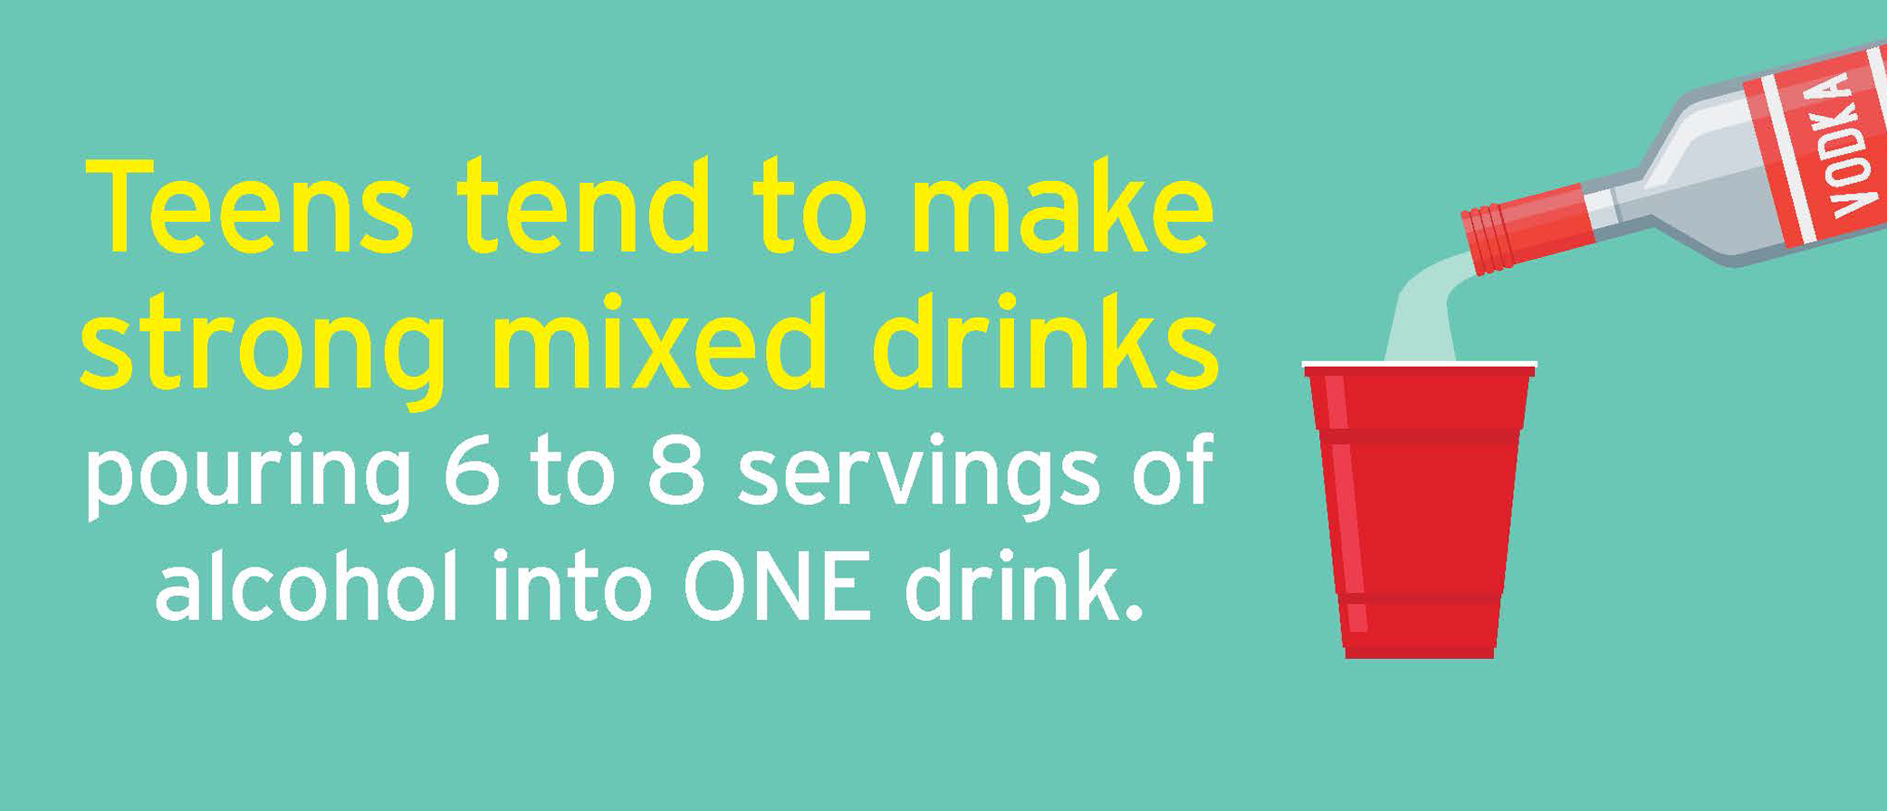
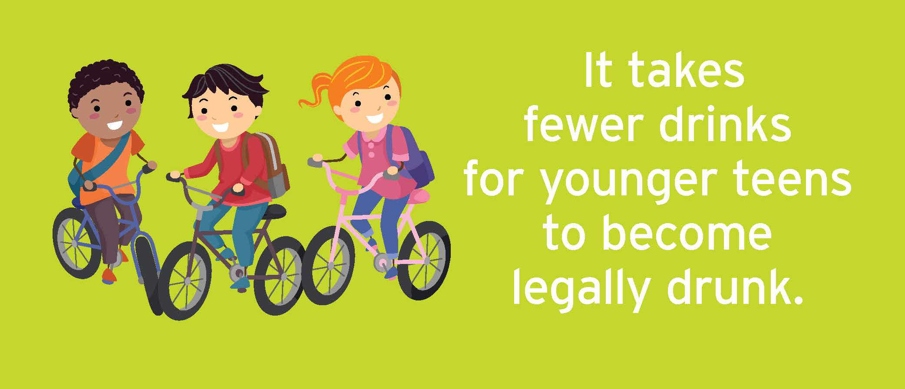
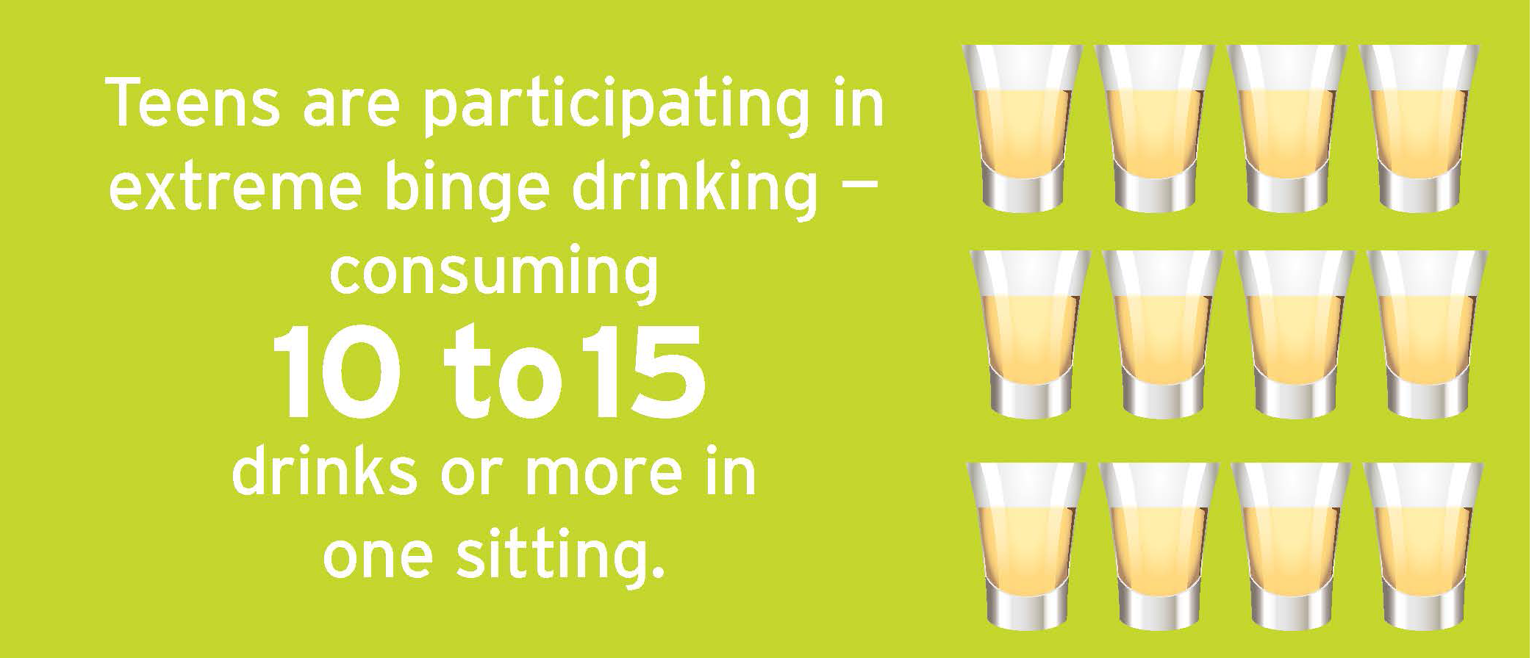
1.
2.
3.
4.
Notes:
Slide 4 - 6: 10 min
When a person uses these substances often they result in addictions. For a teenager to be addicted to drugs during their developmental years will greatly impact their bodies.
Look at the following images 1 -12 and indicate whether you believe these statements to be true or false. Write your answer on your worksheet under Lesson 1 - Worksheet Activity 2.

Slide 5
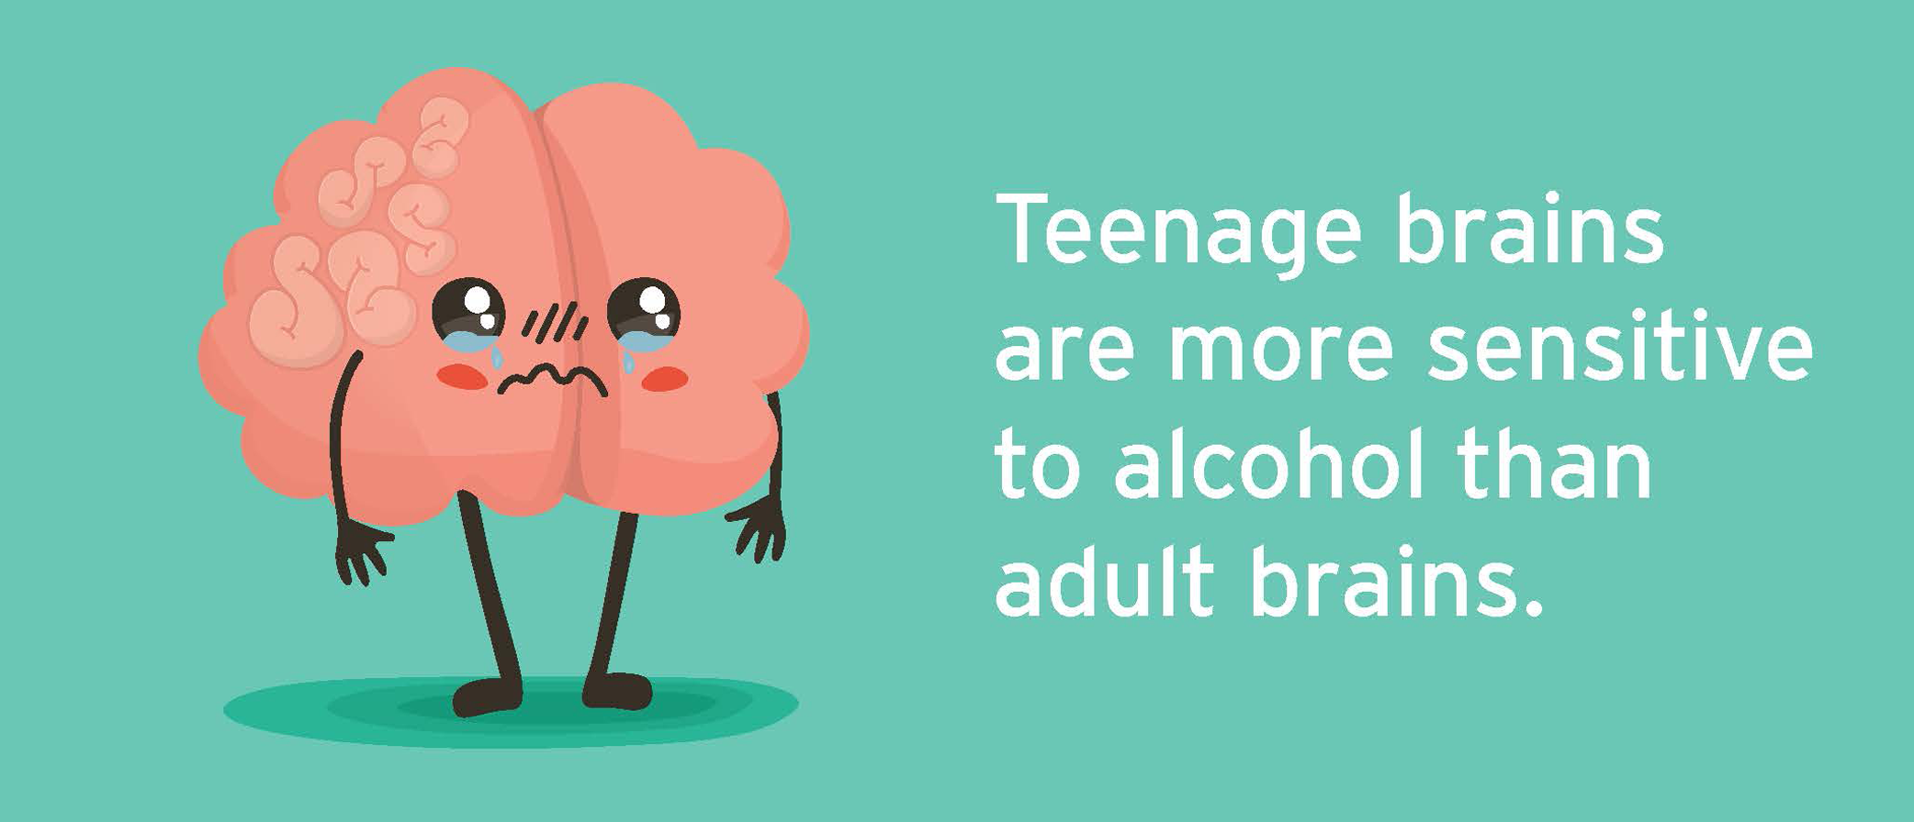
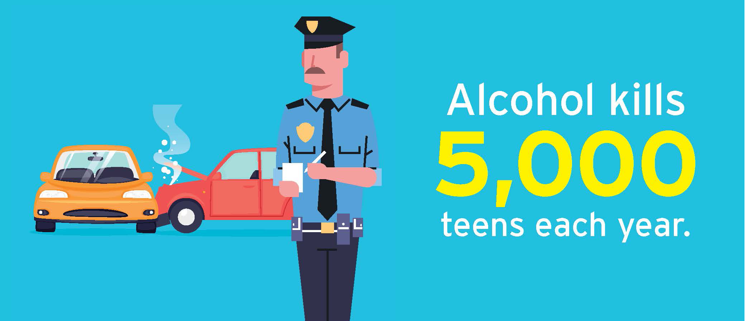
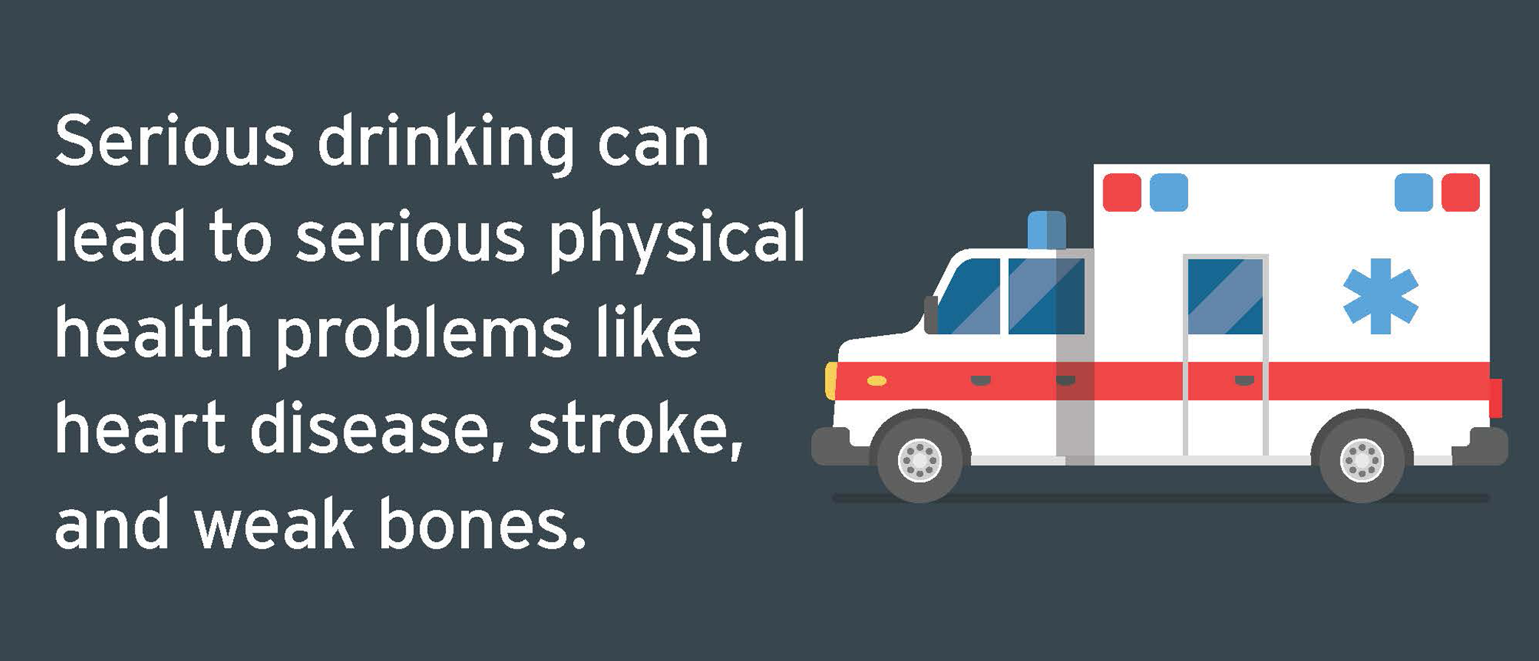
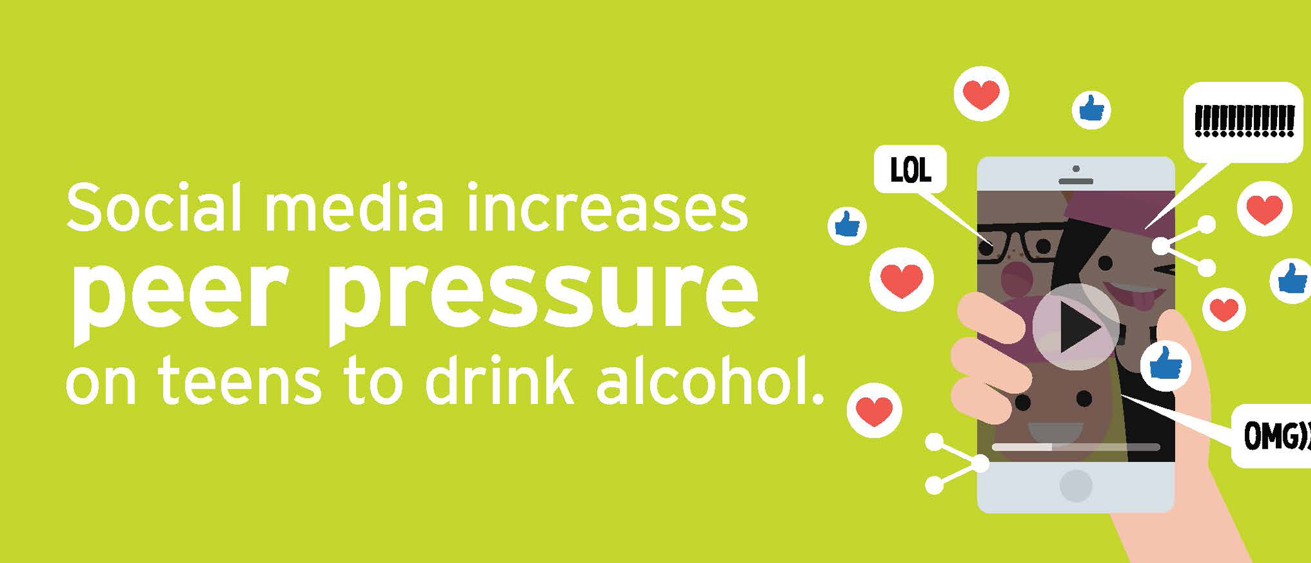
5.
6.
7.
8.
Notes:
Slide 5

Slide 6
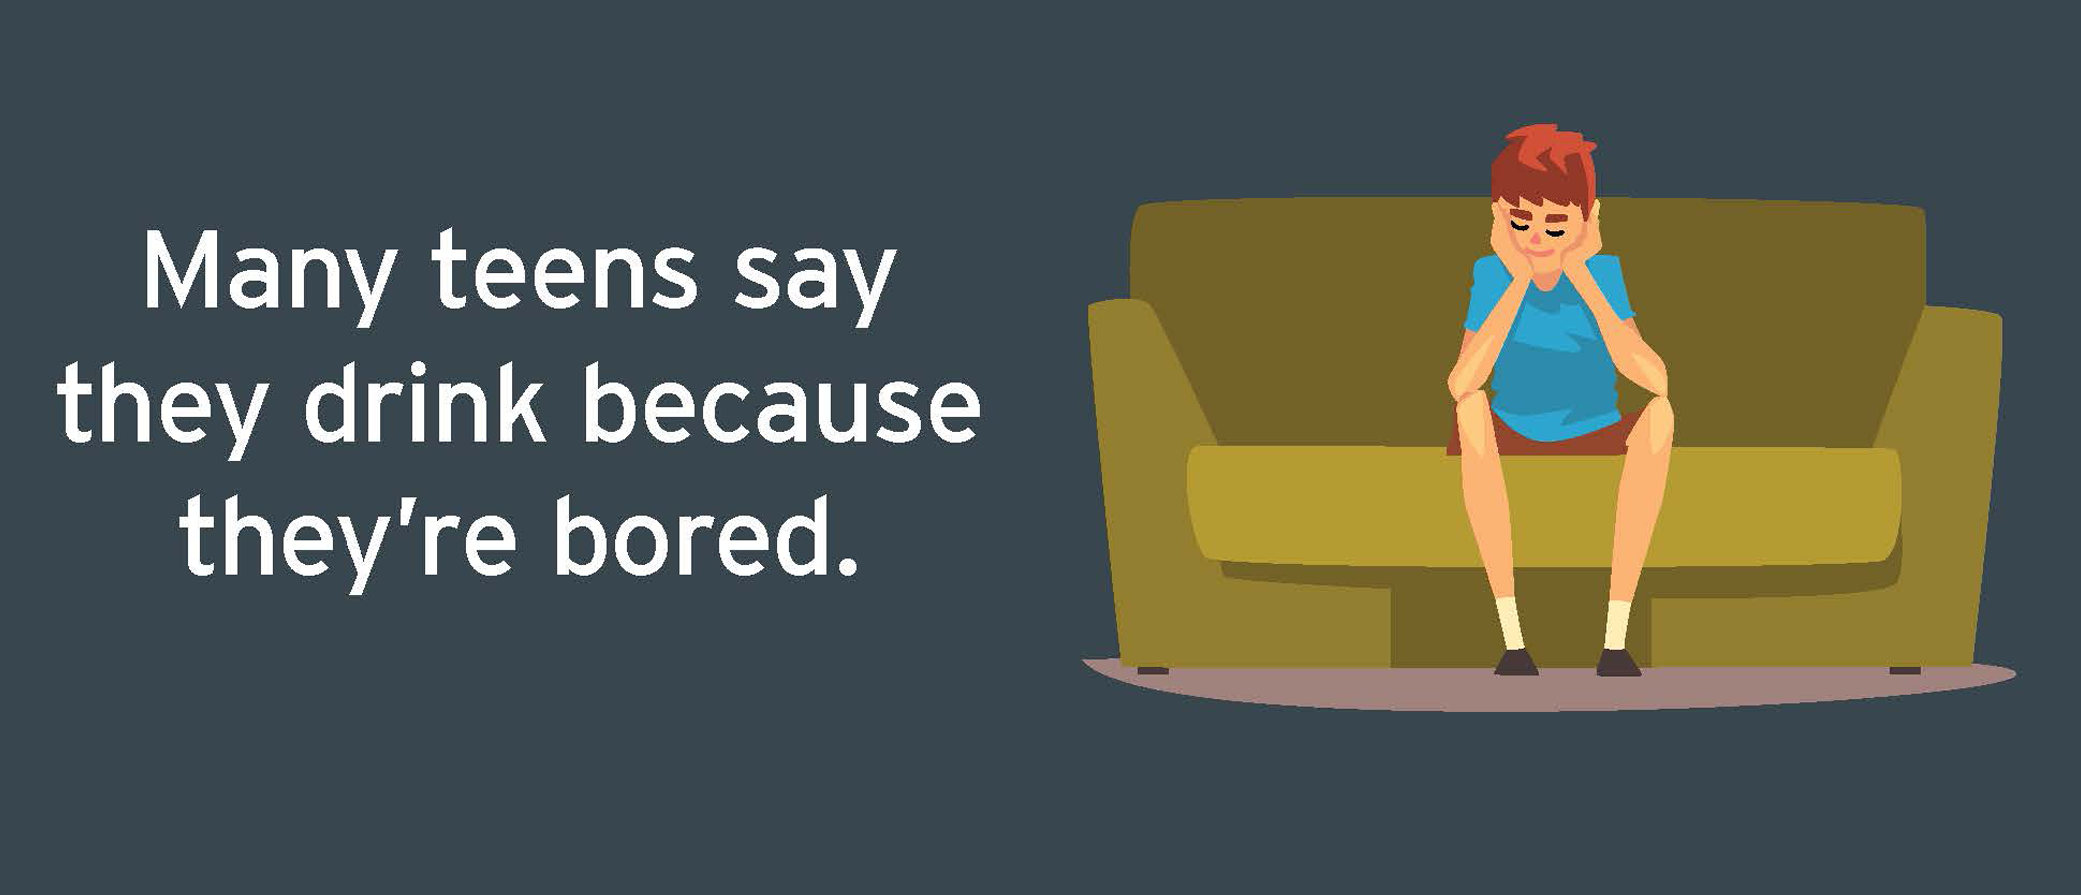
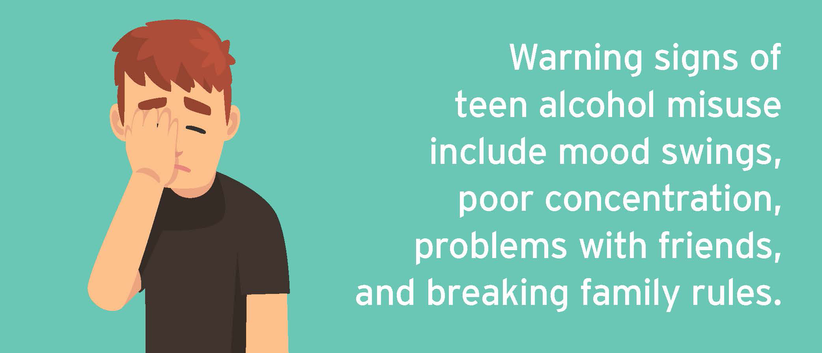
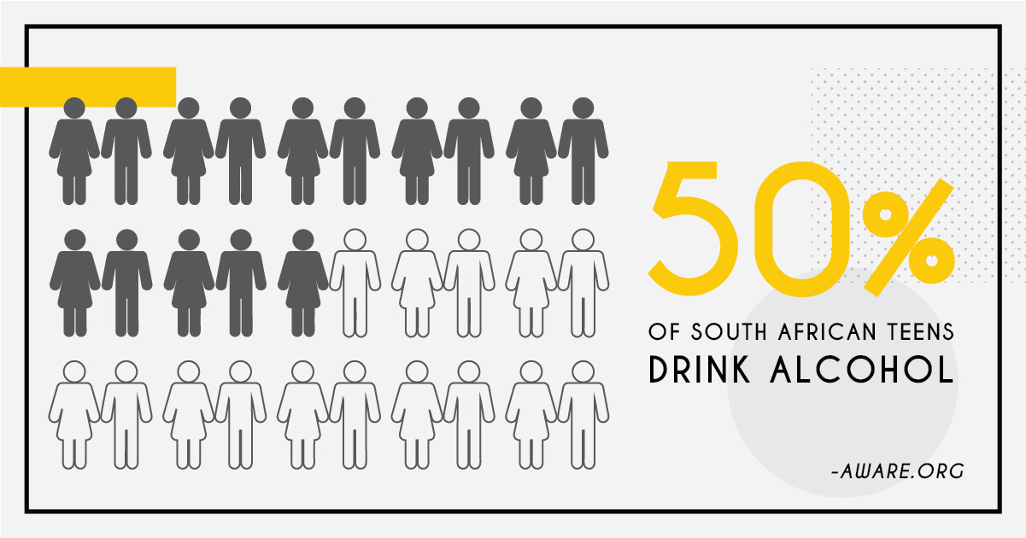
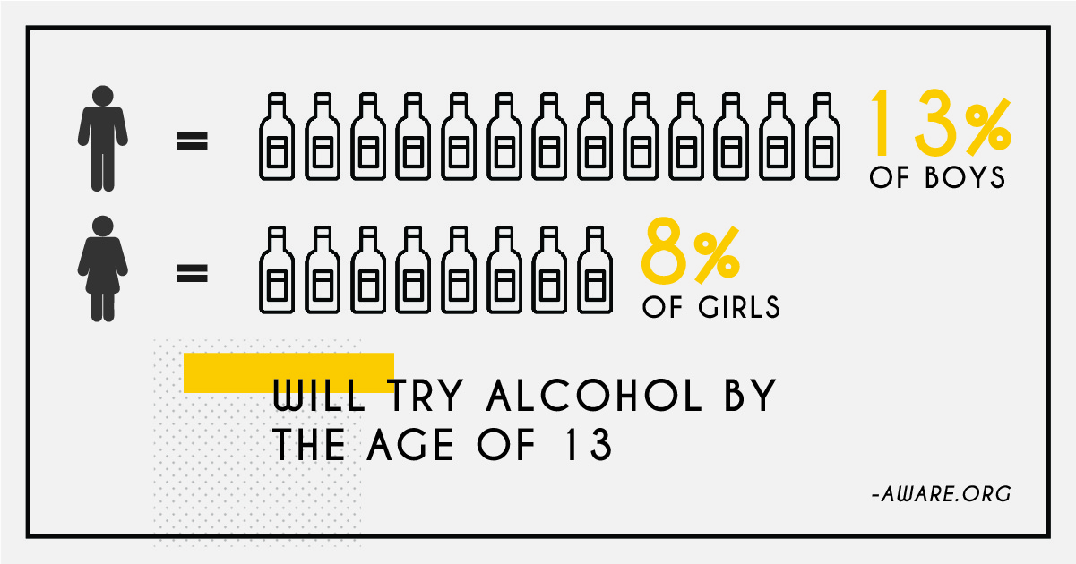
9.
10.
11.
12.
Notes:
Slide 6
Now let’s have a look at your answers. How many of you had any true answers? How many had any false answers? If you had all your answers as true then you were the most correct. Now I want you to take moment and go back and look at your answers again. Answer these questions:
Which of these images do you find the most unbelievable?
Which image has taught you something new about teens and alcohol abuse?
Lets take another look at No 11 and 12 again. If 50% of South African teens drink alcohol that means that we could say that half of this class has had alcohol. Most of you in this class are over 13. Do you believe that your peers have tried drinking alcohol?
Image No 9 says teens say they drink because they are bored, in your groups see if you can come up with another 5 reasons why a teen would abuse substances. (allow 3min for group discussion and 1min for feedback from a few groups.)

Slide 7


Slide 8


Notes:
Slide 8
We know the media influences the way we dress, what we think is cool and even our behaviour. Some times this influence can be positive but sometimes the influence can be negative.
(You will need to make sure you have the Lesson 1 - Media Group Activity Case Study (1 - 4) printed out with one case study per group. Hand one out to each group and a sheet of A4 paper for them to make group comments on. You can put these posters up on your wall for learners to remember.)
In your groups, each group has a song sung by different musicians from around the world and their experiences with drugs. You will need to read through the words of the song as a group and respond to the following:
What does this song tell us about drug abuse and the effects it has?
Does this song make drug abuse look appealing? Is it true?
What can we learn from the experiences of this musician to avoid getting involved in substance abuse?
(Allow learners 8 min to work on this activity.)
Remember to challenge the false messages about drugs and alcohol being fun from the media. Know the facts and make the right choices.

Slide 9
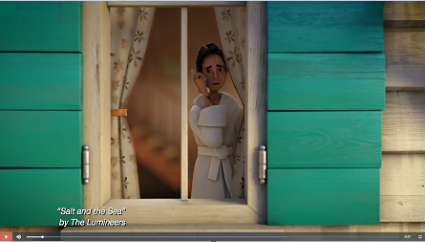
Notes:
Slide 9- 1min clip + 3min
Play the clip from this link:
https://cdn.musebycl.io/2020-10/Start%20with%20Connection%20%7C%20Partnership%20to%20End%20Addiction.mp4
Info on band:
https://musebycl.io/music/lumineers-lend-their-sound-haunting-ad-about-addiction
We're going to end off todays lesson by watching a clip from the short film “Salt and the See” by the Lumineers who feel strongly about drug addiction after loosing a friend to a heroin overdose. Watch this clip and then take a moment to answer the reflection questions on Lesson 1 - Worksheet Activity 3.

