Slide 1
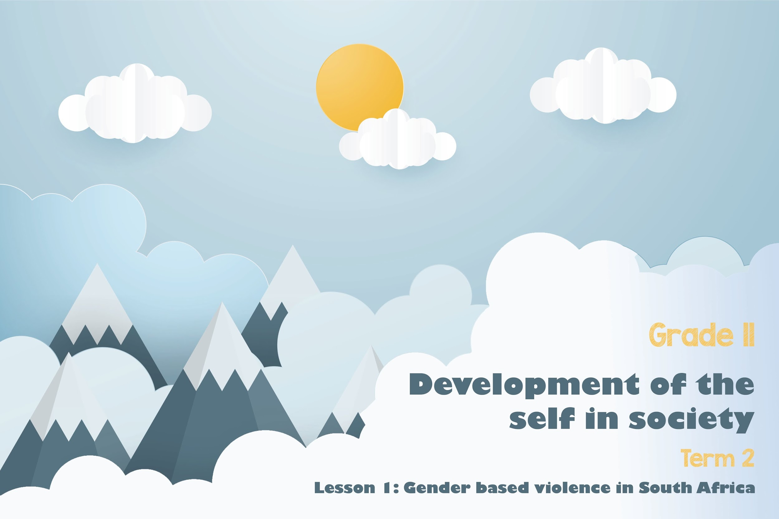


Notes:
Slide 1-2: 5min
Welcome back to Life Orientation in the 2nd term. We will be starting again with the topic Developing of the self in society. Our focus in this sub-section last term was on goal setting, different relationships and the influence on your well-being and the rights that you as an individual have within relationships. This term we will start by looking at: GENDER_BASED VIOLENCE (in SA and in the world) the impact of abuse of power on individuals and on society in general. We are going to look at gender-based violence in South Africa specifically, but it is important to remember it is a global pandemic, the violation of the rights of the victim of violence.

Slide 2
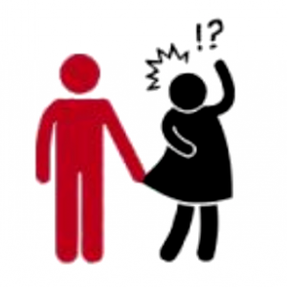


Can you label the following forms of gender-based violence?
A
B
C
Which forms of GVB are the most prevalent in SA?
Notes:
Slide 2:
Let’s start by looking at identifying the different forms of gender-based violence (GBV) in this slide. (Ask the class to identify what they think each image is about. Then explain to them)
Image A - Sexual - Any sexual act performed on an individual without their consent. Sexual violence can take the form of rape or sexual assault or sexual harassment.
Image B – Physical - Any act which causes physical harm because of unlawful physical force. Physical violence can take the form of, among others, serious and minor assault, deprivation of liberty and manslaughter. We often see this form of abuse in domestic situations.
Image C – Psychological - Any act which causes psychological harm to an individual. Psychological violence can take the form of, for example, emotional abuse, mental abuse, coercion, defamation, verbal insult or harassment.
Which form of violence is the most prevalent and happens the most often in relationships?
Tell learners to write the correct term onto their Lesson 1 – Worksheet under Activity 1

Slide 3
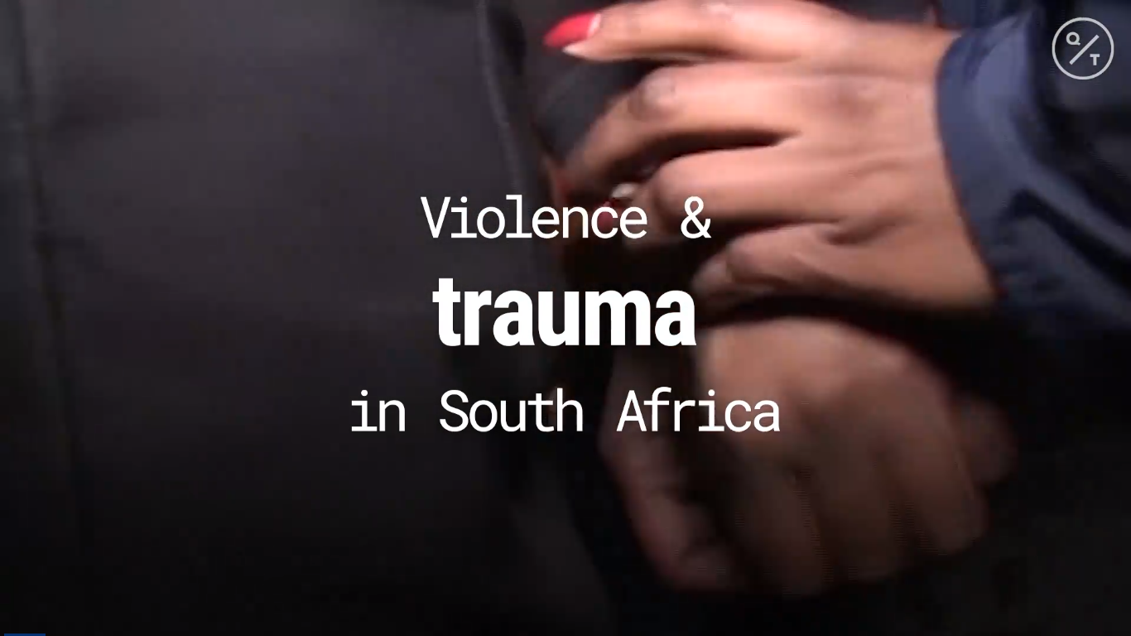
Why Gender-Based Violence Is So Prevalent in South Africa
QuickTake by Bloomberg
July 1st, 2020, 3:35 PM GMT+0200
South Africa's President in June lamented a "surge in murders of women and children" as lockdown eased, calling it a second pandemic. Amnesty International's South Africa director explains why gender-based violence is so pervasive and how to end it. (Source: QuickTake)
Notes:
Slide 3: Watch Video: “Why gender-based violence is so prevalent in South Africa” (4min 27s)
Link: https://www.bloomberg.com/news/videos/2020-07-01/why-gender-based-violence-is-so-prevalent-in-south-africa-video
Or
https://youtu.be/Up8_IKImo38
Published July 2020
As a result of COVID-19, we have seen an increase in gender-based violence around South Africa. This short video clip looks at reasons why this violence is so prevalent. Listen carefully as you will need to reflect on what you have heard in Activity 2 on your Lesson 1 – Worksheet
https://youtu.be/Up8_IKImo38

Slide 4

Informal Assessment Activity
Notes:
Slide 4:
Informal assessment (15min)
Work through the questions in Activity 3 and 4 in your Lesson 1 – Worksheet. First complete the true and false questions in Activity 3 and then Activity 4. These questions resemble the kind of questions you would get in a formal assessment. For the next 15 min we will sit quietly and do the short test. Use the information you have learnt today to help answer your question.

Slide 5



Violence in schools, models violence in society - GBV conference hears
Canny Maphanga
“If a child is neglected, school is where it is picked up.”
“Girls tend to be the victims of GBV in school e.g. rape, harassment and sexual assault, while boys tend to be victims of physical violence and bullying.”
Notes:
Slide 5: 5min
Arrange learners into groups of FOUR
Read the following statements taken from an article:
“If a child is neglected, school is where it is picked up.”
“Girls tend to be the victims of GBV in school e.g. rape, harassment and sexual assault, while boys tend to be victims of physical violence and bullying.”
In your groups, reflect and discuss whether you agree with this statement?
Consider THREE strategies that you as learners could implement to make your school free of gender-based violence.
The full article can be found: https://www.news24.com/news24/southafrica/news/violence-in-schools-models-violence-in-society-gbv-conference-hears-20191205

Slide 6


REFLECTION
What advice would you give to a friend who has told you a family member is abusing them?
How would you explain the different forms of gender-based violence to your 12-year-old sister?
How could you contribute towards gender equality in your classroom?
Notes:
Slide 6: 5min
Allow 5min for learners to take a moment to reflect on what they have learnt about themselves today.
Answer the following questions in Activity 5 (Lesson 1 – Worksheet)
What advice would you give to a friend who has told you a family member is abusing them?
How would you explain the different forms of gender-based violence to your 12-year-old sister?
How could you contribute towards gender equality in your classroom?
(There are no memo answers to these questions. Make sure in this time the class is quiet. You can even play an instrumental song to encourage a quieting down and reflection.)
Having done the above, look at the below list of different kinds of gender-based violence in SOUTH AFRICA. Tick off the terms (in Activity 5 Lesson 1 – Worksheet) you addressed in today’s lesson.
domestic
sexual
rape
physical
emotional mental
femicide
sexual harassment
Remind learners to complete Activity 6 for homework.
For homework FIND news articles of different stories in South Africa on gender-based violence. Bring at least FOUR articles to class for the next lesson.

