Slide 1
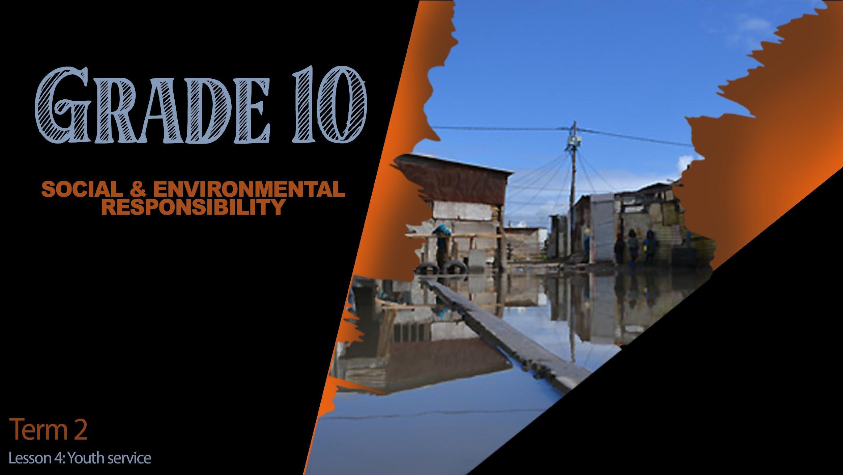

Notes:
Slide 1 & 2: Intro and teach 5min
Note to teacher: It is recommended that learners have access to computers / cell phones for the first part of this lesson. When they do the group planning, it might be able to move them away from computers. If you do not have computers, you might have to research some community opportunities for involvement and share ideas. Look at the examples on slide 5.)
(Note to teacher: GROUP ACTIVITY- This lesson will develop the knowledge for learners to get involved over the next week volunteering. You might need to guide some of the groups if they are struggling to come up with ideas later on in the lesson. Think of simple, manageable ideas like- helping someone younger – going to a pre-school and reading to the children a story in the afternoon OR offering to mow the lawn of some of the elderly members who live in your area. Remind learners to be safe and work in a group.
This planning will include interviews filmed on their phones. If you are uncomfortable with the use of phones. You could simply tell the group they will have to present their findings to the class in the next lesson in a short 3min demonstration which includes photo evidence on a PowerPoint.
However, for the remainder of this lesson, the assumption is made that learners will use their phones. Thus, all the referred planning below for Lesson 4 is moving groups towards producing a short film / film that learners will hand in at the beginning of the next lesson (Lesson 5) that will be seen by the class).
Welcome back class! I’m sure you’re all very excited to meet in your groups and to share what you discovered in your research last lesson. You will have time to plan later in this lesson for our “movie time” in our last lesson (Lesson 5). Let’s get started straight right away.

Slide 2
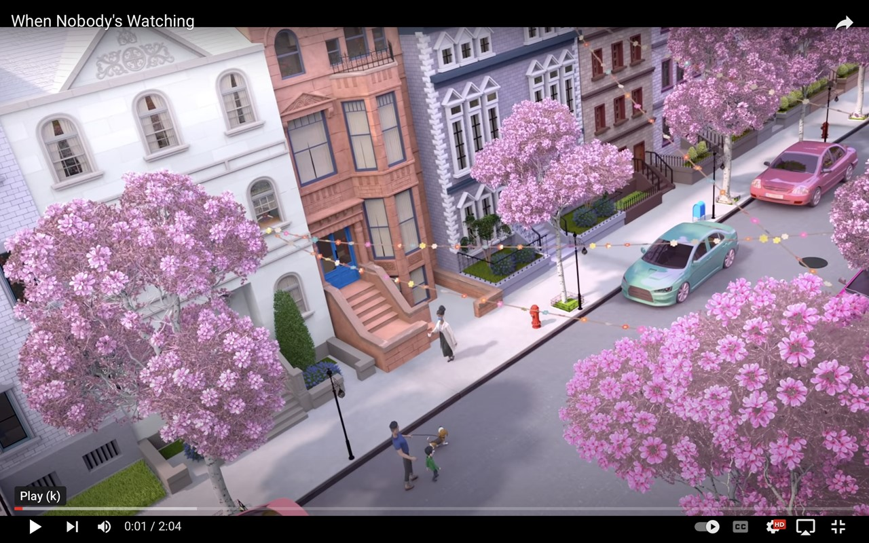
Notes:
Slide 2: Teach
We ended the last lesson watching this short clip where the woman inspired young children. Can you remember THREE ACTS of volunteering that she did? (Allow opportunity for the class to respond)
She helped a homeless man
She fed a little dog
She fed the birds seeds
She gave groceries to someone in need
This woman chose to care for other people in her community by showing kindness with her actions. She inspired the children to also work together to be a blessing to her by showing their gratitude for her acts of kindness. It is interesting to note that in a society, the least likely to volunteer and help in a community are the youth. Why do you think it's difficult for the youth of today to volunteer? (Ask class to respond)
Maybe you think you don’t have time, you have so much schoolwork and sport after school, you barely have time for your family. Maybe you can’t see the point in doing something that will not directly give you anything in return.
As a South African citizen, we have a responsibility to get involved and improve the quality of life of our community. We have seen so many social injustices over the last few lessons and have become aware that these issues need a community to see the NEED and choose to ACT. This will help to stop poverty, disease and the violation of human rights. One of the ways you can act is to volunteer in a community project or offer a service to a community. These youth and civic organisations make it their goal to work together towards improving the lives of everyone.

Slide 3
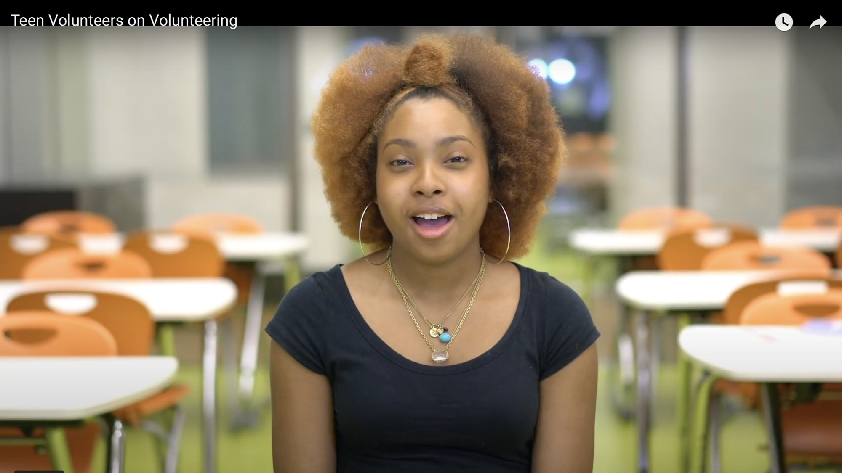
https://www.youtube.com/watch?v=xJq1ZVzG0QA
Notes:
Slide 3 & 4 & 5: Watch 1:30min and individual response (4min)
Watch this clip that tells us about the reasons why youth would volunteer. https://www.youtube.com/watch?v=xJq1ZVzG0QA
On your Lesson 4 - Worksheet by Activity 1, list FIVE reasons from this clip why youth have volunteered. (Allow learners 3 min to complete before revising the reasons below)
Some of those reasons include:
It builds character
Creates opportunities
Teaching us to empathize with others
We would experience different places we would not normally experience
This would affect the quality of life for those you help.
You would also:
Get to know yourself better
Learn new skills
Add value to your CV
Help build South Africa

Slide 4
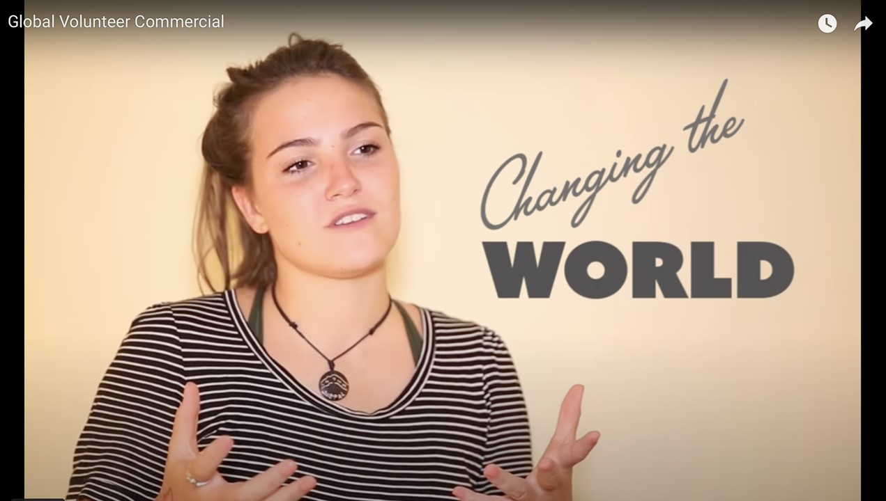
Notes:
Slide:4 Watch, group discuss and research (2+5min)
There is a move of youth all over the world to volunteer called the “Global Youth Challenge.
https://www.youtube.com/watch?v=u7o7b03OLRM
In each community there are opportunities for youth to get involved. Sometimes these are organised by a local faith-based organisation or your library. In your groups, discuss examples of where you have seen youth get involved in community projects. Ask the learners if in their research for homework they heard of organisations in their community where they could volunteer. Allow learners to research on their phones to find THREE organisations they could get involved in within their community. These should be written in Activity 2 in Lesson 4 – Worksheet. Include the THREE requirements for volunteering at these organisations. This could include age limit, times, communication requirements etc.
(Allow 5 min for this activity)
Answer:
Name of organisation
THREE requirements
The purpose of the organisation
How does this organisation help the community?

Slide 5
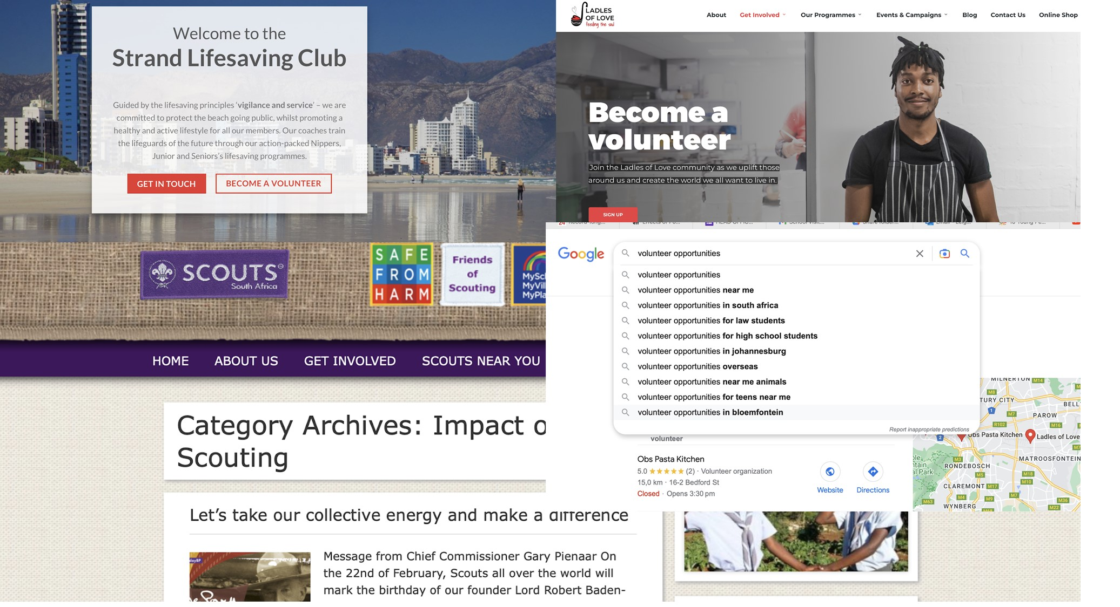
Notes:
Slide 5: 3min
Here are some examples of community projects that you might have found in your area. Ask learners to briefly share some other examples they found with the rest of the class. (Allow 3 min for feedback).

Slide 6

https://www.waterford.org/education/kids-who-changed-the-world/
Notes:
Slide 6: 5min
Maybe you are still not convinced about becoming a teenager that makes a difference in society. As a group, look at the list of 10 teenagers from around the world that have made a radical impact in their communities and the world. Choose ONE person that inspires you and write down their name and what they have done in Activity 3.
https://www.waterford.org/education/kids-who-changed-the-world/

Slide 7

Notes:
Slide 7- 12min
Plan your volunteering this week and your recording of the event. Use the storyboard on Activity 4 to plan a basic script on what to film and who will film what. You could write this in or draw it in.
You want to include:
Someone explaining the social need identified in your community.
Someone explaining what your group chose to do to get involved in the community and “make a change”
Filming of the group volunteering
Short reflection from each group member of what you have learnt from volunteering.
(Note to teacher- The learners will be presenting these videos to the class in the next lesson (Lesson 5). It would also be a wonderful promotion for LO as a subject to upload these videos on the school website. However, if you choose to go that route, please ensure that learners and parents have signed a POPI Act release which gives you permission to share their images.

Slide 8

FLASH REFLECTION….
Notes:
Reflection (1min)
Flash reflection
Turn to a friend and share ONE thing that you find a little nerve wrecking and ONE thing you find exciting about volunteering this coming week.

