Slide 1


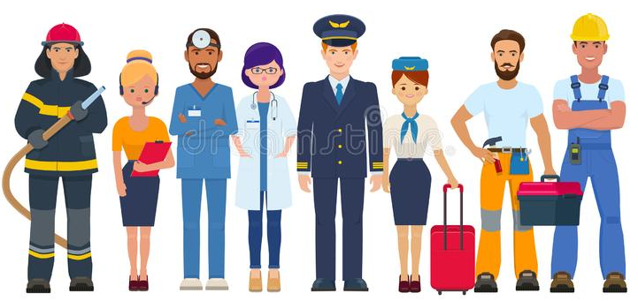


Knowledge of the World of Work:
RIGHTS and RESPONSIBILITIES in the Workplace
Lesson 3
Notes:
Refer to Gr9 T2 WOW NSC vs NCV Lesson Preparation pages 10-13 for detailed teacher slide notes regarding Lesson 3

Slide 2

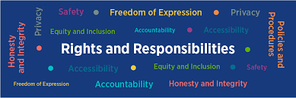
Rights and Responsibilities in the Workplace
South African workers and employers enjoy many rights, thanks to the Basic Conditions of Employment Act.
The South African constitution provides for some basic rights for workers. The Labour Relations Act (LRA) expands on these basic rights.
In addition to this, the Basic Conditions of Employment Act (BCEA) seeks to protect vulnerable workers. The conditions outlined in the LRA and the BCEA aren’t inflexible, meaning that employers can offer better conditions, but not worse conditions.

Slide 3
IMPORTANT FACTS: a
EMPLOYER – that means the person or organisation that employs people for a certain function or role.
EMPLOYEE – the person that does a specific job in return for some kind of payment in the form of salaries or wages.
Essentially, there is a working relationship that is formed when people work together, so there are things that have been put in place to govern those relationships

Slide 4

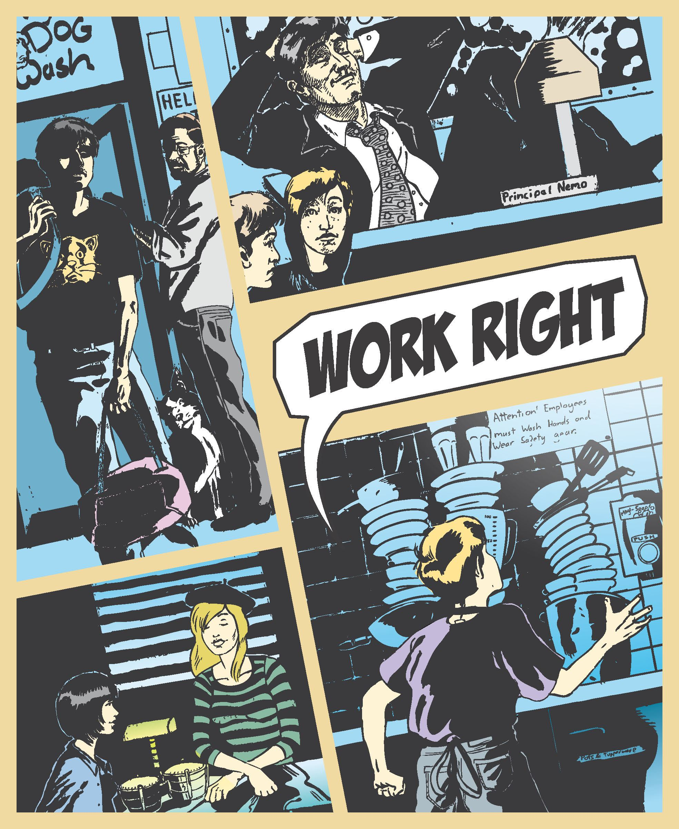
What do you think would be right or wrong in the workplace?
How should people treat one another?

Slide 5

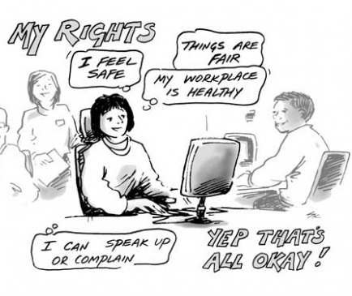

Slide 6
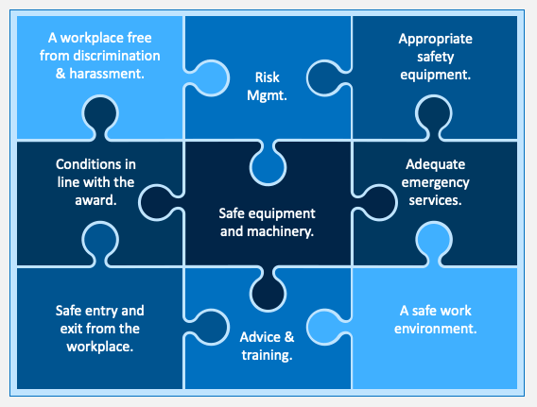
Employer Responsibilities:

Slide 7

The takeaway:
Rights and responsibilities are IMPORTANT in the workplace.
One of the main reasons is so that employees or workers are not abused or exploited in any way by employers and for their safety.
It sets boundaries within the workplace.

Slide 8


