Slide 1
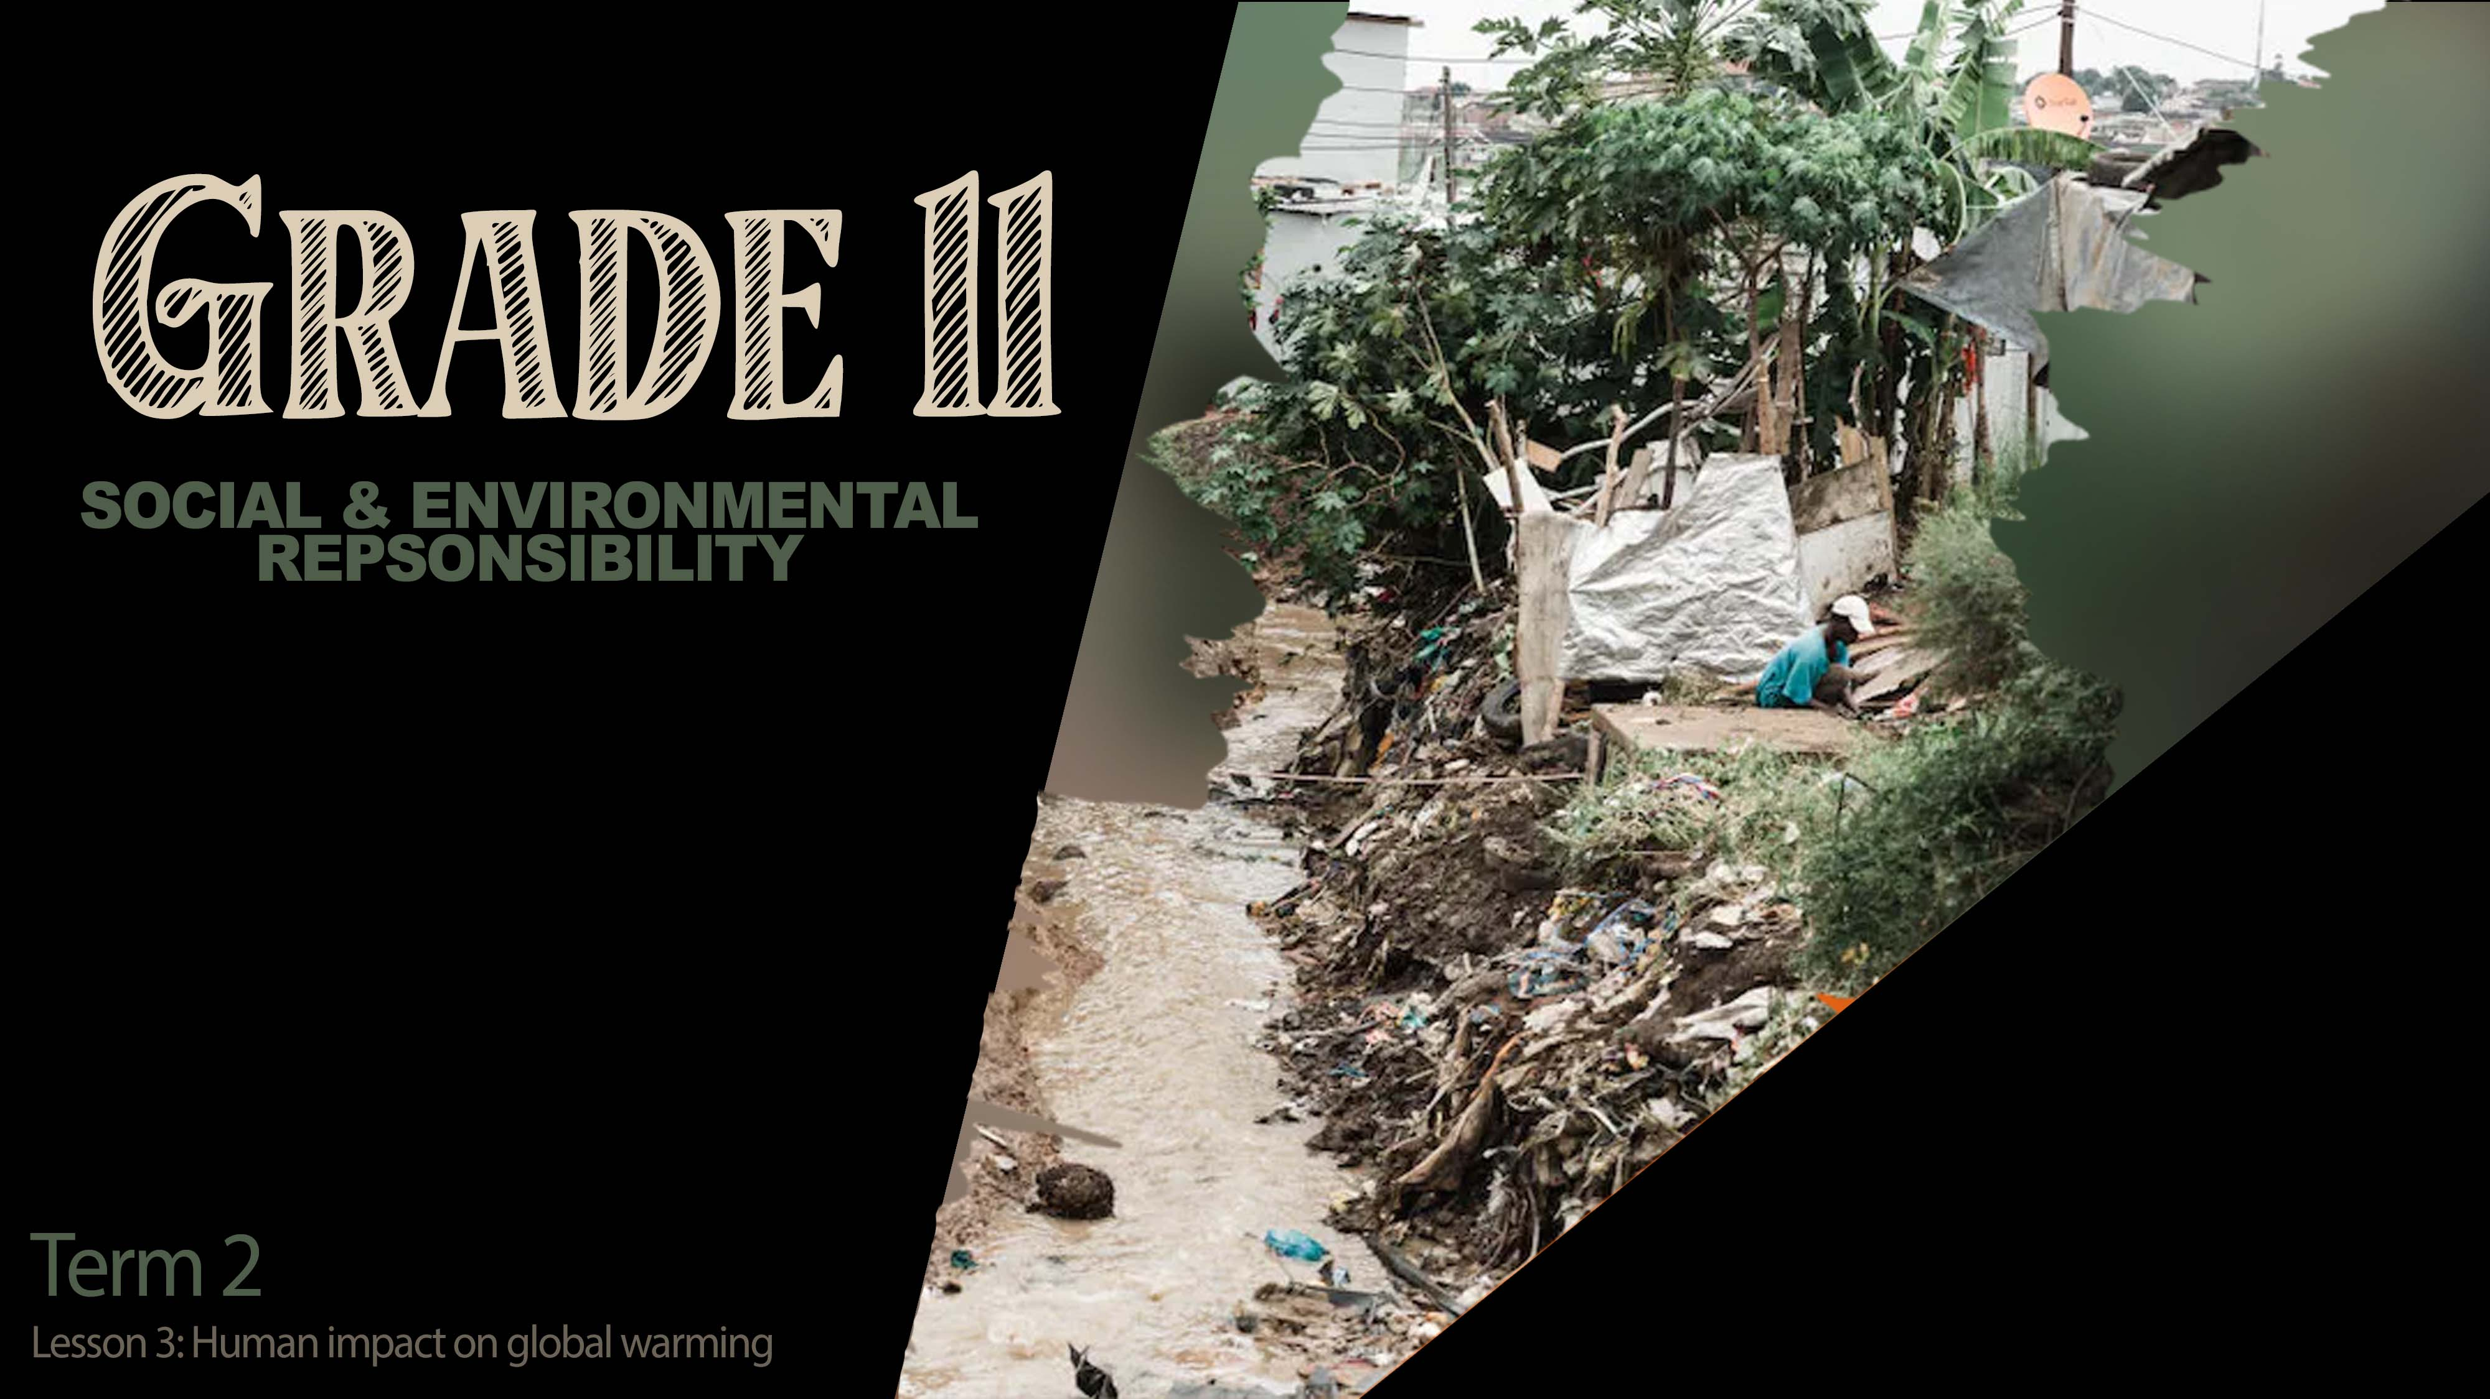

Notes:
Slide 1: 3 min intro
(Note to teacher: GROUP ACTIVTIY- This lesson will develop the knowledge for learners to investigate community involvement in addressing environmental issues over the next week. You might need to guide some of the groups if they are struggling to come up with ideas later on in the lesson. Remind them that they can look at a community project like a recycling company or animal protection like SANCOB OR they can interview members of their community. They must not use YouTube clips for this report. IT must be investigative journalism. Remind learners to be safe and work in a group. This planning will include interviews filmed on their phones.
If you are uncomfortable with the use of phones, you could simply tell the group they will have to present their findings to the class in the next lesson in a short 3min demonstration which includes photo evidence on a PowerPoint. However, for the remainder of this lesson, we will refer to the planning as moving towards a short documentary/ journalism interview that learners will hand in at the beginning of the next lesson and that will be seen by the class. )
Welcome back grade 11’s. We have an exciting lesson prepared today. By our next lesson we will see who the next top investigative journalist is in the class.
But before we can get to that, there is some content you need to have a clear understanding of. Who in this class could say that they are a passionate activist on climate change? (If any learners put their hands up ask them to share what they are passionate about.)
In the last lesson we touched on the impact that environmental damage has on the lives of the people in the community. Climate change is a much larger and more long-term problem. This refers to the changes that take place in the earth’s atmosphere, temperatures, patterns that affect rainfall and severe weather patterns. With the increase in human population where we breathe out CO2 into the atmosphere as well as the CO2 from burning, the earths atmosphere has begun to change in a negative way. Another term you will come across today is global warming. This refers to the increase in the temperature of the earth's atmosphere.

Slide 2
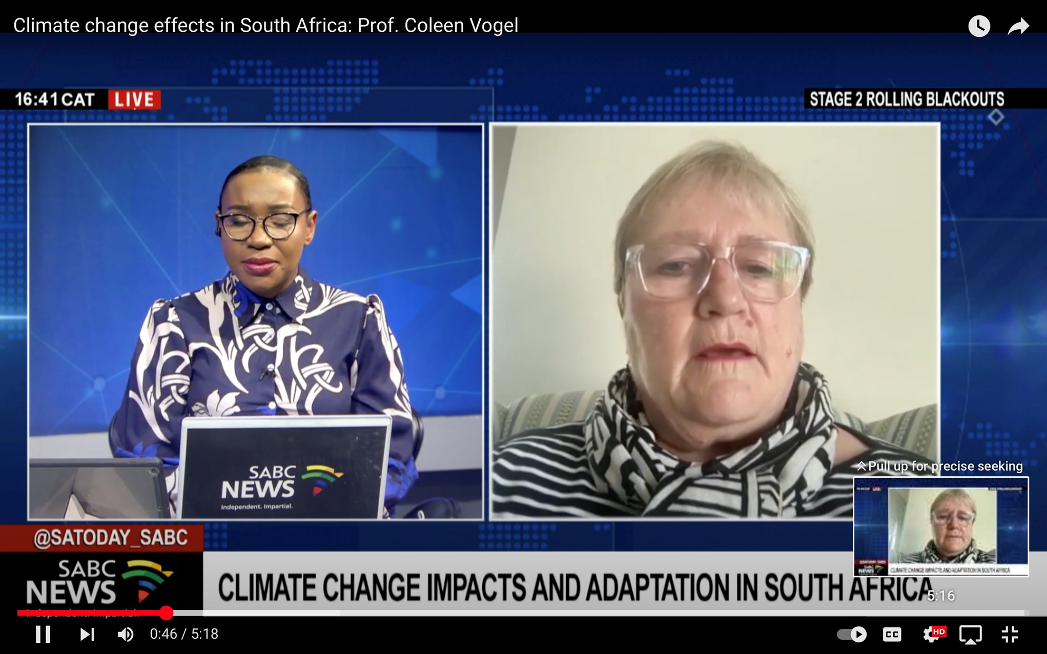
Notes:
Slide 2: 5min + 5min
Watch https://www.youtube.com/watch?v=7oWUZLYXnLw
We will now watch this clip on some recent events in South Africa. (Watch clip)
It’s scary to see the impact of climate change in South Africa. We cannot ignore it anymore.
As a group discuss the following points in Activity 1 (Lesson 3 – Worksheet) that were addressed in this clip:
What are some of the relationships between climate change and biodiversity?
It’s necessary to integrate eco-systems when developing homes.
What has been physical impact on communities in South Africa?
The run off has resulted in the damage of bio areas until the universities assisted with the clean-up.
What has been the impact on the South African weather?
There have been an increase in storms that are more severe and more constant.
How has South Africa been proactive?
Although many visible conversations at an international and national level, there haven’t been many early warning systems to the public.
How do floods impact the health of local communities?
This could be an increase in sickness as people struggle to dry and develop infections.
Loss of their homes and even their lives in severe flooding situations.
With the increase of climate change around the world there is a clear impact on:
Eco-systems
Oceans
Humans
Weather patterns
We have seen over the last few lessons that climate change is impacting the world around us. As
more floods occur, eco-systems are impacted. The oceans are experiencing an increase in
temperature as the glaciers melt. This increases in water levels. Islands like Venice have seen an
increase in water levels, slowly pushing the shoreline back. As these changes occur, humans are
directly impacted.
We have seen how an increase in severe weather conditions, people lose their homes, their lives
and in many cases, they need to start over again. There have been reports all over the world of more
severe tornados and tsunamis than ever before.

Slide 3
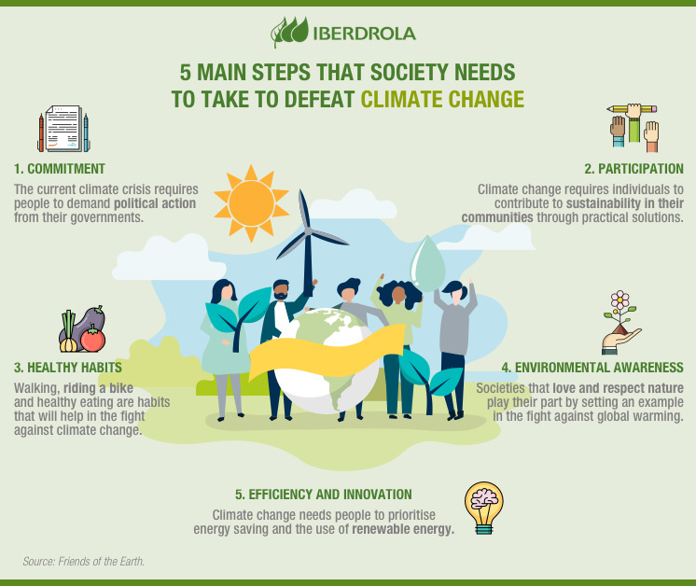
Notes:
Slide 3: 5min + 5min
It is not enough to just identify we have a problem. We needs to make changes to the way we live everyday. We refer to these changes as mitigation. To mitigate is to make something less severe by taking active steps to lesson the effects of climate change. These active steps of changing our daily habits to make a positive impact on climate change could be referred to as adaption.
E.g. As cars produce large amounts of carbon monoxide gas, we mitigate by riding cars less and adapt by using bicycles instead or using a car-pool to prevent more cars on the road.
Read through the list on the slide and provide examples in Activity 2 (Lesson 3 – Worksheet) of what YOU could do to lessen global warming.

Slide 4
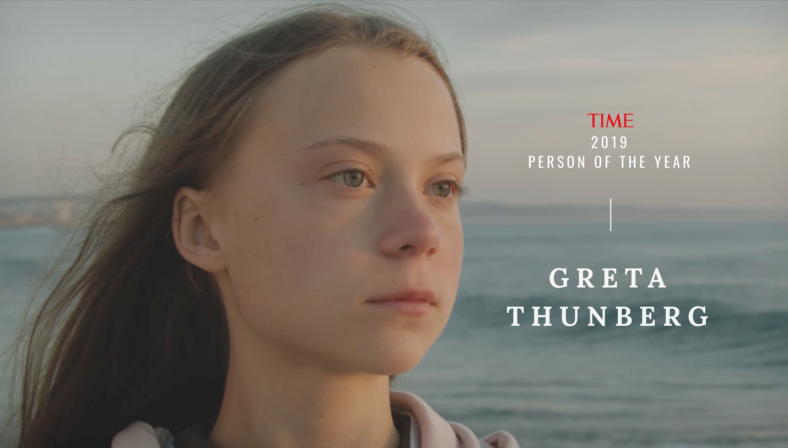
“We can’t just continue living as if there was no tomorrow, because there is a tomorrow,”
https://time.com/person-of-the-year-2019-greta-thunberg/
Notes:
Slide 4: 3min
(Note to teacher, video file is further down the page on this link. https://time.com/person-of-the-year-2019-greta-thunberg/)
How can a 19-year-old be the Time person of the year?
This young lady made an impact on the world by standing up and commenting on the impact of life on the planet in her speech at the United Nations. We will only watch a few minutes. Please take note of the major points she raises.
Watch clip.
Maybe up until today you haven't really cared all that much about climate change and the impact it will have on your future generations. In the words of Greta Thunberg, “We can’t just continue living as if there was no tomorrow, because there is a tomorrow.” It’s time for you to make a stand!

Slide 5

Notes:
Slide 5- 15min
Hopefully you are now inspired to get involved and make an impact in your community. In this activity your group will be required to do some investigative journalism on how members of your community are addressing environmental issues. This needs to include finding an organization that has addressed a particular environmental issue OR discussing with the local community what the needs are of the community in terms of environmental issues. Use the storyboard on Activity 3 (Lesson 3 – Worksheet) to plan a basic script on what to film and who will film what. You could write this in or draw it in.
As a group you need to plan your interview. Your interview needs to include:
Someone explaining the name of an organization in your community and the environmental issue that they address OR someone explaining why your group have chosen to interview certain people.
An interview with someone at this organization explaining how they are impacting on climate change. OR interview members of the community asking how they have tried to positively impact on climate change.
Include an additional FIVE questions to add insight into this organization.
Lastly, interview the group members to find out how they intend to participate in community services?
(Note to teacher- The learners will be presenting these videos to the class in the next lesson. It would also be a wonderful promotion for LO as a subject to upload them on the school website. However, if you choose to go that route, please ensure that learners and parents have signed a POPI Act release which gives you permission to share their images.)

Slide 6

REFLECTION
Notes:
Slide 6: 3min Reflection
As we finish off this lesson, read through and answer the questions on Activity 4 (Lesson 3 – Worksheet). Reflect on the following:
Have you considered the importance of climate change on your future and that of your children one day? How would you change the way you live now, knowing that the planet will be a different place in 20 years time if we don’t change our bad habits?
Explain ONE strategy you could propose to your school RCL to address the issue of climate change.
Reflect on how you could use social media to create awareness?

