Slide 1
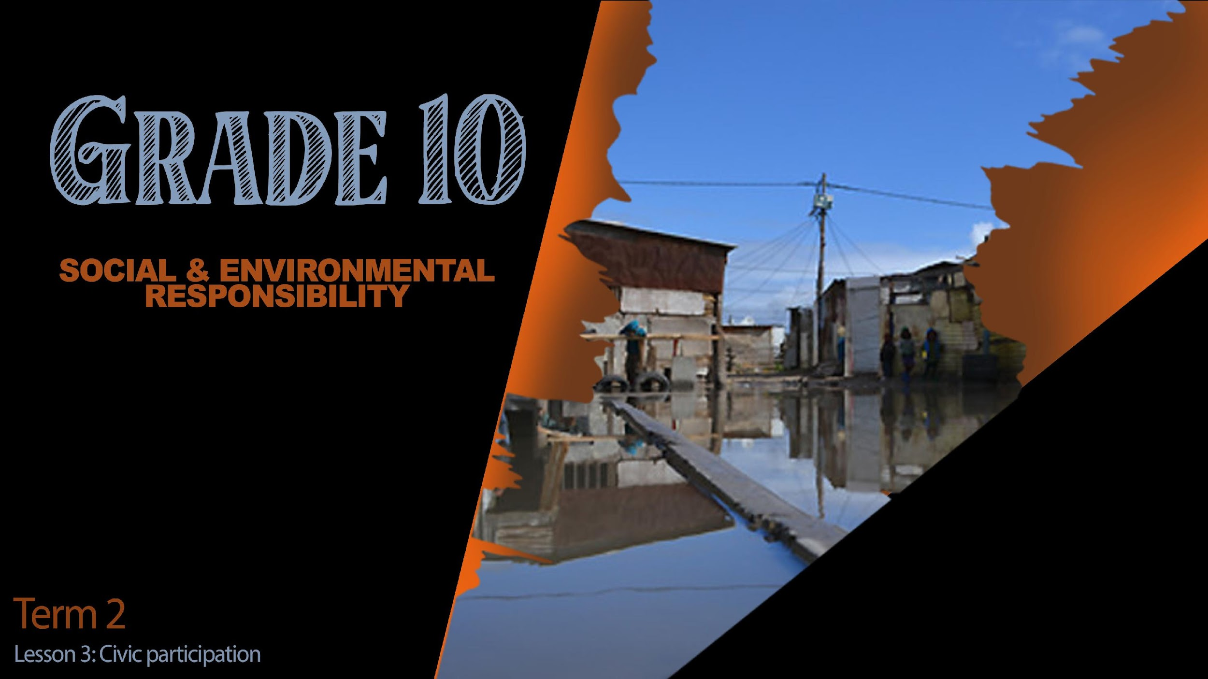

Notes:
Slide 1: intro 4min
Welcome back to class Grade 10’s. I hope you enjoyed your wrap up challenge from the last lesson. Briefly share with one person which of the challenges was the most memorable for you. (1 min)
In the last two lessons we have seen different examples of social and environmental injustice. Briefly share with a different person TWO harmful effects of poverty on a community. (1 min)
Maybe you have begun to feel quite strongly about some of the issues that have been raised and you wish you knew how you could make a difference in your own school or community. Over the next three lessons we are going to develop a plan and make a difference in your local community. But before you can become a person that impacts and adds value to society, we will need to develop different kinds of social thinking and constructive thinking skills, because these challenges are complex and need skills that will help you to give it your best shot.

Slide 2
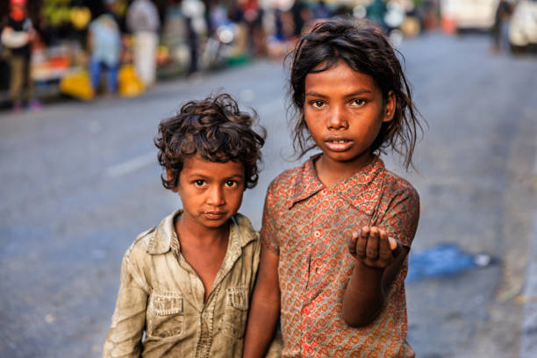
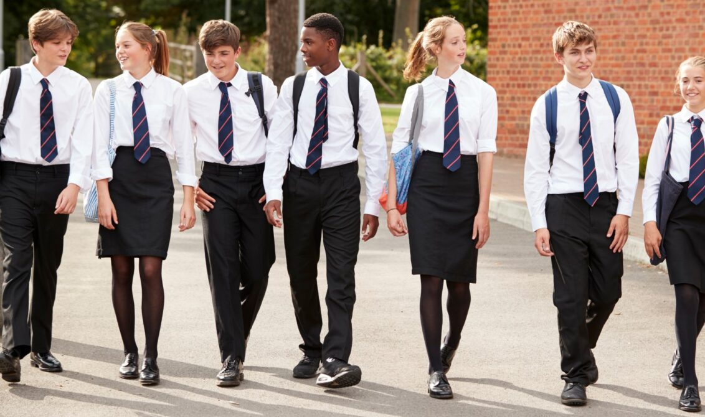
Food please …
?????
Notes:
Slide 2 and 3: Teach and Activity (3+6)
Social thinking skills can be defined as skills that will help you see a need in society and reason out what actions you could take to impact that need. These skills also help you to consider the emotions and responses of other people. (i.e. to show empathy)
Constructive thinking skills let you think in a helpful way. This allows you to analyse a situation and not just act with too much emotion.
When you are confronted by a challenging situation you will need to use these skills. Look at the image on Slide 2. You and your friends are walking home from school, and you come across these two children that are begging for food because they are hungry. You would use your social thinking skills by recognizing the NEED- They are hungry. You would wonder what they are FEELING / THINKING and you would FEEL sympathy towards them. Constructive thinking skills help you consider a solution - like you and your friends putting some money together to buy some bread for these children.

Slide 3
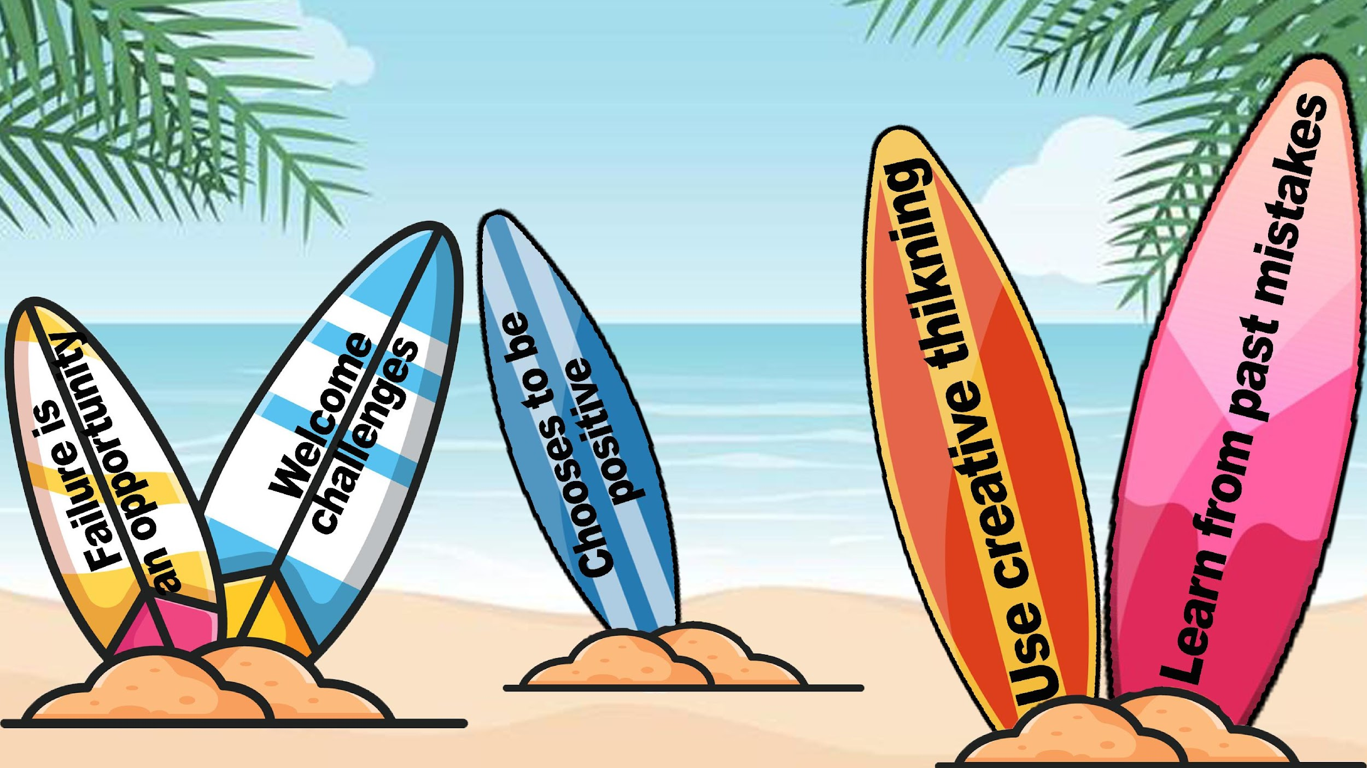
Notes:
Slide 3:
We could say that a constructive thinker will:
See failure as an opportunity to learn something new.
Welcomes challenges with a positive attitude.
Chooses to be positive in the midst of a problem situation.
Uses creative thinking- thinking “out the box” to come up with other possible solutions.
Being a person that learns from past mistakes and applies this knowledge in new situations.
On your worksheet, complete Activity 1. (Lesson 3 – Worksheet).

Slide 4
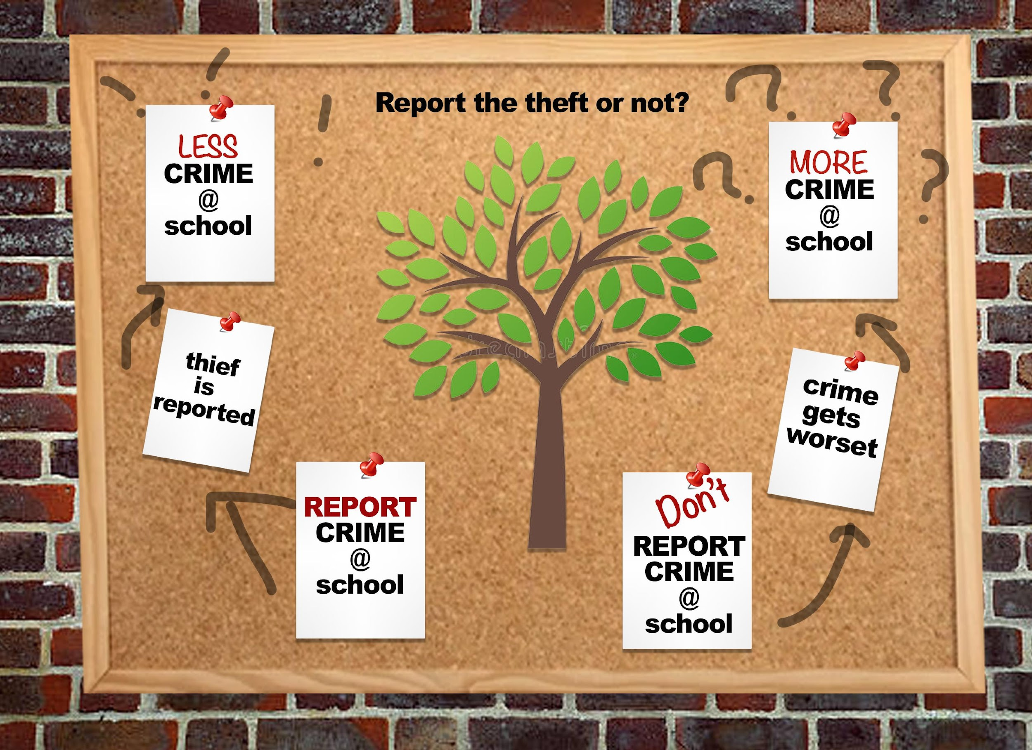
Notes:
Slide 4: 5min teach
In order to address a social issue we need to first find out as much information we can before making a decision. Basically, this means to think about the pro’s and con’s or advantages and disadvantages of responding.
Look at the example on the slide:
If you witnessed the theft of a cell phone at school. You would have a choice to make. Making a decision like this requires looking at the different possibilities. If you report the crime, there is a chance the person might know you saw them and threaten you. But at least the issue will be dealt with and impact on crime becoming less at school. If you choose not to report the crime because you are afraid, the crime at school might actually become more.
So how do we become people that actually take action and make a difference?

Slide 5
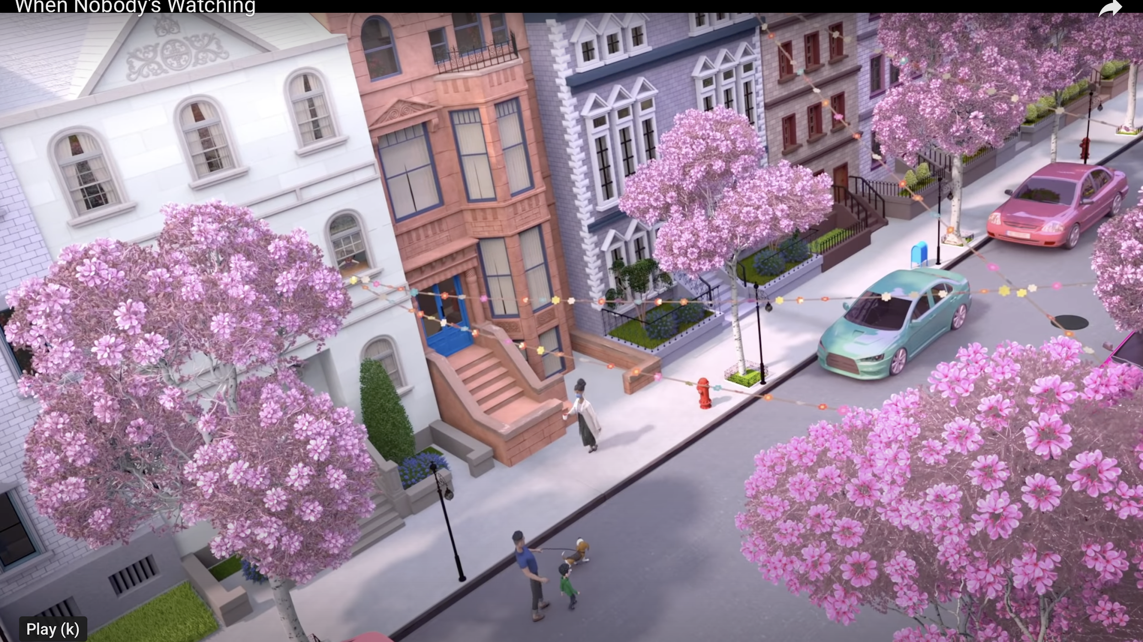
https://www.youtube.com/watch?v=ET4B3UfWrYY
Notes:
Slide 5: Watch (2min) and class discussion (4min)
Watch https://www.youtube.com/watch?v=ET4B3UfWrYY
We can see that one person can make a difference. In this clip one lady volunteered to help people in different situations. Ask learners to respond to clip:
Why do you think this lady was always helping people?
(She cared about people and felt like she could help others who were less fortunate than others. It also made her feel good about helping others.)
What inspired you most about this story?
(Allow learners to respond.)
If you wanted to help the elderly, where would you find more information to know where to help?
(Learners could say they could ask on social media, phone a local old age home and see if they could help. Any other suggestions as well.)
To address a social impact, we need to first outline the knowledge and skills required to make the best decision to help. Basically, this means to think about the pro’s and con’s or advantages and disadvantages of responding.

Slide 6
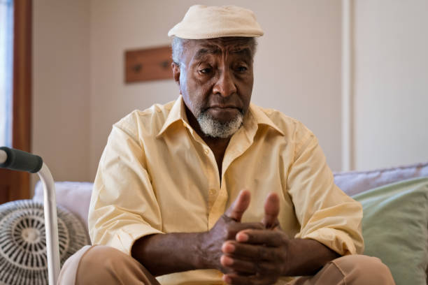
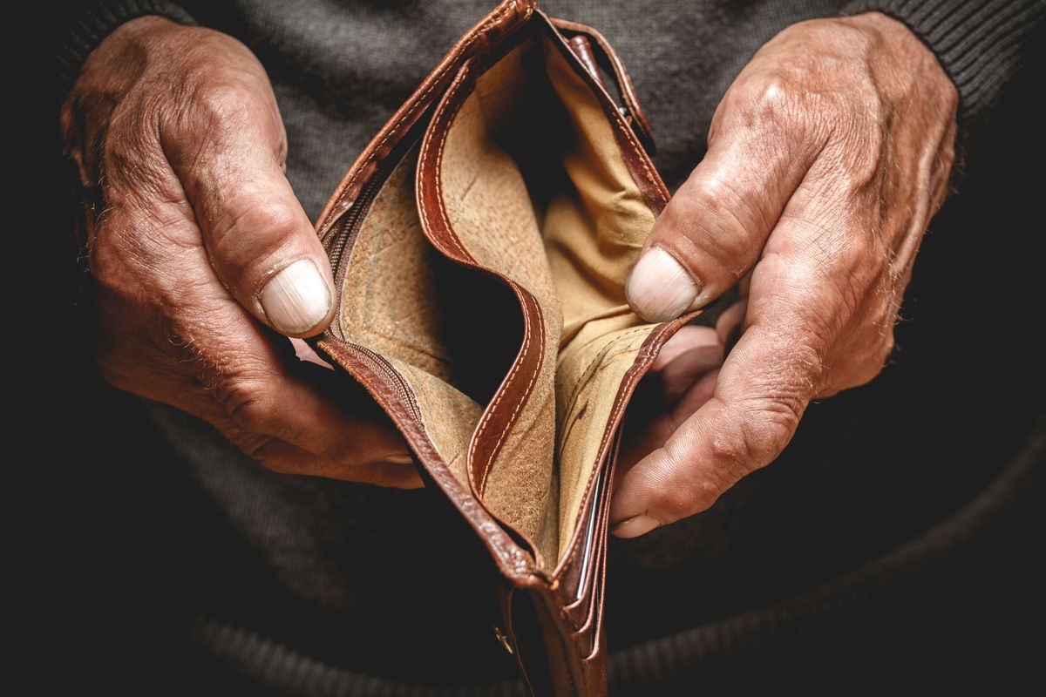
Poor lonely elderly school pre-school litter
??????? Animals
??????
??????
Notes:
Slide 6: 13min Group planning
Using the thinking skills (social & constructive) you have learnt through experience today in your groups, you will begin to start planning how your group will make an impact on your community. If you have no idea where to start, look at the list of some groups of people on the slide. You could also choose your own group of people. You will now use the
Lesson 3 – Worksheet (Activity 2).
As a group, fill in your group planning.
(Lesson 3 Homework). Note to teacher: This is the first stage of learners implementing a plan to volunteer in a simple capacity in the next two weeks. Tell learners they must take their notes from this discussion and collect information before the next lesson. They will have a little time next lesson to finalise their plan on how they will volunteer and what they will do. Encourage learners that this could be a memorable and life changing experience.)

Slide 7
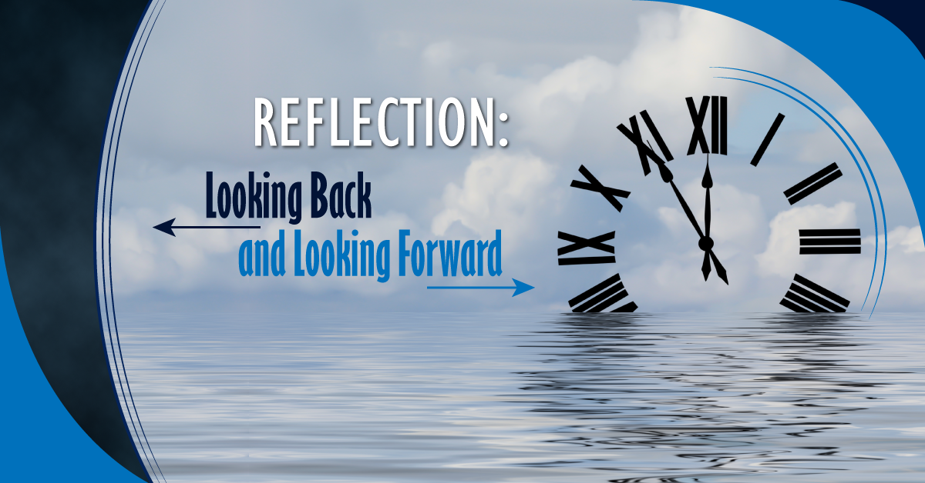
Notes:
Slide 7: Reflection 3min
As we end this lesson, reflect on what you have learnt today.
Refer to the list of what a constructive thinker would say:
Identify TWO of these statements that are difficult for you?
How could you make an effort to change this attitude?
Answer the Reflection Questions at the end of Activity 3. (Lesson 3 – Worksheet).
(Note to teacher- encourage the class to be quiet this time. It might even help to play music. Tell the class to remain quiet until you say they can talk.)

