Slide 1

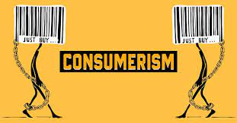
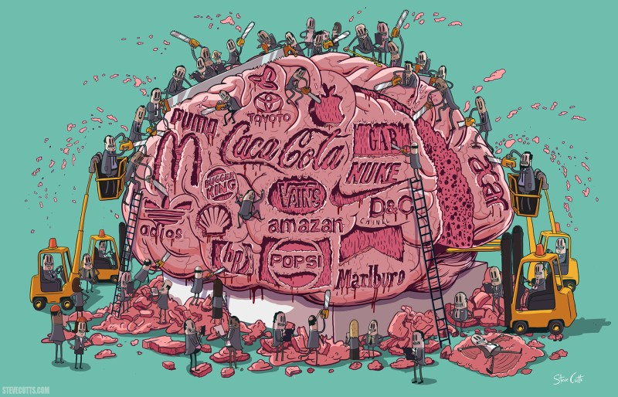
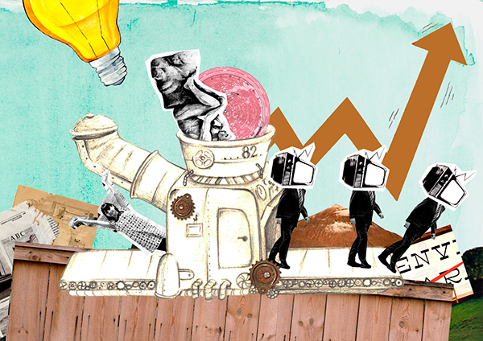
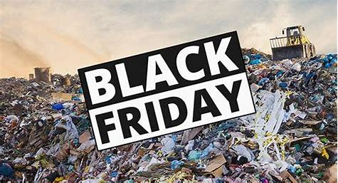
Consumerism
CAT A
2023

Slide 2
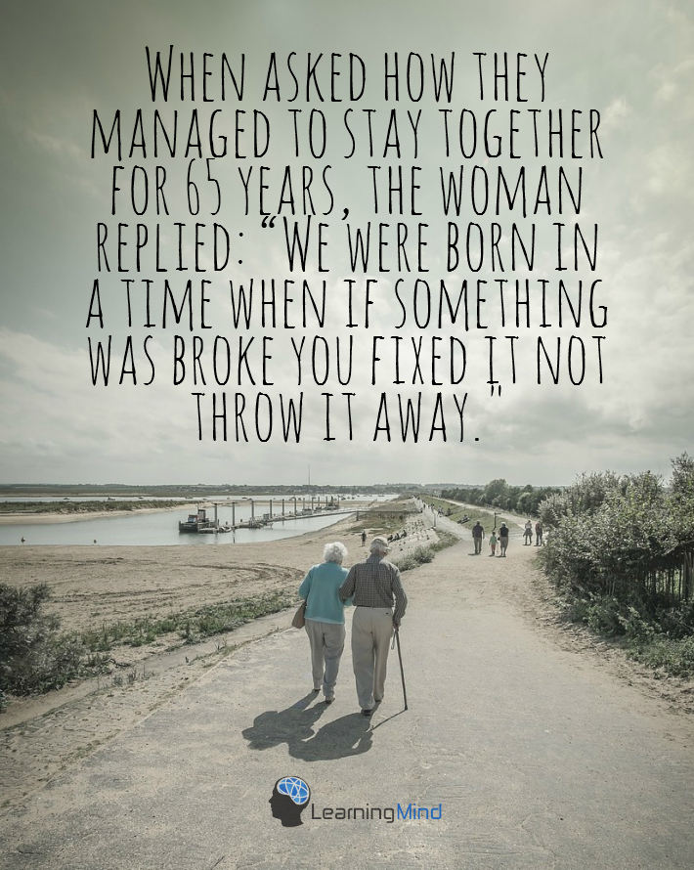

WHAT IS CONSUMERISM
The belief that people’s happiness requires purchasing goods and services in an increasing amount.
“Our consumer society distracts us from the things that have a real value in life. Instead, it directs us towards ephemeral goals, making us serve its interests without even being aware of it.”

Slide 3
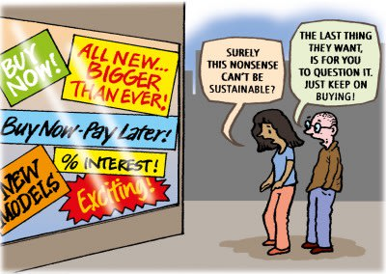
HOW ARE WE IMPACTED BY THE IDEAS OF CONSUMERISM ?
https://www.youtube.com/watch?v=sSDqAnTQsZA

Slide 4
America's Dopamine-Fueled Shopping Addiction
https://www.youtube.com/watch?v=_qWHJ29-s4U

Slide 5
7 reasons we buy more stuff than we need
We think it will make us feel secure
We think it will make us happy
We are more susceptible to advertising than we think
We are hoping to impress other people
We are jealous of people who own more
We are trying to compensate for our deficiencies
We are more selfish than we like to admit

Slide 6
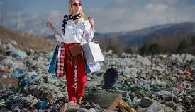
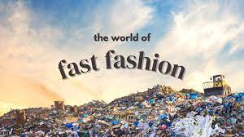
Fast fashion
Fast fashion is a term used to describe the clothing industry's business model of replicating recent catwalk trends and high-fashion designs, mass-producing them at a low cost, and bringing them to retail stores quickly, while demand is highest.

Slide 7
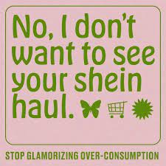
Fast Fashion- STOP SHEIN
https://www.youtube.com/watch?v=U4km0Cslcpg

Slide 8
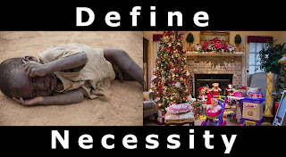
The Problem With Fast Fashion | Teen Vogue
https://www.youtube.com/watch?v=iq0--DfC2Xk
The astonishing amount of water used to make a pair of jeans! | Fashion Conscious - BBC
https://www.youtube.com/watch?v=eSSQOaYkiik

Slide 9
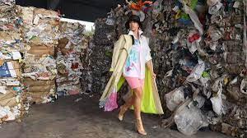
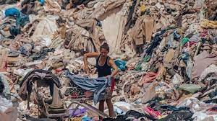
What is fast fashion doing to the environment ?
H&M and Zara: Can fast fashion be eco-friendly?
https://www.youtube.com/watch?v=EFt2zcRhA8Y
H&M and Zara: Can fast fashion be eco-friendly? https://www.youtube.com/watch?v=00NIQgQE_d4

Slide 10
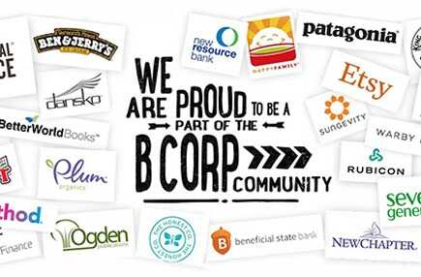
The 15 Most Environmentally Friendly & Sustainable Companies (2022)
https://www.youtube.com/watch?v=JhbZ0b5PH10

Slide 11
Retrieved from: https://growensemble.com/environmentally-friendly-companies/ 8 March 2023
“When a company claims their operations sustainable, know what to look for:
Transparent & ethical sourcing of materials
Environmentally conscious manufacturing practices
Waste-conscious packaging (recyclable, as little material as possible)
Shipping options that negate the carbon footprint
Diverting landfill waste at their products end-of-life”

Slide 12
“Proof of “eco-friendly” claims, such as certifications, audits, or other forms of accountability (like Certified B Corporations)
It’s much more than just “eco-friendly” products—these companies embody positive social and environmental impact at their core. Negatively affecting the environment is out of the question. Rather, it’s how substantial their positive contribution is.”

Slide 13
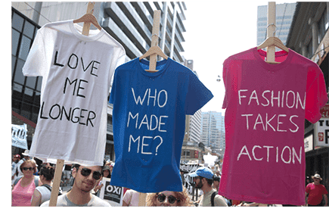
Conscious Consumerism: What it is & Why it Matters
“Conscious consumerism is when buying practices are driven by a commitment to making purchasing decisions that have positive social, economic, and environmental impact.”
https://www.youtube.com/watch?v=BbBuZpfc7-4
7 Ways to Be a More Conscious Consumer
https://www.youtube.com/watch?v=S2fufJ2_vPc

Slide 14
What can we do?
Recycling clothing
“Ethical consumers are informed consumers with a powerful collective voice. By expressing their views in a coordinated way, they can have a positive influence on the quest to create a more sustainable economy.”
https://www.yaga.co.za
Yaga is an app for selling & buying preloved fashion. Everyone can list their items and start selling for free; or shop for second hand finds safely and conveniently.
https://www.vinted.co.uk/
Sell the clothes that have more to give. Shop for items you won’t find in stores. Vinted is open to everyone who believes that good clothes should live long.

