Slide 1

FINANCIAL ASSISTANCE
Bursaries (Example: NSFAS, Fundza Lushaka, and other),
and
Sector Education and Training Authorities (SETA)
Obligations in terms of financial arrangements
Notes:
See detailed slide notes in Lesson Preparation document.

Slide 2

Agenda
There are high costs required to study - including tuition fees, accommodation, transport, food, books, stationery, devices, airtime etc.
If you do not have the money to study, then financial aid is sometimes an option.

Slide 3

Types of Funding Options
THREE main types of funding:
Other types of
funding:
Indirect …
Student Loans
Scholarships
Bursaries
Paying yourself
Funza Lushaka Bursary
The National Student Financial Aid Scheme (NSFAS)
How SETA assists:
- in general
- via Learnerships

Slide 4



A loan is money that you have borrowed. You need to pay it back after completing your studies.
Many banks make these loans attractive, with low interests. A parent/guardian must sign surety. Surety is when someone takes responsibility for another person’s debt if they are unable to make payments for any reason.
Awarded on merit to students with good/top academic results or outstanding talent and achievement in sport/music.
It is a financial reward usually given to students based on achievements - recipients are not always expected to repay or work back the money that they receive.
Financial assistance given to a student for further study. Usually awarded on merit, but often more criteria than only academic achievement.
Some bursaries involve obligations. Higher education institutions have bursaries that are financed by companies. Some bursaries require that you work for the bursary company.

Slide 5


Other types of funding include:
Paying yourself: An option if you decide to work first before studying or work while studying.
Funza Lushaka Bursary: is specifically for students who are studying to become teachers and is awarded annually, based on academic ability.
The National Student Financial Aid Scheme (NSFAS): is a South African government student financial aid scheme which provides financial aid to undergraduate students to help pay for the cost of their tertiary education after finishing high school. Funded by the Department of Higher Education and Training.

Slide 6

Sector Education and Training Authority
(SETA)

Slide 7

Many people don’t have the workplace skills needed to improve their lives. This is where SETA comes in.
The aim of SETA is to upskill workers while enhancing our ever growing and changing economy.
There are a total of 21 SETAs in South Africa.
Each SETA manages and creates learnerships, skills-based programmes and internships in its sector.
Every industry and job in the country is covered by one of the 21 SETAs.
The SETAs provide information on quality education and training offered by employers within their sectors.
They can help you to find funding options and avenues to gain new skills while you are working.

Slide 8



Slide 9
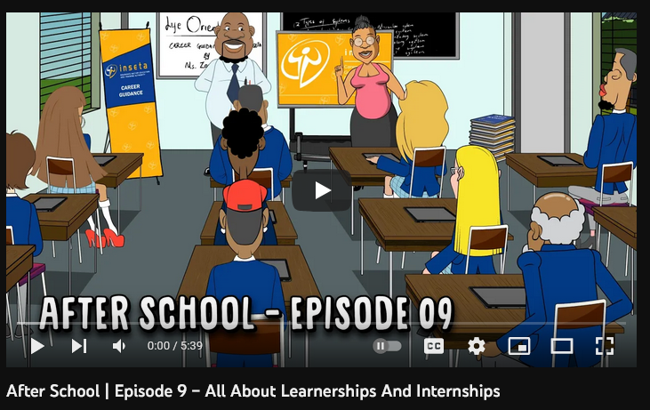
https://www.youtube.com/watch?v=IPyrYSFkZTc

Slide 10


A learnership is a work-based learning programme that leads to an NQF registered qualification. Learnerships are related to an occupation or field of work.
E.g. electrical engineering, hairdressing or project management.
Learnership programmes can help you to gain the necessary skills and workplace experience that will open better employment or self-employment opportunities.
Learnerships are managed by Sector Education and Training Authorities (SETAs). They were introduced by government to help skill learners and to prepare them for the workplace.

Slide 11
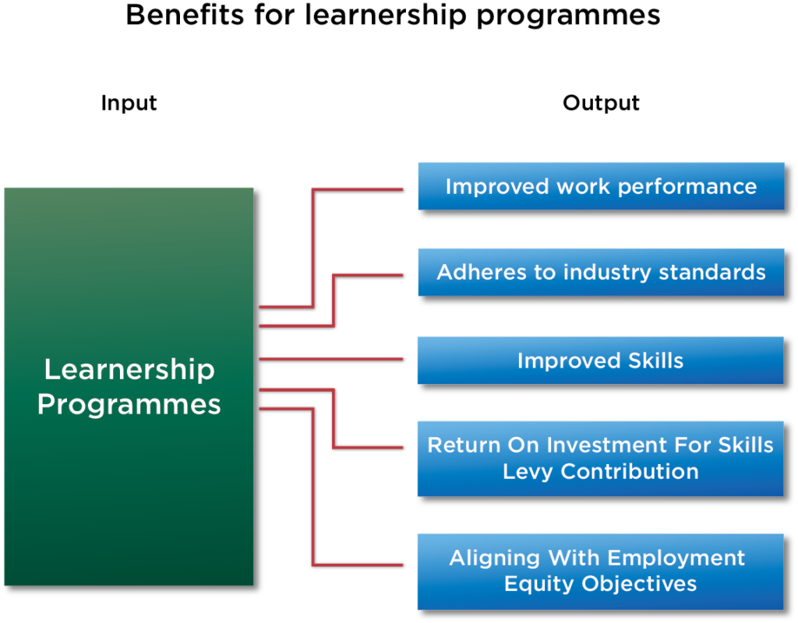

Slide 12

What happens AFTER you’ve gotten funding and finished studies?
That very much depends on what type of funding you received.

Slide 13

Depending on the type of funding received to help you with your studies, will determine what your obligations are.
Loans from a bank or financial institutions are paid with interest (interest is the cost of credit). This would involve a legal contract and loan agreement with the bank.
Bursaries: usually do not need to be paid back, (unless you do not pass or drop out). You may be required to work for the company for a set period once studies have been completed. This can be referred to as a contract bursary.
Scholarships: generally, not required to be paid back, but you do need to do well and get good results.

Slide 14
Study Loan / Student Loan is borrowed money that is repaid over the time once a student has completed their studies and starts a job. In addition to repaying the amount loaned, most loans also require an additional fee called interest. A student loan is used to pay for college or university costs. Once studies are completed, you’ll be responsible for sending out monthly payments to the company or institute that you have taken out a loan with.
Learnerships: do not need to be paid back.
NSFAS: You will only start repaying your loan once you have a salary of R30 000 or more per year. No need to worry as the repayments are worked out at a rate that will not place a great burden on you and is based on your salary. 40% of a general loan is converted into a bursary if you pass all of the courses you were registered for in that year.

Slide 15

But REMEMBER…
If you are going to apply for financial aid, you need to make sure you read and understand all the terms and conditions (Ts&Cs). You need to know what you are responsible for paying back or what conditions may or may not apply to you not having to pay the money back.
Some companies that provide bursaries or scholarships may require you to work for them for a certain length of time. That may be different from one place to another.
There are general bursaries available or nonspecific bursaries, but there are also specific ones related to certain careers or fields of study.
It is vital to EXPLORE all your financial options CAREFULLY before you accepting any offers.

Slide 16


There is a lot of information out there – however its up to you to get out there and make things happen for yourself. These things take time and effort, and most of all
PERSEVERANCE.
There are many wonderful organisations and places that are willing to help students – RESEARCH, set SMART goals and GO FOR IT!

