Slide 1

Grade 11
Life Orientation
CAREERS & CAREER CHOICES
HIGHER EDUCATION: Choices after High School
Notes:
See detailed slide notes in Lesson Preparation document.

Slide 2
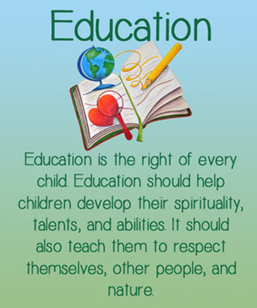
All South Africans have the right to a basic education, including adult basic education and further education. According to the Bill of Rights in the Constitution, the state has an obligation, through reasonable measures, to progressively make this education available and accessible.
In South Africa, there are THREE training levels – each one leads to the next. Like stepping stones to YOUR future.

Slide 3

The Levels:
Currently, you find yourself in the FET Band, and having just begun your journey into Grade 11, you’ve already made many decisions along the way.
Grade R - 9
This includes Primary School as well as the first two years of High School
Grade 10 - 12
Matric is essentially a THREE year qualification, each year builds on the next.
Post Matric
Once the National Senior Certificate has been obtained, students can then study at tertiary institutions depending on the pass that was achieved.

Slide 4
THINGS TO KNOW:
The National Senior Certificate (or NSC) is the school-leaving certificate in South Africa. This certificate is commonly known as the Matric certificate.
Further Education and Training (FET): refers to education and training provided from Grades 10 to 12. This also includes training offered at TVET, community colleges and private colleges.
Higher Education: Studies undertaken after you have successfully written the NSC, qualifying you for further studies.
Tertiary Studies: refers to all formal post-secondary education. It includes both public and private universities, colleges, technical training institutes, and vocational schools.
Postgraduate: People furthering their studies after obtaining a degree – for example: Honours, Masters, PHD or Doctorates.

Slide 5

Recently you have made a lot of important decisions - you have chosen your subjects, and possibly even started some Career Planning.
The stepping stones that we referred to earlier are all part of that.

Slide 6

At the end of Matric, you will write your Final National Senior Certificate Examinations.
The results you get will ultimately determine your path after school.

Slide 7
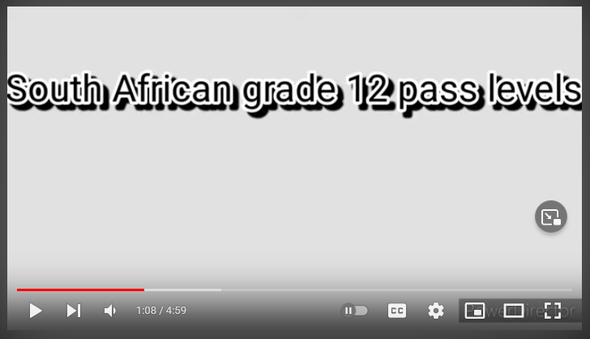
https://www.youtube.com/watch?v=R-PFztLktNs

Slide 8
MATRIC PASSES:
BACHELOR’S DEGREE PASS
DIPLOMA PASS
HIGHER CERTIFICATE PASS
SENIOR CERTIFICATE PASS
Study at any tertiary institution, as long as you meet the requirements for your chosen field of study
Study at a tertiary institution towards a diploma qualification
Study for a Higher Certificate at a tertiary learning institution.
This is an ordinary pass in Matric. Study any course that only requires a pass in Matric.

Slide 9

FURTHER STUDIES
Requirements for admission into Further Studies generally depend on the type of qualification as well the educational institution you choose to study at, and the course you choose to study. Each institution has its own requirements depending on the qualification.
BUT – HIGHER INSTITUTIONS ARE NOT GUARANTEED TO ACCEPT YOU JUST BECAUSE YOU PASSED MATRIC.

Slide 10
HIGHER EDUCATION OPTIONS
The National Qualifications Framework (NQF) is responsible for providing the guidelines which higher education systems make use of.
Higher education qualifications begin from level 5 and go in the following order:
(NSC is a Level 4)
Level 5: Higher Certificates and Advanced National (Vocational) Certificate.
Level 6: National Diploma and Advanced Certificates.
Level 7: Bachelor's degree, Advanced Diplomas.
Level 8: Honours degree, Postgraduate Diploma, and Professional Qualifications.
Level 9: Master's degree.
Level 10: Doctor's degree.
Obtaining a certificate implies that a student has gained a basic level of understanding of higher education knowledge and skills.

Slide 11
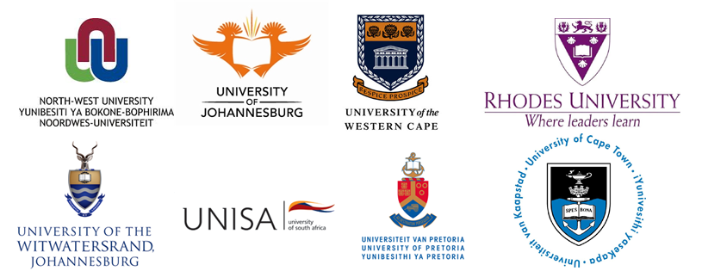
There are many institutions in South Africa to choose from and the best way to know whats out there is to research and look into your options.

Slide 12
Any questions?

