Slide 1
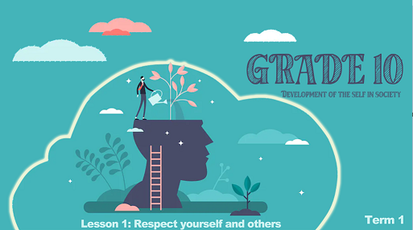

Notes:
Good day Grade 10’s! Welcome back to Life Orientation this year. You are now a senior in the FET phase of high school. The subjects you’re doing this year, you’ve chosen to do because of your interests and hopefully future dreams and goals. This will be an exciting year where you get to know yourself even better and begin to make choices about your interests, values and beliefs that will shape the person you will become as an adult.
What would you say makes a person unique?

Slide 2

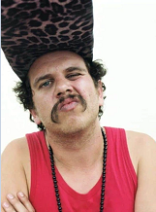
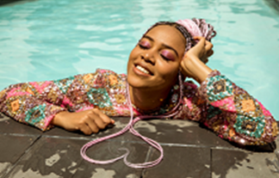
Uniqueness can be defined as that which makes a person special or different to someone else.
Notes:
Uniqueness can be defined as that which makes a person special or different to someone else.
Let's look at these two South African rappers. Do you know their names? Who likes their music? Who doesn’t like their music? We can see that even by our choices of music, we are different.
On a blank piece of paper: Let’s see how many differences you can list that you have compared to these two rappers. You have exactly 30sec. Let’s see who has the longest list.
We can see that our difference extends beyond just our interests in music. There are differences in gender, race, religion, culture, fashion and so much more. When you refer to what interests you, knowing who you are and what your strengths and weaknesses are, we refer to is as Self- knowledge / self-awareness.
We know that our interests can be described as something that attracts your attention and makes you want to learn more about it or to be more involved. Strengths: those things you do that you naturally do well while weaknesses: are those qualities that limit you from being effective. Lastly, we could say that self-esteem is a term that describes how you feel about yourself.
In your Lesson 1 – Worksheet, take a few moments to complete Activity 1 and 2. (5 min)

Slide 3
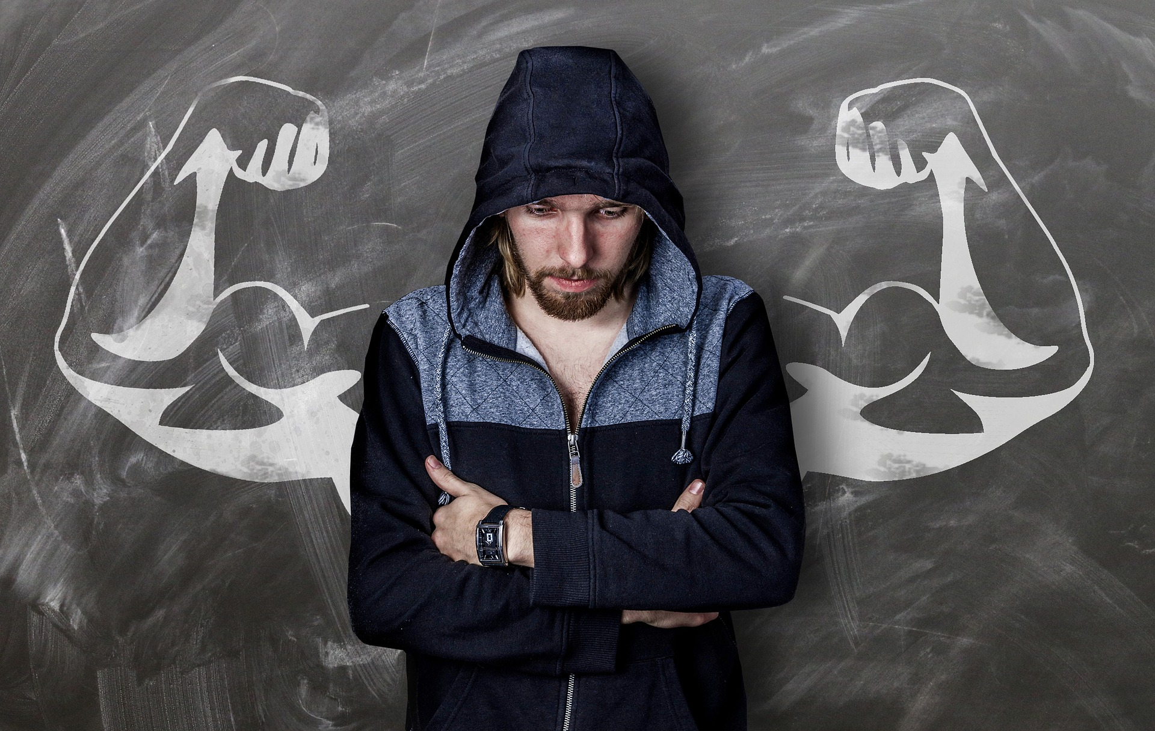
How do you build
self-awareness?
Notes:
If you struggled with some of your answers in Activity 2 and find that your self-esteem is low, then how do you build confidence and self-awareness in yourself?
REMEMBER: We will all struggle from time to time with low confidence and self-esteem. Think of any athlete – even the most talented / successful go through slumps. So, finding strategies to build confidence and self-awareness in yourself applies to all of us.
Strategies to build your self-awareness:
Keep an open mind and be prepared to try new hobbies and discover new interests.
E.g. Try something like walking/ running. You may find you enjoy the exercise even though you’ve never exercised before.
Be mindful of your strengths and weaknesses and be prepared to grow in each.
E.g. Knowing that you are shy and struggle to start a conversation is an opportunity to grow in communication skills.
Stay focused on the moment. Become aware of your emotional triggers and what causes you to become upset or angry quickly.
E.g. knowing that when you’re hungry you get easily irritated and angry with those around you.
Set boundaries for yourself that help you stick to your values.
E.g. No sex before marriage; won’t do drugs
Practice self-discipline.
E.g. Choose not to eat junk food all the time because you know the impact it will have on your health.
Consider how your actions affect others.
E.g. Before you give your opinion in a conversation that could be perceived as judgmental, consider the impact your words would have on those around you.
We are going to go straight into Activity 3 (Lesson 1 – Worksheet) where you will use your self-awareness to illustrate what makes you unique.
Activity 3: On your tables are small pages of square paper. Start by writing your name on the one side of this piece of paper. On the other side you will have 5 min to illustrate what makes you unique. You cannot use any words. These little drawings will end up on my classroom wall in another activity that I’ll explain later. You may get started.

Slide 4
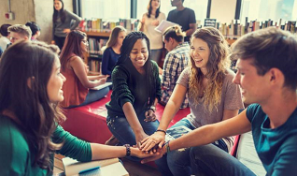
Notes:
At the start of the lesson, when we looking at the differences between ourselves and the two musicians, we saw that although we are different to those around us, we need to respect one another. We don’t need to be the same as someone else to respect them. Respect means acknowledging what makes us unique and admiring others for their unique qualities.

Slide 5
Tips to CHATS when others are different to you:
C- be CALM and friendly
H- HOLD your tongue, listen to what they are saying.
A- ASK questions about their interests/ talents
T- Acknowledge the TALENTS/ qualities that make the person unique.
S- SMILE..You are both human and have that in common.
Notes:
Sometimes we just need to learn a few skills on how to talk to someone when you’re uncomfortable and find that you’re different. All you need is some tips to CHATS
C- be CALM and friendly
H- HOLD your tongue, listen to what they are saying.
A- ASK questions about their interests/ talents
T- Acknowledge the TALENTS / qualities that make the person unique.
S- SMILE. You are both human and have that in common.
In your Lesson 1 – Worksheet, refer to Activity 4
Find a person in the class that you don’t know. Sit opposite them, looking at one another, maintain eye contact during this activity. Each person will have 2min to ask questions and listen to the answers from the other person. After 2min swop and ask the other one questions
1) What is your name?
2) What are your interests/ talents?
3) What are your religious beliefs?
4) Tell me something that you believe makes you unique.
5) What quality about yourself do you like the most?

Slide 6

Notes:
As we draw to a close this lesson. We have seen how important it is to respect others. Remember to respect one another means to accept someone regardless of the differences they have to you. This could include race, gender, interests, talents and even cultural differences and religion. Often the challenge with respecting others is that we find it very difficult to respect ourselves. Sometimes we focus so much on the qualities about ourselves that we do not like, that we fail to see the amazing qualities in others that make them unique.
This year there will be an opportunity for you to grow in respecting yourselves and respecting others. Part of that means being honest about how you are doing in that moment. Remember we all have bad days and good days, but in this class, we care about how you are doing.
On the wall in my class, you will find these three pages:
I am GREAT!
I am alright
I have been better …
At the end of the lesson, I’d like you to take your small page you drew on earlier this lesson that represented your unique qualities and put it on the wall next to the poster you feel refers to you today. Every week you may move your tag at the end of a lesson.

Slide 7


R E F L E C T I O N
Notes:
Today has been about reflecting on respect for oneself and respect for others. I have a challenge for you over the next week. On your Lesson 1 - Worksheet (Activity 5) you will find the RESPECT CHALLENGE.
Look at the list of 15 challenges and choose ONE challenge per day over the next week. Write this challenge onto the challenge poster. Once you finish the challenge, write down a sentence on what you learnt about yourself and others.
HOMEWORK:
It’s important that we appreciate each person for the unique attributes that define us. We need to respect one another regardless of race, religion and ability. There are times the media tries to highlight these differences rather than encourage us to work together. Bring with you ONE example of RACIAL OR GENDER stereotype to class for the next lesson. You can find these in magazines, newspapers or on the internet

