Slide 1


Problem-Solving Thinking Skills
Notes:
Today we are going to look at problem-solving thinking skills.
Let’s look at a little video to start us off:
Watch Video 1: From start to 2min 48s
These little birds have a problem. They want cake but can’t get to it! If only they had a few strategies that
could be completed to resolve this problem. This is what we are going to be looking at today.
Remind learners looked at general Problem-Solving Skills under Study Skills topic in Term 2

Slide 2

WHAT IS A SKILL?
WHAT IS A PROBLEM SOLVING SKILL?
Notes:
Problem-solving thinking skills are like tools in a toolbox. At the simplest level a tool is something which helps get a job done. In order to be able to problem-solve, you need effective tools. Just like using a hammer for every job that requires tools would be completely ineffective, so would using only one skill to problem-solve be ineffective. You need to develop a variety of skills that can work in different situations. We will be learning today about a few of those skills. These skills can be applied as a step-by-step formula for one situation, or as and when they are needed on their own to specific situations.

Slide 3

IN GROUPS OF FOUR, READ CASE STUDY
Notes:
Divide into groups of FOUR. I will provide you with a case study that you must read through in your groups. You have 5 minutes to do this. We will then run through various problem-solving strategies and practice these in our groups, using the case study provided.

Slide 4

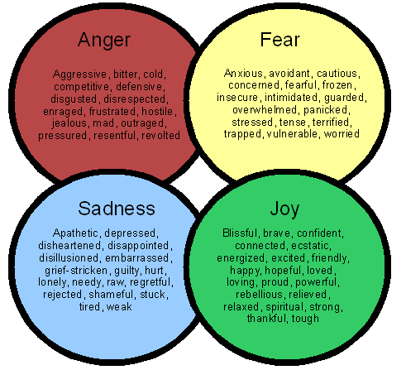
THINKING SKILL NO. 1
Identify and clarify emotions behind actions.
BASIC EMOTIONS
ANGER
FEAR
SADNESS
JOY/HAPPINESS
Notes:
The first skill in problem-solving is learning to identify emotions.
This is especially useful when it comes to dealing with important lifestyle decisions, or decisions regarding sexuality because emotions tend to cloud our thinking, resulting in poor decision making.
It can be difficult to identify emotions.
A good first place to start is deciding whether the emotion is in one of the following categories:
ANGER, FEAR, SADNESS AND JOY
Once you have done that, you can then use the emotions chart (also in content notes and on learner worksheets) to identify the exact emotion you may be feeling.

Slide 5

THINKING SKILL NO. 2
Evaluate:
Did the actions meet the goal?
To evaluate means to make a judgement or assess something.
Notes:
The second skill is evaluating whether the actions taken met the goal. For you to do this, it helps sometimes first to identify the goal related to a situation. A goal is what you want to achieve. After you have identified the goal, make a judgement as to whether the actions you took helped you to meet the goal you chose.
(Recall from Grade 9 how when setting goals – they should be SMART. That will make evaluation of them easier)

Slide 6


THINKING SKILL NO. 3
Reflect on and show what was learnt from past experiences
You get wiser as you get older!
Notes:
The reason we get wiser with age is that we are able to learn through different life experiences. When we make mistakes, these can be turned into life lessons as we learn what no to do in specific situations. Don’t allow past experiences to go to waste - make sure you learn from each of them, what to do and what not to do.

Slide 7

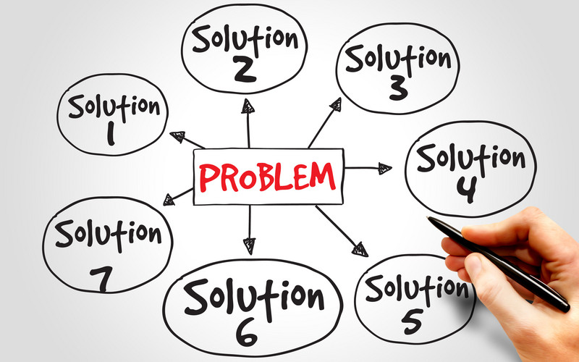
THINKING SKILL NO. 4
Brainstorm different approaches and solutions.
There are always different approaches and solutions
to problems.
Notes:
This is where you get to think creatively. Try to imagine what you’d do if you had all the resources at your disposal, and then try to figure out to make these happen with the resources you do have. Remind yourself that there is always a way. Allow your mind to wonder and come up with different ideas.

Slide 8

THINKING SKILL NO. 5
Explore possible consequences
This is essential!!
We have to live with the consequences of our actions.
Notes:
Always think through the consequences of each option. This is very important, since you have to live with those consequences. Try to think through both the good and the bad.

Slide 9


THINKING SKILL NO. 6
Select and motivate the best alternative
Motivation is important - you need reasons to justify your decisions.
Notes:
Make sure that when you make a decision, you are able to justify why you made that decision in the first place. It is not about explaining yourself to others. But you need to be confident in your decisions and having reasons for them is part of that.

Slide 10

HOW DO PROBLEM SOLVING THINKING SKILLS HELP US?
We are able to make RESPONSIBLE DECISIONS.
INFORMED DECISION MAKING
is a natural
consequence of
EFFECTIVE PROBLEM SOLVING.
Notes:
Having completed the Group Activity, lets recap how Problem Thinking Skills help us?
By using these skills we are able to make responsible decisions about our behaviour, our choices and where we want to be. Informed decision making is a natural consequence of Effective Problem Solving.

Slide 11
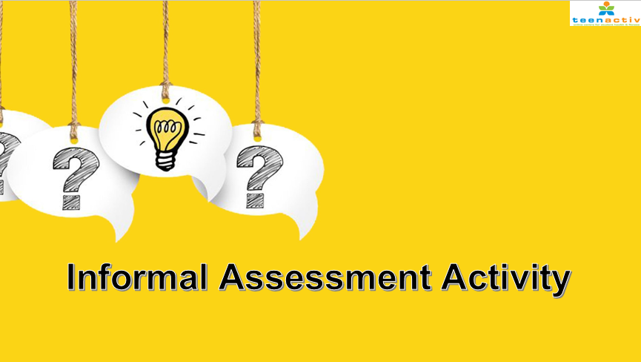
Notes:
Use the Activity questions on the Lesson 5 – Worksheet to assess your understanding of what was covered today.

